Slide 1
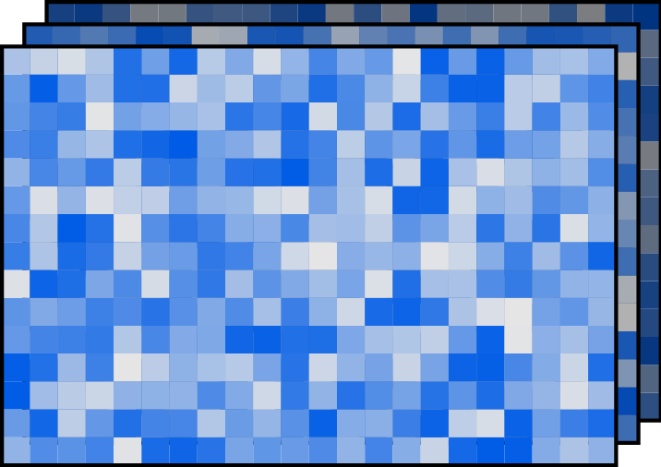
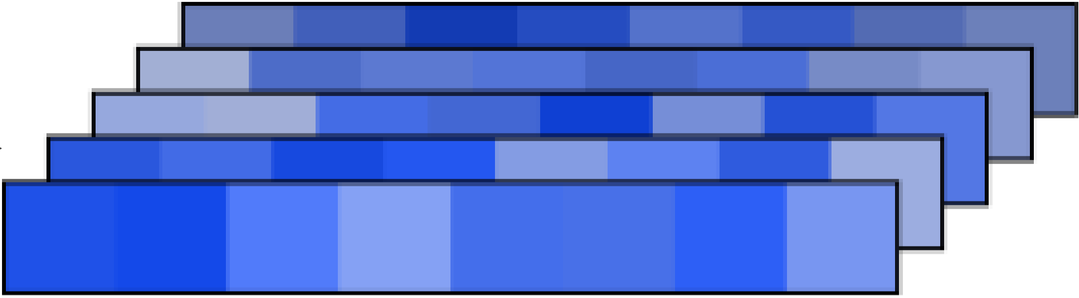
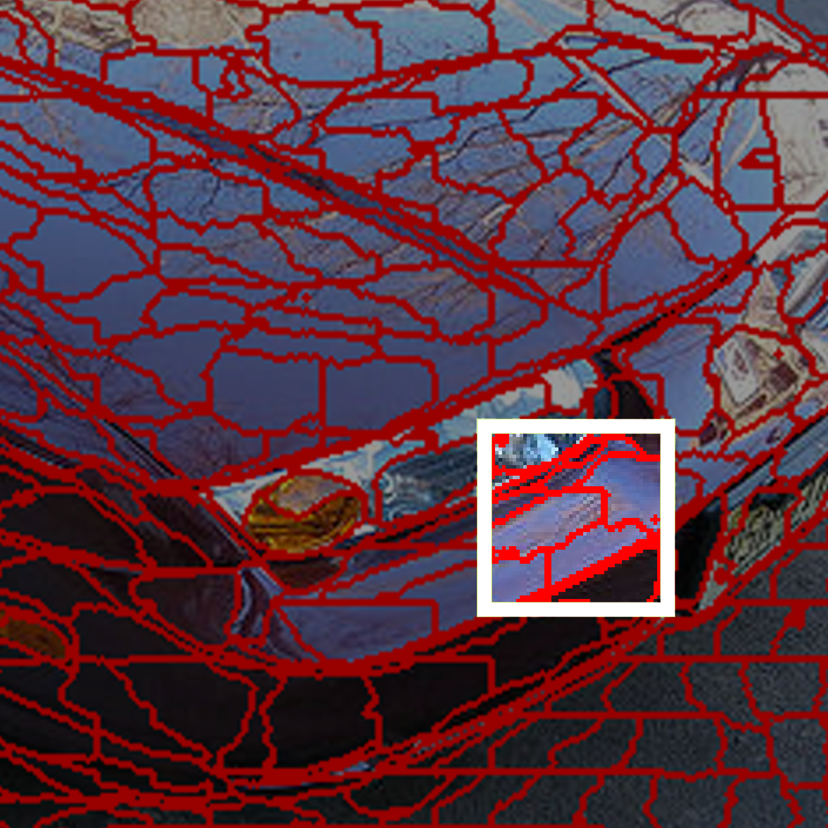
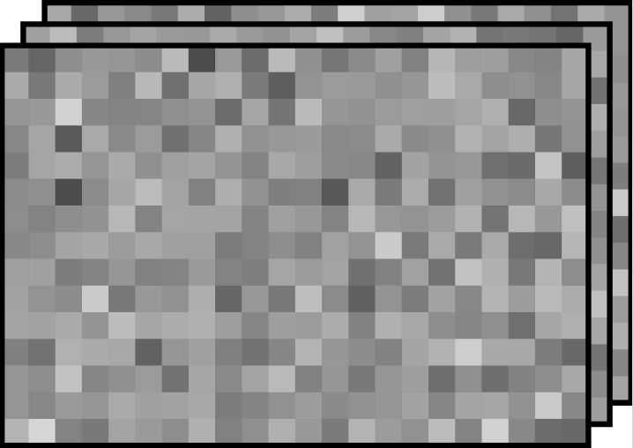
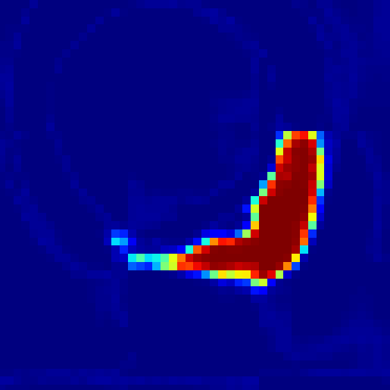
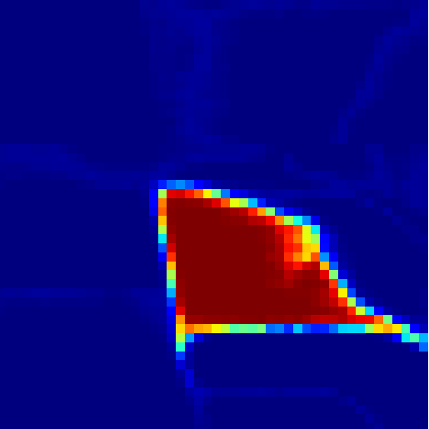
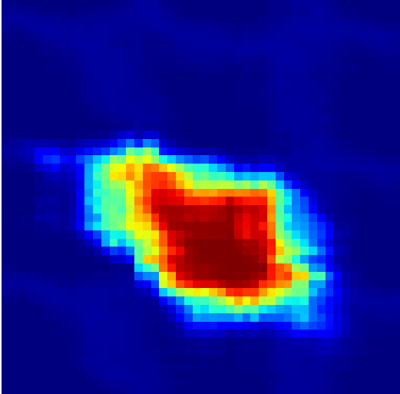
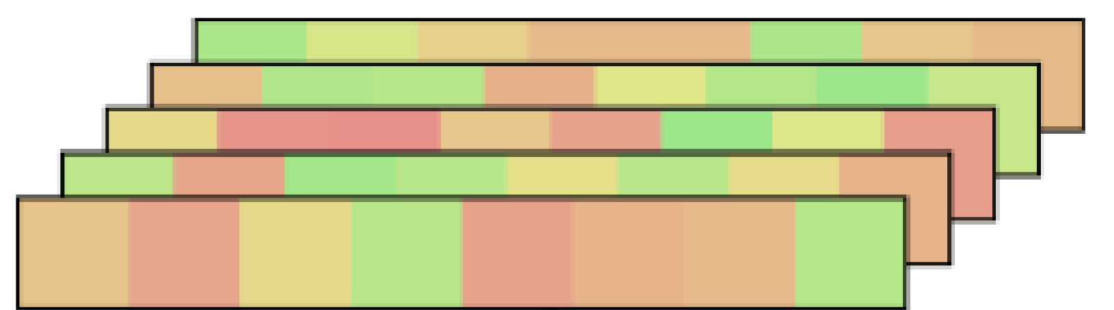
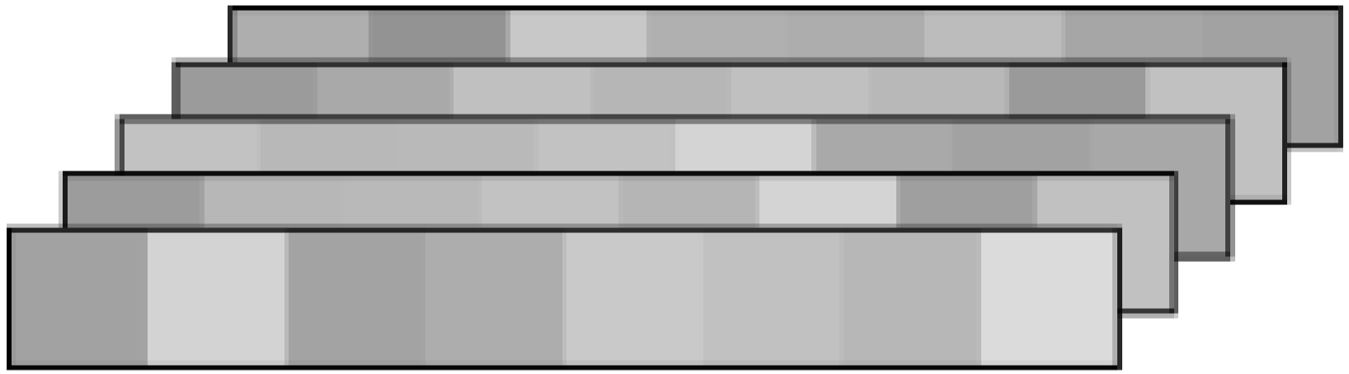
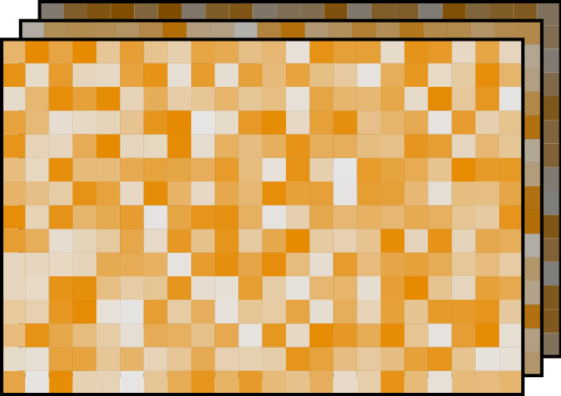

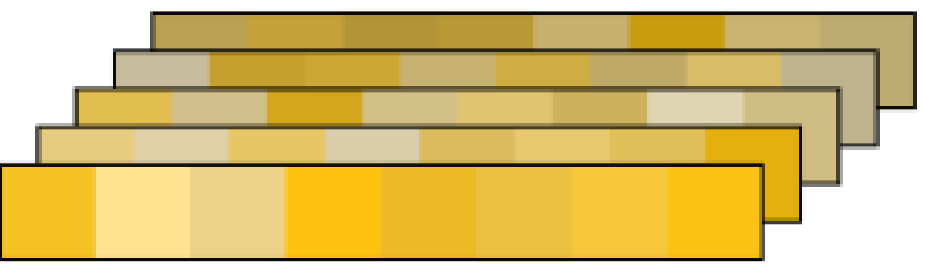








Superpixels'
Physical Carrier
Embeddings of Three Branchs
Superpixel's
Factors
Pixel Features $F$
Appearance Emb. $z^{app}$
Color
FiLM-Style
Gated
Fusion
Module
Weighted Pooling
Texture
Affinity Matrix $Q$
Geometry Emb. $z^{geo}$
Shape
Seed-Centered Affinity Reassembly Operation
Geometry Encoder
Scale
Seed-Centered Local Affinity Map $Q^{′}$
Superpixel Embedding $z$
Absolute Position $P$
Position Emb. $z^{pos}$
Superpixel
Position
Weighted Pooling
Position
Embedding
Centroid

