Slide 1
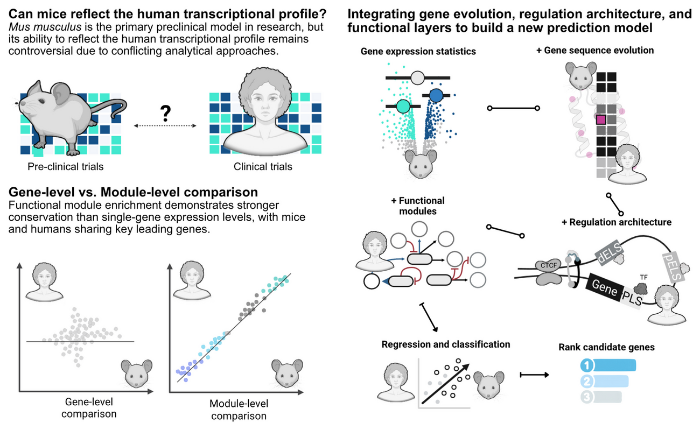
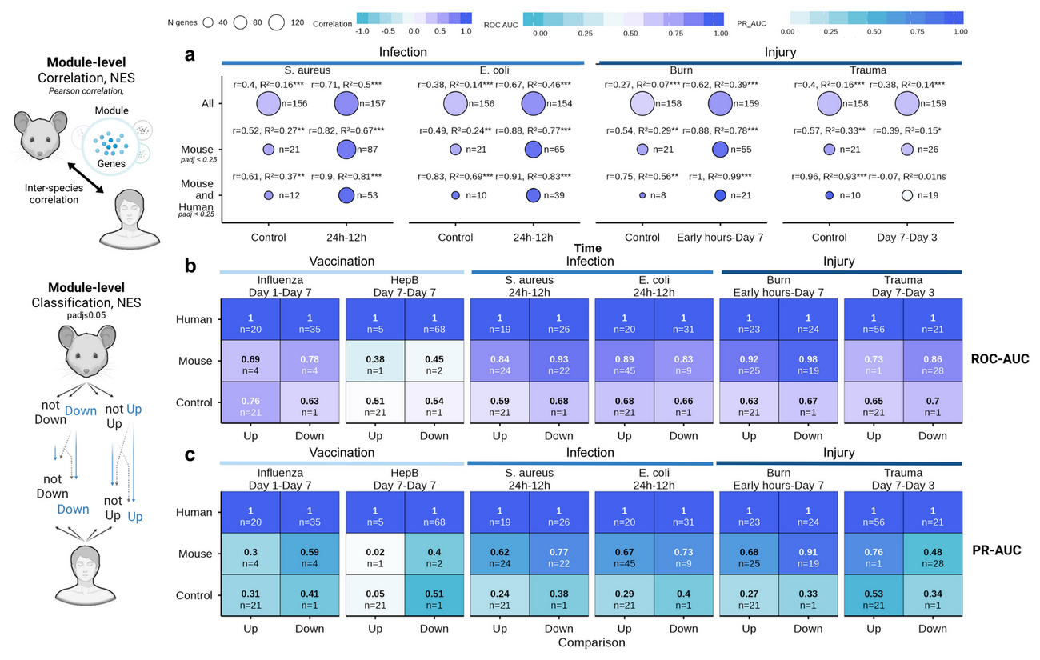
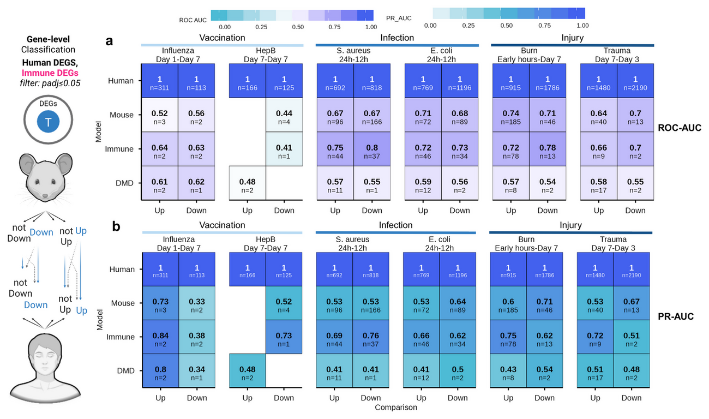
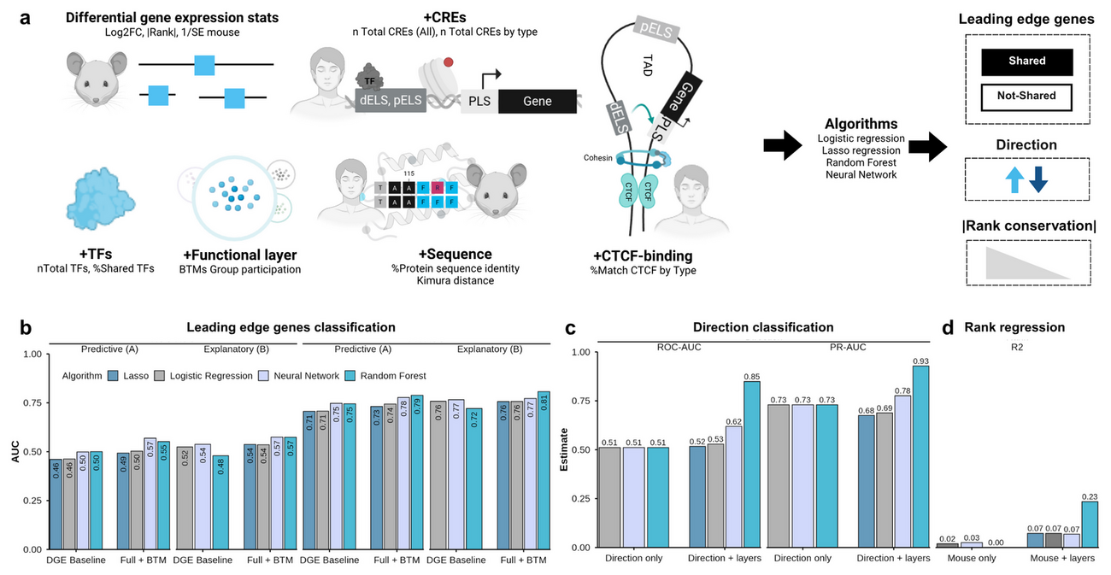
LABORATORY OF GENETICS AND MOLECULAR CARDIOLOGY · INCOR — FMUSP
From mice to humans
A multi-omic predictive framework for translational immunology — linking cross-species
concordance to sequence evolution, cis-regulatory architecture and multilayer machine learning.
Wasim Aluísio Prates-Syed · Lira AA · Cortes N · Silva JDQ · Hamaguchi B · Carvalho E ·
Castillo-Chávez A · Durães-Carvalho R · Cabral-Marques O · Sabino EC · Krieger JE · Hagan T · Cabral-Miranda G
Genes and Immunity (under review) · September 2026 · wasim.syed@usp.br
github.com/wapsyed/mousetohuman_multilayer · wapsyed.github.io/mousetohuman_multilayer
0.89–0.97
0.84–0.98
R² 0.234
AUC 0.849
MODULE-LEVEL (BTM) MOUSE–HUMAN CORRELATION
ROC-AUC · MOUSE BTMS CALLING HUMAN DIRECTION
RANDOM-FOREST HUMAN-RANK REGRESSION (LOCO-CV)
MULTILAYER DIRECTIONAL CONCORDANCE
01 · The problem
06 · Why genes diverge
Murine models underpin preclinical vaccine research, yet their translational value remains contested. Prior cross-species comparisons were largely descriptive — gene-centric and disconnected from sequence evolution and cis-regulatory architecture. 201 mouse immunization datasets were screened from GEO and 6 matched mouse–human conditions carried forward.
• Higher protein sequence identity → lower |ΔLog2FC| (ρ = −0.08)
• Greater TF availability / sharing (ρ = −0.017 / −0.013)
• Greater Kimura K80 distance → higher |ΔLog2FC| (ρ = 0.10)
• Enhancer multiplicity, pELS / dELS (ρ = 0.036 / 0.039)
• CRE turnover & CTCF-bound pELS (ρ = 0.042)
02 · Design & harmonisation
Small per-gene effects, but a consistent direction: sequence constraint tracks stability; regulatory plasticity tracks divergence.
• Vaccination — Fluad® (influenza), Engerix B® (hepatitis B)
• Infection — S. aureus, E. coli
• Injury — burn, trauma-haemorrhage
• + DMD (mdx mouse) as a biological negative control
07 · Multilayer modelling
Blood transcriptomes · GEO / BioProject · limma + empirical Bayes · covariates (age, sex, ethnicity) · human downsampled to n = 5, 200 iterations, median statistics.
leave-one-condition-out CV (4 folds) · 4 algorithms: linear/logistic · lasso · random forest · neural network.
Mouse rank alone R² = 0.001 and direction alone ROC-AUC 0.511 — no transfer. Adding the biological layers lifts the random forest to R² = 0.234 (human rank) and ROC-AUC = 0.849 (direction); shared-LEG lasso 0.617 / 0.627.
03 · Granularity: cells disagree, pathways agree
08 · Conclusions & availability
MODULE LEVEL (BTM NES) · PEARSON
Translatability is not a fixed property of the mouse: it is a function of granularity, stimulus intensity and temporal alignment. Four out-of-fold scores — score_shared, score_rank, score_direction, score_translational — prioritise candidate genes.
ρ = 0.89–0.97
Gene-level effect sizes correlate only moderately; module activation is highly conserved. Shared leading-edge genes = 67.5–79% of mouse LEGs (70.5% pooled): the translational signal lives in the leading edge, not in all genes.
04 · Intensity & kinetics
Limitations: small murine cohorts; two inbred strains (C57BL/6, CB6F1); single-dose vs prime-boost; blood-only BTMs; one-to-one Ensembl orthologs.
INFECTION & INJURY — CONSERVED
PIPELINE
DOCUMENTATION
APPLY IT
ρ = 0.41–0.59
mousetohuman_multilayer
Project site
mousetohuman_predict
Acute S. aureus, E. coli and burn engage evolutionarily stable programs; |ΔLog2FC| differences are smaller than in negative controls (WMW P < 1 × 10⁻¹⁵).
Full R Markdown pipeline: curation, QC, limma DGE, GSEA, evolution/regulation, LOCO modelling.
Overview, complete methodology and the notebook map.
Notebook: DGE input → GSEA → prediction of the four scores. Runs via Binder.
github.com/wapsyed/mousetohuman_multilayer
wapsyed.github.io/mousetohuman_multilayer
github.com/wapsyed/mousetohuman_predict
SINGLE-DOSE VACCINATION — DIVERGES
ρ = −0.32–0.27
Fluad® and Engerix B® stay near baseline; preclinical immunogenicity may need boosters or stronger adjuvants.
Timing ≠ chronology · mouse 2–6 h matches the human peak inflammatory window (days 1–3) → align by biological equivalence.
05 · Classification performance
MOUSE SIGNATURES CALL HUMAN DIRECTION — BEST AT MODULE LEVEL
0.84–0.98
Module-level ROC-AUC; gene-level signatures in infection & injury 0.64–0.74; DMD negative control 0.48–0.61 (near random).
Graphical abstract — from mouse expression and the sequence/regulatory layers to a human prediction.
Fig. 4 — BTM module-level correlation and classification performance.
Fig. 3 — ROC-AUC / PR-AUC matrices; DMD negative control.
Fig. 7 — multilayer modelling across algorithms and feature layers.
Mouse2Human · multilayer — poster (A4) · September 2026
Figures from the manuscript · Genes and Immunity (under review)

