Slide 1
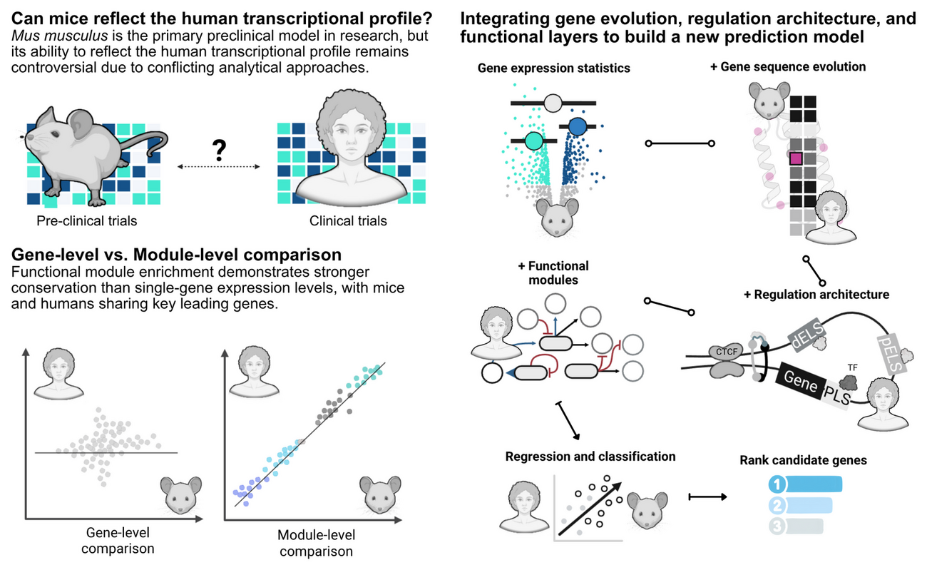
From mice to humans
A multi-omic predictive framework for translational immunology — detailed report version, prepared for reading rather than live presentation
Wasim Aluísio Prates-Syed · Lira AA · Cortes N · Silva JDQ · Hamaguchi B · Carvalho E · Castillo-Chávez A · Durães-Carvalho R · Cabral-Marques O · Sabino EC · Krieger JE · Hagan T · Cabral-Miranda G
Laboratory of Genetics and Molecular Cardiology, InCor — FMUSP
September 2026
Mouse2Human · Report · September 2026 · Genes and Immunity (under review)
1 / 39
Notes:
This is the report-style version of the Mouse2Human deck: it keeps the same paper palette, Merriweather headings and Arial body as the lab-meeting deck but carries far more text, one topic per slide, and a full speaker-note block on every slide. It is meant to be read, not presented live. The graphical abstract on the right summarises the three stimulus categories, the multilayer model and the four translational scores. Everything in this deck is drawn from the manuscript and project documentation — no new numbers are introduced.

Slide 2
ABOUT THIS REPORT
Palette #4DBBD5 · #000000 · #4361ee · #A1B0F7
Merriweather headings · Arial body · monospace only for code and accessions
Mouse2Human · Report · September 2026 · Genes and Immunity (under review)
2 / 39
Notes:
Use this slide to orient the reader before the substance begins. The deck is organised in the same order as the methods: the question and design, the cohort construction and harmonisation, the granularity and intensity results, the classification benchmark, the evolutionary and regulatory layers, the multilayer model, and finally availability and limitations. The visual grammar is copied verbatim from the lab-meeting deck so the two decks feel like one family.

Slide 3
ABSTRACT — EXECUTIVE SUMMARY
Modules travel; genes do not.
Blood transcriptomes from matched mouse and human challenge studies were compared across vaccination, acute bacterial infection and sterile injury. At the level of individual orthologous genes the agreement was only moderate, but once the transcriptome was collapsed into Blood Transcription Modules the cross-species signal became strong and stable. Translational accuracy then scaled with the strength of the perturbation, and adding sequence-evolution, transcription-factor and cis-regulatory layers turned a near-chance mouse baseline into useful prediction.
0.89–0.97
0.85
MODULE-LEVEL (BTM NES) CROSS-SPECIES PEARSON CORRELATION
RANDOM-FOREST ROC-AUC FOR DIRECTIONAL CONCORDANCE, LOCO
Mouse2Human · Report · September 2026 · Genes and Immunity (under review)
3 / 39
Notes:
This single slide is the whole paper compressed. The two headline numbers are the module-level correlation between species (0.89–0.97, with trauma the exception) and the random-forest directional ROC-AUC of 0.85 under leave-one-condition-out cross-validation. The narrative between them is that granularity, stimulus intensity and timing determine how well a mouse study predicts a human one, and that the biological layers recover a conserved signal that mouse effect sizes alone do not carry.

Slide 4
ROADMAP & ANALYTICAL TRAJECTORY
Notebook order: 0, 1, 1.1, 2, 3.1, 3.2, 3.3, 4, 5.1, 5.2, 6 · support: required.R, FIT_Exploration_Prediction.Rmd, ImmuneGO_Mouse.Rmd, Tests.Rmd
Mouse2Human · Report · September 2026 · Genes and Immunity (under review)
4 / 39
Notes:
The left column is the manuscript’s section order; the right column is the executable notebook order documented on the project site. They map onto each other but are not identical: the manuscript groups the results thematically, whereas the pipeline is strictly sequential. Keeping both in view helps a reader move from a result back to the exact script that produced it. The eight-stage ribbon on the code-planning page is the same trajectory.

Slide 5
01 · THE TRANSLATIONAL CONUNDRUM
Mice are the workhorse — but how well do they actually predict human immunity?
• Murine models underpin preclinical vaccine research, yet their translational value remains contested, contributing to clinical trial failures.
• Prior cross-species comparisons were largely descriptive: gene-centric, linear, and disconnected from sequence evolution and cis-regulatory architecture.
• The consequence: contradictory reports and no practical framework to prioritise targets for human translation.
201
6
MOUSE IMMUNIZATION DATASETS SCREENED FROM GEO (FIG. 1A)
MATCHED MOUSE–HUMAN CONDITIONS CARRIED FORWARD
Mouse2Human · Report · September 2026 · Genes and Immunity (under review)
5 / 39
Notes:
Frame the problem: mice are the dominant preclinical model, but their predictive value is contested and the literature is contradictory. Crucially, previous comparisons were descriptive and disconnected from genomic architecture — nobody linked conservation to sequence evolution or cis-regulation. The scale of the screening exercise matters: 201 mouse immunization datasets were retrieved, but only a handful matched human data well enough to compare directly.

Slide 6
02 · HYPOTHESIS & KEY FINDINGS
Higher-order structures are conserved even when single genes diverge
Core question. To what degree do murine models accurately mirror human blood transcriptomic dynamics during vaccination, acute bacterial infection and systemic sterile injury?
Four findings (as reported).
Central hypothesis. Functional pathways, Blood Transcription Modules and coordinated gene networks are evolutionarily conserved across species, retaining high predictive fidelity even when individual gene effect sizes diverge.
Mouse2Human · Report · September 2026 · Genes and Immunity (under review)
6 / 39
Notes:
This slide states the question, the hypothesis and the four findings the rest of the deck will unpack. The logic is deliberately staged: first show that the signal lives at module level, then show it depends on stimulus strength, then show which additional biological layers recover it, and finally localise the source of divergence to the regulatory rather than the coding genome. Each of the four findings gets its own section later.

Slide 7
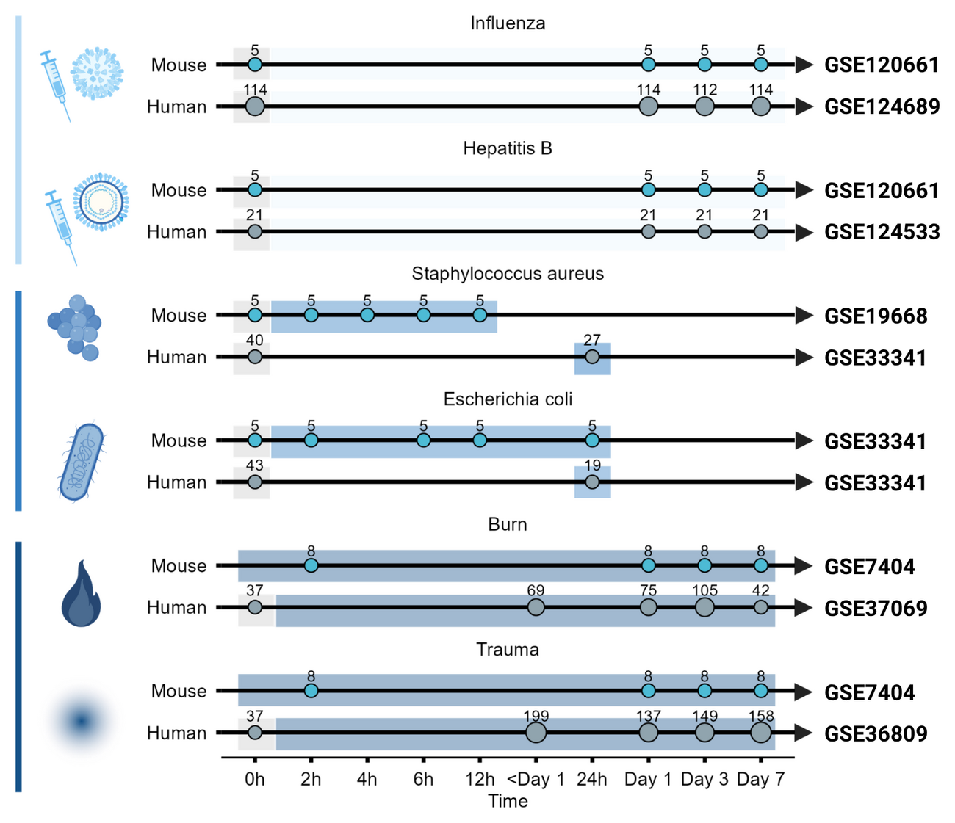
03 · STUDY DESIGN
One framework, three stimulus categories, matched across species
• Vaccination — Fluad® (influenza), Engerix B® (hepatitis B)
• Infection — S. aureus, E. coli
• Injury — burn, trauma-haemorrhage
• + DMD (mdx mouse) as a biological negative control
Blood transcriptomes · GEO / BioProject
limma + empirical Bayes · covariates (age, sex, ethnicity)
human downsampled to n = 5, 200 iterations, median statistics
Fig. 1b — experimental timelines for matched mouse and human datasets across vaccination, infection and injury (GSE120661 · GSE124689 · GSE19668 · GSE33341 · GSE7404 · GSE37069 · GSE36809).
Mouse2Human · Report · September 2026 · Genes and Immunity (under review)
7 / 39
Notes:
Design: three stimulus categories — vaccination, acute infection and injury — each with matched mouse and human blood transcriptomes. DMD (mdx) is the biological negative control. Everything is harmonised: limma with empirical Bayes, covariate adjustment, and iterative downsampling of human subjects to n = 5 over 200 iterations to remove pseudo-significance. The timelines in Fig. 1b show why timing alignment is not automatic — the sampling schedules differ between species.

Slide 8
04 · DATA SOURCES — REPOSITORY SEARCH STRATEGY
Where records conflicted with the publication, the GEO record was prioritised
Mouse2Human · Report · September 2026 · Genes and Immunity (under review)
8 / 39
Notes:
This slide documents the provenance of the data so the pipeline is auditable. The search deliberately excluded human records in the first pass to find mouse cohorts, then restricted to Mus musculus and to expression-profiling assays. The manual annotation step is where most curation effort went, because adjuvants, doses, routes and time points had to be recovered from publications and reconciled with the GEO records. GEO was treated as authoritative when the two disagreed.

Slide 9
05 · FROM 201 DATASETS TO 6 MATCHED CONDITIONS
Only a handful of murine cohorts met the bar for a direct comparison
201
6
MOUSE IMMUNIZATION DATASETS RETRIEVED FROM GEO
MATCHED MOUSE–HUMAN CONDITIONS CARRIED FORWARD
GSE120661 (influenza + hepatitis B) was carried forward; GSE182858 (influenza in “dirty” mice) could not be compared with the human cohort — sampling at 3 h before/after immunisation vs. days 1, 3 and 7 — and was not used
Mouse2Human · Report · September 2026 · Genes and Immunity (under review)
9 / 39
Notes:
Of 201 mouse immunization datasets, only two microarray datasets matched the human vaccination data by tissue, antigen, vaccine type, target condition, time points and adjuvants. GSE120661 covered influenza and hepatitis B and was carried forward. GSE182858, which studied influenza vaccination in “dirty” mice, was excluded because its sampling schedule — three hours either side of immunisation — could not be aligned with the human days 1, 3 and 7. This slide is the honest bottleneck of the study: the matched set is small because the metadata rarely line up.

Slide 10
06 · THE SIX MATCHED MOUSE–HUMAN CONDITIONS
VACCINATION — SUBUNIT / INACTIVATED
STERILE INJURY
• Influenza (Fluad®, TIV + MF59) — human GSE124689 · mouse GSE120661
• Hepatitis B (Engerix B®) — human GSE124533 · mouse GSE120661
• Severe burn — human GSE37069 · mouse GSE7404
• Trauma-haemorrhage — human GSE36809 · mouse GSE7404
BIOLOGICAL NEGATIVE CONTROL
ACUTE BACTERIAL INFECTION
• Duchenne muscular dystrophy (mdx) — mouse GSE1025 , muscle tissue, peak pathological timepoint day 28.
• S. aureus bacteraemia — human GSE33341 · mouse GSE19668
• E. coli sepsis — human GSE33341 · mouse GSE33341
Mouse2Human · Report · September 2026 · Genes and Immunity (under review)
10 / 39
Notes:
These are the six matched conditions plus the negative control. Note the tissue matrix: the vaccination and infection cohorts are blood or PBMC, while DMD is muscle, which is exactly why it works as a specificity control rather than a comparison of like with like. The platforms differ too — Agilent, Affymetrix Human Gene 1.0 ST, U133 Plus 2.0 — which is why platform-specific normalisation is needed before any comparison. The E. coli mouse and human blocks both come from GSE33341, a caveat discussed later.

Slide 11
07 · MOUSE VACCINATION COHORT METADATA
GSE182858 (Quadri 2019-2020, IN route, ±Addavax) and GSE224584 (N. meningitidis ACWY, whole blood) illustrate the screened-but-unused periphery
Mouse2Human · Report · September 2026 · Genes and Immunity (under review)
11 / 39
Notes:
This slide gives the vaccination cohort in full because it is the arm that turns out to be the hardest to translate. Six time points from four hours to one week let the study follow early innate dynamics, but only a single dose was given in mice. The four arms are valuable because they vary adjuvant and vaccine type independently, which is how the analysis can attribute the divergence to weak systemic activation rather than to species identity alone. GSE182858 and GSE224584 are shown as examples of datasets that passed the screen but could not be aligned with the human atlases.

Slide 12
08 · NEGATIVE CONTROL — DUCHENNE MUSCULAR DYSTROPHY
DMD ROC-AUC 0.48–0.61 — near random, as expected
Mouse2Human · Report · September 2026 · Genes and Immunity (under review)
12 / 39
Notes:
DMD is not a fair cross-species comparison and is not meant to be: it is a muscle disease in a mouse, so it should fail to predict human blood immune responses. The value is diagnostic — if the DMD-based classifier also scored well, the pipeline would be picking up a technical artefact rather than biology. Alongside DMD, the ROC framework uses a perfect model as the ceiling and permutation nulls as an additional reference, so every AUC has a clear scale.

Slide 13
09 · PLATFORM-SPECIFIC NORMALISATION
log2 intensity retained; no arbitrary truncation of effect sizes before modelling
Mouse2Human · Report · September 2026 · Genes and Immunity (under review)
13 / 39
Notes:
This slide explains a decision that looks inconsistent but is deliberate: different normalisation for different platforms. Affymetrix data go through RMA because that is the appropriate multi-array model, while Illumina and Agilent arrays get between-array quantile normalisation. The point is to make distributions comparable across samples within a cohort before any cross-species comparison. Effect sizes are kept continuous at this stage to preserve power for the rank-based pathway tests later.

Slide 14
10 · PROBE COLLAPSING & ORTHOLOG MAPPING
Probes: highest median, not mean · Orthologs: MGI 1:1 only · Human ref: highest median Entrez
Mouse2Human · Report · September 2026 · Genes and Immunity (under review)
14 / 39
Notes:
Two collapsing decisions matter signal-wise. First, when several probes report the same gene, the most responsive one is kept rather than the average, which would blur a strong signal with silent probes. Second, mapping is restricted to one-to-one MGI orthologs so that every human gene has at most one mouse partner, keeping the cross-species comparison unambiguous. That restriction is a known limitation: it excludes multi-ortholog families and could bias the gene set toward well-annotated, conserved genes.

Slide 15
11 · QUALITY CONTROL & OUTLIER DETECTION
\[\text{RLE}_{gi} = \log_2(E_{gi}) - \operatorname{median}_{j}\big(\log_2(E_{gj})\big)\]
1.1_QualityControl.Rmd · SA and MA plots · before-vs-processed summaries
Mouse2Human · Report · September 2026 · Genes and Immunity (under review)
15 / 39
Notes:
Quality control here is not cosmetic: it removed human trauma samples whose separation could not be explained by any recorded covariate. That is a scientifically cautious choice, because including them would inflate between-sample variance and weaken the cross-species comparison, but it is also a limitation because unreported severity remains a hidden confounder. PCA and RLE play complementary roles — PCA is multivariate and catches structure, RLE is per-sample and catches scale divergence. All diagnostics are archived for reproducibility.

Slide 16
12 · DIFFERENTIAL EXPRESSION WITH LIMMA
\[\tilde{s}_g^2 = \frac{d_0 s_0^2 + d_g s_g^2}{d_0 + d_g}\]
DGE threshold: BH-adjusted P < 0.05 · effect sizes retained continuously
Mouse2Human · Report · September 2026 · Genes and Immunity (under review)
16 / 39
Notes:
Differential expression is modelled independently for each condition and species. The empirical Bayes step is what makes the design viable with small groups: it borrows strength across genes so that a five-sample arm still yields stable variance estimates. The trend and robust options make the prior intensity-aware and less sensitive to individual outliers. The contrasts are always against the matched baseline, which matters for the time-course comparisons in the next slides.

Slide 17
13 · COVARIATES, BATCH EFFECTS & SAMPLE WEIGHTS
E. coli: mouse and human blocks come from the same GEO series (GSE33341) → batch handled explicitly
Mouse2Human · Report · September 2026 · Genes and Immunity (under review)
17 / 39
Notes:
This is where the human and mouse worlds are made statistically comparable. Clinical cohorts vary in age, sex and ancestry, so those covariates enter the design; longitudinal subjects are treated as random effects; and where a dataset has known batch structure, as in the E. coli series, weights are stratified accordingly. Array weights then down-weight noisy samples rather than deleting them. The honest caveat is that unmeasured clinical variables — especially injury severity — cannot be adjusted for.

Slide 18
14 · WHY LIMMA, NOT T-TESTS
limma: Ritchie et al., Nucleic Acids Research 2015 · eBayes trend + robust
Mouse2Human · Report · September 2026 · Genes and Immunity (under review)
18 / 39
Notes:
This slide exists because the vaccination result is negative, and it would be easy to mistake a statistical artefact for a biological one. Paired t-tests found essentially nothing in the vaccinated mouse cohorts; limma, with moderation and covariate control, found weak but coherent signatures. Without the comparison, a reader might conclude that mice simply do not conserve vaccine responses, when in fact the earlier methods were under-powered. It is a reminder that detection sensitivity is part of the result.

Slide 19
15 · SAMPLE-SIZE BALANCING — DOWNSAMPLING & BOOTSTRAP
n = 5 · 200 bootstrap iterations · median statistics · human downsampling
Mouse2Human · Report · September 2026 · Genes and Immunity (under review)
19 / 39
Notes:
Downsampling is the single most important harmonisation step for fairness between species. Human cohorts often have tens of subjects while the mouse arm has five, and an unmatched comparison would reward the human side with statistical power it would not have in a matched design. Repeatedly drawing five human subjects, running the model, and taking the median statistic puts the two species on the same footing. It also gives a measure of sampling stability, which is used as a quality signal downstream.

Slide 20
16 · SIGNIFICANCE THRESHOLDS & DIAGNOSTICS
Thresholds are analysis-level, not evidence-level: padj ≤ 0.25 is exploratory for modules
Mouse2Human · Report · September 2026 · Genes and Immunity (under review)
20 / 39
Notes:
Two different thresholds are used on purpose. Gene-level calls use a strict BH FDR of 0.05, while module-level GSEA uses padj ≤ 0.25 to avoid discarding weak but coordinated pathway signals, which is standard for exploratory enrichment. The p-value diagnostics are reported because they expose where the data are thin: burn and trauma are cross-sectional and noisy, so their near-uniform adjusted distributions are a warning about power, not a failure of the biology.

Slide 21
17 · BTMS AND PRE-RANKED GSEA
3.2_Compute_GSEA.Rmd · 3.3_Functional_Analyses.Rmd · padj ≤ 0.25
Mouse2Human · Report · September 2026 · Genes and Immunity (under review)
21 / 39
Notes:
This is the analytical pivot of the paper. Instead of comparing thousands of individual genes, the study compares a few hundred immune modules, each an ensemble of co-regulated genes. Pre-ranking by the product of effect size and significance means both magnitude and confidence contribute to a gene’s position, and GSEA normalises for module size. The weighted correlations then ask whether the same modules move in the same direction in both species — the test that produced the headline 0.89–0.97 range.

Slide 22
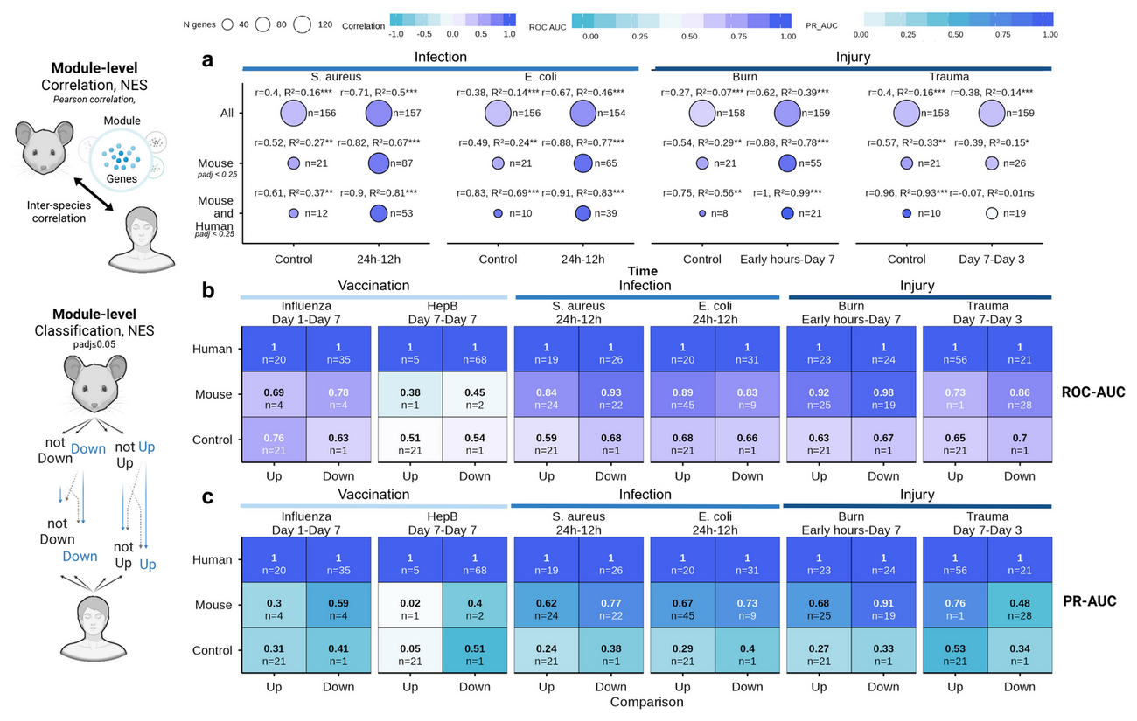
18 · RESULT — ANALYTICAL GRANULARITY
Cells disagree. Pathways agree.
0.89–0.97
MODULE-LEVEL (BTM NES) PEARSON CORRELATION BETWEEN SPECIES
• Gene-level effect sizes correlate only moderately; module activation is highly conserved.
• Shared leading-edge genes = 67.5–79% of mouse LEGs in enriched modules (70.5% pooled).
• Collapsing dimensionality into BTMs reduces noise and exposes a robust translational signature.
Fig. 4a–c — BTM module-level correlation (a) and classification performance (b, c) across conditions. · Fig. 5a — shared leading-edge genes across BTM process categories.
Mouse2Human · Report · September 2026 · Genes and Immunity (under review)
22 / 39
Notes:
First result: granularity matters. Individual orthologous genes correlate only moderately, but when the transcriptome is collapsed into Blood Transcription Modules the correlation jumps to 0.89–0.97, with trauma the exception. Shared leading-edge genes account for 67.5–79% of mouse LEGs, or 70.5% when pooled, so the translational signal lives in the leading edge of a module rather than in all of its members. The practical implication is that a mouse study is best read at pathway level, not gene by gene.

Slide 23
19 · LEADING-EDGE GENE CONSERVATION
Fig. 5a — LEG proportions · Fig. 5b — rank-conservation trajectory
Mouse2Human · Report · September 2026 · Genes and Immunity (under review)
23 / 39
Notes:
This slide zooms into the leading edge, the subset of a module that actually drives its enrichment score. Across conditions, roughly seven in ten mouse LEGs are also human LEGs, and shared LEGs tend to be more highly expressed and more precisely estimated, which is reassuring rather than surprising. The M37.0 module — a generic immune activation cluster — is then used as a worked example of intra-module rank conservation, showing how gene prioritisation within a module lines up across species.

Slide 24
20 · RESULT — STIMULUS INTENSITY
Translatability scales with the strength of the perturbation
INFECTION & INJURY — CONSERVED
SINGLE-DOSE VACCINATION — DIVERGES
ρ = 0.41–0.59
ρ = −0.32–0.27
Acute S. aureus , E. coli and burn engage evolutionarily stable, highly conserved programs.
Fluad® and Engerix B® fail to reach the systemic activation threshold, remaining near baseline controls.
Effect-size difference (|Δlog2FC|) significantly smaller than negative controls — WMW adjusted P < 1 × 10⁻¹⁵.
Preclinical immunogenicity may require boosters or stronger adjuvants to emerge from species-specific noise.
Concordance measured as weighted Spearman ρ on cross-species effect sizes; strength of stimulus, not species identity, sets the ceiling
Mouse2Human · Report · September 2026 · Genes and Immunity (under review)
24 / 39
Notes:
Second result: translatability scales with the strength of the perturbation. Acute bacterial infection and severe injury engage conserved core mammalian programs (ρ = 0.41–0.59), whereas single-dose subunit and inactivated vaccines stay near baseline (ρ = −0.32 to 0.27). The effect-size divergence for infection and injury is significantly smaller than for the negative controls, with a WMW adjusted P below 1 × 10⁻¹⁵. The message is that a weak stimulus simply does not rise above species-specific noise, so boosting signal strength should improve translation.

Slide 25
21 · TIMING ALIGNMENT BY BIOLOGICAL EQUIVALENCE
Mouse 2–6 h ≈ human days 1–3 · cross-temporal ROC tests explicitly sample different timepoints
Mouse2Human · Report · September 2026 · Genes and Immunity (under review)
25 / 39
Notes:
This is a conceptual point with practical consequences: the murine innate response unfolds within hours, while the human sampling schedule often starts at day one. Aligning 6 h with day 3 is not a fudge, it reflects that both represent the peak of the early inflammatory response. The discretisation table on the right shows the bins used to align human injury times to mouse collection points, and it is also why the performance notebook tests different timepoint pairings rather than assuming one canonical match.

Slide 26
22 · CLASSIFICATION FRAMEWORK (ROC / PR)
4_Performance_DifferentTimepoints.rmd · genes and BTMs · ROC + PR
Mouse2Human · Report · September 2026 · Genes and Immunity (under review)
26 / 39
Notes:
The classification framework converts differential expression into a discrimination task: given a mouse signature, how well does it rank the human genes that are truly up- or down-regulated? One-sided p-values are needed because the direction of the effect is part of the prediction, and the probability is defined so that higher values mean stronger evidence for the labelled direction. The perfect and DMD models bracket the achievable range, and the same machinery is re-used at module level so genes and pathways are directly comparable.

Slide 27
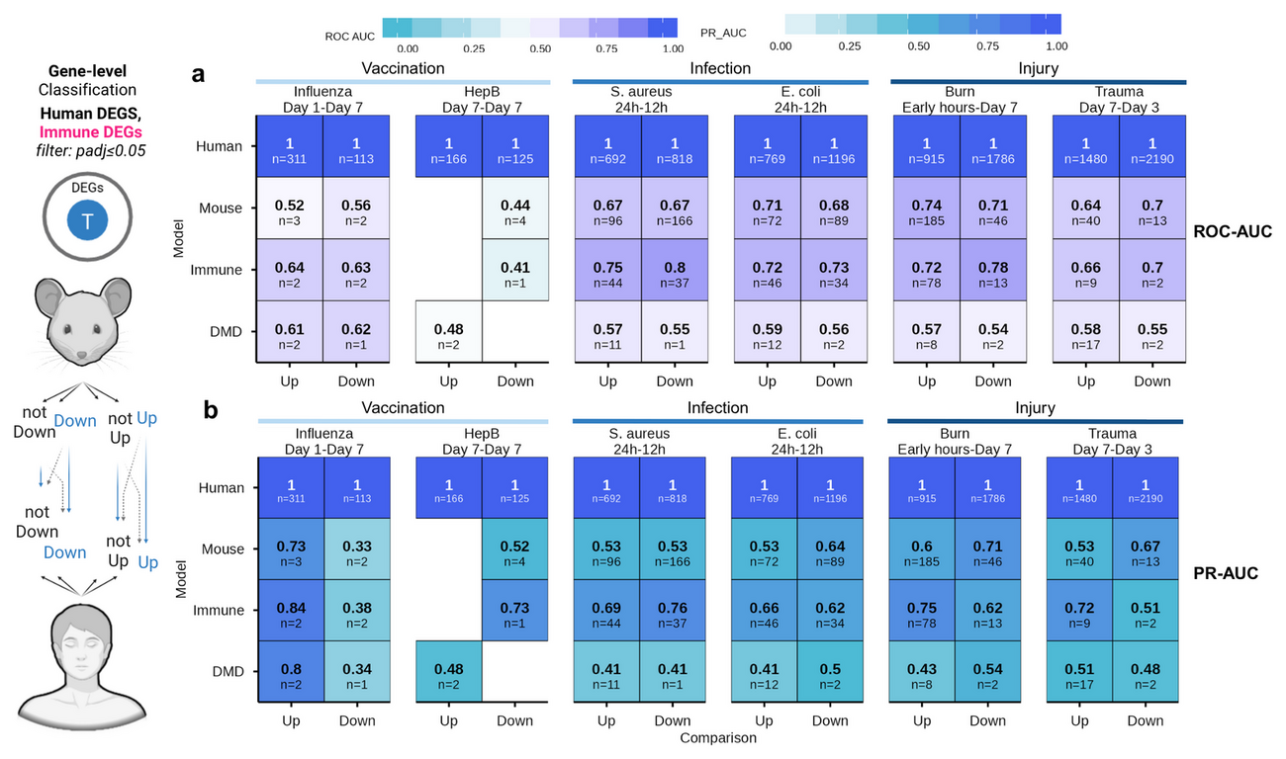
23 · RESULT — CLASSIFICATION PERFORMANCE
Mouse signatures call human direction — best at module level
0.84–0.98
0.64–0.74
ROC-AUC · MOUSE BTM SIGNATURES CLASSIFYING HUMAN MODULE REGULATION
ROC-AUC · GENE-LEVEL MOUSE SIGNATURES IN INFECTION & INJURY
Biological negative control (DMD): ROC-AUC 0.48–0.61 — near random
Fig. 3a–b — ROC-AUC and PR-AUC matrices for mouse signatures classifying up- and downregulated human genes, with human self-prediction and the DMD negative control.
Mouse2Human · Report · September 2026 · Genes and Immunity (under review)
27 / 39
Notes:
Third result: prediction. Mouse signatures classify the direction of human gene regulation, but module-level models clearly beat gene-level ones — 0.84–0.98 ROC-AUC versus 0.64–0.74 — and both beat the DMD negative control (0.48–0.61). Downregulation is easier to predict than upregulation at early timepoints, which is consistent with the idea that conserved shut-down of core programs is a stronger signal than induced genes. The gap between module and gene AUC is the quantitative version of the granularity result.

Slide 28
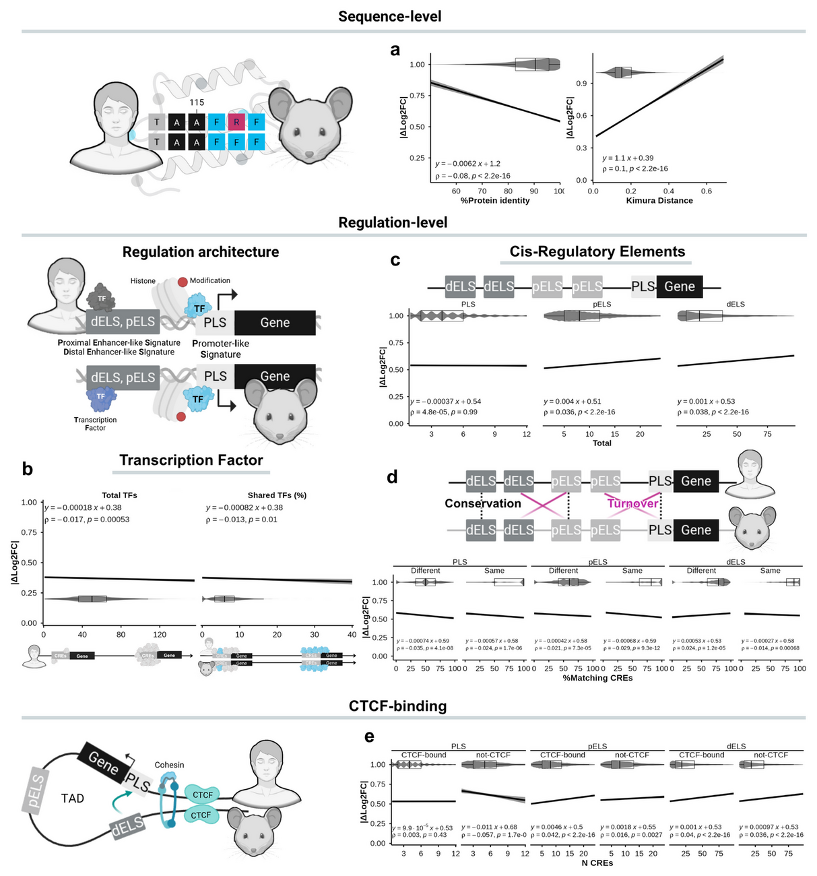
24 · SEQUENCE EVOLUTION — PROTEIN CODING
Coding constraint buys only a small amount of stability
• Greater protein sequence identity is associated with lower |Δlog2FC| — Spearman ρ = −0.08.
• Greater Kimura (K80) distance is associated with higher |Δlog2FC| — ρ = 0.10.
• The per-gene effects are small but consistently signed: coding constraint tracks expression stability.
• Sequences from Ensembl via biomaRt (confidence score = 1); longest coding sequence kept per gene; pairwise global Needleman–Wunsch alignment (pwalign); K80 distance (ape::dist.dna), with JC69 as a control.
• Protein identity came from Ensembl BioMart homology tables.
K80 d = −½ ln(1 − 2P − Q) − ¼ ln(1 − 2Q) · longest-isoform canonical CDS
Fig. 6a–e — protein sequence identity and Kimura distance (a), transcription factor availability (b), cis-regulatory element abundance (c), CRE conservation and turnover (d) and CTCF binding (e) against |Δlog2FC|.
Mouse2Human · Report · September 2026 · Genes and Immunity (under review)
28 / 39
Notes:
This is the first half of the mechanism question: does coding-sequence evolution explain expression divergence? The answer is only weakly — higher protein identity goes with smaller cross-species differences and greater Kimura distance with larger ones, but the correlations are around 0.08–0.10, which is why the study keeps looking for the strong explanatory signal elsewhere. The five-panel evolution/regulation figure collects all of these relationships, so this slide and the next should be read against it. Coding constraint is real but modest; regulatory architecture carries more of the signal.

Slide 29
25 · CIS-REGULATORY ARCHITECTURE
tables/Genomic cCRE BEDs · 5.2_EvolutionaryAnalysis_Regulation.Rmd
Mouse2Human · Report · September 2026 · Genes and Immunity (under review)
29 / 39
Notes:
This is the other half of the mechanism question, and it is the one that carries the signal. Transcription-factor availability and sharing reduce expression divergence, while enhancer multiplicity and cis-regulatory turnover increase it — and promoter-like elements show no relationship at all. The magnitudes are small, but they are consistent and, unlike coding identity, they tell a coherent story: regulatory architecture, not the protein sequence, governs how far orthologous responses drift apart. The ENCODE SCREEN catalogue provides the element classes and CTCF status on both genomes.

Slide 30
26 · INTERPRETING THE EVOLUTIONARY SIGNAL
Sequence constraint tracks stability; regulatory plasticity tracks divergence
ASSOCIATED WITH LOWER |ΔLOG2FC| (CONVERGENCE)
ASSOCIATED WITH HIGHER |ΔLOG2FC| (DIVERGENCE)
• Higher protein sequence identity ρ = −0.08
• Greater TF availability and TF sharing ρ = −0.017 / −0.013
• Conserved promoter-like (PLS) signatures n.s.
• Greater Kimura (K80) evolutionary distance ρ = 0.10
• Enhancer multiplicity — pELS / dELS counts ρ = 0.036 / 0.039
• CRE turnover and CTCF-bound pELS ρ = 0.042
Mouse2Human · Report · September 2026 · Genes and Immunity (under review)
30 / 39
Notes:
This slide is the interpretation that ties the two previous ones together. The per-gene effects are all small, so the claim is not that any one feature predicts divergence; the claim is directional and consistent. Features that constrain a gene — conserved protein sequence, available and shared transcription factors, intact promoters — pull expression toward stability. Features that allow rewiring — accumulated coding distance, many enhancers, enhancer turnover and CTCF-bound proximal enhancers — pull it toward divergence. Regulatory architecture, not the coding sequence, is the stronger axis.

Slide 31
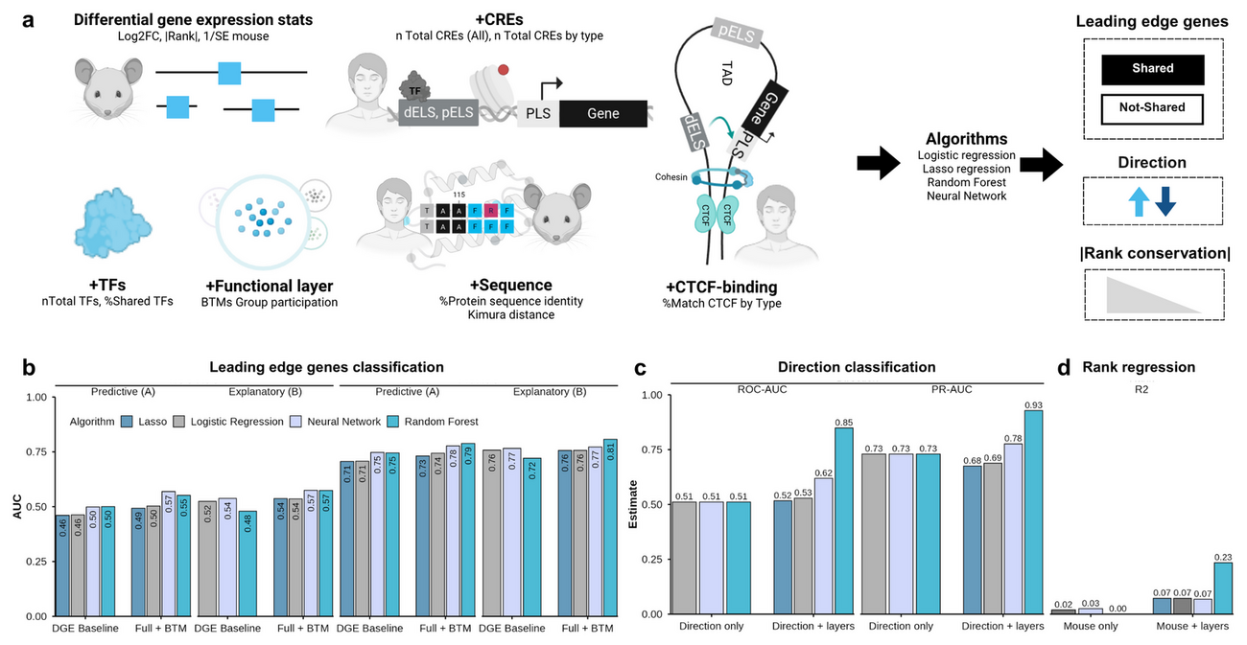
27 · MULTILAYER MODELLING — DESIGN & FEATURE LAYERS
Two nested layers; predict the human response gene by gene
• DGE Baseline — the mouse differential-expression summary only: mouse log2FC, 1/SE, and mouse absolute rank (overall and within BTMs).
• Full + BTM — adds structural coding evolution (identity_human2mouse, dist_k80), cis-regulatory features (PLS/pELS/dELS counts and match percentages, CTCF-bound fractions), TF features (n_tf_total, pct_tf_shared) and BTM membership (immune vs. non-immune).
• Two framings: A (predictive) keeps the mouse magnitude; B (explanatory) removes it to test the biological layers alone.
Fig. 7 — multilayer modelling: (a) layer integration workflow, (b) shared-LEG classification, (c) directional concordance and (d) human rank regression, across algorithms and feature layers.
Mouse2Human · Report · September 2026 · Genes and Immunity (under review)
31 / 39
Notes:
This is the heart of the new modelling work. The pipeline does not treat six independent feature groups; it nests them so that the question “does biology add signal beyond mouse effect size?” can be asked cleanly. The DGE Baseline contains only what a mouse experiment gives you directly; Full + BTM adds evolution, regulation, transcription factors and module membership. The two framings then separate prediction (keep the mouse magnitude) from explanation (remove it), which is why the same model can answer both “how well can we predict?” and “which biological features actually carry the transferable signal?”.

Slide 32
28 · LOCO CROSS-VALIDATION & ALGORITHMS
Feature importance: log-odds (logistic) · standardised effects (linear) · lasso coefficients · Gini (RF)
Mouse2Human · Report · September 2026 · Genes and Immunity (under review)
32 / 39
Notes:
LOCO is what makes the performance numbers honest. A conventional random split would let genes from the same pathogen appear in both training and test sets, inflating the score because those conditions share coordinated signatures. By holding out an entire condition, the model must generalise to an unseen perturbation. Four algorithms are compared under identical preprocessing so that differences can be attributed to the model class rather than to feature handling, and feature importance is extracted in a way native to each algorithm.

Slide 33
29 · RESULT — MODEL PERFORMANCE
Layers turn near-chance transfer into useful prediction
• Mouse rank alone: R² = 0.001 · mouse direction alone: ROC-AUC = 0.511 — no transfer.
• Adding evolution, TF, CRE and BTM layers → random forest R² = 0.2345 for human rank and ROC-AUC = 0.8488 for direction.
• Shared vs. mouse-only LEGs stay hard: lasso best by a whisker — 0.6173 predictive / 0.6271 explanatory.
LOCO-CV (4 folds) · nested layers: DGE Baseline → Full + BTM
4 algorithms: linear/logistic · lasso · random forest · neural network
Fig. 7b–d — shared-LEG classification (b), directional concordance (c) and human-rank regression (d) across algorithms and feature layers under LOCO cross-validation.
Mouse2Human · Report · September 2026 · Genes and Immunity (under review)
33 / 39
Notes:
Fifth result: the multilayer model. Mouse rank and direction alone do not transfer at all — R² = 0.001 and ROC-AUC 0.511, essentially chance. Adding the biological layers raises the random forest to R² = 0.2345 for human rank and ROC-AUC = 0.8488 for directional concordance. Shared-LEG classification stays hard, and the lasso is only marginally best there (0.6173 predictive / 0.6271 explanatory). The contrast between the two task families is the key: rank and direction need the multivariate, non-linear layers, while LEG sharing is largely a linear, modular signal.

Slide 34
30 · WHY THE MULTILAYER SIGNAL IS NON-LINEAR
The lasso improved only marginally over unregularised linear models — regularisation is not the source of the gain
Mouse2Human · Report · September 2026 · Genes and Immunity (under review)
34 / 39
Notes:
It is tempting to read the performance table as “random forest wins”, but the more informative reading is that different tasks have different signal geometries. Rank and direction depend on interactions between mouse effect size, evolutionary distance, regulatory architecture and module membership, which trees capture and linear models cannot. Shared-LEG membership is closer to a linear threshold on a few modular features, so a lasso suffices. The fact that mouse-only features drop every algorithm to chance confirms that the added biological layers, not model capacity, produce the gain.

Slide 35
31 · THE FOUR TRANSLATIONAL SCORES
Every gene is scored by a model trained without its condition (out-of-fold LOCO)
Outputs in Modelling/Tables/ · observed_vs_predicted.csv/.rds
Mouse2Human · Report · September 2026 · Genes and Immunity (under review)
35 / 39
Notes:
The four scores are the practical output of the whole pipeline. score_shared and score_direction express confidence about discrete outcomes; score_rank is a continuous prediction of where a gene will fall in the human response; and score_translational combines the two into a single forward-looking priority. The observed prioritisation score is the retrospective counterpart, using measured rather than predicted concordance, so the two can be compared. Because all scores are out-of-fold, they are not inflated by a gene having contributed to its own model.

Slide 36
32 · MODEL SERIALISATION, ARTEFACTS & APPLICATION
Modelling/{Models,Tables,Figures} · written by 6_Statistical_Modelling.Rmd
Mouse2Human · Report · September 2026 · Genes and Immunity (under review)
36 / 39
Notes:
Reproducibility is a first-class output here: every metric, coefficient, importance vector and out-of-fold prediction is written to disk, and the fitted workflows are butchered so they are small enough to ship and reload. Butchering strips the training data and other heavy components from the model object while preserving predict(). The two-line R snippet is the whole application story: load a model, predict on a feature table assembled the same way as in training. The companion notebook walks through assembling that feature table from a new DGE result.

Slide 37
Open code, trained models, and a notebook to apply them
PIPELINE
DOCUMENTATION
APPLY IT
mousetohuman_multilayer
Project site
mousetohuman_predict
Pipeline
Documentation
Apply it
Full R Markdown pipeline — curation, QC, limma DGE, GSEA, evolutionary and regulatory analyses, and the LOCO modelling script. Pinned with renv .
Overview, complete methodology — including the multilayer modelling pipeline — and the notebook map, in one place.
Step-by-step notebook: from DGE input to GSEA, model prediction and visualisation of the four translational scores. Runs in RStudio via Binder.
wapsyed.github.io/mousetohuman_multilayer
github.com/wapsyed/mousetohuman_multilayer
github.com/wapsyed/mousetohuman_predict
github.com/wapsyed/mousetohuman_multilayer
wapsyed.github.io/mousetohuman_multilayer
github.com/wapsyed/mousetohuman_predict
Mouse2Human · Report · September 2026 · Genes and Immunity (under review)
37 / 39
Notes:
The deliverables are the full open-source pipeline, the project site that documents the methodology and notebook map, and the step-by-step notebook that applies the trained models to a new mouse dataset, runnable in the browser via Binder. Everything is released under an MIT licence so it can be audited, adapted and retrained with additional perturbation models, booster regimens and new multi-omic layers. The pinned renv environment is what makes the results reproducible rather than merely re-runnable.

Slide 38
34 · LIMITATIONS & CAVEATS
COHORT & EXPERIMENTAL LIMITS
SCOPE, RESOLUTION & CAVEATS
• Small murine cohorts constrained statistical power; scarce harmonised metadata limited generalisability.
• Two inbred strains only — C57BL/6 and CB6F1; because host genetics shapes translatability, low correlation in some modules may reflect strain–hypothesis mismatch (Th1-biased C57BL/6 vs. Th2-biased BALB/c) rather than species-level failure.
• Single-dose mouse vaccination vs. human prime-boost regimens limits comparison of adaptive trajectories.
• Lab mice are immunologically naïve , whereas humans carry complex exposure histories (evident in the Fluad® data).
• Human burn/trauma datasets lacked standardised severity scores .
• Analyses rely on Ensembl-annotated one-to-one orthologs ; the ~50% amino-acid identity baseline does not capture domain topology, PPI rewiring or the functional impact of mutations.
• Scores derive from blood-based BTMs and need testing in other tissues and gene sets (MSigDB, Gene Ontology).
• Not yet included: regional constraint (PhastCons/phyloP), transposable elements, associated TF expression; baseline expression, gene length, GC content, CRE alignment and substitution-rate acceleration were not controlled.
• Accession caveat: the E. coli mouse and human blocks both come from GSE33341 (one series with mouse and human blocks), so it is not an independent cross-species accession — batch was handled explicitly via var.group .
Mouse2Human · Report · September 2026 · Genes and Immunity (under review)
38 / 39
Notes:
The limitations are stated plainly because they bound every claim. The cohort is small and the strains are only two, so some low module correlations may say more about strain choice than about species, and the vaccination comparison is weakened by single-dose mice against prime-boost humans. The genomic resolution is one-to-one orthologs and the scores are blood-only, so they still need testing beyond blood and beyond BTMs. Finally, the Escherichia coli comparison is a special caveat — mouse and human blocks share the GSE33341 series, so it is not an independent accession even though the analysis stratifies by batch. Future work should therefore test prime-boost and adjuvanted regimens, refine regulatory annotation and align timepoints by biological equivalence.

Slide 39
35 · CONCLUSIONS
Translatability is a function of granularity, intensity and timing
WHAT THE STUDY ESTABLISHES
WHAT TO DO NEXT
• Module-level analysis beats gene-level analysis for cross-species concordance (BTM NES ρ = 0.89–0.97).
• Acute infection and injury translate; single-dose vaccination does not (ρ = 0.41–0.59 vs. −0.32–0.27).
• Evolutionary and regulatory layers carry a conserved signal beyond mouse DGE — lifting the random forest to R² = 0.2345 and ROC-AUC = 0.8488.
• Divergence is governed by cis-regulatory architecture , not coding identity.
• Four out-of-fold scores — score_shared , score_rank , score_direction , score_translational — prioritise candidate genes.
Thank you — questions welcome.
• Match timepoints by biological equivalence , not chronology.
• Test prime-boost and adjuvanted regimens for low-immunogenicity platforms.
• Align strain with the hypothesis and standardise clinical metadata.
• Extend the scores beyond blood-based BTMs to other tissues and gene sets.
• Keep the whole framework open and retrainable with new multi-omic layers.
Mouse2Human · Report · September 2026 · Genes and Immunity (under review)
39 / 39
Notes:
Take-aways: translatability is not a fixed property of the mouse; it is a function of granularity, stimulus intensity and temporal alignment. Module-level comparisons are the most robust, strong acute stimuli translate while single-dose vaccines do not, and the evolutionary and regulatory layers add a conserved signal beyond mouse differential expression. The model outputs four complementary scores that can be used to prioritise genes, and the whole pipeline is open so the community can retrain it. Be candid about the limits: small cohorts, two inbred strains, single-dose vaccines, blood only, one-to-one orthologs and the shared E. coli accession.

