Slide 1
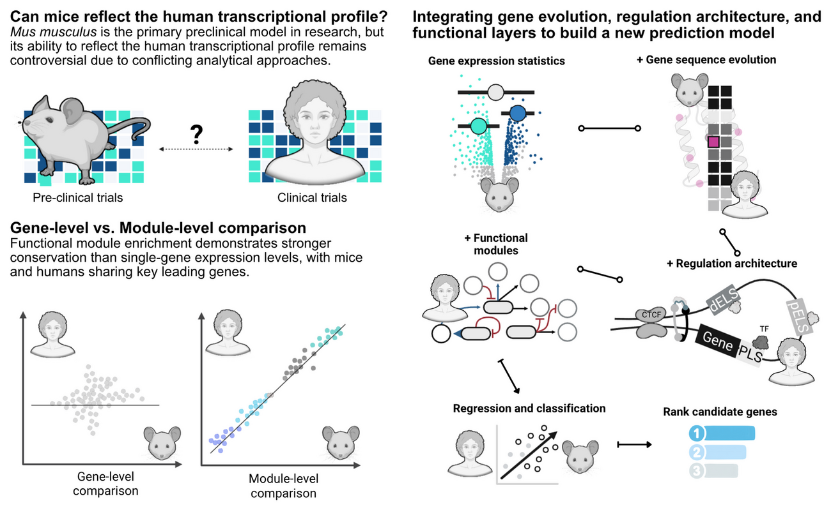
From mice to humans
A multi-omic predictive framework for translational immunology
Wasim Aluísio Prates-Syed · Lira AA · Cortes N · Silva JDQ · Hamaguchi B · Carvalho E · Castillo-Chávez A · Durães-Carvalho R · Cabral-Marques O · Sabino EC · Krieger JE · Hagan T · Cabral-Miranda G
Laboratory of Genetics and Molecular Cardiology, InCor — FMUSP
September 2026
Mouse2Human · Lab meeting · September 2026 · Genes and Immunity (under review)
1 / 10

Slide 2
01 · THE PROBLEM
Mice are the workhorse — but how well do they actually predict human immunity?
• Murine models underpin preclinical vaccine research, yet their translational value remains contested, contributing to clinical trial failures.
• Prior cross-species comparisons were largely descriptive: gene-centric, linear, and disconnected from sequence evolution and cis-regulatory architecture.
• The consequence: contradictory reports and no practical framework to prioritise targets for human translation.
201
6
MOUSE IMMUNIZATION DATASETS SCREENED FROM GEO (FIG. 1A)
MATCHED MOUSE–HUMAN CONDITIONS CARRIED FORWARD
Mouse2Human · Lab meeting · September 2026 · Genes and Immunity (under review)
2 / 10
Notes:
Frame the problem: mice are the dominant preclinical model, but their predictive value is contested and the literature is contradictory. Crucially, previous comparisons were descriptive and disconnected from genomic architecture — nobody linked conservation to sequence evolution or cis-regulation.

Slide 3
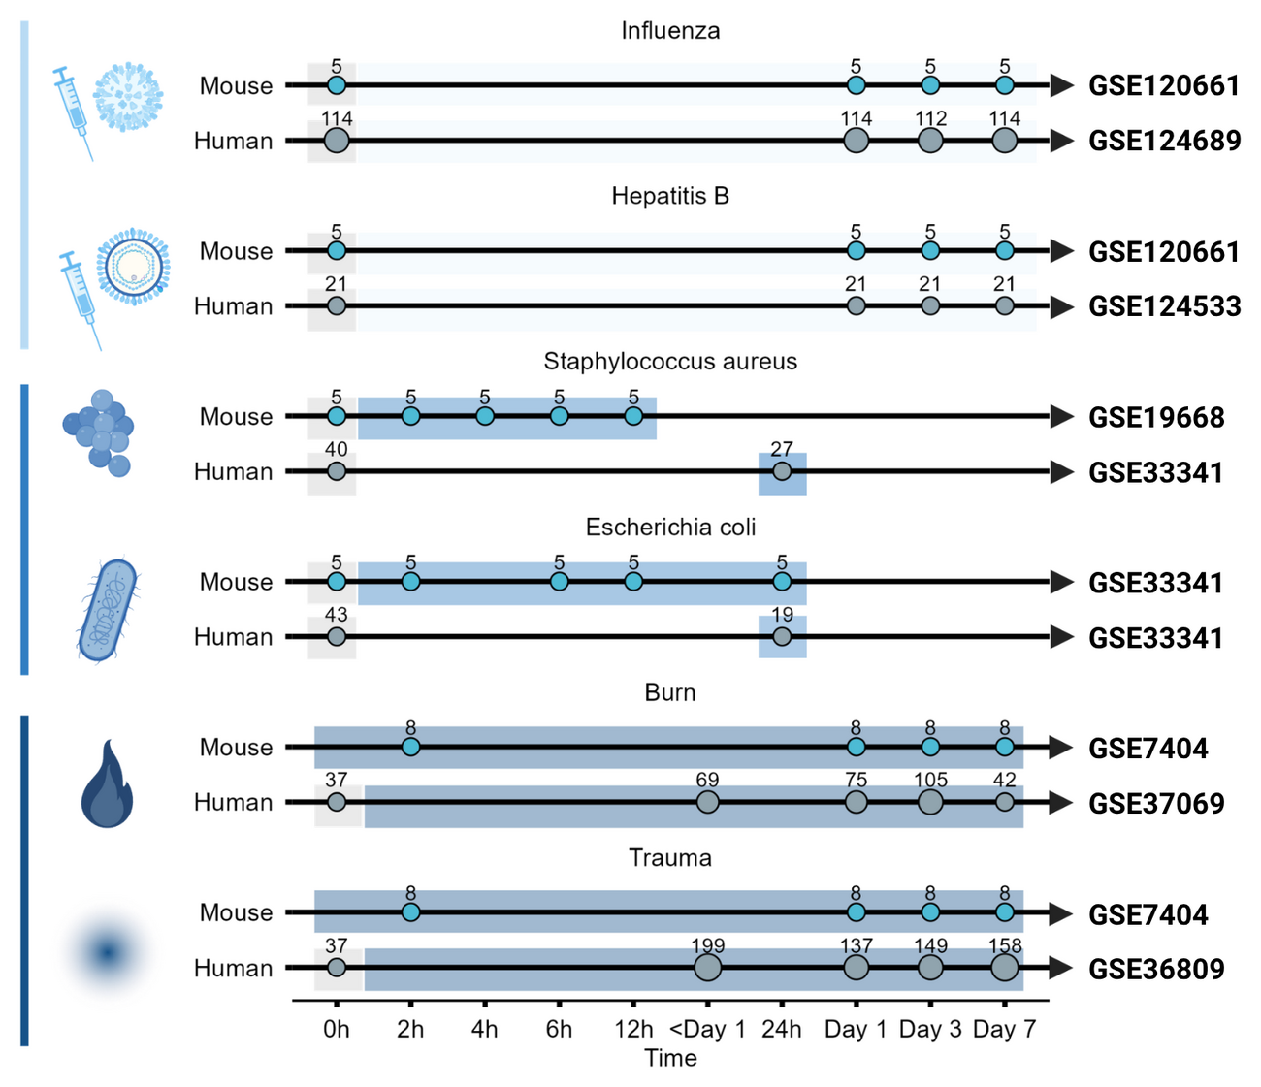
02 · STUDY DESIGN
One framework, three stimulus categories, matched across species
• Vaccination — Fluad® (influenza), Engerix B® (hepatitis B)
• Infection — S. aureus, E. coli
• Injury — burn, trauma-haemorrhage
• + DMD (mdx mouse) as a biological negative control
Blood transcriptomes · GEO / BioProject
limma + empirical Bayes · covariates (age, sex, ethnicity)
human downsampled to n = 5, 200 iterations, median statistics
Fig. 1b — experimental timelines for matched mouse and human datasets across vaccination, infection and injury (GSE120661 · GSE124689 · GSE19668 · GSE33341 · GSE7404 · GSE37069 · GSE36809).
Mouse2Human · Lab meeting · September 2026 · Genes and Immunity (under review)
3 / 10
Notes:
Design: three stimulus categories — vaccination, acute infection and injury — each with matched mouse and human blood transcriptomes. DMD (mdx) is our biological negative control. Everything is harmonised: limma with empirical Bayes, covariate adjustment, and iterative downsampling of human subjects to n = 5 over 200 iterations to remove pseudo-significance.

Slide 4
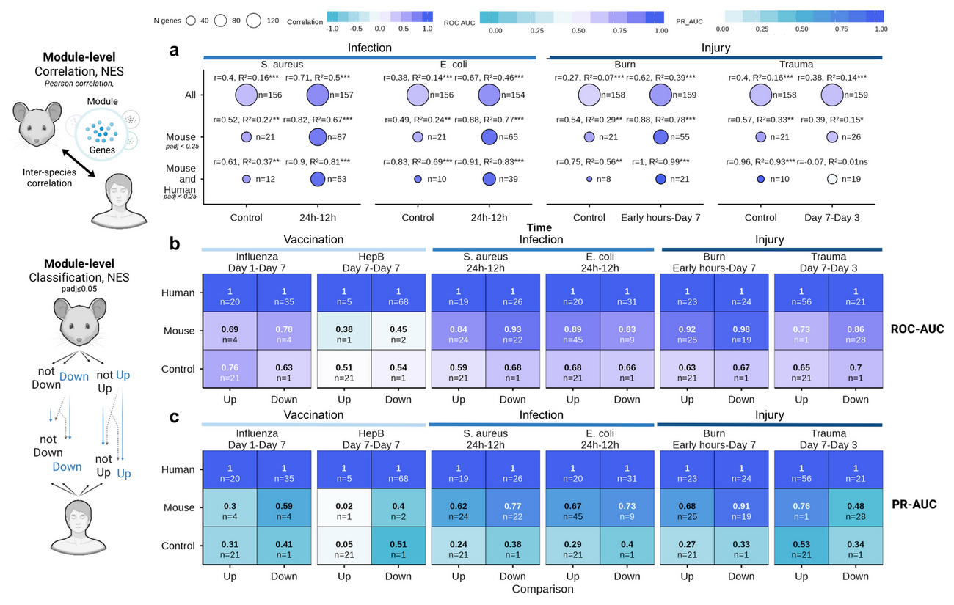
03 · RESULT — ANALYTICAL GRANULARITY
Cells disagree. Pathways agree.
0.89–0.97
MODULE-LEVEL (BTM NES) PEARSON CORRELATION BETWEEN SPECIES
• Gene-level effect sizes correlate only moderately; module activation is highly conserved.
• Shared leading-edge genes = 67.5–79% of mouse LEGs in enriched modules (70.5% pooled).
• Collapsing dimensionality into BTMs reduces noise and exposes a robust translational signature.
Fig. 4a–c — BTM module-level correlation (a) and classification performance (b, c) across conditions. · Fig. 5a — shared leading-edge genes across BTM process categories.
Mouse2Human · Lab meeting · September 2026 · Genes and Immunity (under review)
4 / 10
Notes:
First result: granularity matters. Individual orthologous genes correlate only moderately, but when we collapse the transcriptome into Blood Transcription Modules the correlation jumps to 0.89–0.97 (trauma being the exception). Shared leading-edge genes account for 67.5–79% of mouse LEGs — the translational signal lives in the leading edge, not in all genes.

Slide 5
04 · RESULT — STIMULUS INTENSITY & KINETICS
Translatability scales with the strength of the perturbation
INFECTION & INJURY — CONSERVED
SINGLE-DOSE VACCINATION — DIVERGES
ρ = 0.41–0.59
ρ = −0.32–0.27
Acute S. aureus , E. coli and burn engage evolutionarily stable, highly conserved programs.
Fluad® and Engerix B® fail to reach the systemic activation threshold, remaining near baseline controls.
Effect-size difference (|ΔLog2FC|) significantly smaller than negative controls — WMW adjusted P < 1 × 10⁻¹⁵.
Preclinical immunogenicity may require boosters or stronger adjuvants to emerge from species-specific noise.
Timing ≠ chronology · mouse 2–6 h matches the human peak inflammatory window (days 1–3) → align by biological equivalence
Mouse2Human · Lab meeting · September 2026 · Genes and Immunity (under review)
5 / 10
Notes:
Second result: translatability scales with the strength of the perturbation. Acute bacterial infection and severe injury engage conserved core mammalian programs (rho 0.41–0.59), whereas single-dose subunit/inactivated vaccines stay near baseline (rho −0.32 to 0.27). And timing rarely matches chronologically: mouse 2–6 h aligns with the human days 1–3 window.

Slide 6
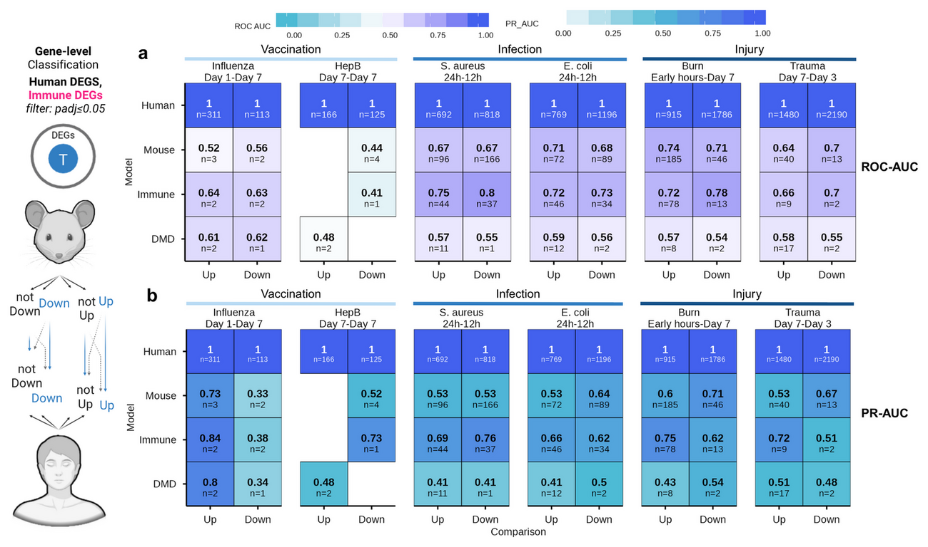
05 · RESULT — CLASSIFICATION PERFORMANCE
Mouse signatures call human direction — best at module level
0.84–0.98
0.64–0.74
ROC-AUC · MOUSE BTM SIGNATURES CLASSIFYING HUMAN MODULE REGULATION
ROC-AUC · GENE-LEVEL MOUSE SIGNATURES IN INFECTION & INJURY
Biological negative control (DMD): ROC-AUC 0.48–0.61 — near random
Fig. 3a–b — ROC-AUC and PR-AUC matrices for mouse signatures classifying up- and downregulated human genes, with human self-prediction and the DMD negative control.
Mouse2Human · Lab meeting · September 2026 · Genes and Immunity (under review)
6 / 10
Notes:
Third result: prediction. Mouse signatures classify the direction of human gene regulation, but module-level models clearly beat gene-level ones — 0.84–0.98 ROC-AUC versus 0.64–0.74 — and both beat the DMD negative control (0.48–0.61). Downregulation is easier to predict than upregulation at early time points.

Slide 7
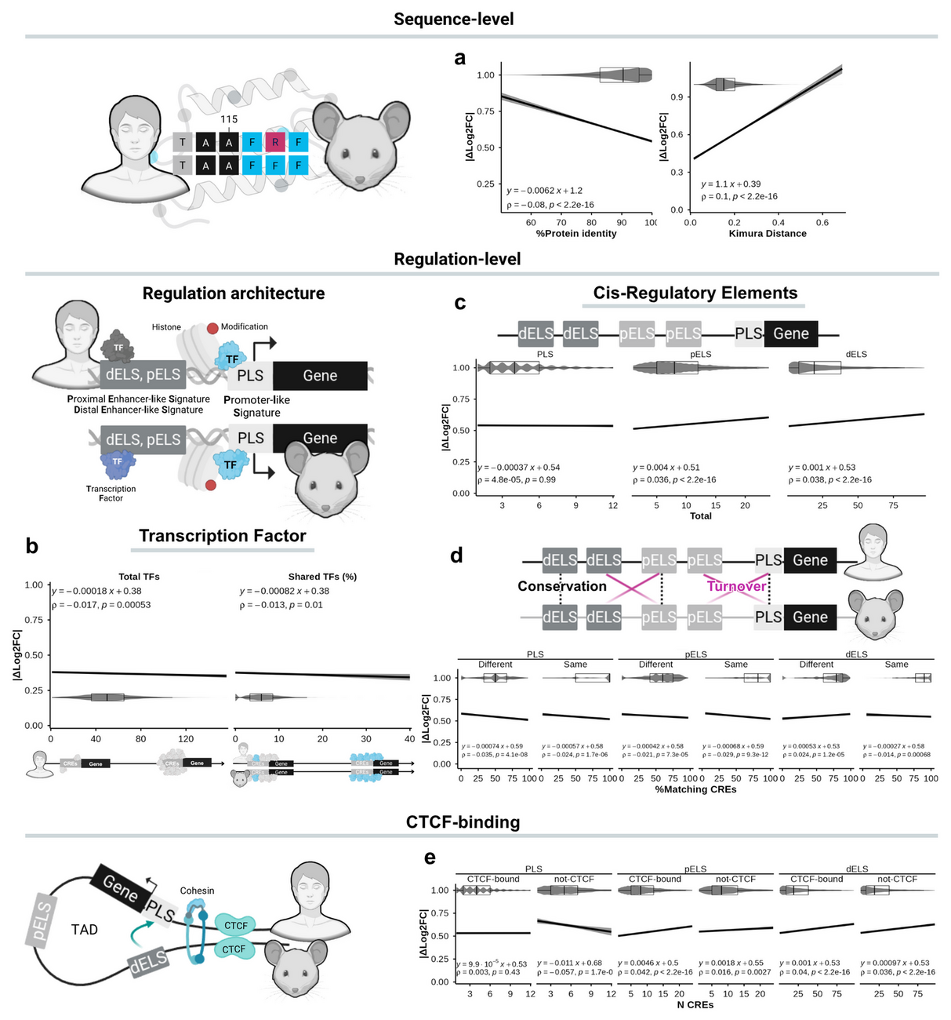
06 · RESULT — EVOLUTION & REGULATION
Why genes diverge
Small per-gene effects, but a consistent direction: sequence constraint tracks stability; regulatory plasticity tracks divergence.
ASSOCIATED WITH LOWER |ΔLOG2FC|
• Higher protein sequence identity rho = −0.08
• Greater TF availability and TF sharing rho = −0.017 / −0.013
• Conserved promoter-like (PLS) signatures n.s.
ASSOCIATED WITH HIGHER |ΔLOG2FC|
• Greater Kimura (K80) evolutionary distance rho = 0.10
• Enhancer multiplicity — pELS / dELS counts rho = 0.036 / 0.039
• CRE turnover and CTCF-bound pELS bound rho = 0.042
Fig. 6a–e — protein sequence identity and Kimura distance (a), transcription factor availability (b), cis-regulatory element abundance (c), CRE conservation and turnover (d) and CTCF binding (e) against |ΔLog2FC|.
Mouse2Human · Lab meeting · September 2026 · Genes and Immunity (under review)
7 / 10
Notes:
Fourth result: why individual genes diverge. Coding-sequence constraint and trans-regulatory availability reduce expression divergence, while enhancer multiplicity and CRE turnover increase it. The association is small in magnitude but highly significant, and it is directional: sequence constraint ↔︎ stability; regulatory plasticity ↔︎ divergence.

Slide 8
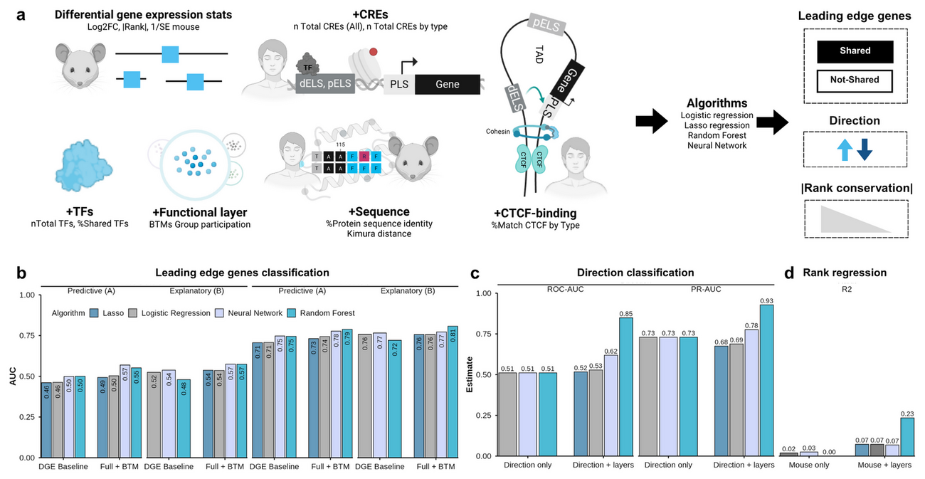
07 · RESULT — MULTILAYER MODELLING
Layers turn near-chance transfer into useful prediction
• Mouse rank alone: R² = 0.001 · mouse direction alone: ROC-AUC 0.511 — no transfer.
• evolution, TF, CRE and BTM layers → random forest R² = 0.234 for human rank and ROC-AUC = 0.849 for direction.
– evolution, TF, CRE and BTM layers → random forest R² = 0.234 for human rank and ROC-AUC = 0.849 for direction.
• Shared vs mouse-only LEGs stay hard: lasso best by a whisker (0.617 predictive / 0.627 explanatory).
LOCO-CV (4 folds) · nested layers: DGE Baseline → Full + BTM
4 algorithms: linear/logistic · lasso · random forest · neural network
Fig. 7 — multilayer modelling: (a) layer integration workflow, (b) shared-LEG classification, (c) directional concordance and (d) human rank regression, across algorithms and feature layers.
Mouse2Human · Lab meeting · September 2026 · Genes and Immunity (under review)
8 / 10
Notes:
Fifth result: the multilayer model. Mouse rank and direction alone do not transfer at all — R² = 0.001 and ROC-AUC 0.511. Adding the biological layers raises the random forest to R² = 0.234 for human rank and 0.849 for directional concordance. Shared-LEG classification stays hard; the lasso is only marginally best there (0.617/0.627). Everything is evaluated by leave-one-condition-out cross-validation, so every gene is scored by a model that never saw its pathogen.

Slide 9
08 · TAKE-AWAYS & LIMITATIONS
Translatability is a function of granularity, intensity and timing
WHAT THE STUDY ESTABLISHES
LIMITATIONS TO KEEP IN MIND
• Module-level analysis beats gene-level analysis for cross-species concordance.
• Acute infection and injury translate; single-dose vaccination does not.
• Evolutionary and regulatory layers carry a conserved signal beyond mouse DGE.
• Four out-of-fold scores — score_shared , score_rank , score_direction , score_translational — prioritise candidate genes.
• Small murine cohorts; scarce harmonised metadata.
• Two inbred strains only (C57BL/6, CB6F1) — strain choice shapes translatability.
• Single-dose mouse vaccination vs. human prime-boost regimens.
• Blood-based BTMs and one-to-one Ensembl orthologs — needs testing in other tissues and gene sets.
Mouse2Human · Lab meeting · September 2026 · Genes and Immunity (under review)
9 / 10
Notes:
Take-aways: translatability is not a fixed property of the mouse; it is a function of granularity, stimulus intensity and temporal alignment. The model outputs four complementary scores that can be used to prioritise genes. Be honest about the limitations: small murine cohorts, two inbred strains, single-dose vaccines, blood only, and one-to-one orthologs only.

Slide 10
Open code, trained models, and a notebook to apply them
PIPELINE
DOCUMENTATION
APPLY IT
mousetohuman_multilayer
Project site
mousetohuman_predict
Pipeline
Documentation
Apply it
Full R Markdown pipeline — curation, QC, limma DGE, GSEA, evolutionary and regulatory analyses, and the LOCO modelling script. Pinned with renv .
Overview, complete methodology — including the multilayer modelling pipeline — and the notebook map, in one place.
Step-by-step notebook: from DGE input to GSEA, model prediction and visualisation of the four translational scores. Runs in RStudio via Binder.
wapsyed.github.io/mousetohuman_multilayer
github.com/wapsyed/mousetohuman_multilayer
github.com/wapsyed/mousetohuman_predict
github.com/wapsyed/mousetohuman_multilayer
wapsyed.github.io/mousetohuman_multilayer
github.com/wapsyed/mousetohuman_predict
Thank you — questions welcome.
Mouse2Human · Lab meeting · September 2026 · Genes and Immunity (under review)
10 / 10
Notes:
Close by pointing to the deliverables: the full open-source pipeline, the project site that documents the methodology and the notebook map, and the step-by-step notebook that applies the trained models to a new mouse dataset — runnable in the browser via Binder. Everything is open so the community can audit and retrain.

