Slide 1
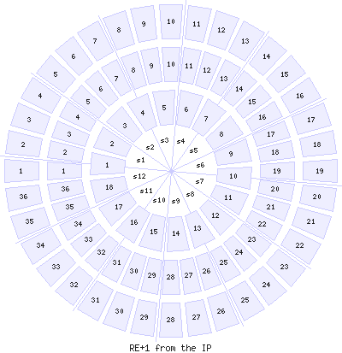
Gas Sector -30 deg
Cooling Sector 20 deg

