Slide 1
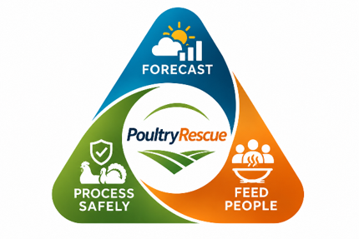

Food safety should not mean unnecessary food loss.
THE CHALLENGE
PoultryRescue
When testing identifies Salmonella, how can processors choose a safe, compliant next step?
Detect • Decide Safely • Preserve Food
Team Early Signal
NAFSI HUB DATA CHALLENGE 2026
Notes:
Salmonella is an important food-safety challenge, while poultry is also an affordable source of high-quality protein. Our starting question was practical: when contamination is identified, what should a processor do next? Discarding is not always the only possible response. PoultryRescue is an early decision-support prototype designed to help professionals examine whether safe, legally permissible further processing can preserve food without compromising consumer protection.

Slide 2
OUR SOLUTION
From detection to safe processing decisions
A transparent workflow for quality assurance and HACCP professionals
1
2
3
4
›
›
›
SIGNAL
ASSESS
COMPARE
PRESERVE
FSIS surveillance and available lot test results
Check product type, measurement, and applicable rules
Compare permissible, validated processing options
Compare modeled exposure and food preserved
SAFETY FIRST
Every management action remains subject to applicable regulations, validated processes, and professional review.
POULTRYRESCUE • NAFSI SENS-D
02
Notes:
The intended workflow begins with information about the product and, when available, laboratory testing that identifies or quantifies Salmonella. The product category matters because regulatory requirements differ: a numerical threshold for certain covered not-ready-to-eat breaded stuffed chicken products is not a universal rule for raw poultry. The tool guides a review of applicable requirements and possible management actions, such as holding, verification, or validated cooking where permitted. It also compares the modeled implications for food retention and food security. Historical FSIS surveillance adds advance context and preparedness; it cannot establish the contamination of an individual lot.

Slide 3
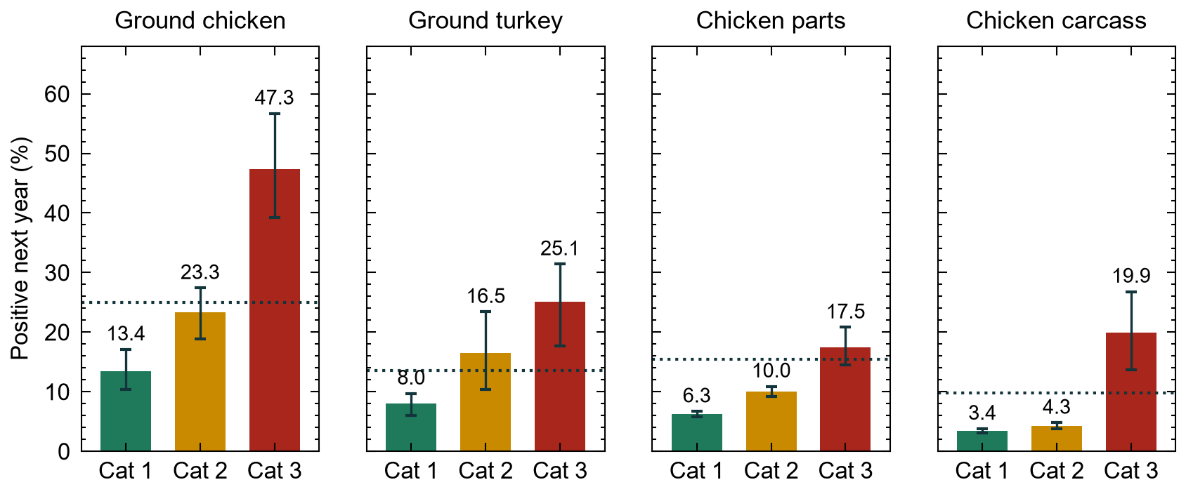
EVIDENCE
Surveillance helps processors prepare
Historical categories predict future sampling patterns—not measured lot contamination
GROUND CHICKEN
Category 1
13.4%
Category 2
23.3%
Category 3
47.3%
4.3% lower Brier score
Source: PoultryRescue report, Figure 4
relative to product-only baseline
POULTRYRESCUE • NAFSI SENS-D
03
Notes:
Our team also tested whether existing public FSIS information could help with preparedness before a test result arrives. For ground chicken processing lines, subsequent Salmonella positivity was 13.4 percent for Category 1, 23.3 percent for Category 2, and 47.3 percent for Category 3. Adding the category to product type reduced Brier score by 4.3 percent relative to product type alone. These findings demonstrate predictive value at the establishment-line level. They are not measured Salmonella concentrations and do not justify a product disposition on their own. That distinction is critical to the intended application.

Slide 4
ILLUSTRATIVE SCENARIO
When a quantitative test result is available
Illustrative covered breaded stuffed chicken · measured 2.0 CFU/g · validated cooking available
ILLUSTRATIVE ACTION
EXAMPLE TEST RESULT
Review diversion to validated cooking
2.0 CFU/g
19,211
example measured level
Product-specific rule and test result guide the review
estimated servings retained
Modeled servings are not recovered food. Any action requires compliant disposition, validated processing, and professional review.
POULTRYRESCUE • NAFSI SENS-D
04
Notes:
Here is the clearest illustration of the intended decision-support role. The report models a not-ready-to-eat breaded stuffed chicken product with a measured Salmonella concentration of 2.0 CFU per gram. For products covered by the specific 2024 FSIS determination, the one-CFU-per-gram criterion is relevant; it must not be applied indiscriminately to other raw poultry. The scenario evaluates redirecting eligible material to a validated cooking process, rather than automatically assuming disposal. Under the model's assumptions, about 19,211 servings could be retained. These are simulated servings, not observed recovery, and a qualified professional would still have to confirm the applicable requirements, processing eligibility, and validated controls. The 2024 determination's verification implementation has been delayed, which is why we present this as a future-oriented decision scenario, not a currently deployed regulatory workflow.

Slide 5
THE PROTOTYPE
A tool for decisions after testing
Surveillance supports preparedness; product-specific testing informs disposition review
PoultryRescue | Decision workspace
What it does NOT do
LOT INPUTS
DECISION OUTPUTS
Product • FSIS category
Available test result • Cook capacity
Decision-path explanation
Eligible management options
Modeled retention and exposure
• Authorize product release
• Determine individual-lot safety
• Predict actual illnesses prevented
Schematic of application functions; not an actual screenshot
POULTRYRESCUE • NAFSI SENS-D
05
Notes:
Our prototype translates inputs and assumptions into an explainable sequence of management choices. The current application incorporates product information, FSIS category, screening information, and available processing options; the report includes an illustrative scenario with a quantitative result. The future goal is a validated workflow accepting reliable, product-specific quantitative measurements as they become operationally available. The platform does not independently declare products safe, authorize release, or replace QA, HACCP, or FSIS decisions. It makes the decision process and food-preservation tradeoffs easier to inspect.

Slide 6
IMPACT AND NEXT STEPS
Detect contamination. Evaluate options. Preserve food.
One integrated approach to food safety and food security
NOW
NEXT
LATER
Surveillance signals + rule-based prototype
Validate quantitative inputs, rules, and plant constraints
Integrate validated sensors, capacity, and logistics
Our contribution
Turn available testing into informed, compliant decisions while preserving eligible poultry.
POULTRYRESCUE • NAFSI SENS-D
06
Notes:
PoultryRescue combines two pieces: surveillance-based early warning and decisions informed by product-specific testing. The data analysis establishes that historical categories can anticipate future positivity. The rule-based scenario demonstrates how the platform could compare responses after a measured result is available. The next steps are to validate quantitative inputs, regulatory rules, actual plant processing capabilities, logistics, and professional review processes. Our aim is not simply to predict Salmonella: it is to help processors choose safe, compliant actions and preserve nutritious food whenever it is genuinely eligible for further processing.

