Slide 1

Healthy-Routine Stability Score System
A Database-Driven Python Application for Personal Wellness Consistency Tracking
DATABASE SYSTEMS
2026
Shazim Javed- Senior Software Engineer

Slide 2


The Problem with Modern Wearables
Modern wearables like Apple Watch and Fitbit excel at tracking individual metrics steps taken, hours slept, calories burned. Yet no existing tool measures overall lifestyle consistency across multiple habits simultaneously.
What Wearables Miss
Cross-habit consistency patterns
Behavioral disruption detection
Longitudinal stability trends
Correlation between habits and mood
Actionable improvement suggestions
Research consistently links routine stability to improved mental health, higher productivity, and long-term wellness outcomes. A fragmented picture of isolated data points fails to capture what truly matters: how consistently a person maintains their habits day over day.
Our project introduces a genuinely novel metric: the Routine Stability Score (RSS) a single composite value that quantifies daily lifestyle consistency.

Slide 3




Project Overview: HRSS at a Glance
The Healthy-Routine Stability Score (HRSS) is a fully database-backed Python system that captures, stores, analyzes, and reports on six daily lifestyle habits to produce a single, statistically grounded consistency metric.
Data Capture
Relational Storage
CLI input for 6 daily habits: sleep, meals, activity, hydration, screen time, and mood
SQLite database with 6 normalized tables, foreign keys, and indexed queries
Score Engine
Reports & Export
Composite Stability Score (0–100) computed via Coefficient of Variation per habit
Daily/weekly terminal reports, 3 auto-generated charts

Slide 4
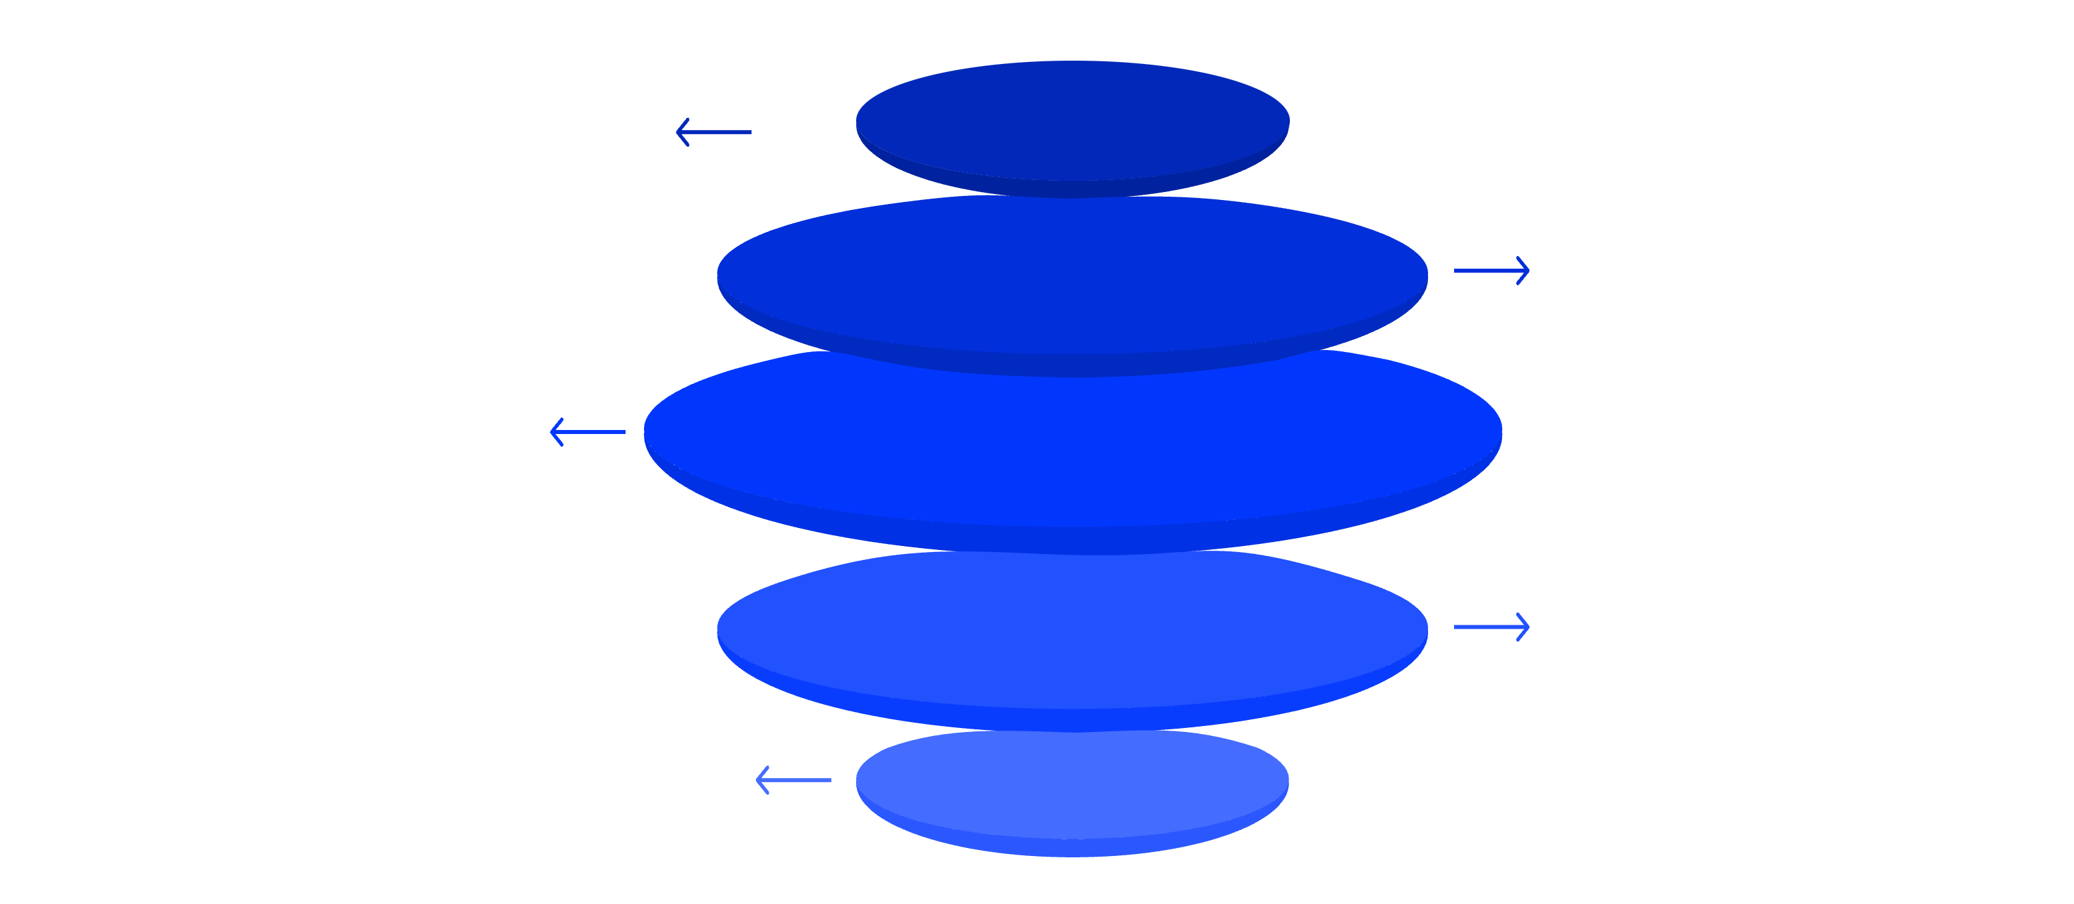
System Architecture
HRSS follows a clean 5-layer architecture that enforces separation of concerns — from user input all the way through to exportable output. The database layer sits at the core, ensuring every computation is persistent and auditable.
CLI Input
User commands with validation
SQLite DB
Six normalized, auditable tables
Python Engine
score_engine.py and pattern_detector.py
Report Generator
Rich, Matplotlib, ReportLab stacks
Output
Terminal, PNG charts
Each layer communicates exclusively through the database, making the system modular, testable, and extensible. The SQLAlchemy ORM abstracts raw SQL while preserving full relational integrity across all six normalized tables.

Slide 5
Database Schema Design
The relational schema is the backbone of HRSS. All six tables are fully normalized, use proper primary and foreign keys with ON DELETE CASCADE, and are indexed on user_id and log_date for query performance.
Table
Purpose
users
User profiles and personal habit targets
daily_logs
One row per day: sleep, meals, steps, water, screen time, mood
habit_scores
Per-habit stability % and disruption flags
stability_scores
Daily and weekly composite scores
disruptions
Detected anomalies with severity classification
suggestions
Stored improvement tips with priority flags

Slide 6
The Stability Score Algorithm
The scoring engine applies statistical rigor to transform raw habit logs into a meaningful, normalized consistency metric. Every calculation pulls directly from the database and writes results back — ensuring full auditability and 30-day historical trends.
Fetch 7-Day Window
1
Retrieve the last 7 days of habit logs from daily_logs for each tracked habit
Compute CV per Habit
2
Coefficient of Variation: CV = std ÷ mean × 100 — measures relative variability
Habit Stability %
3
Stability = max(0, 100 − CV) — higher consistency yields a higher score
Weighted Composite
4
Sleep×0.30 + Meals×0.20 + Activity×0.20 + Hydration×0.15 + Screen×0.15
Disruption Detection
5
Flag any daily value deviating more than 2× standard deviation from the rolling mean

Slide 7
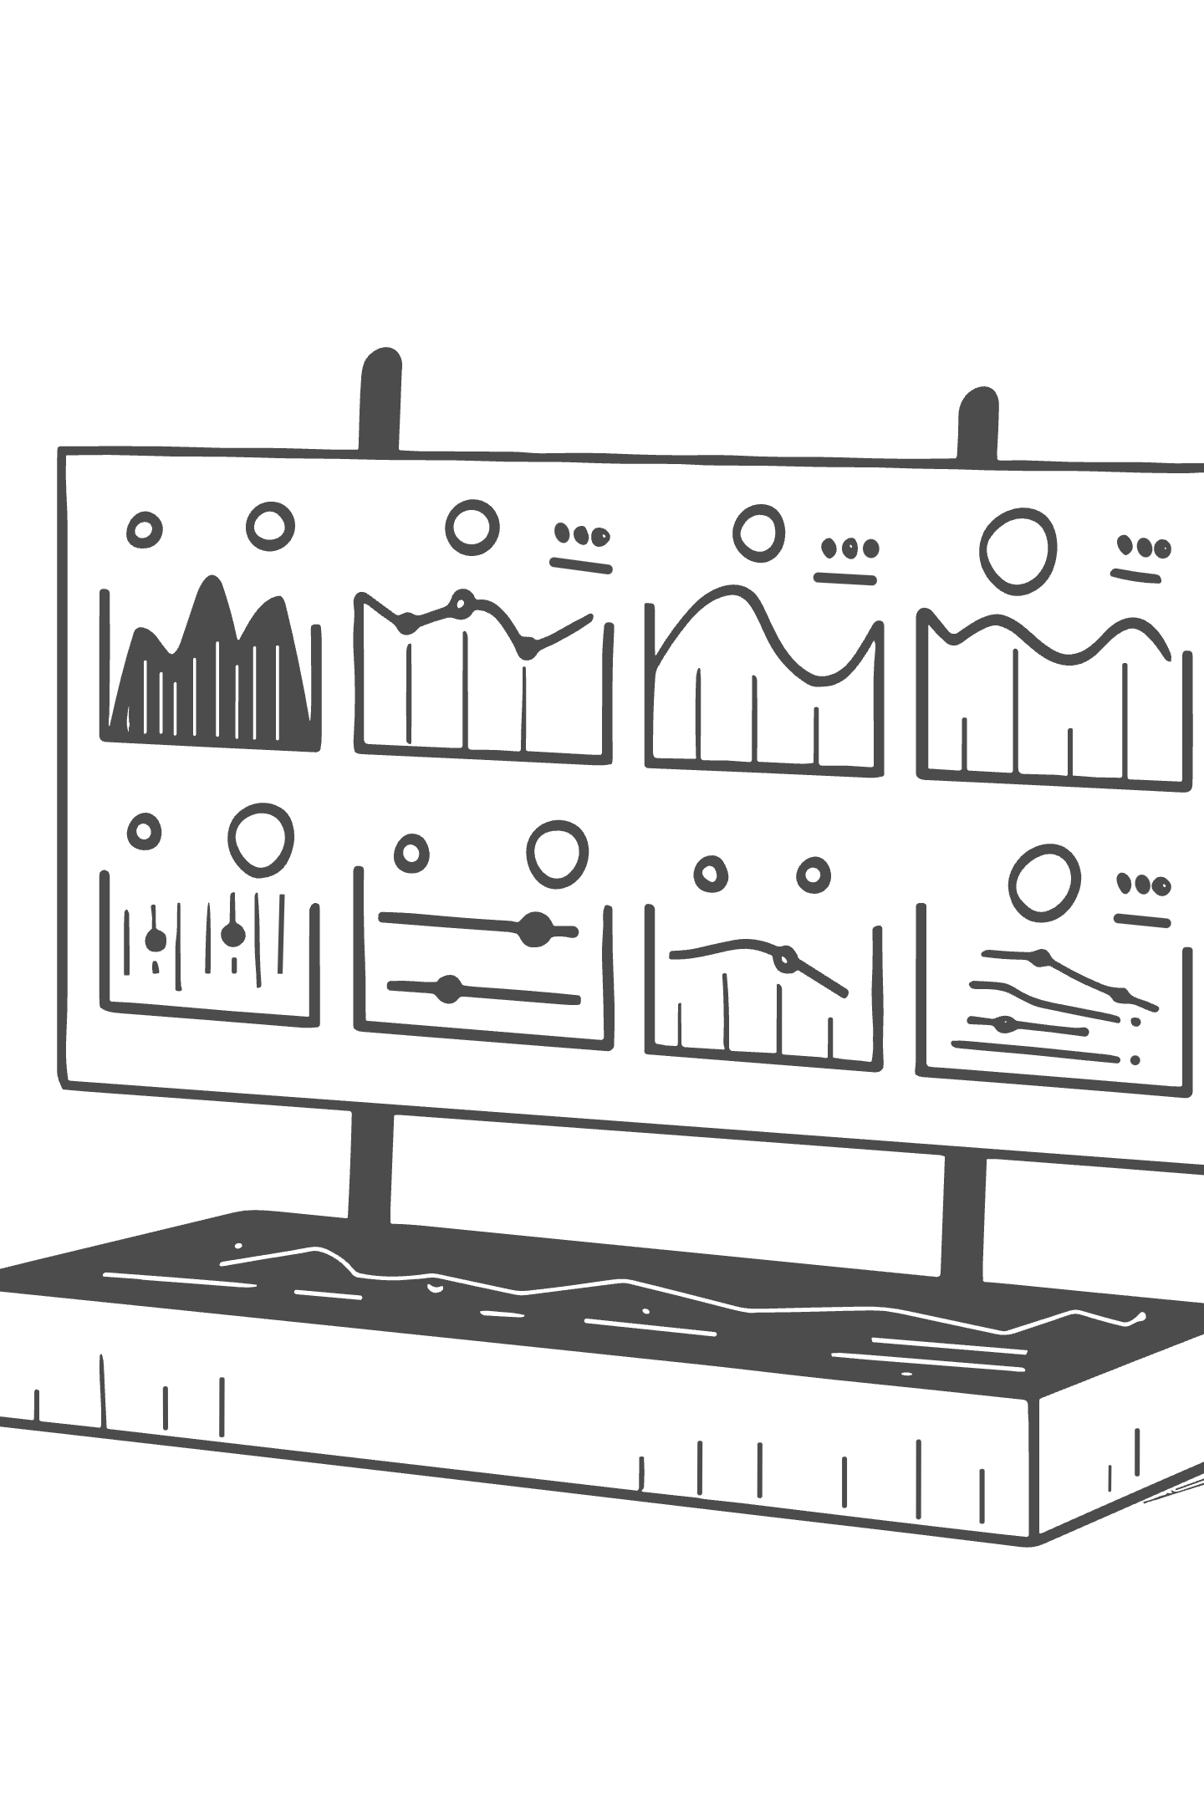
Key Features & Output
Daily Report
Auto-Generated Visualizations
Color-coded score: green / yellow / red thresholds
Per-habit breakdown table with disruption alerts
Inline improvement suggestions from DB
Trend line chart: 7-day score progression
Habit bar chart : per-habit stability breakdown
Scatter plot : stability score vs. mood/energy
Weekly Report
Export
7-day stability trend with mood correlation
Stable vs. unstable habit classification
Pearson correlation: stability ↔ mood/energy/productivity
PNG chart files for standalone sharing
Rich-formatted terminal UI for live session output

Slide 8


Technology Stack
HRSS is built on a carefully selected Python ecosystem each library chosen for a specific role, ensuring the system is statistically sound, visually informative, and production-ready with 13 automated end-to-end tests.
Core Runtime
Statistical Engine
Python 3.10+ with SQLite and SQLAlchemy ORM for robust, schema-enforced relational data management
Pandas and NumPy power the CV calculations, rolling windows, and Pearson correlation analysis
Visualization
UI & Testing
Matplotlib and Seaborn generate three chart types
Rich renders color-coded terminal output

Slide 9

Why HRSS is Genuinely Novel
Consistency Over Quantity
The core innovation: shifting wellness measurement from "how much?" to "how reliably?" a statistically grounded distinction no existing consumer tool makes.
Apple Watch tracks whether you slept HRSS tracks how consistently you sleep. A person sleeping exactly 6 hours every night scores higher than someone sleeping 8 hours some nights and 4 hours others. Regularity is the metric that matters.
Schema as Documentation
Database as the Source of Truth
The six-table relational schema communicates the entire application logic at a glance. The foreign key chain from daily_logs → habit_scores → stability_scores → disruptions → suggestions reflects a clean, intentional data pipeline that any database professional can audit immediately.
Every feature is database-backed. Scores persist for 30-day trend analysis, disruptions are fully auditable with timestamps and severity, and suggestions are stored with priority flags not just printed and forgotten.

Slide 10



Conclusion & Future Work
What We Achieved
Roadmap
Fully functional, database-driven Python application with clean 5-layer architecture
Web/Mobile Front-End : Flask-based dashboard with interactive charts
Wearable API Integration : Apple HealthKit and Fitbit data ingestion
ML Disruption Prediction : forecast instability before it occurs
Social Accountability : multi-user habit streaks and peer comparisons
Six normalized SQL tables with proper relational integrity and indexed queries
Statistically valid scoring algorithm using Coefficient of Variation and weighted composites
The Routine Stability Score concept is genuinely novel and carries real-world application potential beyond this academic context.
Automated daily/weekly reports, 3 chart types

