Slide 1

ALPACA × LABLAB.AI / OPTIONS ALPHA AGENTS
Autonomous options intelligence
with authority separated from reasoning.
EXPLAINABLE · DEFINED RISK · PAPER ONLY
Notes:
Open on the separation-of-powers idea; avoid leading with features.
[Sources]
- Generated CloudRise cover artwork (project asset, 2026)
- https://lablab.ai/ai-hackathons/alpaca-ai-trading-agents-hackathon
[/Sources]

Slide 2
THE PROBLEM
02
A trading agent should never
grade its own homework.
When the same model invents the thesis, sizes the risk, and authorizes the order, confidence can become permission. CloudRise breaks that loop.
RESEARCH
→
GOVERNANCE
→
EXECUTION
Intelligence can propose. Only policy can authorize.
CLOUDRISE · PAPER ONLY
Notes:
Frame the design philosophy: research, governance, and execution are separate authorities.
[Sources]
[/Sources]

Slide 3
STRATEGY
03
One week rewards focus, not a sprawling universe.
CloudRise concentrates on structures that can be evaluated and executed repeatedly.
01
02
03
Liquid index ETFs
15-minute signals
7–21 DTE spreads
SPY · QQQ · IWM
Avoid single-company earnings gaps and prioritize option depth.
Fast enough for a seven-day contest; slow enough to suppress microstructure noise.
Directional convexity with the maximum loss known before entry.
Built for the required fresh $100,000 Alpaca paper account — and for measurable P&L.
CLOUDRISE · PAPER ONLY
Notes:
Explain why index ETFs and short-horizon signals match the competition format.
[Sources]
- https://lablab.ai/ai-hackathons/alpaca-ai-trading-agents-hackathon
[/Sources]

Slide 4
ARCHITECTURE
04
Autonomy moves through four explicit authorities.
Every boundary produces inspectable evidence.
OBSERVE
DEBATE
GOVERN
EXECUTE
→
→
→
IEX bars
Option snapshots
4 independent
specialist votes
11 hard gates
Risk-sized authority
Atomic MLeg
Alpaca CLI
THESIS + VETO + RISK DECISION + COMMAND + BROKER RESPONSE → APPEND-ONLY LEDGER
CLOUDRISE · PAPER ONLY
Notes:
Walk left-to-right and emphasize that each stage has a narrower authority than the prior stage.
[Sources]
- https://docs.alpaca.markets/us/docs/alpacas-cli
[/Sources]

Slide 5
AI LOGIC
05
Agreement creates the thesis.
No single model decides; the same input yields the same scored explanation with no paid inference.
38%
30%
22%
10%
REGIME
MOMENTUM
BREAKOUT
REVERSION
8/21 EMA separation
12-bar return
20-bar channel
RSI veto
direction ≥ ±0.24 · agreement ≥ 60% · confidence ≥ 62%
CLOUDRISE · PAPER ONLY
Notes:
The ensemble is deterministic and explainable. Reversion is a veto-sized vote, not the primary direction engine.
[Sources]
[/Sources]

Slide 6
OPTIONS CONSTRUCTION
06
The structure defines the loss before the order.
Bullish → call debit spread. Bearish → put debit spread.
LONG ≈ 0.55Δ
SHORT ≈ 0.30Δ
EXPIRY
nearest to 12 DTE
ENTRY
long ask − short bid
MAX LOSS
debit × 100 × quantity
LOWER STRIKE
HIGHER STRIKE
ORDER
BULL CALL SPREAD
single atomic MLeg limit
Reject wide quotes, invalid debit, or reward/risk < 0.60×.
CLOUDRISE · PAPER ONLY
Notes:
Use a bull call spread as the concrete example. The bearish construction mirrors it with puts.
[Sources]
- https://docs.alpaca.markets/us/v1.1/reference/optionchain
- https://docs.alpaca.markets/us/v1.4.2/docs/options-level-3-trading
- https://docs.alpaca.markets/us/reference/postorder
[/Sources]

Slide 7
RISK GOVERNANCE
07
Eleven gates can veto. None can be bypassed.
The agent preserves optionality by making “no trade” a first-class outcome.
11
SURVIVAL
TRADE QUALITY
INTEGRITY
01
Paper-only invariant
05
≥62% confidence
09
Market session open
02
−1.5% daily circuit
06
≥60% agreement
10
No duplicate exposure
NON-BYPASSABLE
AUTHORIZATION CHECKS
03
2.5% portfolio risk
07
Liquidity threshold
11
0.6% trade sizing
04
Maximum 3 spreads
08
≥0.60× reward/risk
One failed gate → zero quantity → timestamped veto.
CLOUDRISE · PAPER ONLY
Notes:
This is the core safety innovation: the research layer cannot edit, skip, or override these checks.
[Sources]
[/Sources]

Slide 8
ALPACA IMPLEMENTATION
08
Alpaca’s CLI is the control plane.
The Trading API is the execution rail; structured JSON keeps every interaction auditable.
MARKET DATA
CLI SYNC
RISK AUTH
PAPER ORDER
15m IEX bars
Indicative option chain
Account · clock
positions · orders
MLeg preview
unique client ID
POST /v2/orders
atomic spread
ALPACA_LIVE_TRADE = false
Credentials stay in process environment — never in UI, source, or ledger.
CLOUDRISE · PAPER ONLY
Notes:
The CLI satisfies the required developer-tool integration and is forced into paper mode by the application.
[Sources]
- https://docs.alpaca.markets/us/docs/alpacas-cli
- https://docs.alpaca.markets/us/reference/postorder
[/Sources]

Slide 9
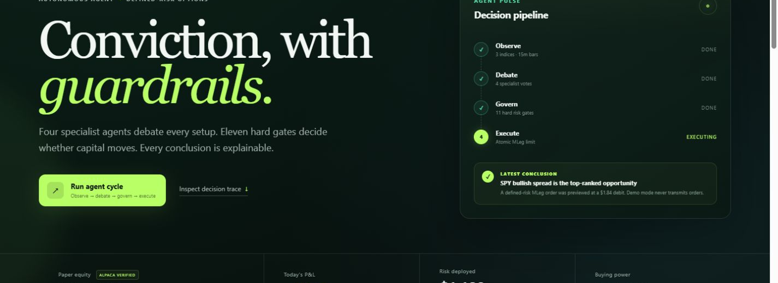
PRODUCT PROOF
09
Every conclusion stays inspectable.
Paper equity, specialist votes, active gates, positions, and the append-only ledger share one judge-facing view.
DEMO REPLAY SHOWN · REAL SUBMISSION USES THE FRESH ALPACA PAPER ACCOUNT
CLOUDRISE · PAPER ONLY
Notes:
Be explicit that this screenshot is the zero-credit demo replay. During judging, switch to paper mode and show the fresh account.
[Sources]
- CloudRise local dashboard screenshot (project asset, 2026)
[/Sources]

Slide 10

CLOUDRISE
Conviction,
with guardrails.
The agent finds the opportunity.
The governor earns the right to take it.
AUTONOMOUS · DEFINED RISK · AUDITABLE · MIT
Notes:
Resolve the opening tension: autonomy is credible when authority is constrained and every action is evidenced.
[Sources]
- Generated CloudRise shield artwork (project asset, 2026)
[/Sources]

