Slide 1
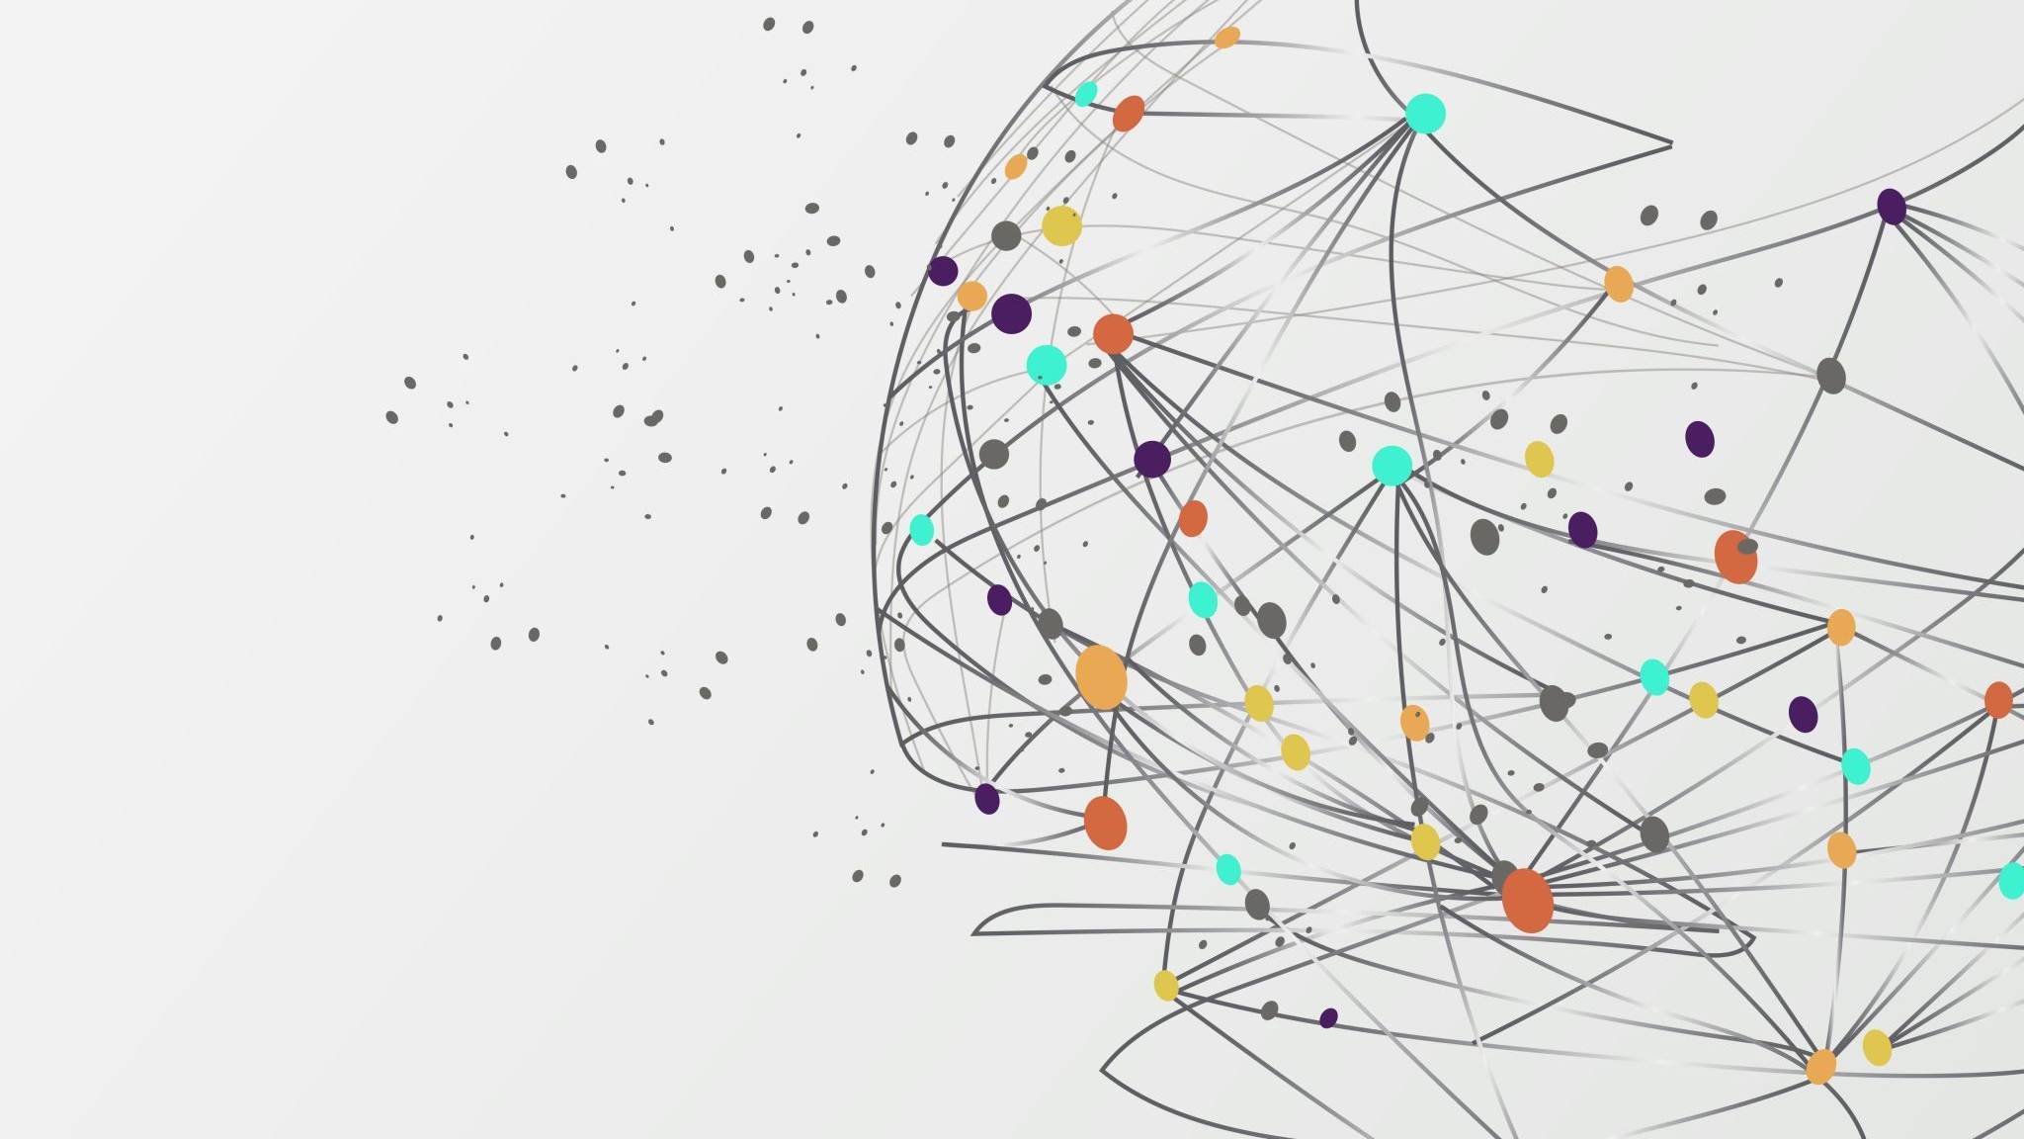
BankChurn AI Predictor
A Data Science Project by Muhammad Waqas

Slide 2

Why Predict Customer Churn?
Churn Definition: Customers leaving a bank.
Business Problem: Losing customers impacts revenue significantly.
Objective: Predict customer churn and provide insights to retain them.

Slide 3
Understanding the Data
Source: Kaggle
Size: Rows: 10,000, Columns: 14.
Features:
Numerical: Age, CreditScore, Balance, etc.
Categorical: Geography, Gender, etc.
Target Variable: Exited (1 = Churn, 0 = Retained).

Slide 4
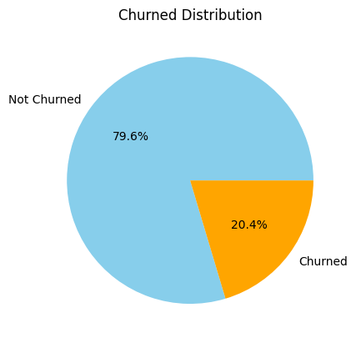
Insights from Data Analysis
Key Observations:
Almost 21 percent customers churned.
Older customers had higher churn rates.
Geography impacted churn (e.g., Germany had more churners).
Balance and activity levels strongly influenced churn.

Slide 5
Transforming the Data for Better Predictions
Feature Engineering Techniques:
Age groups: 18–30, 31–45, etc.
Balance categories: <50K, 50K–100K, etc.
Encoding categorical variables.
Scaling Numerical features.

Slide 6
Building the Prediction Model
Algorithms tested: Multiple simple and ensemble algorithms.
Chosen Model: Random Forest Classifier (high Recall score and interpretability).
Workflow:
Data Preprocessing
Hyperparameter Tuning
Model Training
Prediction
Making Pipeline of all the process to avoid data leakage.

Slide 7
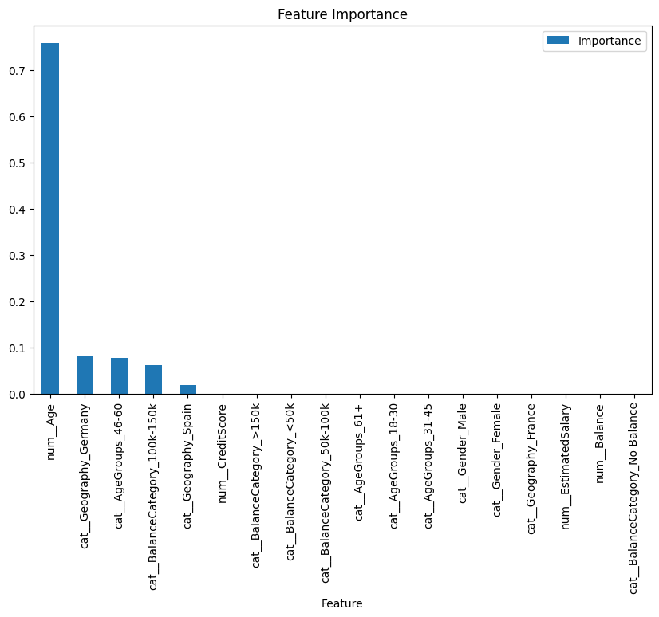
What Features Matter Most?

Slide 8

How Well Does the Model Perform?
Accuracy: 71.16%
Recall: 72.64%
Precision: 38.16%
F1-Score: 50.03%
As Recall is too much important in this case, so main aim was to achieve highest recall as possible.

Slide 9
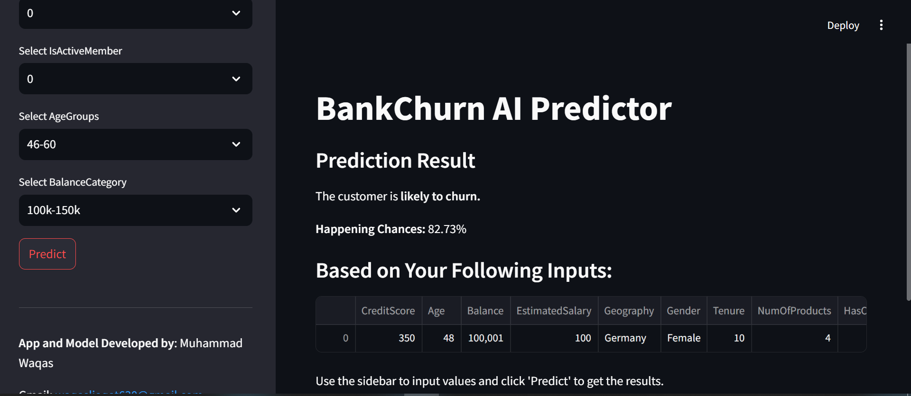
Making the Model Accessible
Deployment platform: Streamlit.
Features of the app:
Easy user interface to predict churn.
Accepts user inputs and returns prediction results.

Slide 10

Project Highlights
Achievements:
Predicted churn with high accuracy.
Identified actionable factors to reduce churn.
Successfully deployed the model via Streamlit for easy access.
Business Impact:
Proactively retaining customers can lead to significant revenue savings.

Slide 11
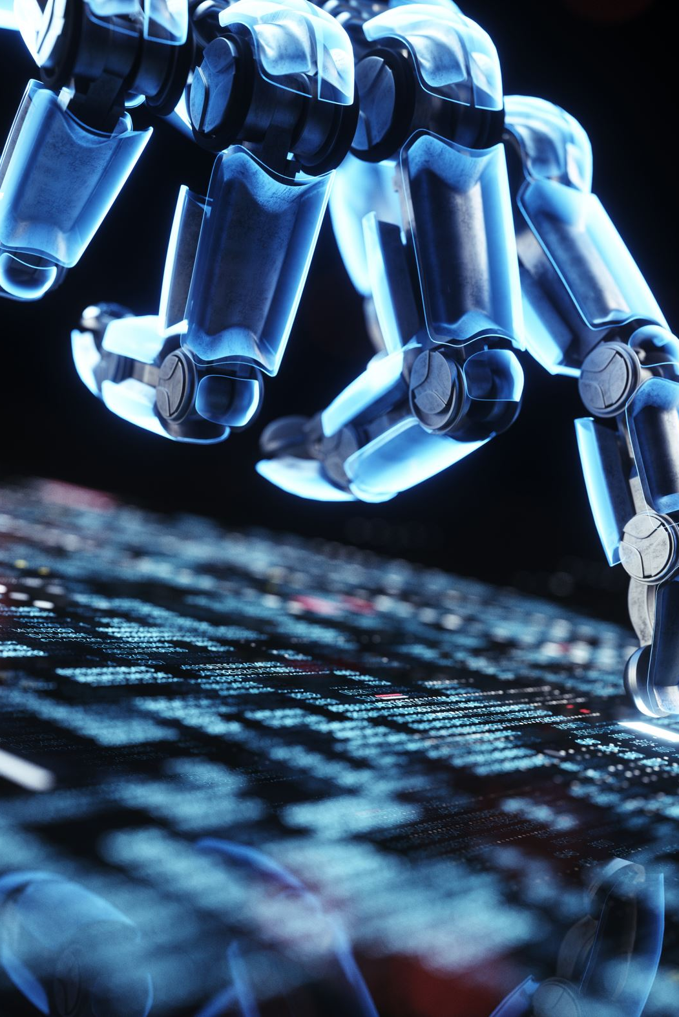
Reflections on the Project
Challenges:
Handling imbalanced data.
Feature engineering for complex variables.
Learnings:
Gained hands-on deployment experience.

Slide 12
What’s Next?
Enhancements:
Improve app with data visualizations and explanations for predictions.
Experiment with more advanced algorithms.
Integration:
Real-time data updates for continuous predictions.

Slide 13
Let’s Connect!
Thank you for your attention!
Contact Details (to contact, correct or advice me):
Email: waqasliaqat630@gmail.com
WhatsApp: +92 3097829808
Linkedin
Github

