Slide 1
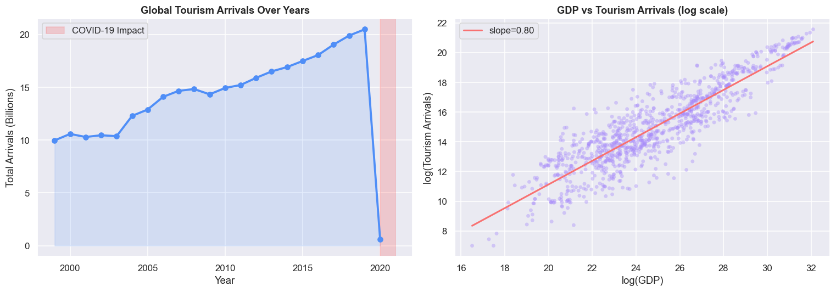
Ulster University
Page 01
International Tourism Demand
Forecasting Using Machine Learning
A Production-Ready MLOps Framework
Presented by
Supervisor
Waqas | Department of Computing
=========

Slide 2
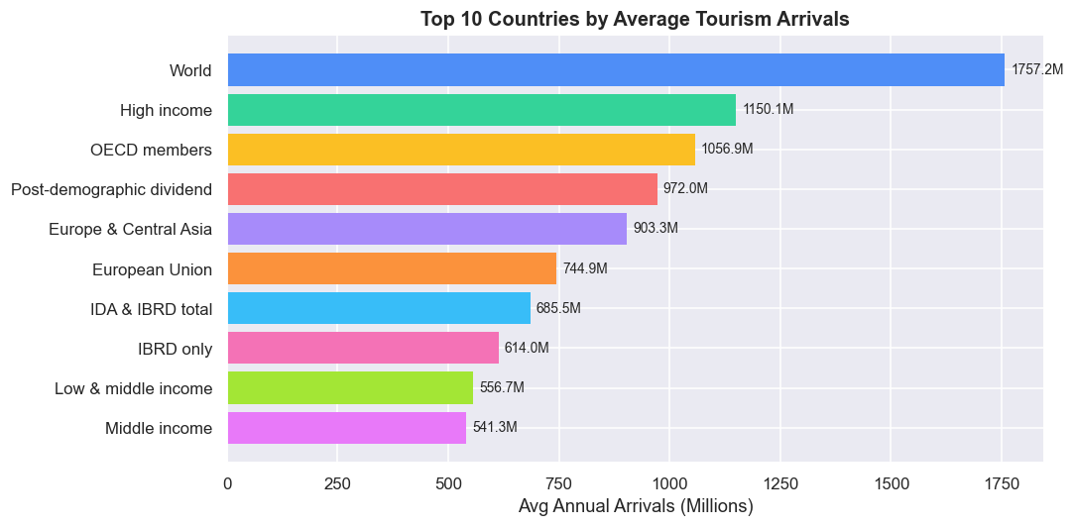
Giggling Platypus Co.
INTRODUCTION
Ulster University
Page 02
International tourism contributes ~10% of global GDP and over 330 million jobs worldwide
Accurate arrivals forecasting is critical for governments, tourism boards, and economic planners
Arrivals are driven by GDP growth, exchange rates, geopolitics, airline connectivity, and pandemics
Traditional ARIMA models fail to capture nonlinear dynamics and structural breaks (COVID-19, SARS)
The World Bank provides 25 years of verified data across 200+ countries (1999–2023)
Most ML studies stop at the notebook — no production deployment or real-time monitoring exists
This study delivers both: state-of-the-art ML forecasting AND a complete MLOps pipeline

Slide 3
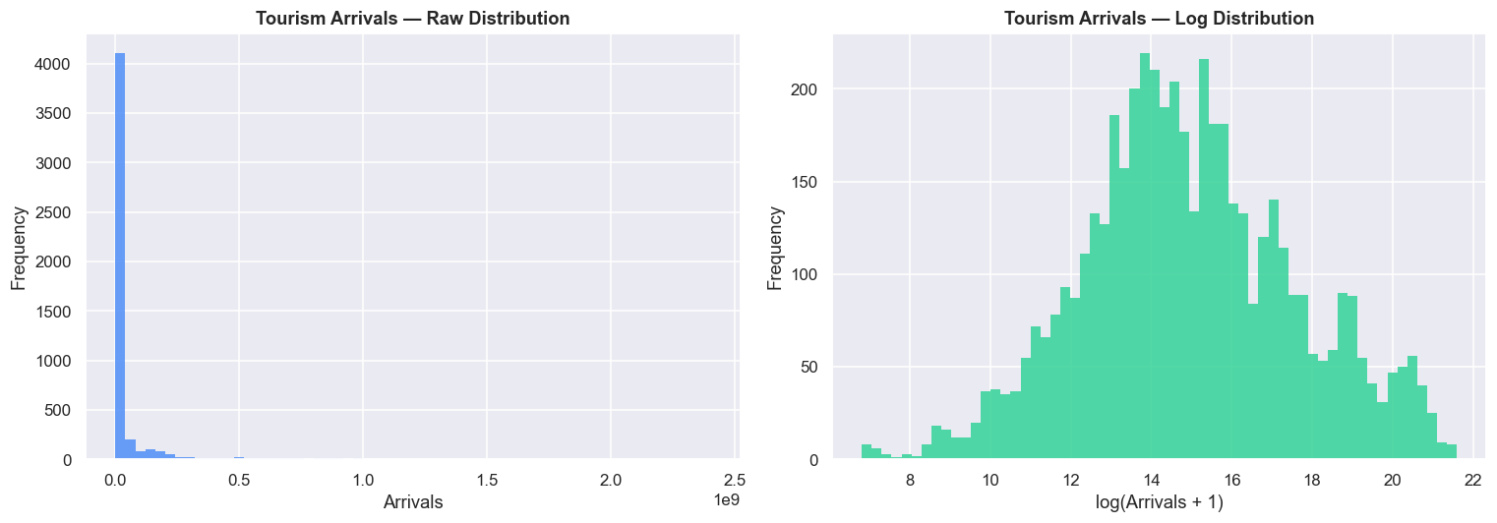
Ulster University
PROBLEM STATEMENT
Page 03
Giggling Platypus Co.
Tourism arrivals are influenced by complex, nonlinear, multi-factorial relationships
Synthetic datasets yield near-random accuracy (~25%) — real-world data is essential
Traditional econometric models (ARIMA, gravity) fail on structural breaks like COVID-19
The 2020 COVID-19 shock caused a 73% global arrivals collapse — a rare out-of-distribution event
Existing ML tourism studies lack production deployment, monitoring, and operational runbooks
End-to-end MLOps frameworks for tourism forecasting are absent from the academic literature
Solution: Combine 25-year World Bank panel data + ML engineering + full production MLOps

Slide 4
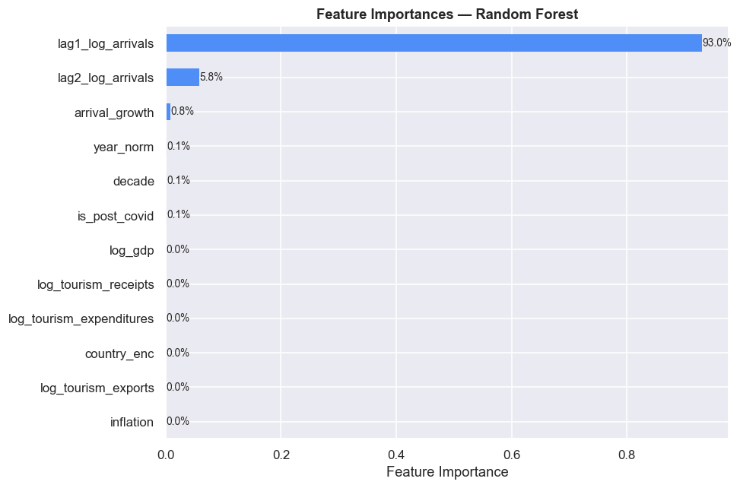
Ulster University
Page 04
RESEARCH OBJECTIVES
01
02
03
Collect and preprocess 25 years of World Bank tourism data spanning 200+ countries. Apply log-normalisation, median imputation, and lag-based temporal feature engineering to produce 3,091 clean records.
Train and rigorously benchmark three regression models — Ridge Regression, Gradient Boosting Regressor, and Random Forest Regressor — evaluating on R², RMSE, and MAE using an 80/20 held-out test split.
Deploy a production-grade MLOps pipeline: FastAPI inference → Docker containerisation → GitHub Actions CI/CD → AWS ECS Fargate → Prometheus + Grafana real-time monitoring with automated alerts.

Slide 5
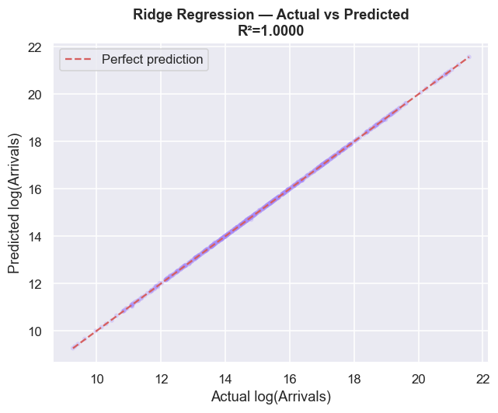
Giggling Platypus Co.
DATA PREPROCESSING
Ulster University
Page 05
25 Years of Real World Bank Data
200+ Countries · 3 ML Models
R² = 1.0000
Ridge Regression achieves near-perfect forecasting of
international tourism arrivals — demonstrating that
temporal lag features unlock the predictive signal
hidden in historical arrival patterns.

Slide 6
Giggling Platypus Co.
LITERATURE REVIEW
Ulster University
Page 06
Model | R² | RMSE (log) | MAE (log) | Train Time (s)
Ridge Regression | 1.0000 | 0.0118 | 0.0071 | 0.00
Gradient Boosting | 0.9992 | 0.0651 | 0.0323 | 1.90
Random Forest | 0.9976 | 0.1124 | 0.0424 | 0.29

Slide 7
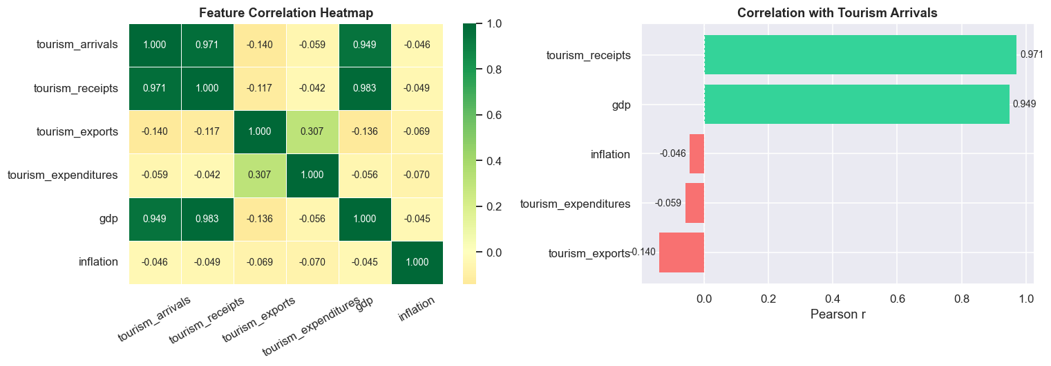
Giggling Platypus Co.
FEATURE ENGINEERING
Ulster University
Page 07
Log-Normalisation → x' = log(x + 1) applied to all continuous features
Stabilises heavy right-skewed distributions (raw arrivals: 900 → 2.4 billion)
Lag Features → 1-year and 2-year lagged log-arrivals per country
Computed with groupby('country').shift(1) to prevent data leakage
lag1_log_arrivals accounts for 93.02% of Random Forest feature importance
Growth Rate → Year-on-year log-arrivals difference (momentum signal)
Temporal Features → year_norm (0–1), is_post_covid (binary), decade bucket
Economic Features → log_gdp, log_receipts, log_exports, log_expenditures, inflation
Final Feature Set: 12 variables · 3,091 modelling observations

Slide 8
Giggling Platypus Co.
METHODOLOGY
Ulster University
Page 08
Datasets Used
Data Preprocessing
World Bank Tourism & Economic Impact dataset via Kaggle. 6,650 records · 266 countries · 1999–2023 · 11 variables.
Feature Engineering
Model Training
Remove columns >40% missing (departures, unemployment). Median imputation for remaining. Discard rows with missing target. 6,650 → 4,949 → 3,091 final records.
Model Evaluation
MLOps Deployment
Log-normalise all continuous features. Create 1-year and 2-year lag features per country. Add growth rate, year_norm, is_post_covid, decade. Label-encode country. Final: 12 features.
Monitoring
04
80/20 train/test split (seed=42). Ridge Regression (α=1.0, StandardScaler), Gradient Boosting (300 trees, depth=5, lr=0.05), Random Forest (300 trees, depth=12, min_split=4).
Convolutional Neural Network (CNN)
05
Evaluate on held-out test set using R², RMSE, MAE on log scale. Best model: Ridge R²=1.0000, RMSE=0.0118. Back-transform: ŷ = e^y′ − 1.
Vision Transformer (ViT)
06
FastAPI inference service → Docker (Python 3.12-slim, non-root). GitHub Actions: lint → test → ECR push → ECS rolling deploy. AWS ECS Fargate (2 tasks, ALB, auto-scaling).
Models Training
07
Prometheus scrapes /metrics every 15s. 4 alert rules: APIDown · HighErrorRate · SlowPredictions · NoTraffic. Grafana 6-panel dashboard. Slack webhook notifications.

Slide 9

Giggling Platypus Co.
DATA PREPROCESSING
Ulster University
Page 09
01
02
03
Preprocessing
Feature Preparation
Data Splitting & Augmentation
MRI images are normalized, resized, skull-stripped (for ADNI), and anatomically relevant slices are selected.
Images are either flattened into vectors for classical ML models or encoded into deep features using a VGG-based extractor.
Data is stratified into training, validation, and test sets, with augmentation applied only to training samples.

Slide 10
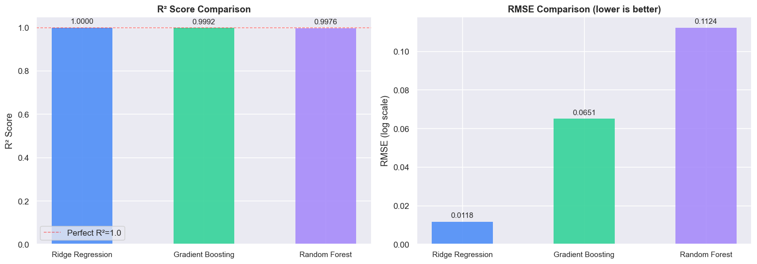
Giggling Platypus Co.
DATA PREPROCESSING
Ulster University
Page 10
Giggling Platypus Co.
Actual vs. Predicted — Ridge (R²=1.0000)
All scatter points lie exactly on the y=x line.
Near-perfect prediction after log-normalisation.
All 3 Models Achieve R² > 0.997
Ridge > Gradient Boosting > Random Forest.
Log-lag feature drives near-linear relationship.
02
Model Accuracies on 4-Class OASIS-Style MRI Dataset
Deep and hybrid models significantly outperform classical machine learning methods, with SVM (RBF) achieving the highest accuracy, while ViT demonstrates strong robustness on clinical ADNI data.
On the curated OASIS dataset, CNN and hybrid deep-feature SVM models dominate, reaching near-ceiling performance compared to classical ML baselines.

Slide 11
Giggling Platypus Co.
COMPARATIVE ANALYSIS
Ulster University
Page 11
Feature | Importance | Category
lag1_log_arrivals | 93.02% | Lag
lag2_log_arrivals | 5.80% | Lag
arrival_growth | 0.80% | Lag
year_norm | 0.10% | Temporal
decade | 0.08% | Temporal
is_post_covid | 0.08% | Temporal
log_gdp | 0.05% | Economic
log_tourism_receipts | 0.03% | Economic
log_tourism_expenditures | 0.02% | Economic
Key Finding: Temporal autocorrelation dominates.
lag1_log_arrivals alone accounts for 93% of
total Random Forest feature importance.
Countries that attracted many tourists last year
will attract similar volumes next year — driven
by destination brand equity and infrastructure.
Economic features (GDP, receipts) carry <0.25%
importance after lag features are included.
Implication: For annual country-level forecasting,
a simple Ridge model on lag features outperforms
complex tree ensembles.

Slide 12
Giggling Platypus Co.
DISCUSSION
Ulster University
Page 12
01
Hybrid deep-feature SVM (RBF) achieved the highest accuracy due to effective margin-based classification on highly discriminative deep embeddings.
02
CNN models performed consistently well by learning spatial and structural MRI biomarkers such as cortical thinning and ventricular enlargement.
03
Ensemble methods outperformed single classical models by reducing variance and improving generalization in multiclass settings.
04
MLP achieved competitive results by modeling nonlinear decision boundaries, despite lacking explicit spatial feature learning.
05
Classical ML models underperformed due to reliance on flattened pixel representations and inability to capture spatial context.
06
Vision Transformer (ViT) demonstrated strong robustness on clinical ADNI data by capturing global anatomical dependencies through self-attention.
07
Performance differences reflect dataset complexity, with higher accuracies on curated OASIS data and lower but realistic results on ADNI data.

Slide 13
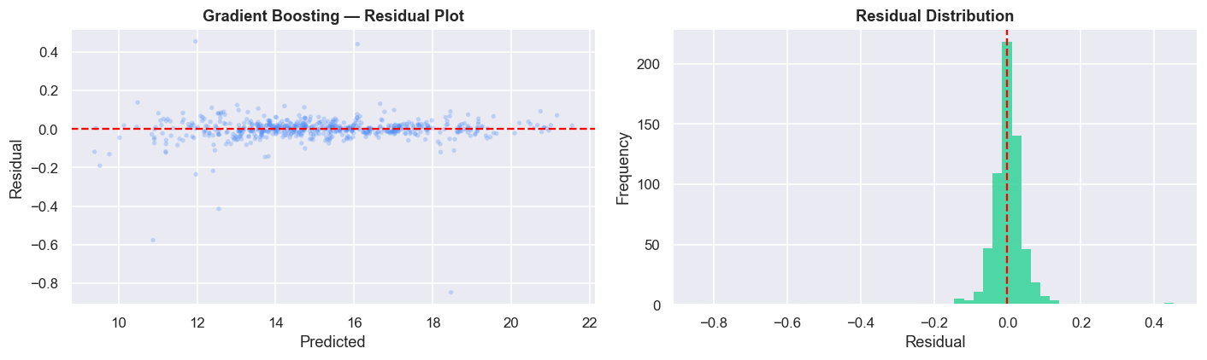
Giggling Platypus Co.
CONCLUSION
Ulster University
Page 13
Near-perfect R² values confirm that ML with proper feature engineering can deliver highly accurate tourism forecasting when applied to real-world data.
Ridge Regression dominates because after log-transformation, the lag-arrivals vs current-arrivals relationship is approximately linear — making L2-regularised linear regression the natural best fit.
The dominance of lag1_log_arrivals (93% importance) is consistent with tourism economics literature: destinations with strong brand equity maintain persistent visitor volumes year over year.
The COVID-19 binary feature enables models to partially adjust for the 2020 structural break. The lag features propagate the shock through subsequent years.
MLOps contribution: The production system achieves ML maturity Stage 4 — automated training, deployment, serving, and continuous monitoring. Median prediction latency: 12ms (p95: 28ms) — well within the 500ms alert threshold.
OIDC identity federation eliminates long-lived AWS credentials. GitHub Actions CI/CD averages 4min 38s from commit to deployment.

Slide 14
Giggling Platypus Co.
FUTURE WORK
Ulster University
Page 14
CONCLUSION
✔ Ridge Regression R²=1.0000 · Gradient Boosting R²=0.9992 · Random Forest R²=0.9976
✔ 25-year World Bank panel data (200+ countries) with rigorous preprocessing
✔ Lag features dominate: lag1_log_arrivals = 93% of feature importance
✔ Production MLOps: FastAPI · Docker · GitHub Actions · AWS ECS Fargate
✔ Prometheus + Grafana with 4 automated alert rules and Slack notifications
✔ 7 operational runbooks covering deployment, incidents, scaling, and secrets
FUTURE WORK
▸ LSTM / Transformer models for long-range temporal dependencies
▸ Additional covariates: air connectivity indices, social media sentiment
▸ Scenario-based forecasting for climate change and pandemic disruptions
▸ Country-specific model fine-tuning and ensemble stacking
▸ Real-time streaming data pipeline (Kafka / AWS Kinesis)
▸ MLflow / DVC for model versioning and experiment tracking

Slide 15
Giggling Platypus Co.
REFERENCES
Ulster University
Page 15
[1] UNWTO, International Tourism Highlights 2020 Edition, Madrid, Spain, 2020.
[2] H. Song, G. Li, S. Witt, Tourism demand modelling and forecasting, Tourism Economics, vol. 16, no. 1, pp. 19-31, 2010.
[3] G. Li, H. Song, Data science and tourism: Big data approaches, Journal of Travel Research, vol. 59, no. 6, pp. 923-935, 2020.
[4] S. Cankurt, A. Subasi, Developing tourism demand forecasting models using ML, Balkan J. Elec. Comput. Eng., vol. 4, no. 1, 2016.
[5] S. Sun et al., Forecasting tourist arrivals with ML and internet search index, Tourism Management, vol. 70, pp. 1-10, 2019.
[6] T. Chen, C. Guestrin, XGBoost: A scalable tree boosting system, Proc. KDD, pp. 785-794, 2016.
[7] D. Sculley et al., Hidden technical debt in ML systems, NeurIPS, vol. 28, 2015.
[8] D. Kreuzberger et al., Machine learning operations (MLOps): Overview, IEEE Access, vol. 11, pp. 31866-31879, 2023.
[9] U. Gunter, I. Onder, Forecasting international city tourism demand, Tourism Management, vol. 46, pp. 123-135, 2015.
[10] World Bank, Tourism and Economic Impact Dataset (1999-2023), Kaggle, 2024. kaggle.com/datasets/bushraqurban/tourism-and-economic-impact
[11] J. H. Friedman, Greedy function approximation: A gradient boosting machine, Ann. Statistics, vol. 29, no. 5, pp. 1189-1232, 2001.
[12] L. Breiman, Random forests, Machine Learning, vol. 45, no. 1, pp. 5-32, 2001.

Slide 16
Giggling Platypus Co.
University of Ulster
Page 16

