Slide 1

LinguaSign: An AI-Based Vision-Language System for Real-Time Sign-to-Speech Conversion
Final Year Project – Presentation
By
Abdul Wahid – 22-CS-090
Muhammad Moiz Ur Rehman – 22-CS-100
Waqas Ahmed – 22-CS-105
Supervisor: Dr. Samia Ijaz

Slide 2
Problem Statement
No widely available, reliable real-time system exists to translate Pakistan Sign Language (PSL) into Urdu text and speech.
Existing solutions often require specialized hardware, support limited vocabularies, or lack reliable real-time recognition, making them impractical for everyday communication.
An accessible, AI-powered Pakistani Sign Language (PSL) recognition system is needed to accurately translate gestures into Urdu text and speech, helping bridge the communication gap

Slide 3
Achieved Objectives
Built a real-time Pakistan Sign Language (PSL) recognition system with 98.6% accuracy using a lightweight MLP model.
Developed a full-stack web app using Next.js and FastAPI with live MJPEG streaming and REST API integration.
Integrated Urdu speech output to convert recognized signs into spoken words for communication assistance.
Implement the system as an offline-capable.
Incorporate a sentence builder feature to compose recognized letters and words

Slide 4
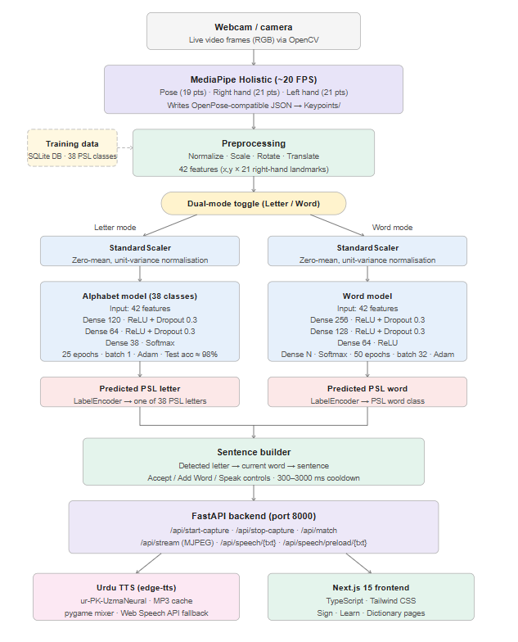
Proposed Methodology

Slide 5
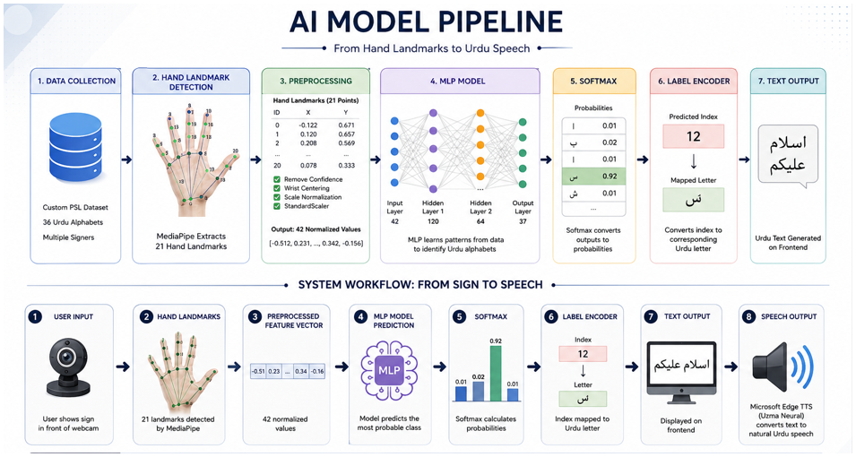
AI Model
Dataset: Custom Pakistani Sign Language (PSL) Dataset (38 Classes)
Model: Multilayer Perceptron (MLP) with MediaPipe Hand Landmarks
Process: Hand Landmark Detection → Preprocessing → Feature Normalization → MLP Classification → Label Encoding
Output: Real-time Urdu Text and Natural Urdu Speech (Microsoft Edge TTS)
5

Slide 6
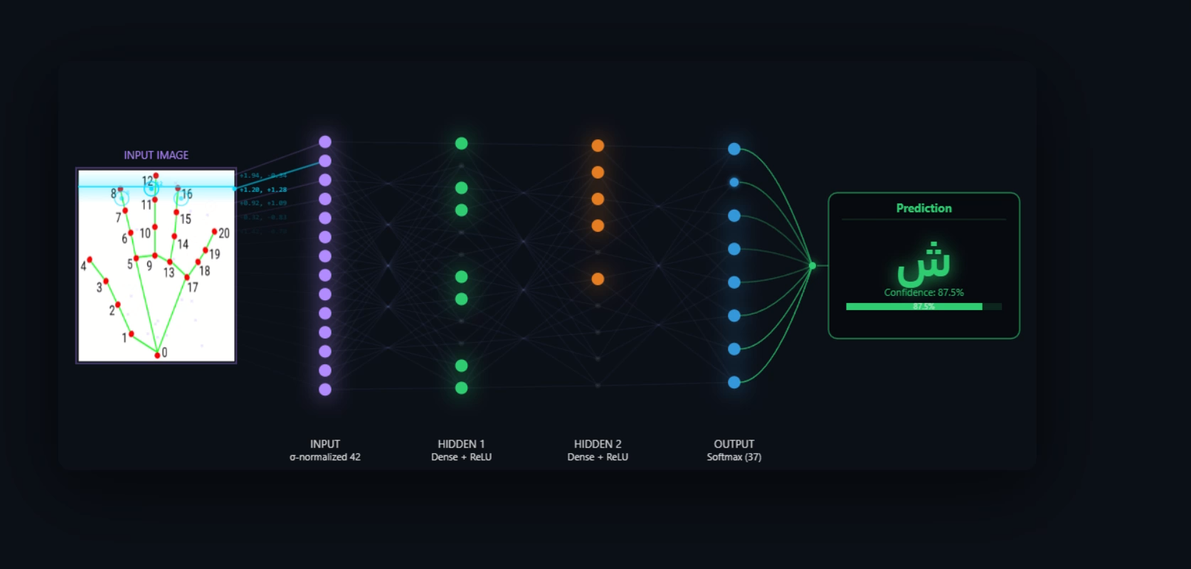
MODEL WORKING

Slide 7
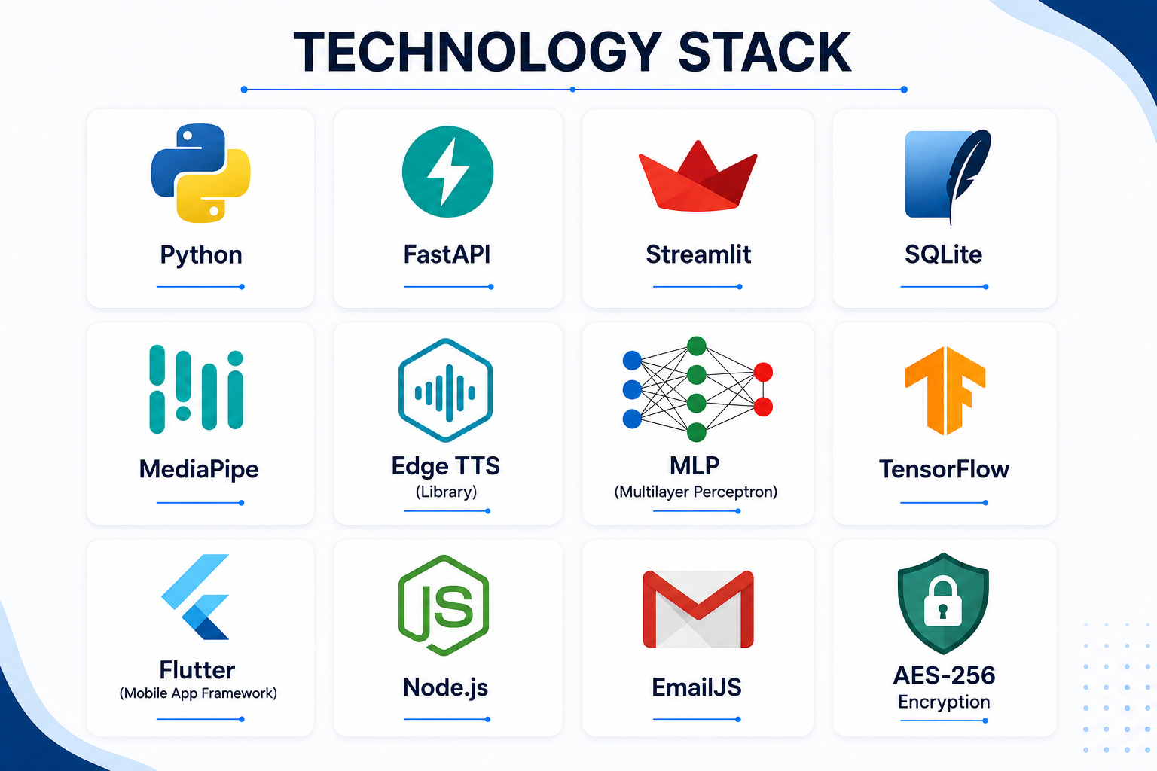
Technology Stack
Our application integrates frontend, backend, AI, database, and deployment technologies.
7

Slide 8
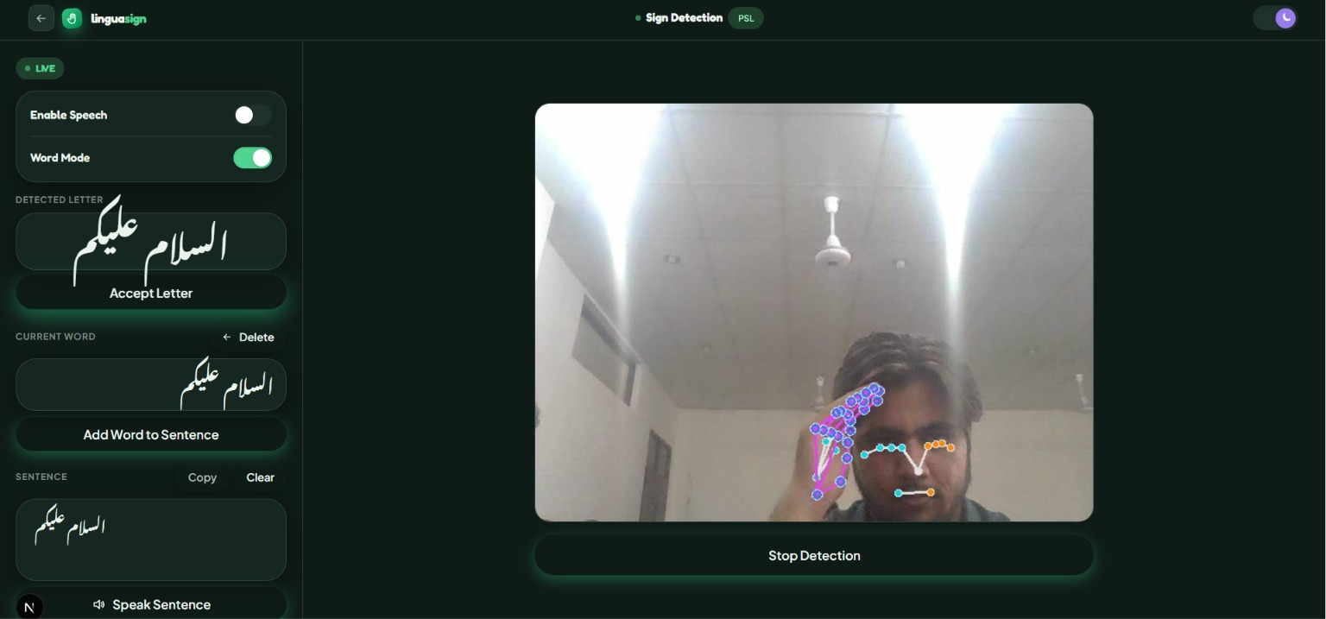
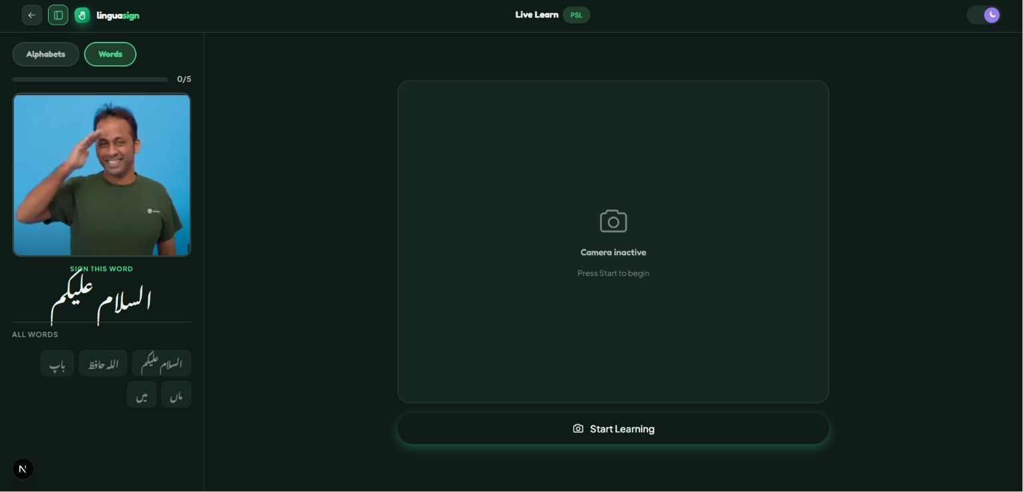
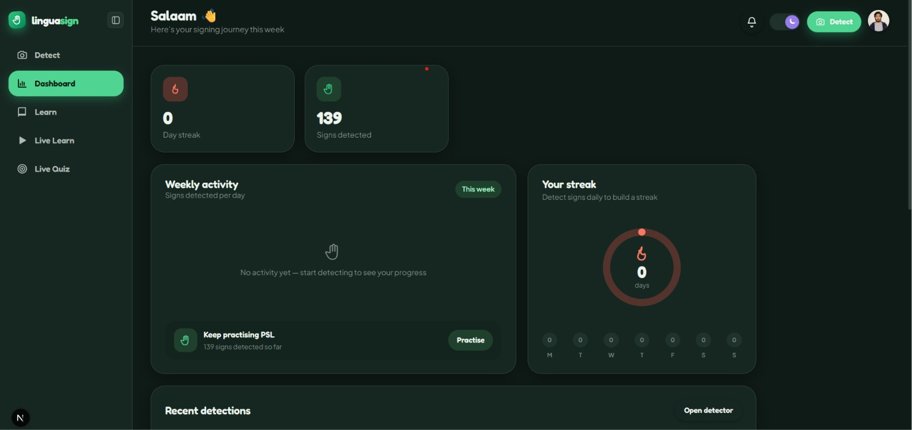
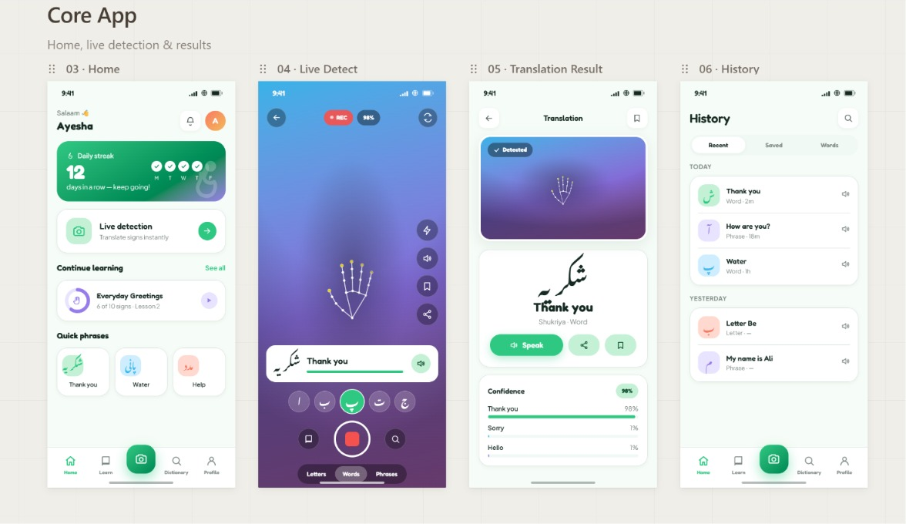
Key Features

Slide 9
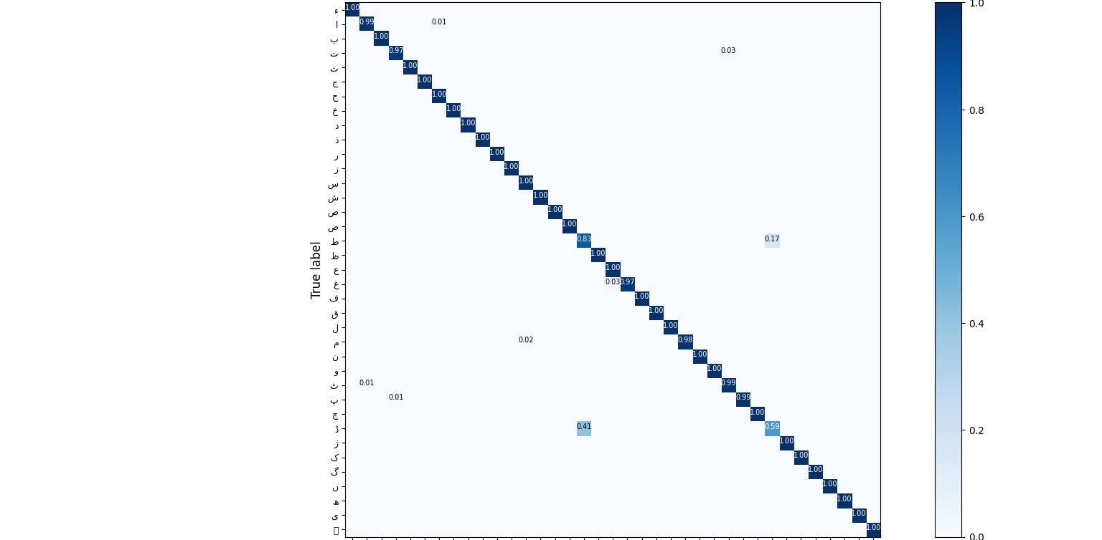
Confusion matrix

Slide 10
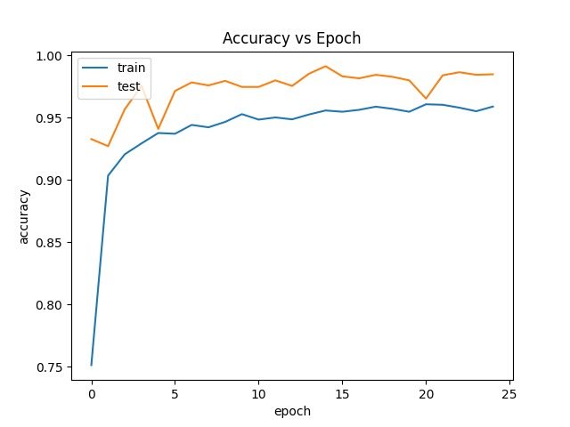
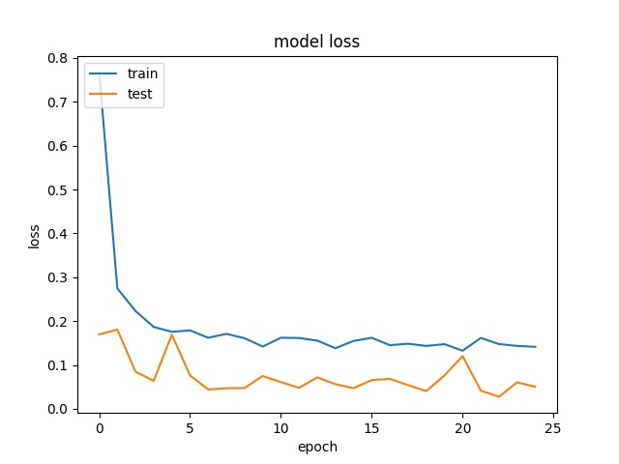
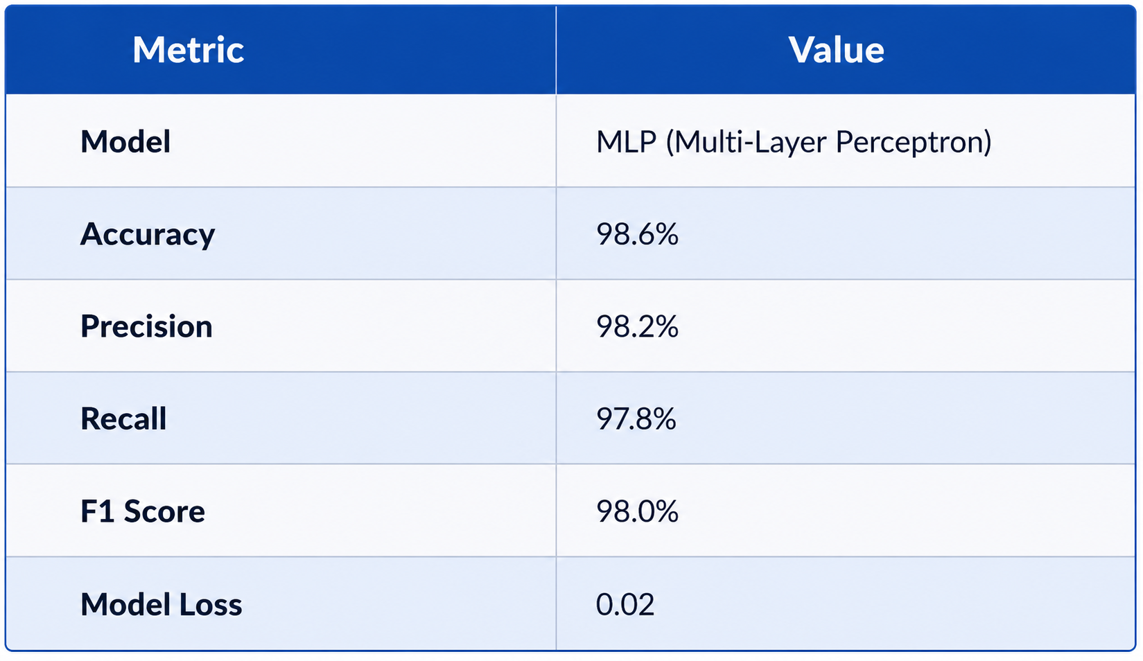
Results

Slide 11
Future Work
Support Dynamic Sign Recognition by recognizing continuous hand gestures, words, and complete sentences in real time.
Expand the PSL Dataset by incorporating additional vocabulary, phrases, and official Pakistani Sign Language (PSL) signs to improve model coverage and accuracy.
Enable Intelligent Sentence Formation using Natural Language Processing (NLP) to generate grammatically correct and context-aware Urdu sentences.
Support Bilingual Translation by extending the system to generate both Urdu and English text and speech outputs.
Deploy as a Scalable Cloud Platform with enhanced security, user management, and support for a larger number of concurrent users.

Slide 12
References
M. El Rwelli, A. T. Mahmoud, and H. M. Ahmed, “Glove-based CNN system for Arabic Sign Language recognition and voice translation,” J. Ambient Intell. Humaniz. Comput., vol. 11, pp. 1234–1245, 2020.
Imran, A. Razzaq, I. A. Baig, A. Hussain, S. Shahid, and T. Rehman ur, “Dataset of Pakistan Sign Language and automatic recognition of hand configuration of Urdu alphabet through machine learning,” Data Brief, vol. 36, 2021.
Nasharudin, A. A. Shafie, and S. Hussain, “YOLO-based deep neural network for American Sign Language alphabet recognition,” J. Intell. Fuzzy Syst., vol. 41, no. 2, pp. 2699–2711, 2021.
R. Kumari and A. Anand, “Hybrid CNN–LSTM model for sign language recognition using the WLASL dataset,” Multimedia Tools Appl., vol. 81, no. 19, pp. 26945–26962, 2022.
H. M. Hamza and A. Wali, “Pakistan sign language recognition: leveraging deep learning models with a limited dataset,” Mach. Vis. Appl., vol. 34, no. 5, p. 71, 2024.

Slide 13
Thank You

