Slide 1
OOPD PROJECT 2
19. Interest Rate Calculation for Bank
Arpit Saxena (MT20058)
Waquar Shamsi (MT20073)

Slide 2
Files submitted in zip
MT20073_MT20058_Project2.py
MT20073_MT20058_Project2.pptx
database.db
Initial usernames and passwords
For admin_interface-
Username: admin
Password: admin
For client_interface-
Username: client2
Password: client

Slide 3
Dependencies for Project
Python 3.6 and above
Library - tabulate : pip install tabulate
Database.db and MT20073_MT20058_Project2.py should be present in same folder
MT20073_MT20058_Project2.py should be executed in linux environment(ubuntu) because of clear screen command used in it, if executing on windows remove all the clear screen lines and run.

Slide 4
Contents
About Project
The project description
Identification of initial OO design from the problem statement
OO design resulting from SRP, OCP, and LSP
The list of features implemented
The code flow
Contribution of every member in the project

Slide 5
About Project
Purpose: To make it easier to manage information about bank accounts by keeping record of all loans and deposits.
Features:
Account Management - Add/Delete Client accounts
Separate Client and Admin Interfaces
Register and View Complaints
Request/Approve Loans
View Non Performing Accounts
OO design resulting from SRP, OCP, and LSP

Slide 6
Project Description
It is a retail bank application which collects money from customers and in return gives them an interest at predetermined rate.
The application assumes that money must be deposited by giving cash to the admin who will then add the amount to client’s account.
We have designed the code using OO design resulting from SRP, OCP, and LSP.

Slide 7
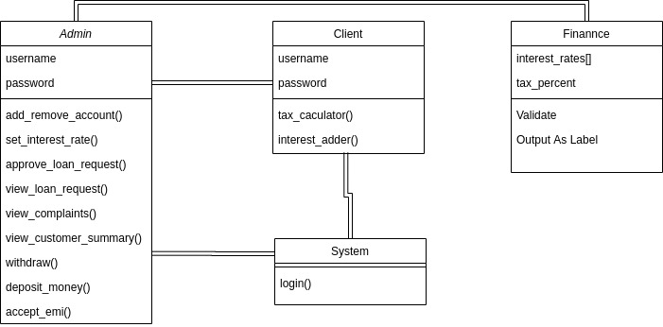
Identification of initial OO design from the problem statement

Slide 8
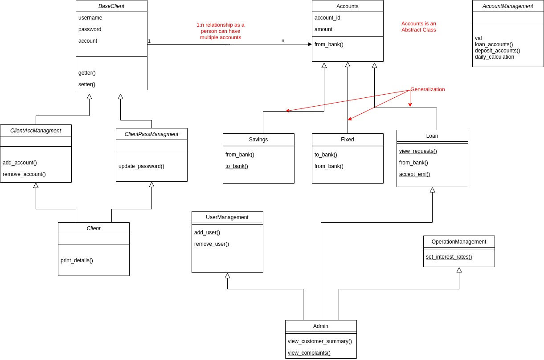
OO design resulting from SRP, OCP, and LSP

Slide 9
Class Descriptions
Base client is base class which is inherited by clientAccManagment and ClientPassManagement. This is to ensure SRP and OCP
Here OCP is ensured as all the member variables are private and they cannot be modified, to add any new feature the class must be inherited and same thing is done in the project.
Here client inherits the other two classes so indirectly it inherits base client class too.

Slide 10
Continued...
Base client and accounts has 1:n relationship as base client has a list of objects of accounts.
Accounts is an abstract class as it has an abstract method which must be implement by the child classes.
Savings Fixed and Loans are the child classes of Accounts class. Loans is also futher inherited by another class of Admin

Slide 11
Continued
Admin inherits user managment class and operations managment class apart form loan class in order to use all of their features as its own.
There is also another class of Account Managment which handles the calculation of adding of interests and other routine activities.

Slide 12
LIST OF FEATURES IMPLEMENTED
Role based access control
EMI
Complaint Registration
Different User Interfaces
Password Updation
Savings and Fixed Deposits
Changing of Interest Rates by Admin
Calculate and Add Interest amounts after deducting taxes.
View Non Performing Accounts
Creation Deletion of Accounts
Log Management
Hidden Password Inputs

Slide 13
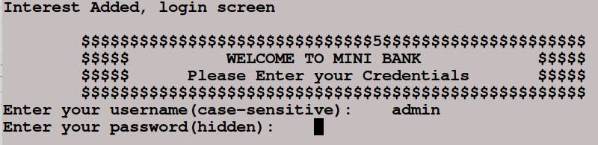
Code Flow with Screenshots
Home Page- Daily and monthly interest calculation done before login request

Slide 14
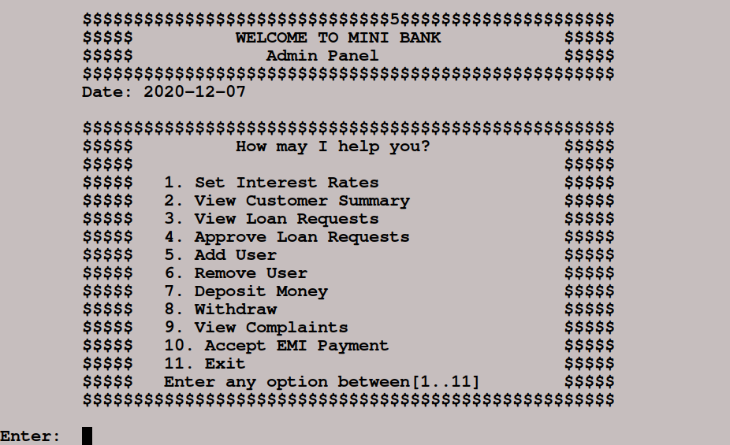
Code Flow with Screenshots
Admin Interface

Slide 15
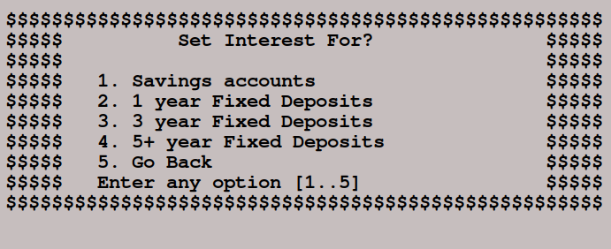
Code Flow with Screenshots
Set Interest Interface

Slide 16
Code Flow with Screenshots
View Customer Summary Interface

Slide 17
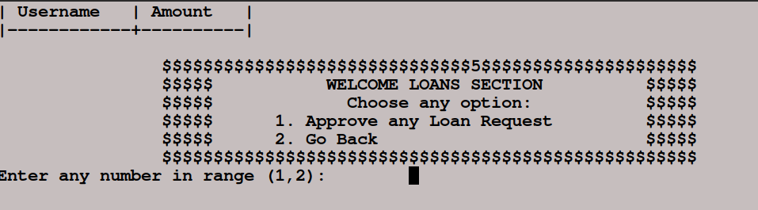
Code Flow with Screenshots
Approve Loan Interface

Slide 18
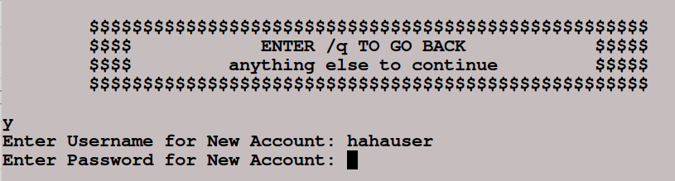
Code Flow with Screenshots
Add Remove Account Interface

Slide 19
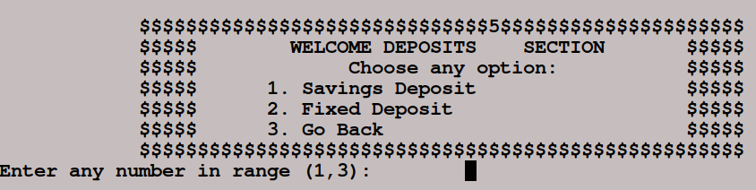
Code Flow with Screenshots
Deposit Money Interface

Slide 20
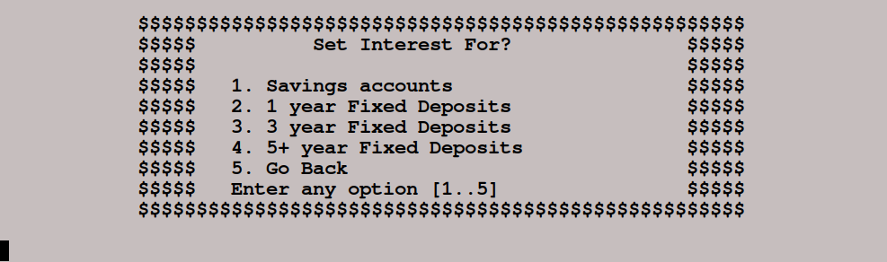
Code Flow with Screenshots
Set Interest Interface

Slide 21
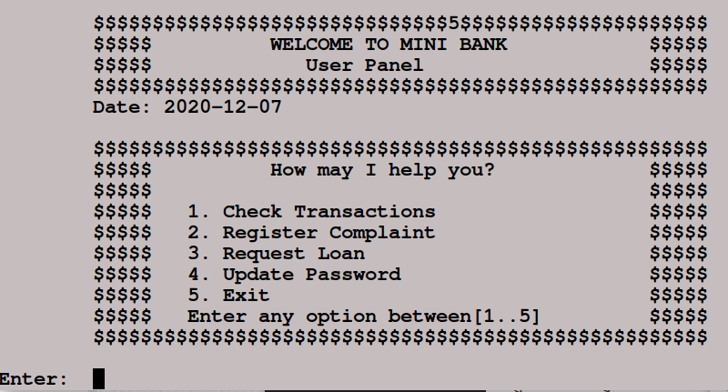
Code Flow with Screenshots
Client Interface- Login

Slide 22
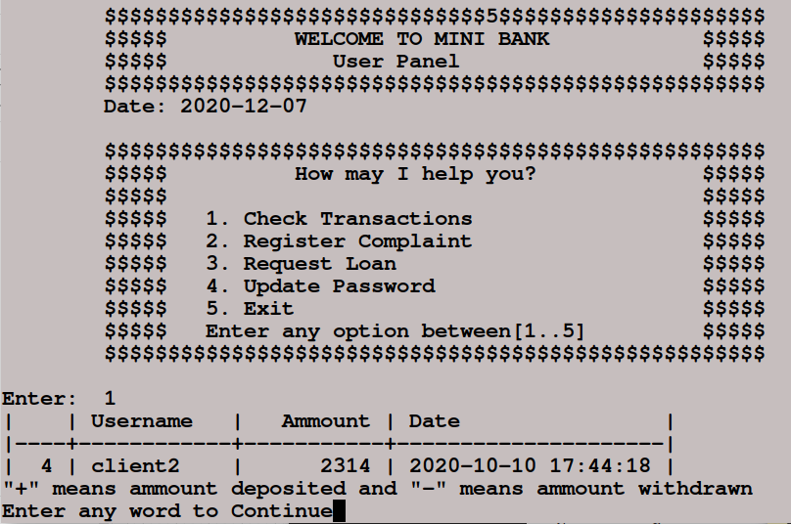
Code Flow with Screenshots
Client Interface-
Check Transactions

Slide 23
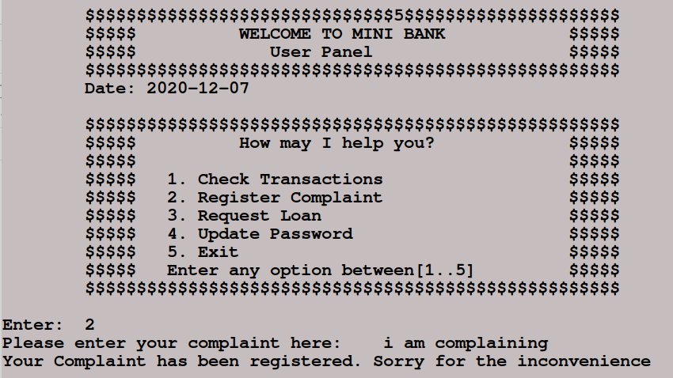
Code Flow with Screenshots
Client Interface-
Register Complaint

Slide 24
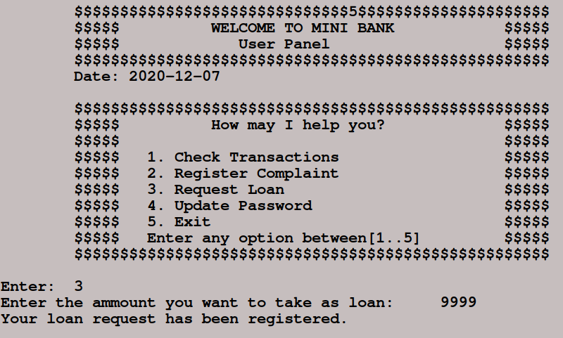
Code Flow with Screenshots
Client Interface-
Request Loan

Slide 25
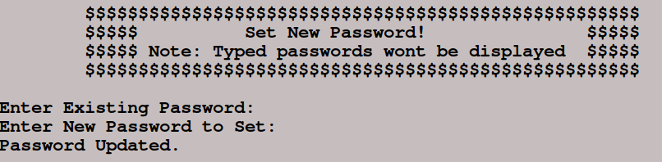
Code Flow with Screenshots
Client Interface-
Update Password

Slide 26
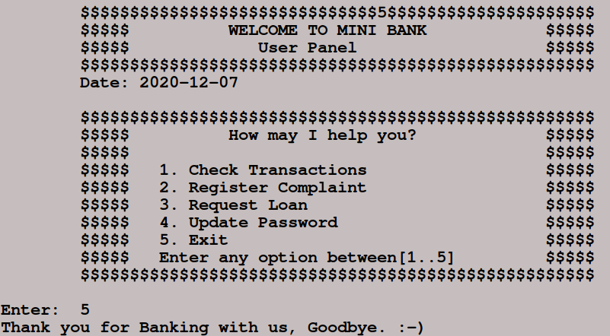
Code Flow with Screenshots
Client Interface-
Exit

Slide 27
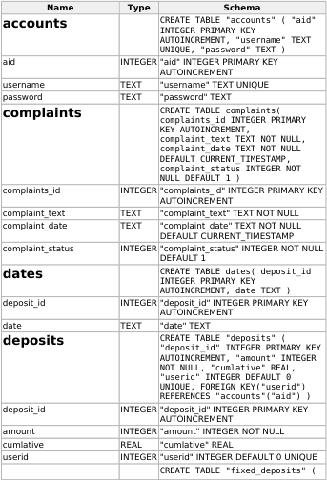
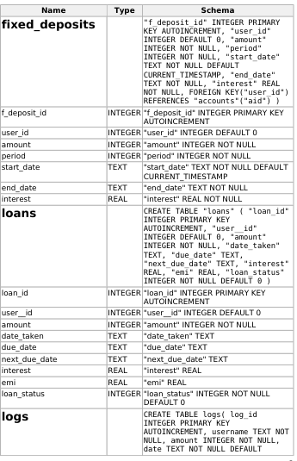
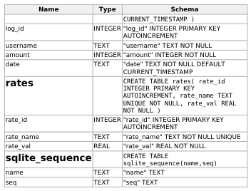
Database Schema

Slide 28
Contribution of Members
Waquar Shamsi (MT20073)
Arpit Saxena (MT20058)
Admin Interface
Add / Remove Accounts
Set Interest Rates
Deposit Money (Fixed, Savings)
Withdraw Money
View Customer Summary /Non performing Clients
Logs Management
View/Approve Loan Requests
View Complaints
Database Management for admin interface
Accept EMI
Login Panel / Home Screen
Powerpoint Presentation
Update Password
Client Interface
Request Loan
Register Complaint
Check Transactions
Database Management for client Interface
Account Management
Tax Calculation
Interest Calculation
Daily
Monthly
Database Management for account management
EMI Calculation in Admin Interface
Powerpoint Presentation

Slide 29
THANK YOU ALL TAs, TF and Faculty

