Slide 1

Collision Detection
CSCE 441

Slide 2
What is Collision Detection?
Given two geometric objects, determine if they overlap.
Typically, at least one of the objects is a set of triangles.
  Rays/lines
  Planes
  Polygons
  Frustums
  Spheres
  Curved surfaces
<number>/60

Slide 3
When Used
Often in simulations
  Objects move – find when they hit something else
Other examples
  Ray tracing speedup
  Culling objects/classifying objects in regions
Usually, needs to be fast
  Applied to lots of objects, often in real-time applications
<number>/60

Slide 4
Bounding Volumes
Key idea:
  Surround the object with a (simpler) bounding object (the bounding volume).
  If something does not collide with the bounding volume, it does not collide with the object inside.
  Often, to intersect two
  objects, first intersect their
  bounding volumes
<number>/60

Slide 5
Choosing a Bounding Volume
Lots of choices, each with tradeoffs
<number>/60

Slide 6
Choosing a Bounding Volume
Lots of choices, each with tradeoffs
Tighter fitting is better
  More likely to eliminate “false” intersections
<number>/60

Slide 7
Choosing a Bounding Volume
Lots of choices, each with tradeoffs
Tighter fitting is better
Simpler shape is better
  Makes it faster to compute with
<number>/60

Slide 8
Choosing a Bounding Volume
Lots of choices, each with tradeoffs
Tighter fitting is better
Simpler shape is better
Rotation Invariant is better
  Easier to update as object moves
<number>/60

Slide 9
Choosing a Bounding Volume
Lots of choices, each with tradeoffs
Tighter fitting is better
Simpler shape is better
Rotation Invariant is better
Convex is usually better
  Gives simpler shape, easier computation
<number>/60

Slide 10
Common Bounding Volumes: Sphere
Rotationally invariant
  Usually
Usually fast to compute with
Store: center point and radius
  Center point: object’s center of mass
  Radius: distance of farthest point on object from center of mass.
Often not very tight fit
<number>/60

Slide 11
Common Bounding Volumes:
Axis Aligned Bounding Box (AABB)
Very fast to compute with
Store: max and min along x,y,z axes.
  Look at all points and record max, min
Moderately tight fit
Must update after rotation, unless a loose box that encompasses the bounding sphere
<number>/60

Slide 12
Common Bounding Volumes: k-dops
k-discrete oriented polytopes
Same idea as AABBs, but use more axes.
Store: max and min along fixed set of axes.
  Need to project points onto other axes.
Tighter fit than AABB, but also a bit more work.
<number>/60

Slide 13
Choosing axes for k-dops
Common axes: consider axes coming out from center of a cube:
Through faces: 6-dop
  same as AABB
Faces and vertices: 14-dop
Faces and edge centers: 18-dop
Faces, vertices, and edge centers; 26-dop
More than that not really helpful
Empirical results show 14 or 18-dop performs best.
<number>/60

Slide 14
Common Bounding Volumes:
Oriented Bounding Box (OBB)
Store rectangular parallelepiped oriented to best fit the object
Store:
  Center
  Orthonormal set of axes
  Extent along each axis
Tight fit, but takes work to get good initial fit
OBB rotates with object, therefore only rotation of axes is needed for update
Computation is slower than for AABBs, but not as bad as it might seem
<number>/60

Slide 15
Common Bounding Volumes:
Convex Hull
Very tight fit (tightest convex bounding volume)
Slow to compute with
Store: set of polygons forming convex hull
Can rotate CH along with object.
Can be efficient for some applications
<number>/60

Slide 16
Testing for Collision
Will depend on type of objects and bounding volumes.
Specialized algorithms for each:
  Sphere/sphere
  AABB/AABB
  OBB/OBB
  Ray/sphere
  Triangle/Triangle
<number>/60

Slide 17
Collision Test Example
Sphere-Sphere
Find distance between centers of spheres
Compare to sum of sphere radii
  If distance is less, they collide
For efficiency, check squared distance vs. square of sum of radii
d
r₂
r₁
<number>/60

Slide 18
Collision Test Example
AABB vs. AABB
Project AABBs onto axes
  i.e. look at extents
If overlapping on all axes, the boxes overlap.
Same idea
for k-dops.
<number>/60

Slide 19
Collision Test Example
OBB vs. OBB
How do we determine if two oriented bounding boxes overlap?
<number>/60

Slide 20
Separating Axis Theorem
Two convex shapes do not overlap if and only if there exists an axis such that the projections of the two shapes do not overlap
<number>/60

Slide 21
Enumerating Separating Axes
2D: check axis aligned with normal of each face
3D: check axis aligned with normals of each face and cross product of each pair of edges
<number>/60

Slide 22
Enumerating Separating Axes
2D: check axis aligned with normal of each face
3D: check axis aligned with normals of each face and cross product of each pair of edges
<number>/60

Slide 23
Enumerating Separating Axes
2D: check axis aligned with normal of each face
3D: check axis aligned with normals of each face and cross product of each pair of edges
<number>/60

Slide 24
Enumerating Separating Axes
2D: check axis aligned with normal of each face
3D: check axis aligned with normals of each face and cross product of each pair of edges
<number>/60

Slide 25
Enumerating Separating Axes
2D: check axis aligned with normal of each face
3D: check axis aligned with normals of each face and cross product of each pair of edges
<number>/60

Slide 26
Collision Test Example
Triangle-Triangle
Many collision detection tests eventually reduce to this.
Two common approaches. Both involve finding the plane a triangle lies in.
  Cross product of edges to get triangle normal.
  This is the plane normal [A B C] where plane is Ax+By+Cz+D=0
  Solve for D by plugging in a triangle vertex
<number>/60

Slide 27
Triangle-Triangle Collision 1
Find line of intersection between triangle planes.
Find extents of triangles along this line
If extents overlap, triangles intersect.
<number>/60

Slide 28
Triangle-Triangle Collision 2
Intersect edges of one triangle with plane of the other triangle.
2 edges will intersect – form line segment in plane.
Test that 2D line segment against triangle.
<number>/60

Slide 29
Bounding Volume Hierarchies
What happens when the bounding volumes do intersect?
  We must test whether the actual objects underneath intersect.
  For an object made from lots of polygons, this is complicated.
  So, we will use a bounding volume hierarchy
<number>/60

Slide 30
Bounding Volume Hierarchies
Highest level of hierarchy – single BV around whole object
Next level – subdivide the object into two (or maybe more) parts.
  Each part gets its own BV
Continue recursively until only one triangle remains
<number>/60

Slide 31
Bounding Volume Hierarchy Example
<number>/60

Slide 32
Bounding Volume Hierarchy Example
<number>/60

Slide 33
Bounding Volume Hierarchy Example
<number>/60

Slide 34
Bounding Volume Hierarchy Example
<number>/60

Slide 35
Bounding Volume Hierarchy Example
<number>/60

Slide 36
Bounding Volume Hierarchy Example
<number>/60

Slide 37
Bounding Volume Hierarchy Example
<number>/60

Slide 38
Bounding Volume Hierarchy Example
<number>/60

Slide 39
Bounding Volume Hierarchy Example
<number>/60

Slide 40
Bounding Volume Hierarchy Example
<number>/60

Slide 41
Bounding Volume Hierarchy Example
<number>/60

Slide 42
Bounding Volume Hierarchy Example
<number>/60

Slide 43
Intersecting Bounding Volume Hierarcies
For object-object collision detection
Keep a queue of potentially intersecting BVs
  Initialize with main BV for each object
Repeatedly pull next potential pair off queue and test for intersection.
  If that pair intersects, put pairs of children into queue.
  If no child for both BVs, test triangles inside
Stop when we either run out of pairs (thus no intersection) or we find an intersecting pair of triangles
<number>/60

Slide 44
BVH Collision Test example
<number>/60

Slide 45
BVH Collision Test example
<number>/60

Slide 46
BVH Collision Test example
<number>/60

Slide 47
BVH Collision Test example
<number>/60

Slide 48
BVH Collision Test example
<number>/60

Slide 49
BVH Collision Test example
<number>/60

Slide 50
BVH Collision Test example
<number>/60

Slide 51
BVH Collision Test example
<number>/60

Slide 52
BVH Collision Test example
<number>/60

Slide 53
BVH Collision Test example
<number>/60

Slide 54
BVH Collision Test example
<number>/60

Slide 55
BVH Collision Test example
<number>/60

Slide 56
Broad Phase vs. Narrow Phase
What we have talked about so far is the “narrow phase” of collision detection.
  Testing whether two particular objects collide
The “broad phase” assumes we have a number of objects, and we want to find out all pairs that collide.
Testing every pair is inefficient
<number>/60

Slide 57
Broad Phase Collision Detection
Form an AABB for each object
Pick an axis
  Sort objects along that axis
  Find overlapping pairs along that axis
  For overlapping pairs, check along other axes.
Limits the number of object/object tests
Overlapping pairs then sent to narrow phase
<number>/60

Slide 58
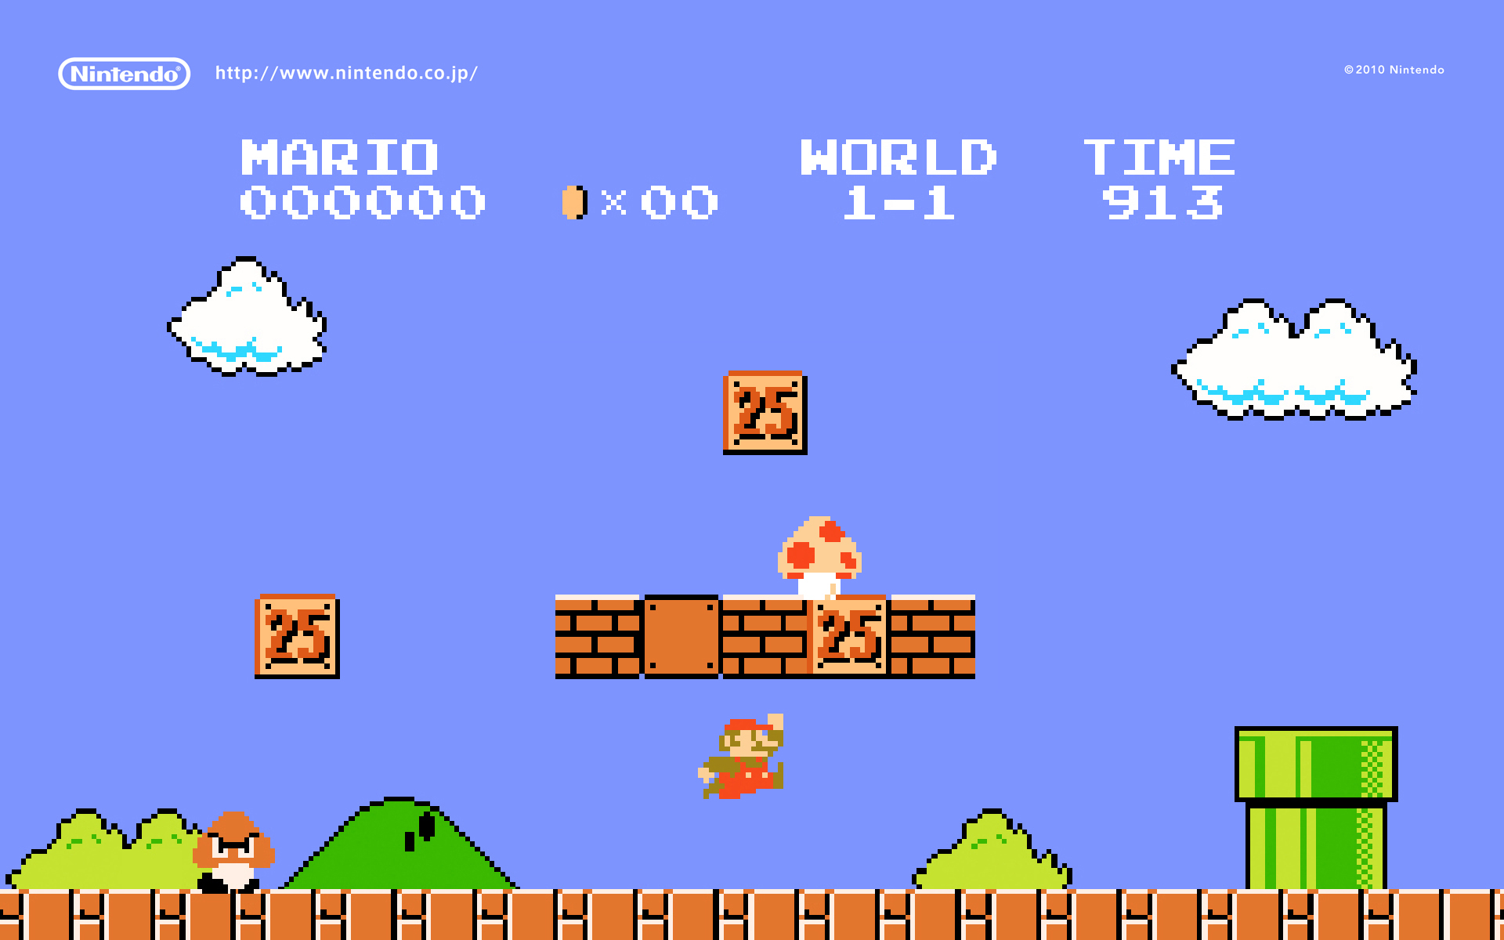

Broad Phase Collision Detection
<number>/60

Slide 59
Collision Detection in a Physically-Based Simulation
Must account for object motion
  Obeys basic physical laws – integration of differential equations
Collision detection: yes/no
  Collision determination: where do they intersect
  Collision response: how do we adjust the motion of objects in response to collision
Collision determination/response are more difficult, but are key for physically based simulation.
<number>/60

Slide 60
Some Other Issues
Constructing an optimal BVH
Convergence of BVH (i.e. how fast do the BVs approach the actual object).
  OBBs asymptotically better, here
Optimizing individual tests
Handling stacking and rest contacts
<number>/60

