Slide 1
Barbeerdrinker group 35 pavendeep kaur & wajeeha Rehman November 18,2018

Slide 2
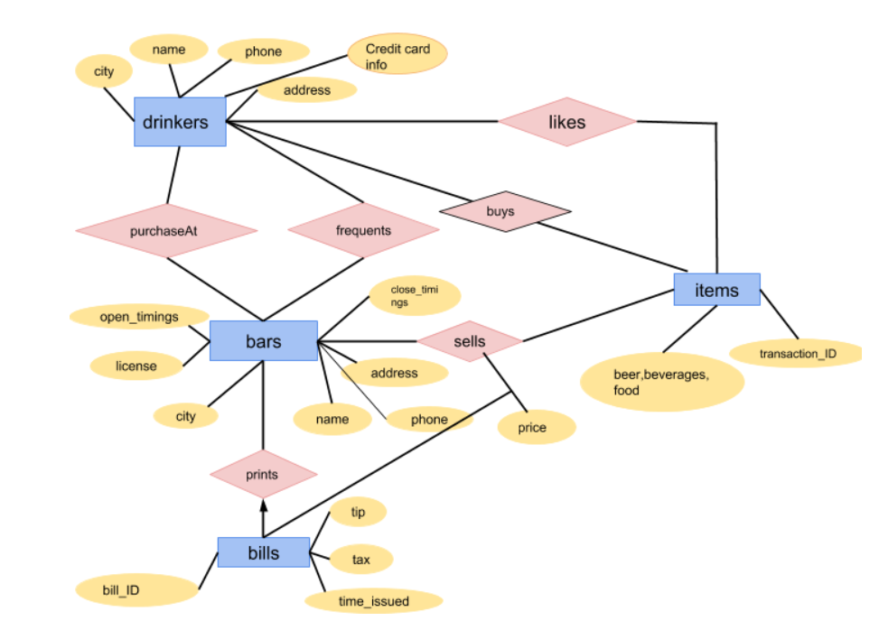
ER Diagram

Slide 3
Database Schema
purchaseAt(drinker.name, bar.name)
drinkers(name,city,phone,address, creditcardnumber,expiry)
bars(name, open_timings,close_timings, address, license, city,phone,tax)
bills(transaction_ID, tip, total_price, time_issued)
frequents(bars.name, drinkers.name)
sells(bars.name, items.beer,items.beverages,items.food, price)
items(beer,beerTransID,beverages,bevTransID,food,foodTransID)
likes(drinker.name, items.type)

Slide 4
Some patterns

Slide 5

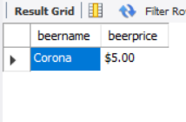
Most expensive beer:
select distinct sells.beername, sells.beerprice
from sells
order by beerprice desc
limit 1;

Slide 6
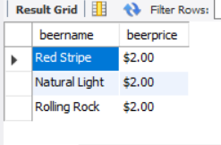
Least Expensive Beer(s):
select distinct s.beername, s.beerprice
from sells s
where 0= (select count(*)
from sells s1
where s1.beerprice
< s.beerprice);

Slide 7

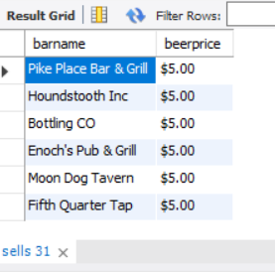
All the bars where Corona is the most expensive beer:
select s.barname, s.beerprice
from sells s
where s.beername='Corona'
and 0= (select count(*)
from sells s1
where s1.beerprice > s.beerprice
and s1.beername='Corona’)

Slide 8
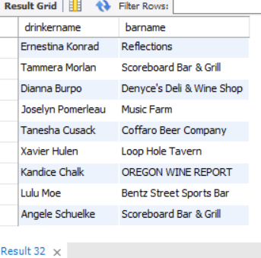
Drinkers who frequent only those bars which sell some beer they like:
Select distinct f.drinkername, f.barname
from frequents f , likes l, sells s
where f.drinkername=l.drinkername
and f.barname=s.barname
and s.beername=l.beername;

Slide 9
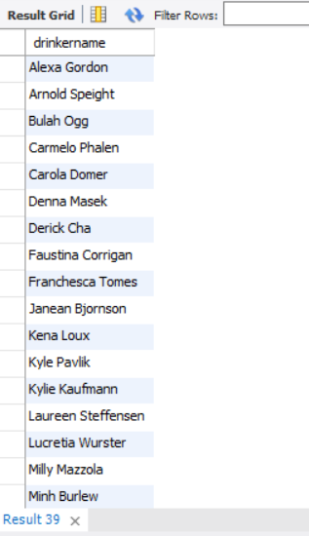
Drinkers who do not like any beer:
select d.drinkername
from drinkers d
LEFT JOIN likes l on l.drinkername=d.drinkername
where l.drinkername IS NULL;

Slide 10
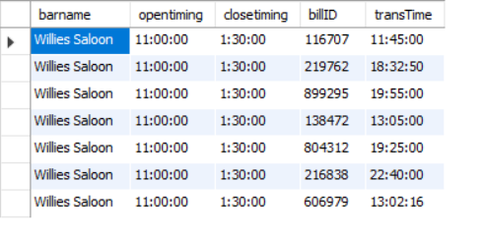
Bars have transactions within the opening and closing time
select b.barname, b.opentiming, b.closetiming, c.billID, c.transTime
from bars b, bills c
where b.barname = c.barname
and b.barname = "Willies Saloon";

Slide 11
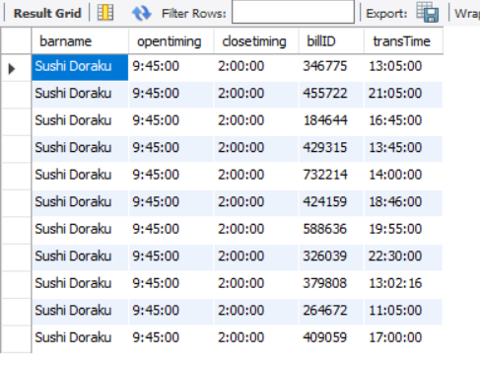
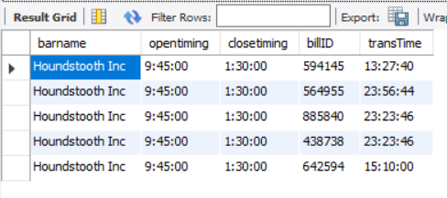
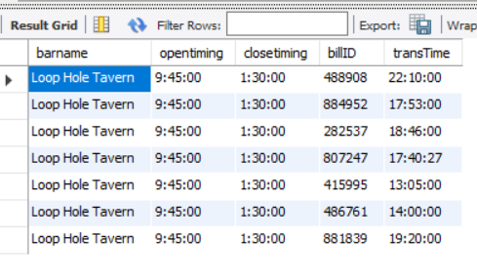
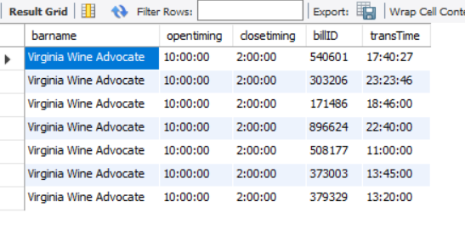
Bars have transactions within the opening and closing time cont.

Slide 12
URL:

