Slide 1

4.
Principal Component Analysis
from Singular Value Decomposition technique
May, 2023
1/15

Slide 2
Table of Content
01 | SVD
02 | Derive SVD Form
03 | PCA Steps
04 | Rules of Thumb
05 | Example
2/15

Slide 3


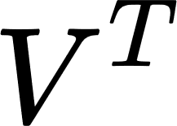
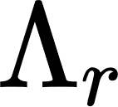




Singular Value Decomposition (SVD)
diagonal with non-negative diagonal elements
orthogonal
orthogonal
01 SVD | 02 Derive SVD Form | 03 PCA Steps | 04 Rules of Thumb | 05 Example
3/15

Slide 4
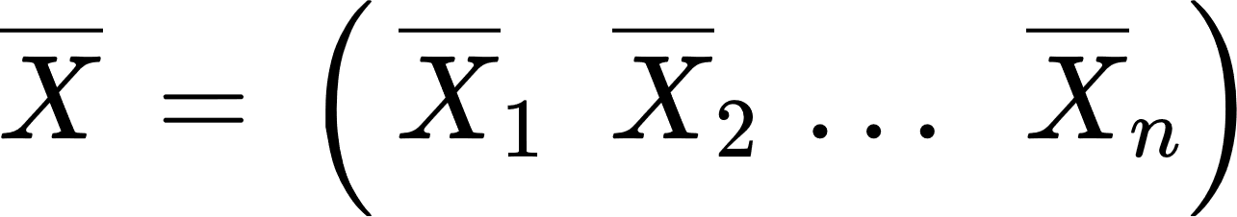
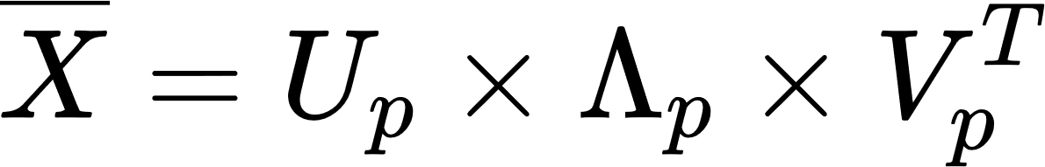


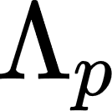
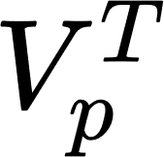
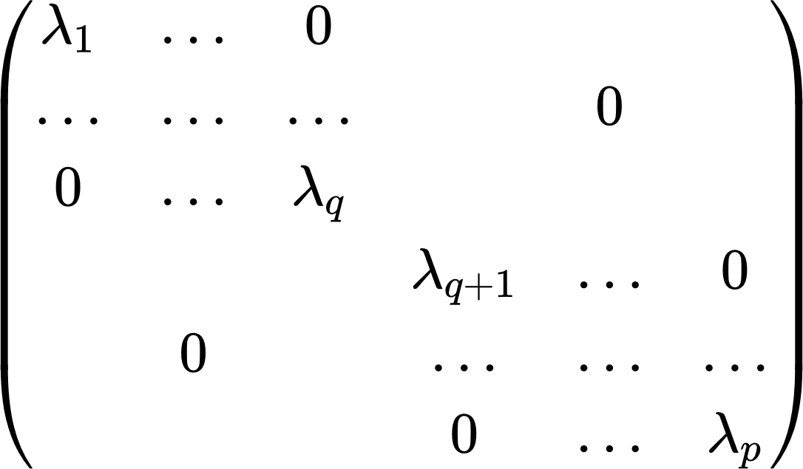

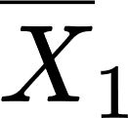
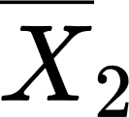
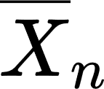




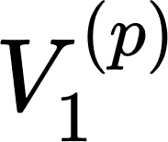
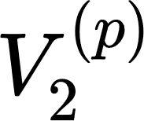
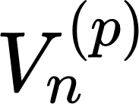

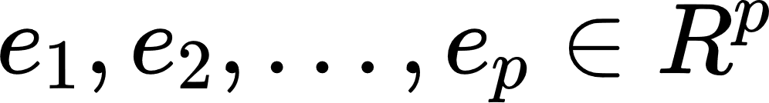
Derive SVD Form
Let is p × n centered data matrix and p < n.
Apply SVD:
 |  |  | …
 |  | …
 |  |  | …
Orthogonal matrix
with orthonormal vectors-columns
Diagonal
matrix
Orthogonal matrix
01 SVD | 02 Derive SVD Form | 03 PCA Steps | 04 Rules of Thumb | 05 Example
4/15

Slide 5
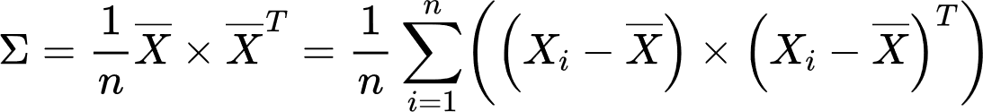
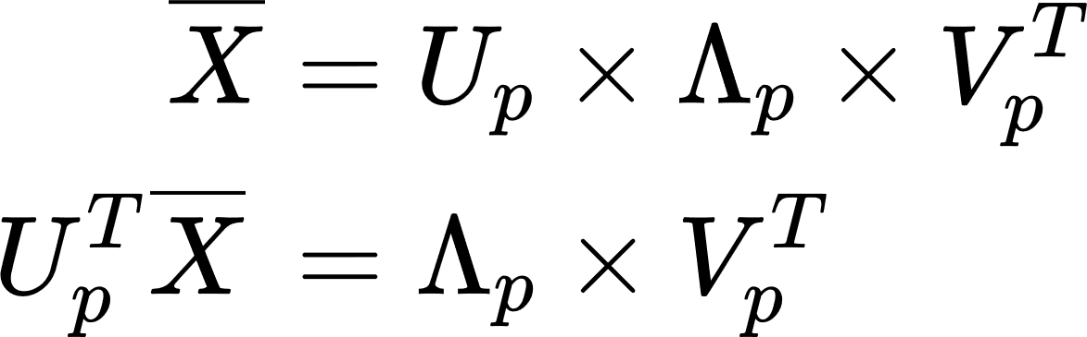
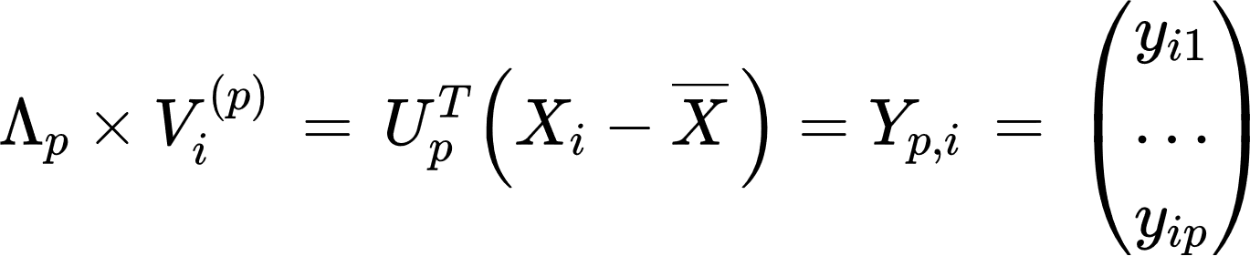
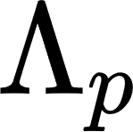
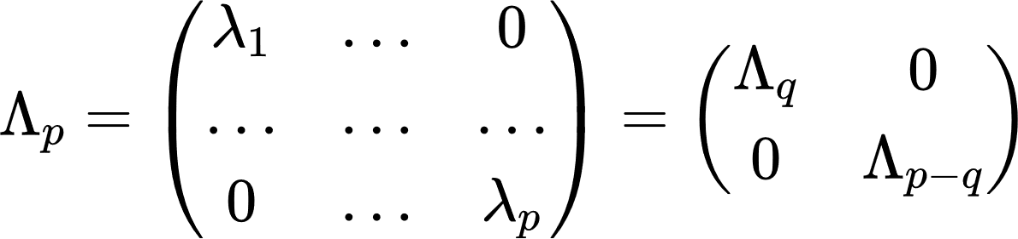
Derive SVD Form
Covariance matrix :
From :
Write in column form :
Then, consider about :
transformed centered vectors
01 SVD | 02 Derive SVD Form | 03 PCA Steps | 04 Rules of Thumb | 05 Example
5/15

Slide 6
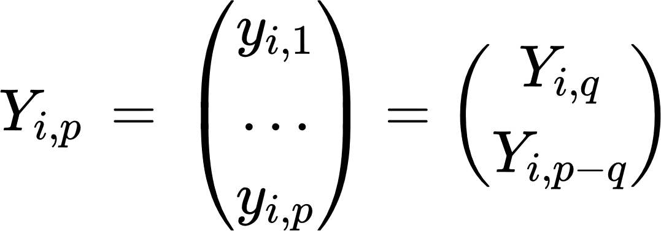
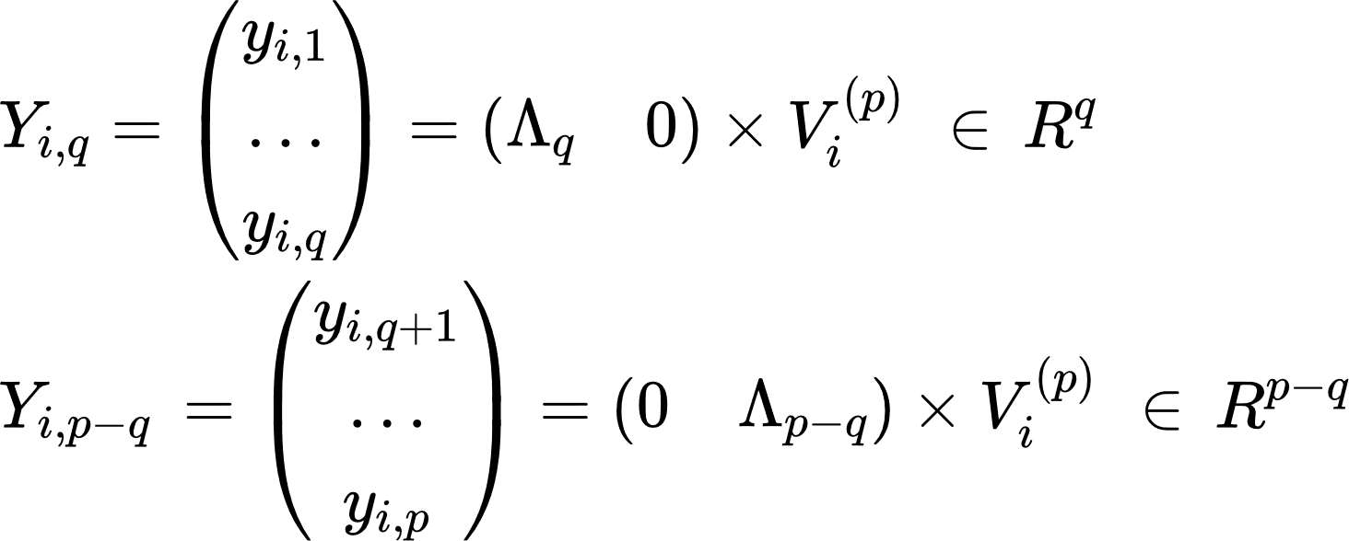
Derive SVD Form
We have :
where :
01 SVD | 02 Derive SVD Form | 03 PCA Steps | 04 Rules of Thumb | 05 Example
6/15

Slide 7
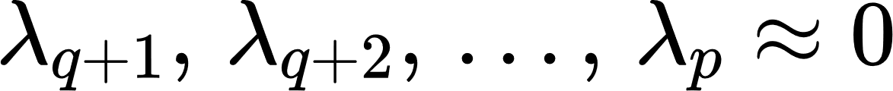
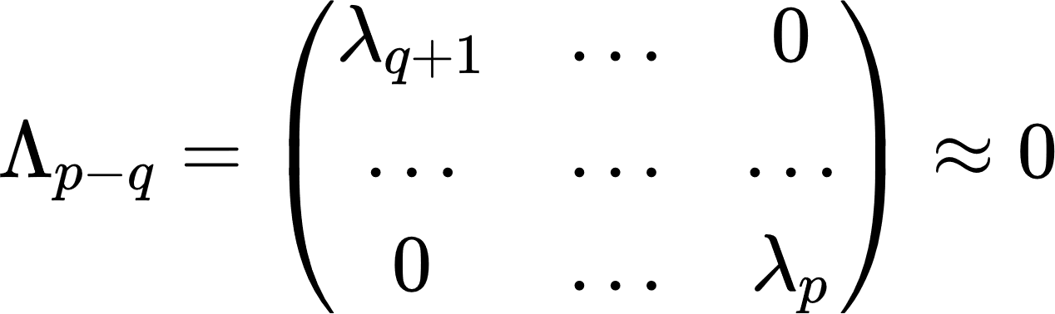
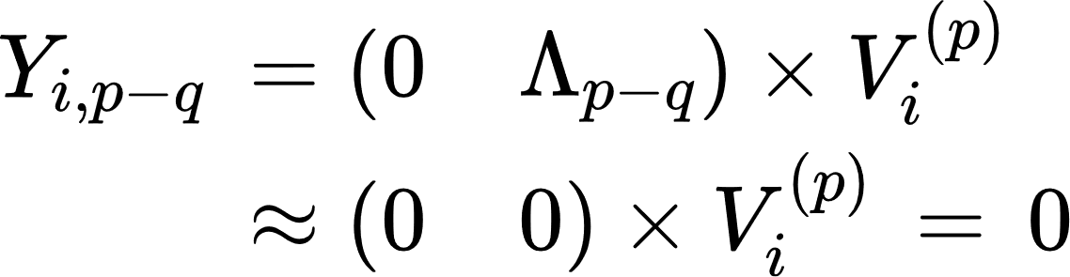
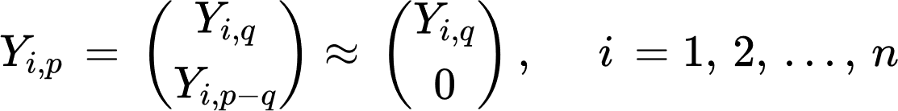
Derive SVD Form
Let the eigenvalues are small :
So,
Transformed features:
01 SVD | 02 Derive SVD Form | 03 PCA Steps | 04 Rules of Thumb | 05 Example
7/15

Slide 8
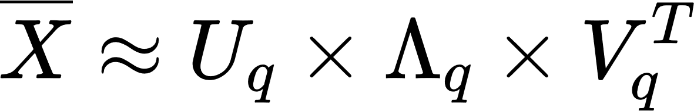
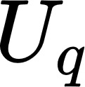
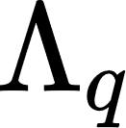
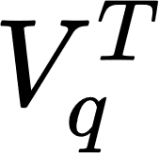
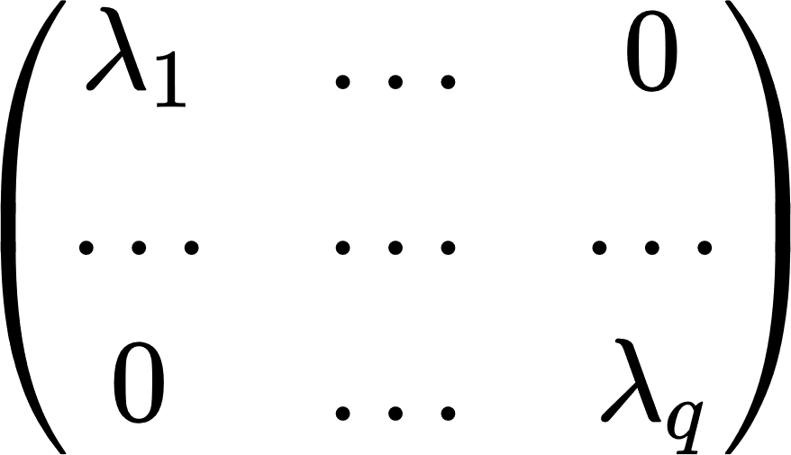

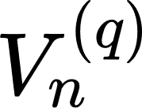


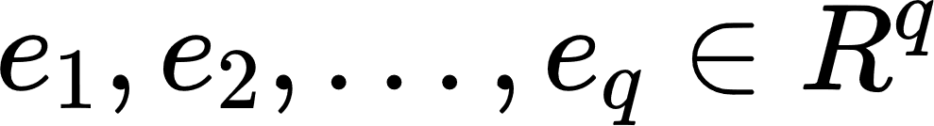
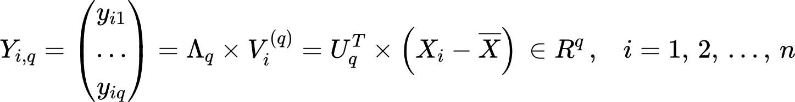
Derive SVD Form
 |  |  | …
 |  | …
 |  |  | …
orthogonal matrix spanned by
Diagonal
matrix
Orthogonal matrix
01 SVD | 02 Derive SVD Form | 03 PCA Steps | 04 Rules of Thumb | 05 Example
8/15

Slide 9
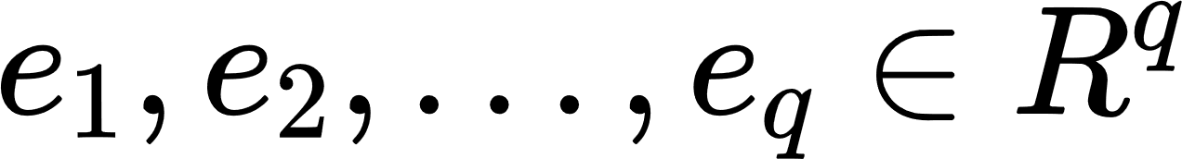
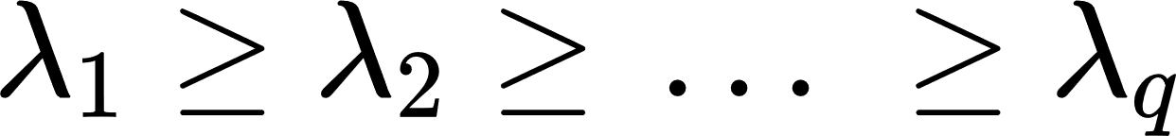
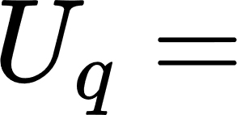


Derive SVD Form
Then : orthonormal vectors are p-dimensional eigenvectors of p × p matrix and matrix Σ corresponding to q largest eigenvalues of the matrix Σ
is the first q PCA components and
Reduced PCA - features
e₁ | … | e_{q}
01 SVD | 02 Derive SVD Form | 03 PCA Steps | 04 Rules of Thumb | 05 Example
9/15

Slide 10
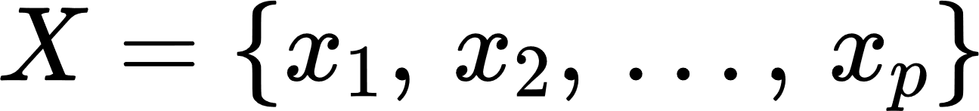
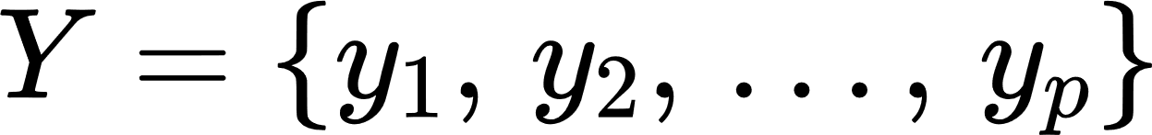
PCA Steps
Step 1 : based on the training dataset, PCA transform the original p-dimensional feature vector to the vector consisting of new features
Step 2 : Removing the number of last transformed features which are non-informative respected to the chosen criteria
01 SVD | 02 Derive SVD Form | 03 PCA Steps | 04 Rules of Thumb | 05 Example
10/15

Slide 11

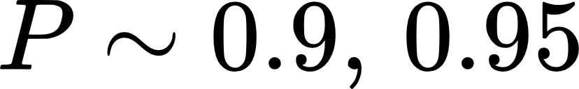
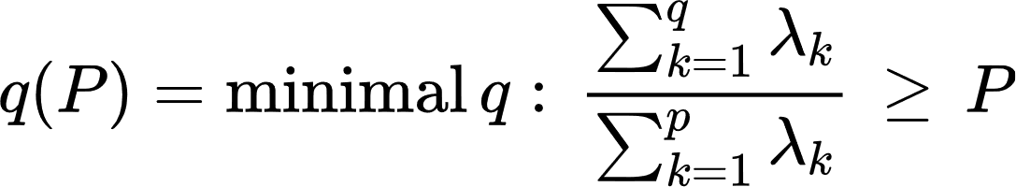
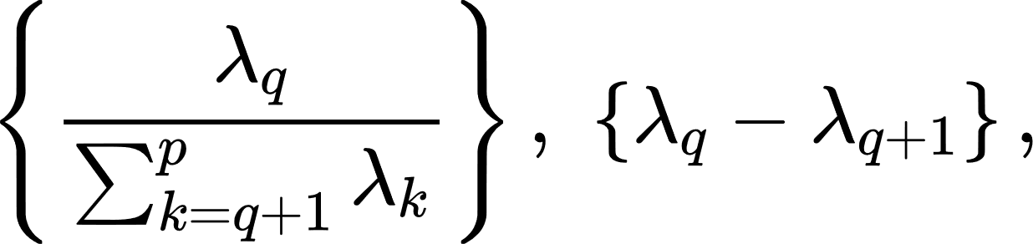
Rules of Thumb
Consider how many features should be retained:
Base on at least the faction of , for example,
Base on quantities
01 SVD | 02 Derive SVD Form | 03 PCA Steps | 04 Rules of Thumb | 05 Example
11/15

Slide 12
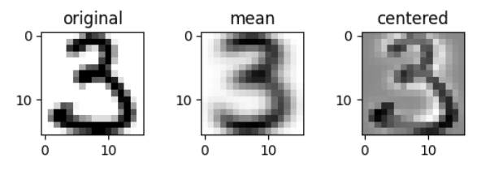
Example : Handwritten Digits USPS dataset
Example of original, mean, and centered data of digit 3
01 SVD | 02 Derive SVD Form | 03 PCA Steps | 04 Rules of Thumb | 05 Example
12/15

Slide 13
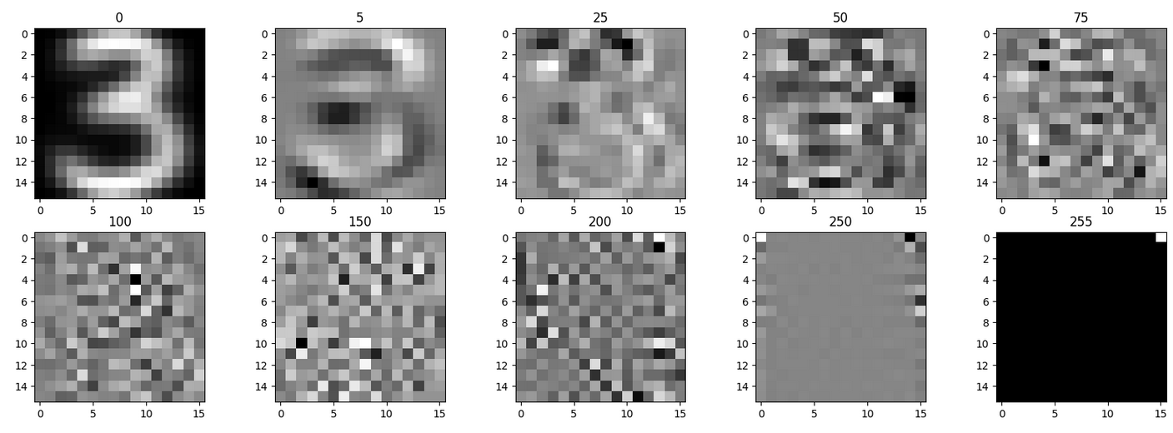
Example : Handwritten Digits USPS dataset
Principal digit 3 of components: 0, 5, 25, 50, 75, 100, 150, 200, 250, 255
01 SVD | 02 Derive SVD Form | 03 PCA Steps | 04 Rules of Thumb | 05 Example
13/15

Slide 14
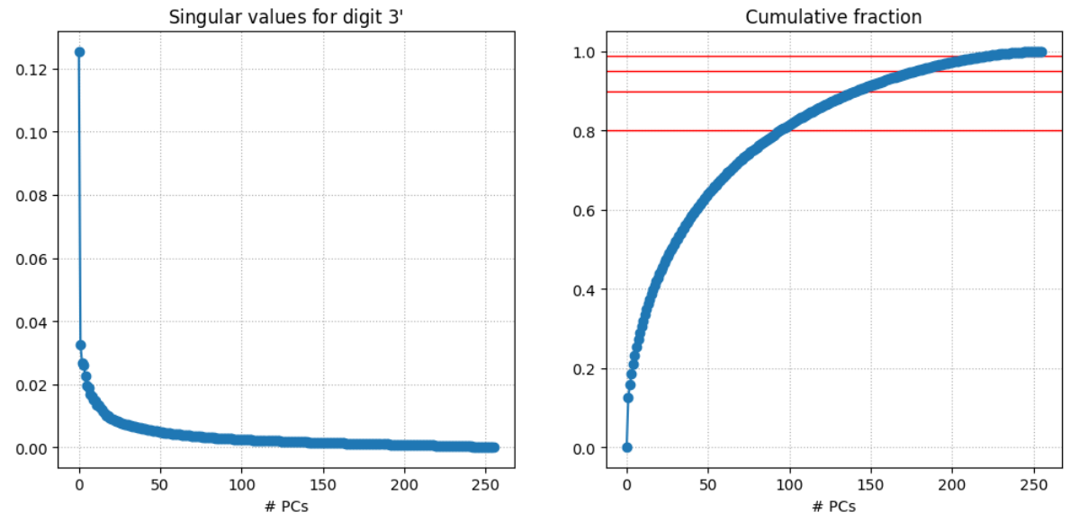
Example : Handwritten Digits USPS dataset
Singular values plot and its cumulative fraction
Cumulative fraction reach to 0.9501 at 177th-component
01 SVD | 02 Derive SVD Form | 03 PCA Steps | 04 Rules of Thumb | 05 Example
14/15

Slide 15
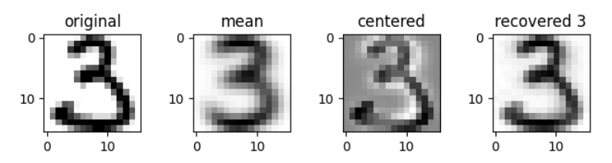
Example : Handwritten Digits USPS dataset
Example of original digit 3 and the recovered digit with 79-dimensional reduced feature vector
01 SVD | 02 Derive SVD Form | 03 PCA Steps | 04 Rules of Thumb | 05 Example
15/15

