Slide 1
Astrological prediction for stock market
Artem Chuprov
Sudarut Kasemsuk
Waralak Pariwatphan
Geometrical Methods of Machine Learning, Skoltech 2023

Slide 2

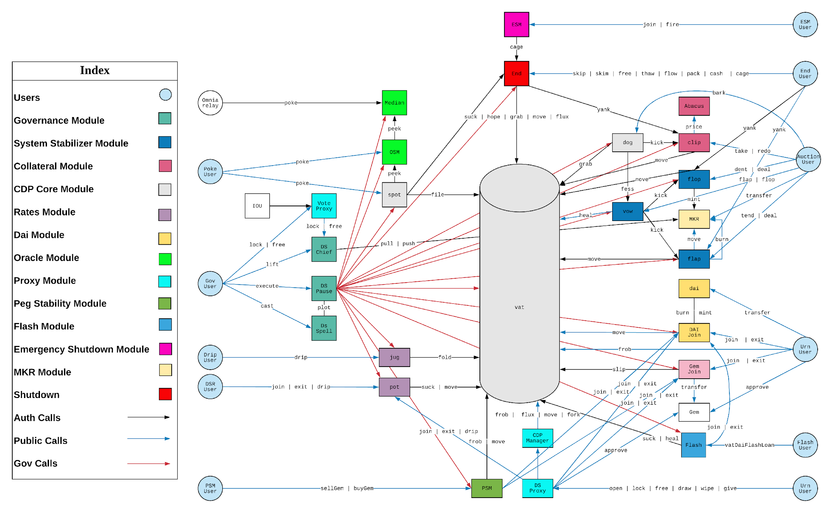
Table Contents
01 | Introduction
02 | Background
03 | Methods
04 | Results
05 | Conclusion
Geometrical Methods of Machine Learning, Skoltech 2023
2

Slide 3

Introduction

Slide 4
Introduction
Time Series Analysis can apply Topological methods to understand the patterns inside the data.
Why do we need TDA with time series data?
To constructing graph that captures the relationships between data points
Persistent homology identifies topological structures, providing insights into the connectedness, holes, and voids present in the data
Visualize the topological features to gain insights into the structure and patterns of the time series data
01 Introduction | 02 Background | 03 Methods | 04 Results | 05 Conclusion
4

Slide 5
Background

Slide 6
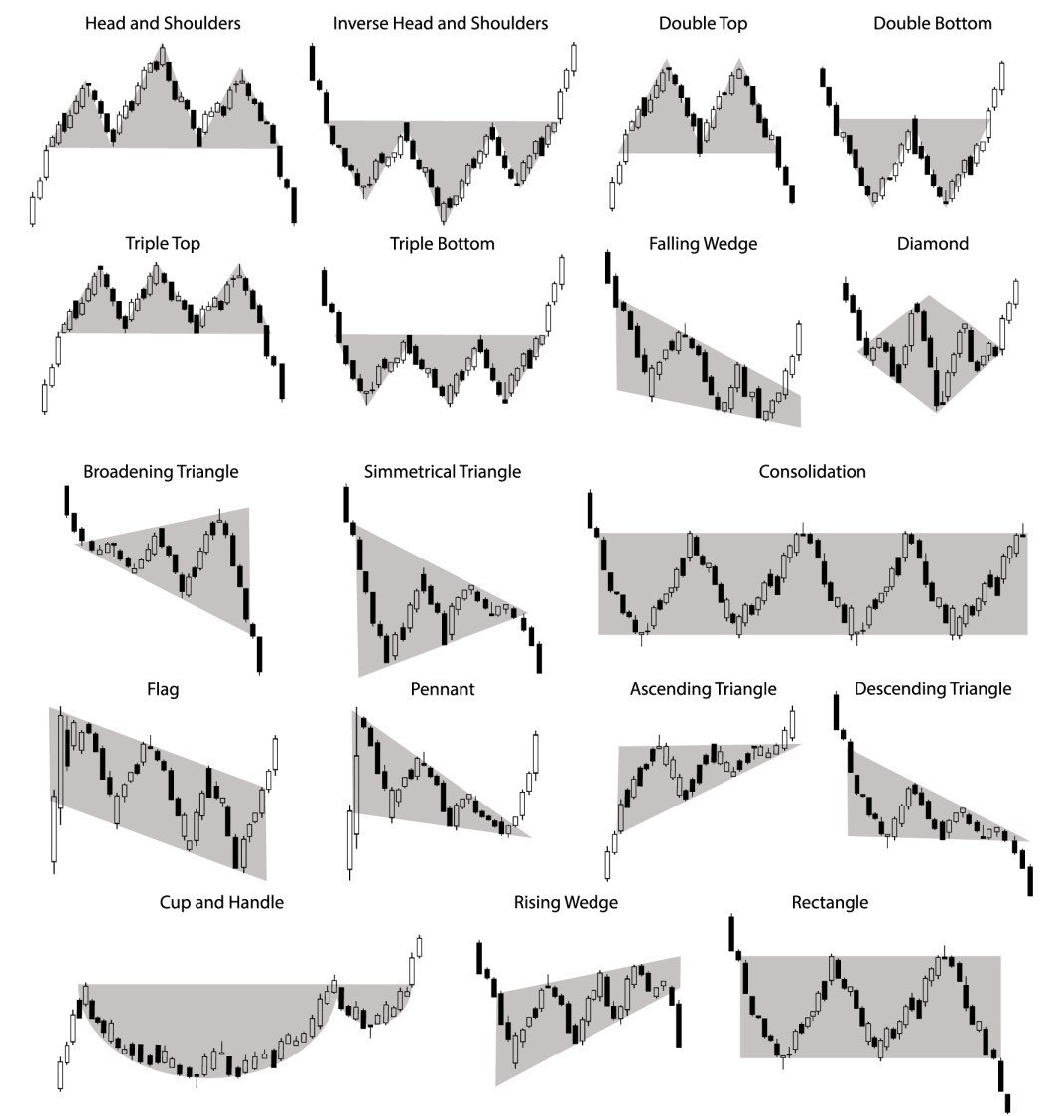
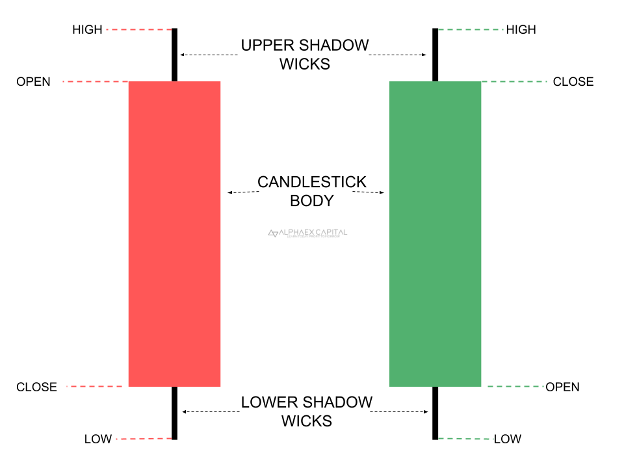
Technical analysis in stock prices
Japanese Candlestick Patterns
The exchange market contains four parameters: open, high, low, and close. These are represented by "Japanese candles" in the image (5D points).
01 Introduction | 02 Background | 03 Methods | 04 Results | 05 Conclusion
6

Slide 7
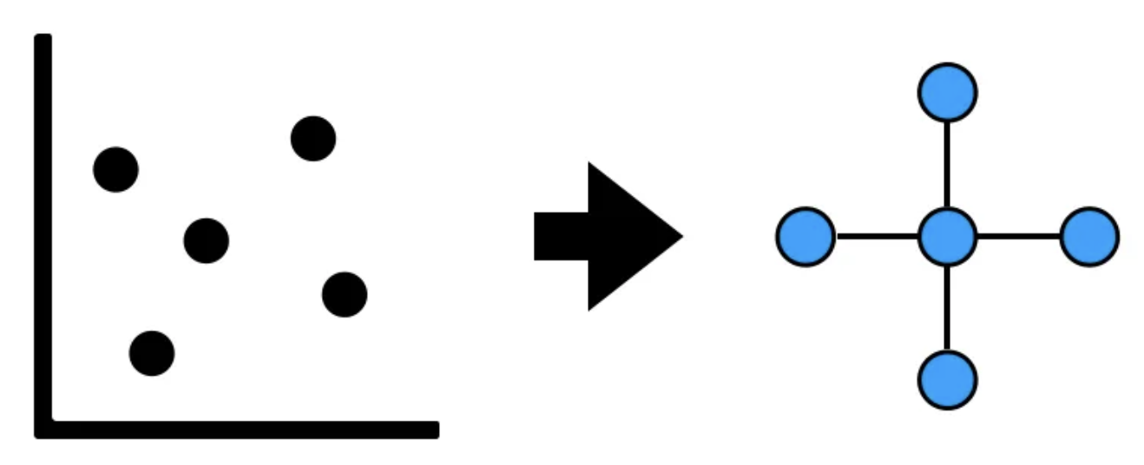
Topological data analysis (TDA)
Topological data analysis (TDA) is the tool that looks at the shape of data. It consists of various approaches with an underlying theme of extracting structure from unstructured data.
Data → Shape. The basic idea of TDA is to extract shape from data
https://towardsdatascience.com/topological-data-analysis-tda-b7f9b770c951
01 Introduction | 02 Background | 03 Methods | 04 Results | 05 Conclusion
7

Slide 8
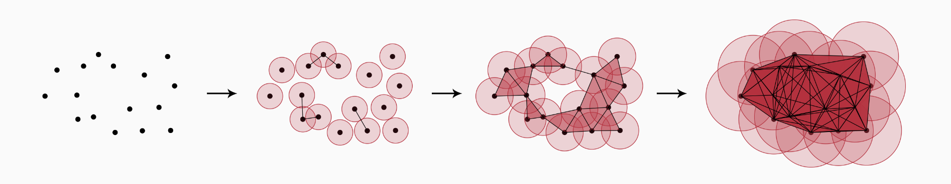
Persistent Homology
Measuring topological characteristics of shapes and functions is referred to as persistent homology. It turns data into simplicial complexes and describes the topology of a space at various spatial resolutions.
Figure : The filtration process applied to a 2-dimensional point cloud.
https://christian.bock.ml/posts/persistent_homology/
01 Introduction | 02 Background | 03 Methods | 04 Results | 05 Conclusion
8

Slide 9
Methods

Slide 10
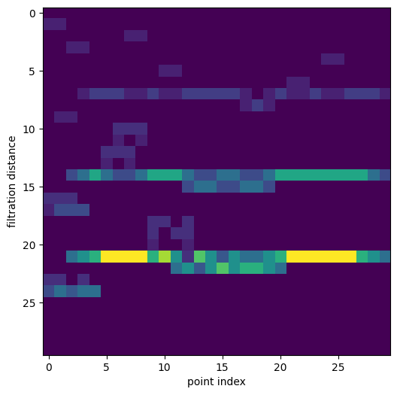
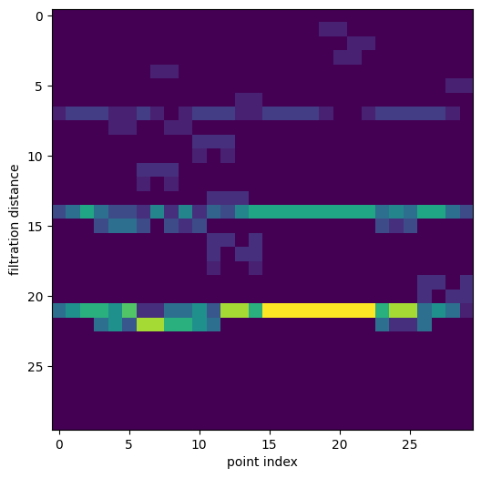
Our Method
Filtration distance of each point index (window=30)
Here the intensity represents the order of simplex formed. The max order used was 1.
01 Introduction | 02 Background | 03 Methods | 04 Results | 05 Conclusion
10

Slide 11
Our method
Preprocessing data
Model
Time series data
Reshape input to (30, 30, 1)
last_close, last_open, last_max, last_min,
and target (price ↑ or ↓)
Convolutional layer with
Filters = 4, kernel_size = 3
Rescaling with min, max for each periods
Flatten the output
Persistent analysis
Dense layer with 12 units
Set of connected nodes
and distance
Dense output layer with
Sigmoid activation
Results
Compile model with Adam optimizer
01 Introduction | 02 Background | 03 Methods | 04 Results | 05 Conclusion
11

Slide 12
Results

Slide 13
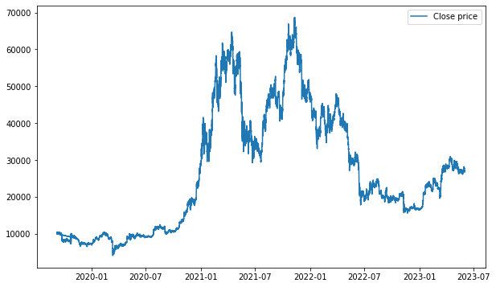
Results
Stock: BTCUSDT price from 2019-09-08 to 2023-06-01
01 Introduction | 02 Background | 03 Methods | 04 Results | 05 Conclusion
13

Slide 14
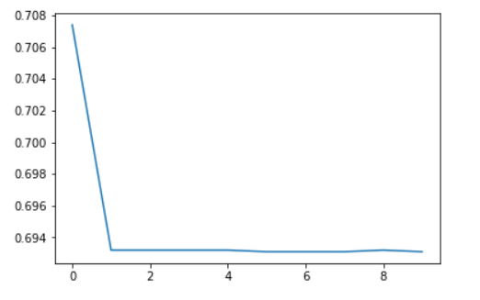
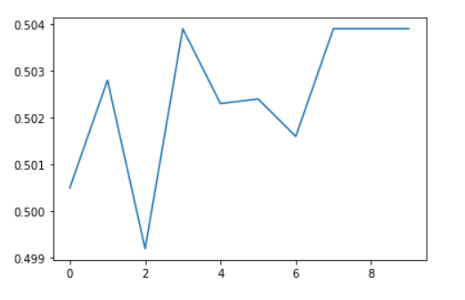
Results
Loss of model ( 10 epochs)
Accuracy of model ( 10 epochs)
Model | Accuracy
Our method | 0.5135
Source code: https://github.com/ArtemChuprov/TopologicalProject/blob/main/main.ipynb
01 Introduction | 02 Background | 03 Methods | 04 Results | 05 Conclusion
14

Slide 15
Conclusion

Slide 16
Conclusion
Topological Data Analysis (TDA) can provide valuable insights by applying TDA techniques to time series data, we gain a deeper understanding of the underlying structure and patterns and TDA can improve time series prediction with predictive models by using a convolutional neural network (CNN).
Although our test accuracy may seem poor, for stock market this is a result. As long as test data contained about 4000 hour time steps, our result is statistically significant and may mean that this technique has predictive power.
01 Introduction | 02 Background | 03 Methods | 04 Results | 05 Conclusion
16

Slide 17
References
https://github.com/SamirMoustafa/Time-Series-Classification
https://arxiv.org/pdf/1909.10604.pdf
https://giotto-ai.github.io/gtda-docs/0.3.0/notebooks/time_series_classification.html
01 Introduction | 02 Background | 03 Methods | 04 Results | 05 Conclusion
17

Slide 18
Thank You!

