Slide 1



Security and Privacy Experiences of First- and Second-Generation Pakistani Immigrants to the US: Perceptions, Practices, Challenges, and Parent-Child Dynamics
Warda Usman*¶, John Sadik*†, Taha ‡, Ran Elgedawy†, Scott Ruoti†, Daniel Zappala¶
¶
†
‡

Slide 2
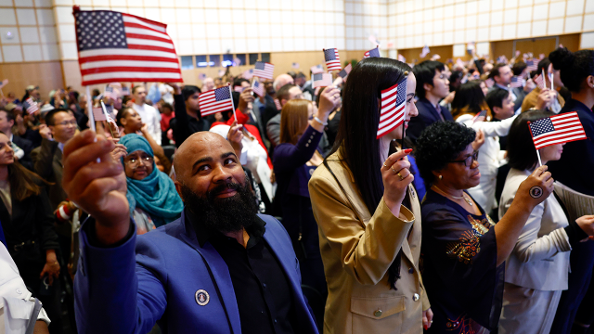
There are over 44 million immigrants in the US, accounting for 13.7% of the US population.
This number is increasing every year.
About 200 people wave American flags after being sworn in at a naturalization ceremony in Boston on April 17, 2024. (Danielle Parhizkaran/The Boston Globe via Getty Images)
Key findings about U.S. immigrants, Pew Research Center
Notes:
In recent years, we have witnessed unprecedented levels of international migration. In the US alone, there are 44 million immigrants, accounting for 14% of the US population. Despite their significant presence, immigrants often find themselves marginalized, facing discrimination and prejudice in their lives

Slide 3
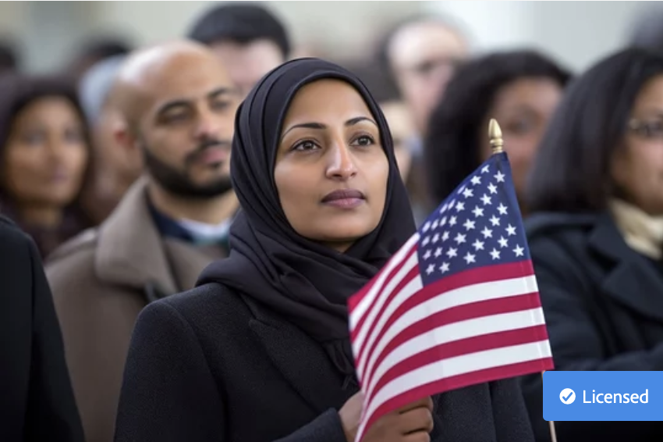
The voices and experiences of Pakistani immigrants remain virtually nonexistent in the usable security and privacy literature
A woman wearing a dark hijab and coat holds a small American flag while standing in a crowd.
Notes:
Pakistani immigrants in particular navigate heightened scrutiny and stigmatization due to the intersecting factors of religion, culture, and immigration status. We hypothesize that due to these factors, Pakistani immigrants in the US have distinct security and privacy needs that need to be explored. We believe that these needs might be even more pronounced due to recent events.

Slide 4
Research Questions
01.
Socio-technical challenges
Notes:
We were interested in studying three particular aspects about the Pakistanis living in the US: 1. What socio-technical challenges they encounter in the US?

Slide 5
Research Questions
01.
02.
Socio-technical challenges
Threat models
Notes:
What their threat models are, including their security and privacy perceptions, practices, and needs?

Slide 6
Research Questions
01.
02.
03.
Socio-technical challenges
Parent-child dynamics
Threat models
Notes:
How generational differences influence the perception and prioritization of security and privacy concerns

Slide 7
Methodology
Recruitment
Interviews
Analysis
Through social media, closed Facebook group
25 semi-structured interviews conducted over Zoom
Thematic analysis
Notes:
To answer these questions, we conducted a semi-structured, in-depth interview study.
We recruited through a private facebook group with about 35k members. We conducted 25 interviews: 15 with first generation, and with 10 second-generation Pakistani immigrants.
We conducted thematic analysis on our data, the finding of which I will now present.

Slide 8
Findings
01.
02.
03.
Socio-technical challenges
Threat models
Parent-child dynamics
Notes:
but in the interest of time I’ll go over only one theme for each.

Slide 9
Findings
01.
02.
03.
Socio-technical challenges
Threat models
Parent-child dynamics
Notes:
First, the challenges.

Slide 10
Challenges
First Generation
Discrimination
Communication barriers
Self-presentation
Navigating new technologies
Lack of social support
Notes:
First-gen immigrants described a variety of challenges while living in the US, such as facing discrimination, communication barriers, struggling to manage their identities online, navigating new technologies, and dealing with a general lack of social support in the US.

Slide 11
Challenges
First Generation
Discrimination
“If I was white, or if I was black, I would be just another American talking something about politics, but when they see a Pakistani or Muslim say something, it is not accepted as just a view. It is accepted as if I’m representing the Taliban community.” (P24)
Communication barriers
Self-presentation
Navigating new technologies
Lack of social support
Notes:
They recounted a number of events where they had to deal with prejudice or discrimination. This affected the way they presented themselves both offline and online. For example, P24 mentioned being careful of sharing anything sensitive with anyone. And said; “If I was white, or if I was black, I would be just another American talking something about politics, but when they see a Pakistani or Muslim say something, it is not accepted as just a view. It is accepted as if I’m representing the Taliban community.”

Slide 12
Challenges
Second Generation
“My parents were a little heavier on monitoring what I was doing online, and whether or not I was safe. They were themselves very cautious. And they were cautious for me too.” (C15)
Clash of cultures
Notes:
The only challenge the second generation mentioned was navigating the clash between the Pakistani culture their parents follow, and the American culture they are more accustomed to, as well as all their friends. For example, C15 says, My parents were a little heavier on monitoring what I was doing online, and whether or not I was safe. They were themselves very cautious. And they were cautious for me too

Slide 13
Findings
01.
02.
03.
Socio-technical challenges
Threat models
Parent-child dynamics
Notes:
I’ll now briefly cover the threats our participants perceived to their safety and privacy and the protective strategies they had, to mitigate those threats

Slide 14
Threat Models
First Generation
Threats from posting online
Government surveillance
Reputational harm
Apps collecting data for profiling
Physical threats
Notes:
First-generation mentioned threats that were very linked to either their identities, or very specific actions they would do online and offline. For example, they worried about threats from the posts they would make online, govt surveillance because theyre Muslims, reputational harm, apps collecting data for racial profiling, and physical threats

Slide 15
Threat Models
First Generation
Threats from posting online
Government surveillance
Reputational harm
Apps collecting data for profiling
Physical threats
Notes:
for threats from posting online, they worried about

Slide 16
Threat Models
First Generation
Negative reactions from friends and family
Threats from posting online
Government surveillance
Reputational harm
Apps collecting data for profiling
Physical threats
Notes:
getting negative reactions from friends and family. B
ecause the lifestyles in Pakistan and the US are so different, they worried their social circles would judge them or become distant.

Slide 17
Threat Models
First Generation
Negative reactions from friends and family
“Those people say ‘Oh, she’s having a good life’ and I feel maybe they don’t have [this lifestyle]... I want to maintain good relations.” (P8)
Threats from posting online
Government surveillance
Reputational harm
Apps collecting data for profiling
Physical threats
Notes:
For example, P8 says, Those people say ‘Oh, she’s having a good life’ and I feel maybe they don’t have [this lifestyle]... I want to maintain good relations

Slide 18
Threat Models
First Generation
Negative reactions from friends and family
Threats from posting online
Government surveillance
Reputational harm
Apps collecting data for profiling
Physical threats

Slide 19
Threat Models
First Generation
Negative reactions from friends and family
Threats from posting online
Evil eye
Government surveillance
Reputational harm
Apps collecting data for profiling
Physical threats
Notes:
They similarly worried about evil eye. This belief is rooted in Muslim traditions, where it is believed that an evil or envious glance may have the potential to inflict injury, harm, and even death to those upon whom it falls

Slide 20
Threat Models
First Generation
Negative reactions from friends and family
Threats from posting online
Evil eye
“Evil eye is real. I don’t want to invite problems in my life because I shared too much online” (P7)
Government surveillance
Reputational harm
Apps collecting data for profiling
Physical threats
Notes:
For example P7 says.. Evil eye is real. I don’t want to invite problems in my life because I shared too much online

Slide 21
Threat Models
First Generation
Negative reactions from friends and family
Threats from posting online
Evil eye
Government surveillance
Reputational harm
Apps collecting data for profiling
Physical threats

Slide 22
Threat Models
First Generation
Negative reactions from friends and family
Threats from posting online
Evil eye
Government surveillance
Physical harms
Reputational harm
Apps collecting data for profiling
Physical threats
Notes:
They also worried about physical harms as a result of online posts.

Slide 23
Threat Models
First Generation
Negative reactions from friends and family
Threats from posting online
Evil eye
Government surveillance
Physical harms
Reputational harm
“I was a heavy user of Facebook, and I think I posted a picture, like, we’re going here, and then two days later, we had a robbery at our house, So, based on that, I think maybe people knew that I wasn’t at home or whatnot.” (P3)
Apps collecting data for profiling
Physical threats
Notes:
For example, P3 says…I was a heavy user of Facebook, and I think I posted a picture, we’re going here, and then two days later, we had a robbery at our house, So, based on that, I think maybe people knew that I wasn’t at home

Slide 24
Threat Models
First Generation
Negative reactions from friends and family
Threats from posting online
Evil eye
Government surveillance
Physical harms
Reputational harm
Apps collecting data for profiling
Physical threats

Slide 25
Threat Models
First Generation
Negative reactions from friends and family
Threats from posting online
Evil eye
Government surveillance
Physical harms
Reputational harm
Apps collecting data for profiling
Mitigation: maintain a low profile on social media, self-censorship
Physical threats
Notes:
The mitigations they had for these threats were to be maintain a low profile on social media, and have certain levels of self-censorship

Slide 26
Threat Models
Second Generation
Scams and identity theft
Hacking and data breaches
Fake news and misinformation
Notes:
The threat models of second-generation were NOT linked to their identities. They perceived general risks to online safety, such as scams and identity theft, hacking and data breaches, fake news and misinformation.

Slide 27
Threat Models
Second Generation
Scams and identity theft
“To me personally? No. I don’t think anyone’s out to get me or anything. I think the only attacks I can be at a risk for is when there’s like massive data leaks from the different websites and stuff. But yeah, I think that’s it.” (C19)
Hacking and data breaches
Fake news and misinformation
Notes:
C19 says for example, To me personally? No. I don’t think anyone’s out to get me or anything. I think the only attacks I can be at a risk for is when there’s like massive data leaks from the different websites and stuff

Slide 28
Threat Models
Second Generation
Scams and identity theft
“To me personally? No. I don’t think anyone’s out to get me or anything. I think the only attacks I can be at a risk for is when there’s like massive data leaks from the different websites and stuff. But yeah, I think that’s it.” (C19)
Hacking and data breaches
Fake news and misinformation
Mitigation: exercise caution when storing or sharing personal information, avoid “shady” websites, use stronger passwords
Notes:
Their mitigation strategies involved exercising caution when storing or sharing personal information, avoiding shady websites, using stronger passwords and not reusing them, and so forth

Slide 29
Findings
01.
02.
03.
Socio-technical challenges
Threat models
Parent-child dynamics
Notes:
I will now briefly cover the parent-child dynamics our analysis discovered. To clarify, all our participants were adults. I call them children only in reference to their relationship to their parents.

Slide 30
Parent-child dynamics
Role of children in parent’s technology use
Role of parents in children’s technology use
Device and password sharing
Perceptions of safety habits
Willingness to learn from children
Filial piety
Notes:
In the paper, we talk about the role of children in their parent’s technology use and vice versa, we talk about device and password sharing in families, their perceptions of safety habits of each other. We also found that parents were very willing to learn from their children, and we found that children were motivated by filial piety.

Slide 31
Parent-child dynamics
Role of children in parent’s technology use
Role of parents in children’s technology use
Device and password sharing
Perceptions of safety habits
Willingness to learn from children
Filial piety
Notes:
Filial piety is a value we saw in children where they perceive it as their duty to support their aging parents

Slide 32
Parent-child dynamics
Role of children in parent’s technology use
Role of parents in children’s technology use
“I don’t truly understand the reason why [my mother] says the things she does, but I kind of understand where she comes from, so I listen to her and don’t post pictures” (C13)
Device and password sharing
Perceptions of safety habits
Willingness to learn from children
Filial piety
Notes:
This “support” also sometimes meant that they obeyed the parent in online interactions even when they didn’t agree. For example, C13 says..

Slide 33
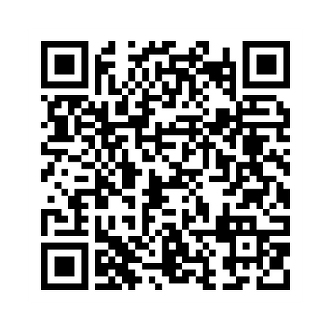
Takeaways
Participants consider cost-benefit tradeoffs when making security decisions
Participants lack access to resources about digital safety
Participants’ religious and cultural ideologies impact their security and privacy practices
Scan to read the paper
Participants struggle to manage multiple facets of their identity
Please find us in the poster session for any questions
Participants are motivated by filial piety
Warda Usman
Warda.pieas@gmail.com
Notes:
Our study offers various takeaways about the security and privacy of first and second gen Pakistani immigrants. We learned that they consider cost-benefit tradeoffs when making security decisions, their cultural and religious identities impact their practices. We learned that the second gen is motivated by filial piety, and that the first gen lacks resources about digital safety. We also learned that participants struggled to manage the multiple facets of their identities, being both Pakistani and Americans. I encourage you to read our paper to learn more about these takeaways, as well as their implications for the security and privacy community. Please find us in the poster session for any questions, thank you!

