Slide 1
The process of Running a Testcase in Selenium Grid

Slide 2
Selenium Grid is a part of the Selenium Suite that specializes in running multiple tests across different browsers, operating systems, and machines in parallel.

Slide 3
Selenium Grid uses a hub-node concept where you only run the test on a single machine called a hub,
but the execution will be done by different machines called nodes.

Slide 4
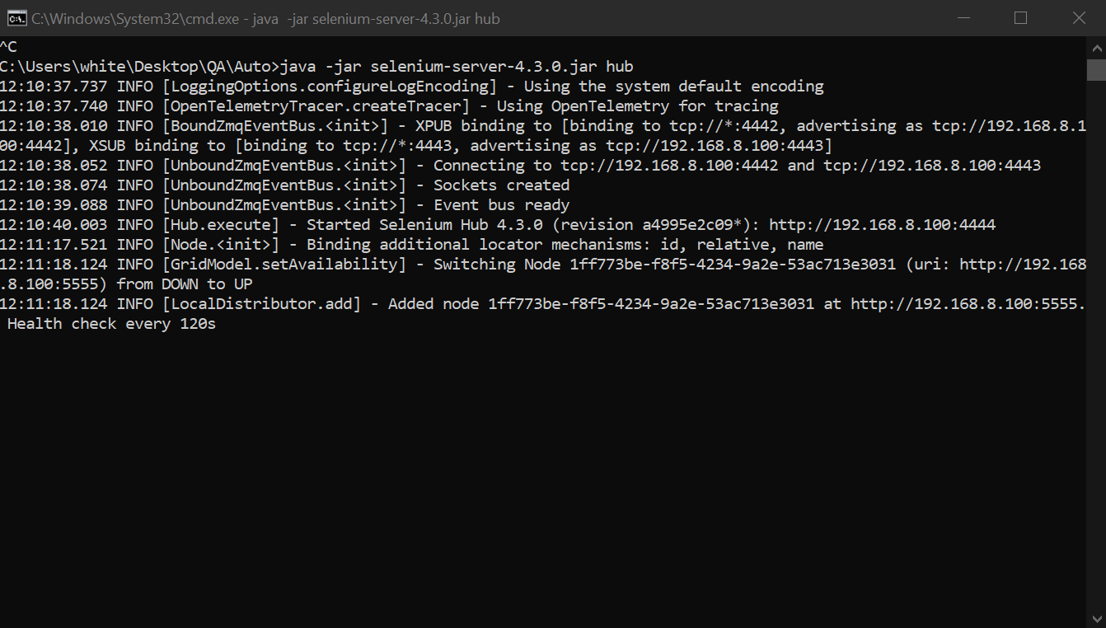
To Start a Hub
Run: java -jar selenium-server-4.3.0.jar hub

Slide 5
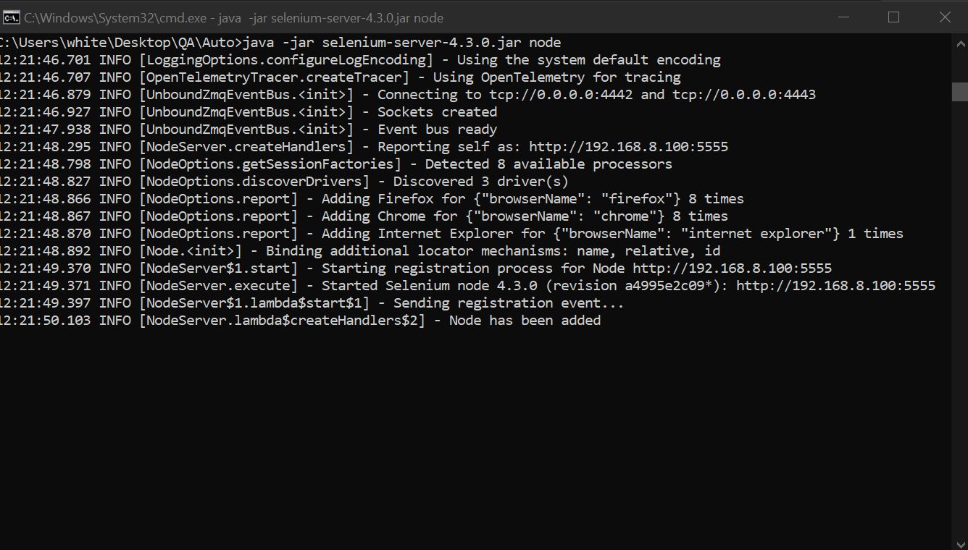
To Start a Node
Run: java -jar selenium-server-4.3.0.jar node

Slide 6

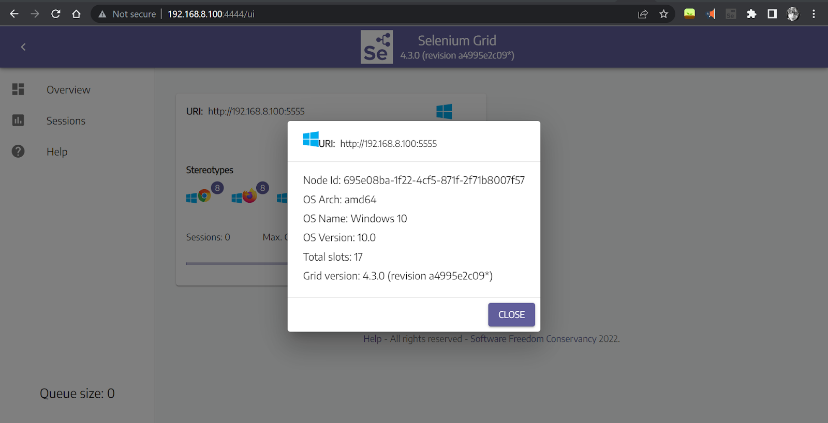
In your browser open your localhost: http://192.168.8.100:4444

Slide 7
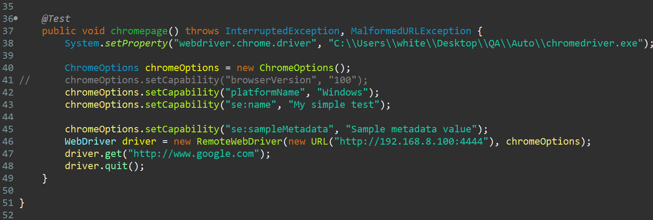
Running tests
To run tests after starting successfully Selenium Grid, you can use a RemoteWebDriver.

Slide 8

Useful Resources
https://www.selenium.dev/documentation/grid/getting_started/
selenium.dev/documentation/webdriver/remote_webdriver/
https://www.guru99.com/introduction-to-selenium-grid.html

Slide 9
Thank you
Questions?!

