Slide 1

Habitable Planets Analysis

Slide 2
Habitable Exoplanet Questions
Which planets are most likely to support life as we know it?
Which planets could we potentially prepare to settle on?
What are some challenges to consider when choosing a planet, and what are some other factors outside the planet immediate measurements to consider?
Which planets should be focused on for further research and study for potential habitation?

Slide 3
Why conduct further study on potential planets?
As humans continue to explore the boundaries and study the universe, it is only natural that one day there will be an attempt at a journey as many people in history have done before us such as Magellan, Polo, Cabot, Columbus, etc.
There are other reasons such as more resources as humans continue to exponentially populate.
Regardless of the reason, the best possible planets need to be narrowed down for further research to determine which would be out best bet to attempt a journey of this magnitude.
With our current technology, we would be putting all our eggs in one basket and none of us will be alive when that journey is over as the nearest exoplanet is 4 light years away.

Slide 4
Who Needs This Kind of Data?
This data will be helpful to researchers and scientists to help determine where to focus more time and energy researching certain planets and other factors to consider such as atmosphere, density, tidal lock, etc.
Investors will know where they focus their funds for further study, and in preparation for a future spacecraft and technologies.
Finally, this will generate more public interest as the entire planet will be able to focus on one of many, and it will no longer just be an abstract thought.

Slide 5
Measurements to Know
ESI is Earth Similarity Index, measures how similar a planet is to Earth irrespective of the star, Earth = 1
Comp is the composition of the planet (Jovian, Neptunian, Superterran, Terran, Subterran)
Distance is the distance from Earth the planet is in light years (1 light year = 5.88 trillion miles)
Mass is the weight of the planet measured as M⊕, Earth = 1
Radius is the size of the planet measured as R⊕, Earth = 1
Orbit is the period it takes a planet to complete one revolution around its star, Earth = 365.25 days
Kelvin is the average surface temperature of the planet in Kelvin
AU is the distance the planet is from its star (1 AU = 93 million miles)
S_Mass is the mass of the star measured as M☉, Sun = 1
S_Radius is the radius of the star measured as R☉, Sun = 1
S_Temp is the average surface temperature of the star measured in Kelvin
S_Lumin is the energy radiated per second by the star measured as L☉, Sun = 1

Slide 6
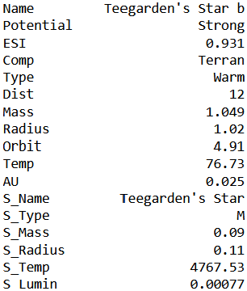
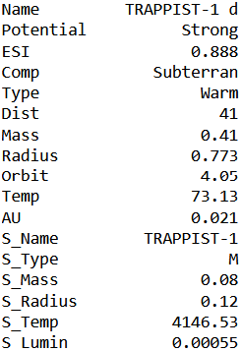
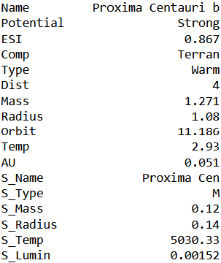
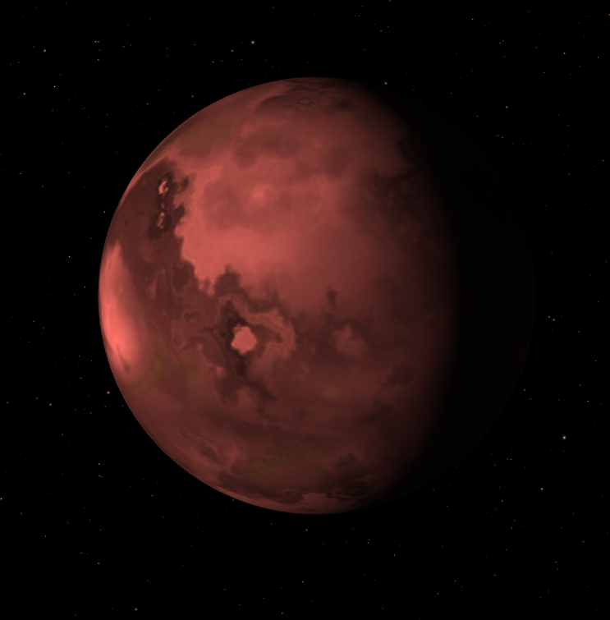
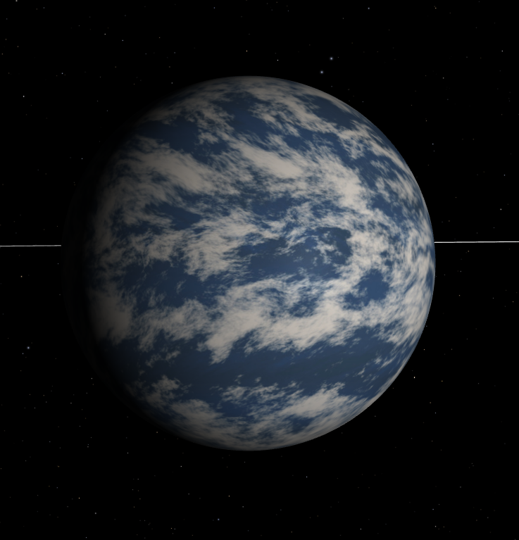
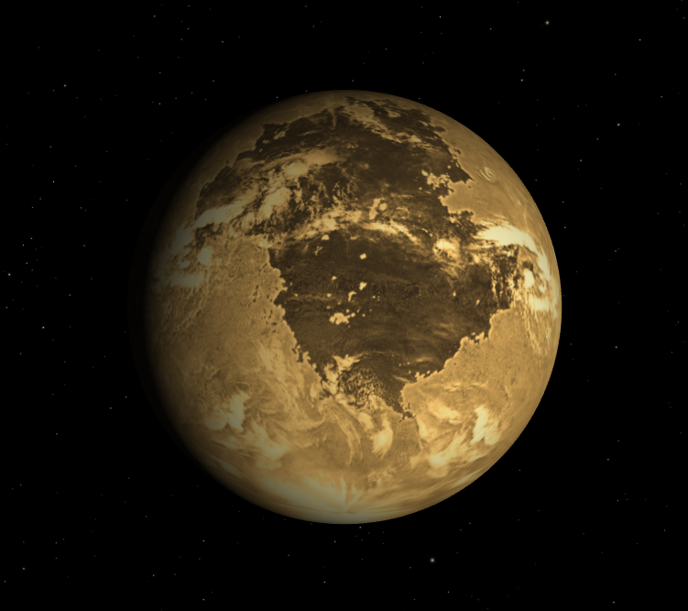
Teegarden’s Star b
TRAPPIST-1 D
Proxima Centauri b

Slide 7
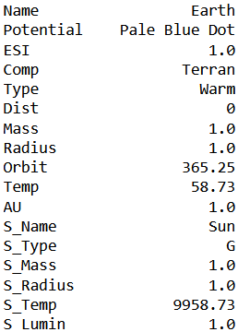
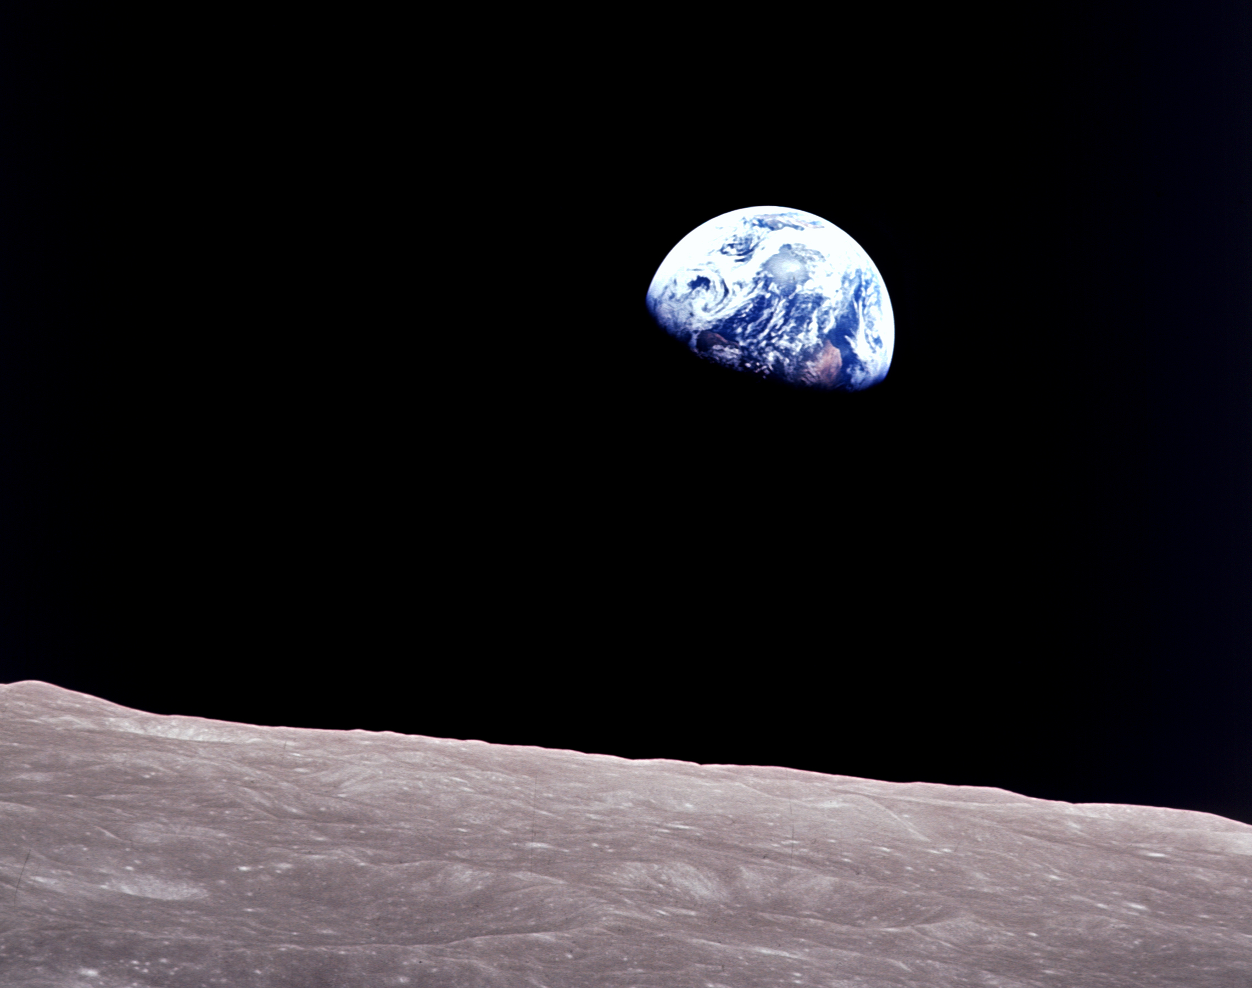
Earth

Slide 8
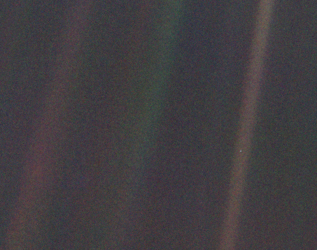
That’s here. That’s home. That’s us.
- Carl Sagan, Pale Blue Dot, 1994
Photo of Earth from Voyager 1 space craft leaving the Solar System 4 billion miles away.

