Slide 1

Drunken Noodle
GMOD Meeting
16 January 2014
Ken Youens-Clark
Cold Spring Harbor Lab

Slide 2


CMap of Olde
In development 2001-2008 primarily for Gramene
By me and Ben Faga
Entirely Perl/CGI/libgd/RDBMS
http://gmod.org/wiki/CMap

Slide 3
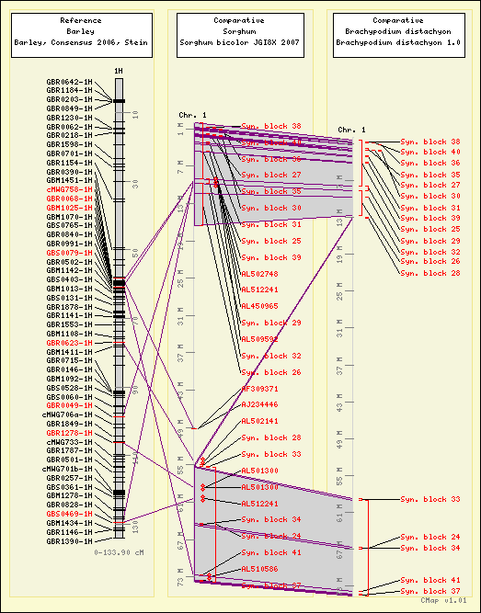
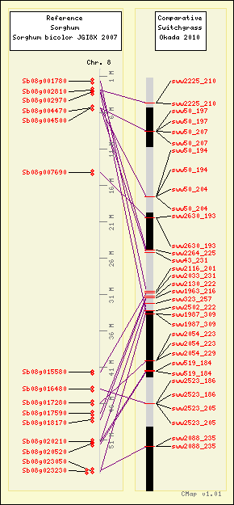
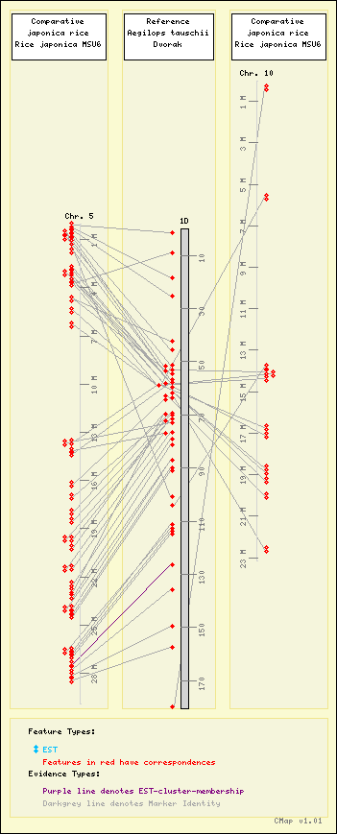
http://archive.gramene.org/cmap/

Slide 4
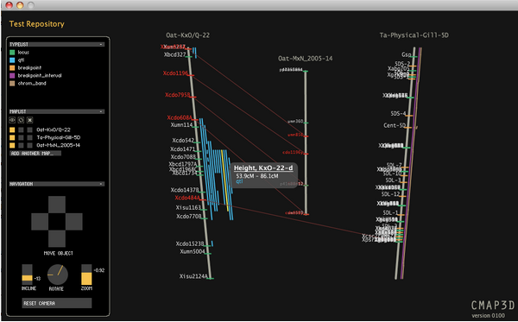
CMap3D
CMap3D: a 3D visualization tool for comparative genetic maps. Duran C, Boskovic Z, Imelfort M, Batley J, Hamilton NA, Edwards D. Bioinformatics. 2010 Jan 15;26(2):273-4. Epub 2009 Nov 25.

Slide 5
Goals
Faster and more scalable for larger data sets
  Solr
  Fastbit
  Tabix
More interactive, client-side user interface
Allow end users to upload data sets (maps, annotations, correspondences, DAS)
Allow site administrators greater customization

Slide 6


https://github.com/warelab/
Sage: Nodejs REST architecture
Iris: Browser-side library for data visualization widgets written in JavaScript

Slide 7
Snapdragon
Snapdragon is a collection of low level tools written in C++ mostly built on top of fastbit.
You can parse, query, and compare genome annotations.
There are stand alone command line programs as well as a node module that wraps some Fastbit functions designed to be used by a web service.
E.g., histogram data for feature type distribution

Slide 8
Explore visualization libraries
CMap generates static server-side images (maps)
Explore D3 (http://d3js.org/) and other tools (http://selection.datavisualization.ch/)
“Beauty” is ultimate goal
Beauty is truth, truth beauty -- that is all
Ye know on earth, and all ye need to know
-- Keats
Notes:
clarify hopelessness inspired by previous SVG exploration- d3 uses SVG heavily, I think?
Should emphasis be on “beauty” (ala Circos static eye-candy) or on “functionality” (interactivity and navigation of cross-genomic projective inference)?
How much do we want to reproduce what other viewers can do vs complement the functionality by providing a coordinated comparative perspective?

Slide 9
Data loading formats
tab-delimited
GFF
VCF
BED
Notes:
What are the goals in terms of data content to be included- not completely clear to me that VCF would be “in scope” for this effort (though I can imagine arguments for including it).
Personally, would like to see some support for something like a wiggle, or other form of numerical distribution across genome (e.g. QTL LOD profiles)
Something to support a visualization like a VISTA-plot might be another candidate.
Major one would be a format for regions to be considered comparable. GFF representation of Target/Query one possibility. Do we always want pairwise? Should we be thinking about full-fledged genomic alignment “operators” (ie CIGAR at the level of synteny blocks)?
Maybe instead of starting with file formats, we should sketch out the data model and then think how existing formats would map into it?
Also, what is core data (minimal infoset) vs metadata (biological context)
What sort of attributes should the comparisons themselves support (subtypes of homology/homeology/paralogy/etc, sequence-based similarity
measures)
Support for ontologies (both in terms of controlling display and as basis of comparisons)

Slide 10
Map type support
genetic (QTL, indel, SNP)
sequence (scaffolds, finished chromosome)
physical (contigs)
Notes:
Optical maps (incl. BioNano/Nabsys style) possibly more relevant these days than physical maps. But
possibly this type of use case is further out of scope than we should consider for now?
Should we be thinking about pan-genomes?

Slide 11
Data storage
Previous version used RDBMS (MySQL, etc.); probably not scalable
May store maps in GFF, use tabix for speed in range queries
Store map-to-map relationships in pair-wise files, possibly use bit vectors (FastBit?) for indexing, querying (e.g., histograms)

Slide 12
REST interface, server architecture
If rendering is to be done client-side, then data will be delivered via REST/JSON
May use Perl server (Mojolicious) as there are good tools for manipulating upload formats, interfaces to FastBit, tabix, etc.; maybe Nodejs

Slide 13
User data
Ability to upload user maps comes first
Public/private option for user maps
Server-side code to integrate maps, create correspondences, generate syntenic blocks
User logins to manage maps, update, etc.
Pulling maps from other sites via DAS, REST
Notes:
Does upload user maps mean loading them into the client or onto the server? How much do we want happening client-side vs server-side?
Do we want to support “mash-ups” from data collected from diverse sites?
Would consensus-map construction be “in scope” Consider the multi-environment QTL experiment.
What about mosaic views (ie block-wise concatenated genomes)

Slide 14
Performance goals
Maximum feature density on maps?
Ways to represent genomic-level sequence maps
Use of synteny blocks/alpha channels to show high-level views, density of relationships
Digest data on server, deliver minimum data points (via JSON, shudder at SOAP) to draw
Notes:
what is maximum granularity of comparison (ie, are we going to want to get into bp-level correspondences = alignments)

Slide 15
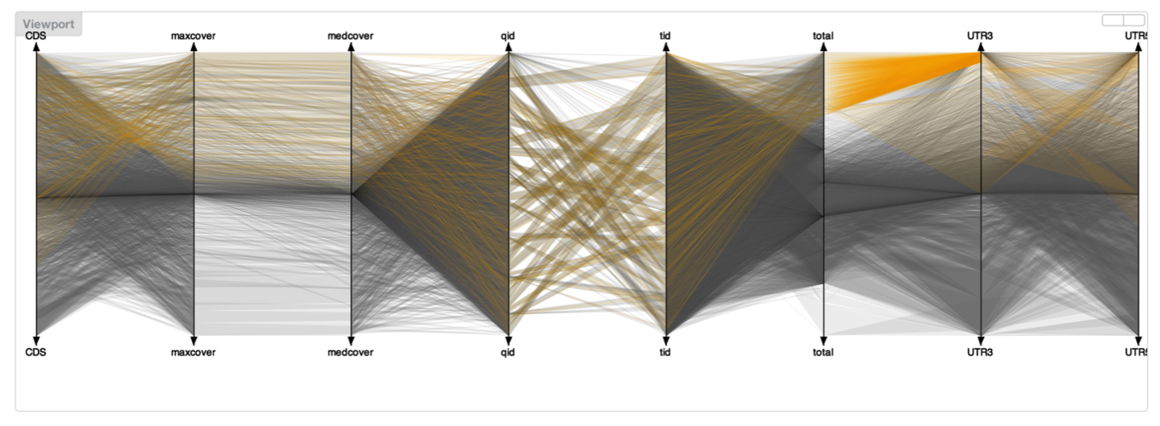
Parallel Coordinate Plot in Iris
Notes:
d3 scatterplot could serve as dotplot analog too.

Slide 16
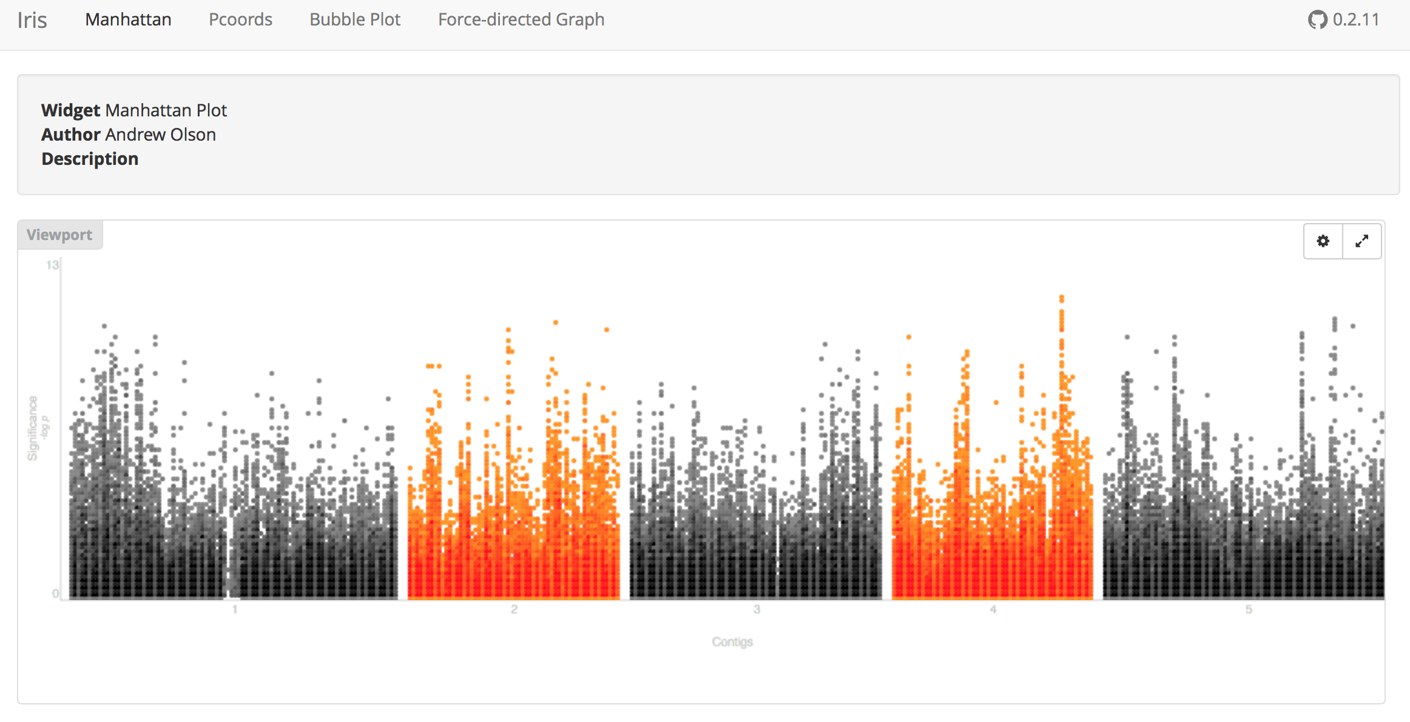
Manhattan Plots

Slide 17
Visualization options
One map: vertical, horizontal line; circle
Two maps: add dot plot
Three maps: add Hiveplot
Four maps: …
Any number, esp. contig maps: GraphViz (see https://code.google.com/p/canviz)
Notes:
How much user manipulation of layouts do we envision?

Slide 18
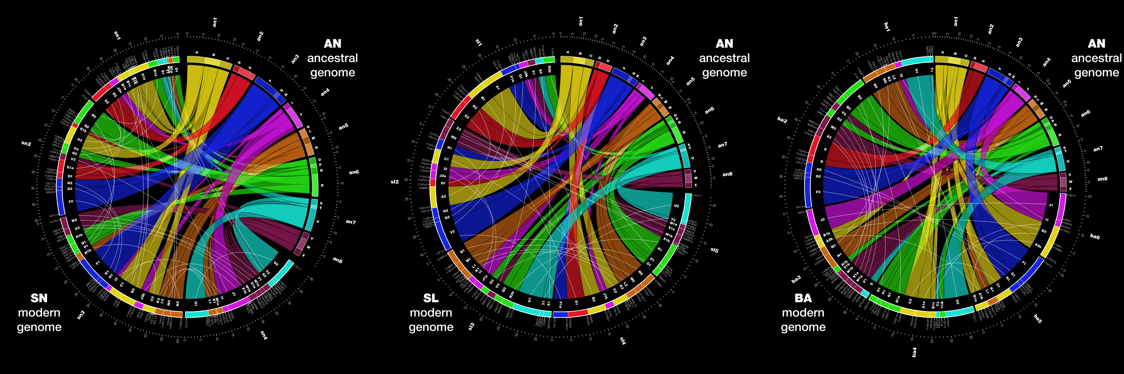
Circos

Slide 19
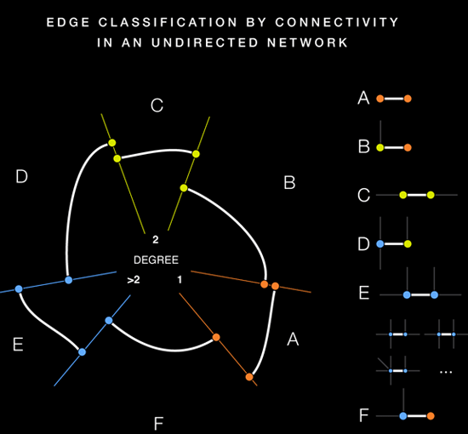
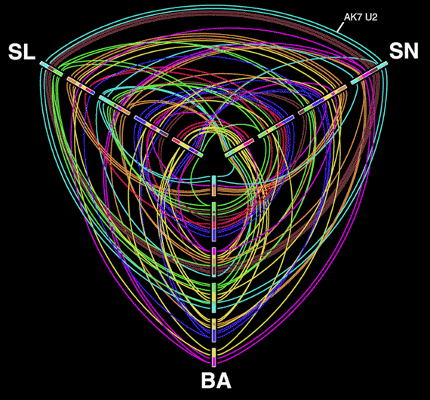
Hive Plots

Slide 20
Gathering Use Cases
Working group: NCGR, Soybase, Gramene
Gathering data sets
https://github.com/kyclark/drunken-noodle

Slide 21



Support

Slide 22
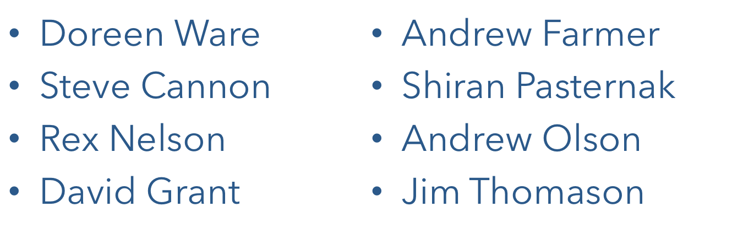
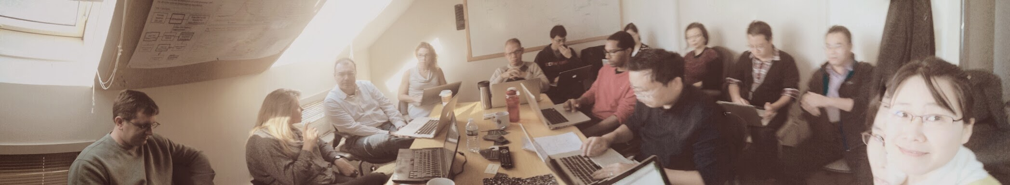
Acknowledgements

