Slide 1
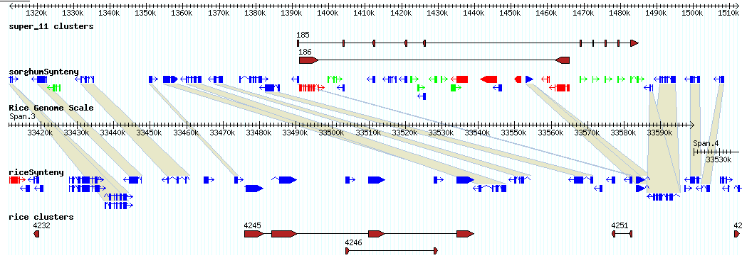
Figure: Differential Expansion of Tandem Gene Clusters
Differentially expanded gene clusters are found both in sorghum and rice. In this image examples of both occur within a single 200 kb region. Genes and gene-clusters are shown for sorghum in the upper panel and rice in the lower panel. Collinear genes are connected with ribbons. Genes are colored red to indicate transposable elements, green to indicate having no homology to Genbank proteins (threshold e-value 1e-05), or blue to indicate homology with non-transposable element proteins. Genes belonging to local clusters are indicated with connected brown glyphs, with assigned a cluster_id.
In rice a cluster of four rust resistance-like genes (cluster_id 4245) are present compared to only one (dashed circle) in sorghum. Within this cluster is a second cluster (cluster_id 4246) consisting of two genes encoding hypothetical proteins that is absent in the corresponding region of sorghum. In sorghum, cluster_id 185 is comprised of ten genes whereas the corresponding region in rice, cluster_id 4251, contains only two genes. These genes represent a novel family whose members have weak homology to carboxypeptidases and/or possess a LysM domain. The latter is found in a variety of enzymes involved in bacterial cell-wall degradation. We speculate that this family, like the rust-resistance genes, may play role in host-pathogen defense.
Notes:
http://ascutney.cshl.edu/cgi-bin/gbrowse/synteny_test/?ref=super_11;start=1312452;stop=1512451;nav4=1;plugin=RestrictionAnnotator
Method:
Defined tandem gene clusters based on all_vs_all blastp of fgenesh peptides and proximity. To be included in a cluster a gene must align (1e-05) and lie within 100 kb of at least one member of the cluster (single linkage clustering). A query-hit table was derived from the blast results (/export/home/steinj/blastjobs/results/20070201_tigr4_pep/vs_self/) and narrowed to include only query-hit combinations within 100 kb using script "local_hits.pl" to give file "local_hits". Script "single_link_cluster.pl" was used to cluster 'local_hits' to give "local_hits.clust" and "local_hits.stats". Script "clust2gff.pl" was used to convert cluster information to gff format.

