Slide 1
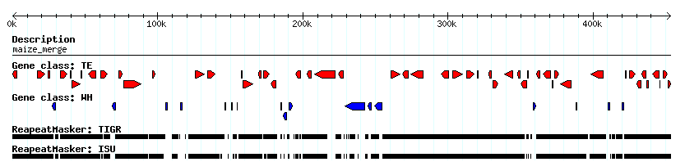

Maize Region Updated with MDR’s
Transposable Elements
Genes with Homology to NR
RepeatMasked Regions
MDR Repeats:
Copy Number Against Maize WGS
Notes:
Gene models with homology: repeat deserts
TE’s correspond to high copy regions
Note the scale: a LOT of repeats

Slide 2
EST’s vs. Retrotransposons
Notes:
An example that contrasts the extremes
whole fractions follow the contours of the others

Slide 3
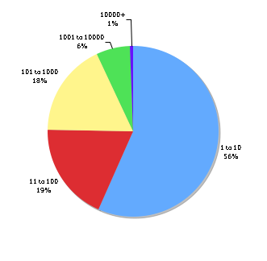
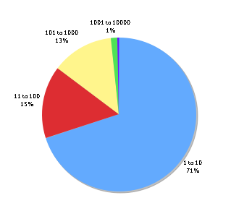
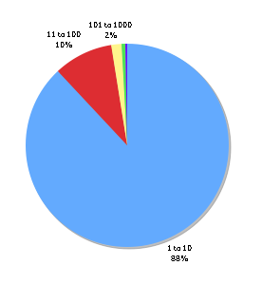
Total 20mer Frequencies in Maize,
Sorghum, and Rice
2400 MB
818 MB
389 MB
Genome Size Assumptions:
Rayburn et al. Heredity 1993.
Price et al. Ann Bot (London) 2005.
IRGSP. Nature 2005.
Notes:
Japonica considerably less repetitive; put references at the very bottom

Slide 4
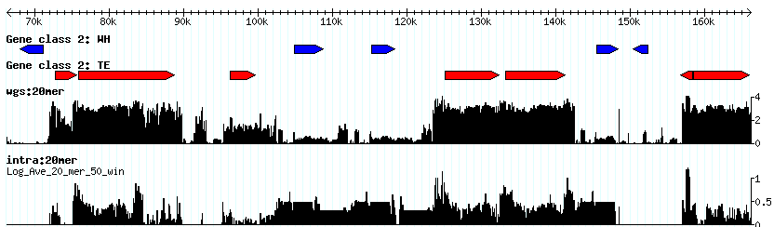
Tandem Repeat Detection
Genes
Retroelements
Genome Repeat Frequency
Local Repeat Frequency
Tandem cluster of pentatricopeptide-repeat (PPR) genes
Notes:
Good way to detect tandem gene duplications.
Axes very different

Slide 5
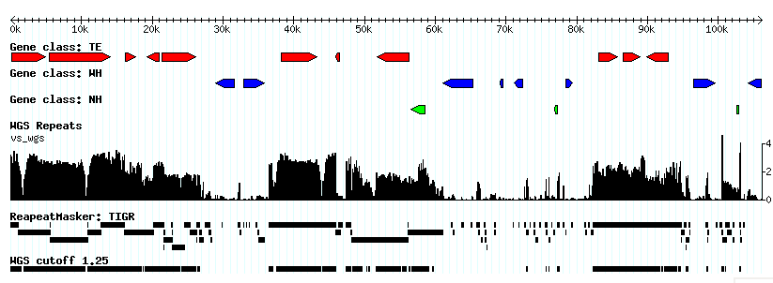
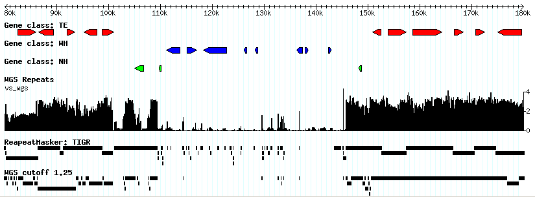
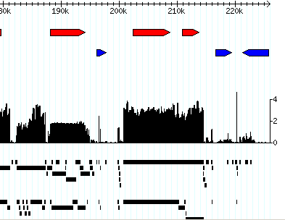
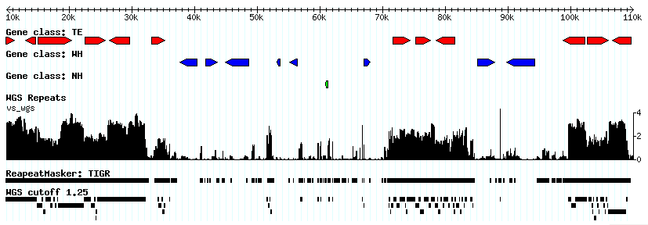
B73 Index Useful Across Maize Cultivars
AF448416 B73
AF391808 McC
HelA HelB
AY664416 Mo17
Bronze Locus
Lai, J. et al. PNAS 2005.
Notes:
Highly divergent, dynamic transposition histories but conserved genomic organization.
B73-specific repeats still useful in detecting repeats in other cultivars.
Pairing this info with what we saw before: an index useful within a species with little divergence between cultivars, but indexes not useful across species

Slide 6
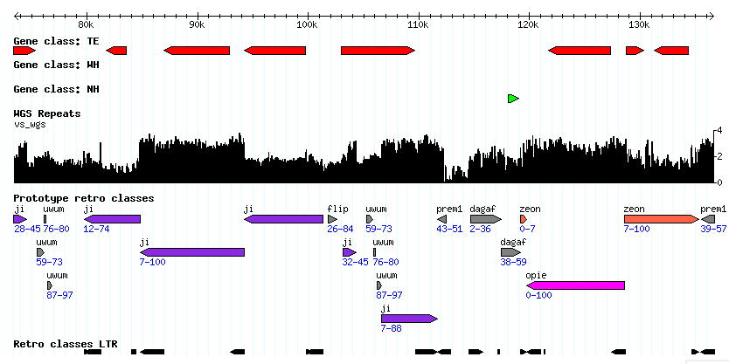
Relate Insertion History to Copy Number
Recent insertions
Higher copy number could be attributed to a limited time to accumulate mutations
Notes:
Numerical history of nested transposition
High copy number: less time for divergence? Or simply more repetitive in the genome?

