Slide 1
YIA: Comparative Mapping of Rice, Sorghum, and Maize
NSF Project #0333074
Project Web-Site:
  http://ware.cshl.org/yia/
Collaborators:
  Patricia Klein (Texas A&M)
  Georgia Davis (U. Missouri-Columbia)
  Scott Jackson (Purdue U.)
  Richard McCombie (CSHL)

Slide 2
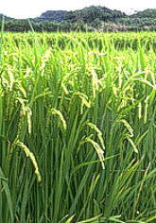
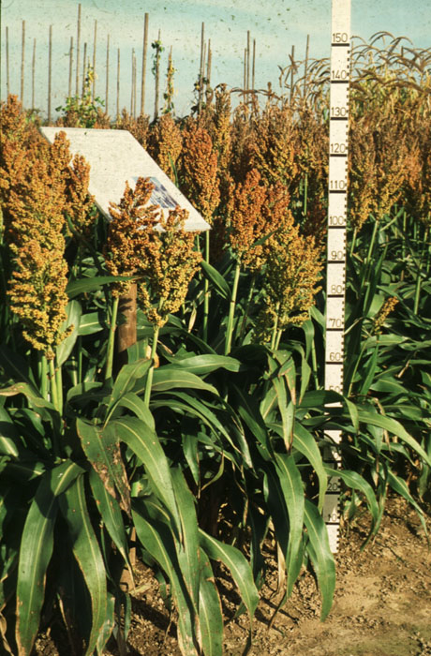
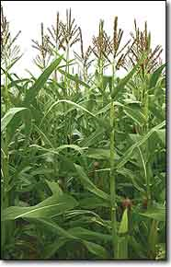
Comparative Mapping in Cereals
~70 MYA
Paleopolyploid
Ancestor
~50 MYA
~12 MYA
Tetraploid
Retrotransposon invasion
Rice
(n= 12)
430 Mb
Sorghum
(n= 10)
750 Mb
Maize
(n= 12)
2500 Mb
Notes:
Credit sorghum :http://images.google.com/imgres?imgurl=http://www2.mpiz-koeln.mpg.de/pr/garten/schau/Sorghumbicolor/BSorghumbicolor2.jpg&imgrefurl=http://www2.mpiz-koeln.mpg.de/pr/garten/schau/Sorghumbicolor/Sorghum.html&h=700&w=460&sz=141&tbnid=Vk9S-wgcdO17RM:&tbnh=138&tbnw=90&hl=en&start=4&prev=/images%3Fq%3Dsorghum%26svnum%3D10%26hl%3Den%26lr%3D%26client%3Dfirefox-a%26rls%3Dorg.mozilla:en-US:official_s%26sa%3DG
Credit Maize: http://www.edp24.co.uk/Content/Campaigns/Cred03/images/Maize.jpg
Credit rice: http://images.google.com/imgres?imgurl=http://www.biologie.uni-hamburg.de/b-online/fo53/reis08.jpg&imgrefurl=http://www.biologie.uni-hamburg.de/b-online/e53/reis.htm&h=236&w=367&sz=38&tbnid=g8q63lHtmdPyKM:&tbnh=75&tbnw=118&hl=en&start=97&prev=/images%3Fq%3Doryza%2Bsativa%26start%3D80%26svnum%3D10%26hl%3Den%26lr%3D%26client%3Dfirefox-a%26rls%3Dorg.mozilla:en-US:official_s%26sa%3DN

Slide 3
Post-Divergence Fractionation Hypothesis
Rice
a
b
Progenitor of the grasses
c
c
Implication:
  Extant “b” genes are paralogues (70 MYA), not orthologues (50 MYA).
Questions:
  Did this happen?
  Could this have driven speciation?
d
a
a
e
b
b
b
f
f
c
duplication
fractionation
c
c
Speciation w/ continued fractionation
Chr 1
Chr 5
d
d
e
e
e
f
f
f
a
Homeologous pair
b
c
c
Sorghum
d
e
e
f
f
Chr 3
Chr 10

Slide 4
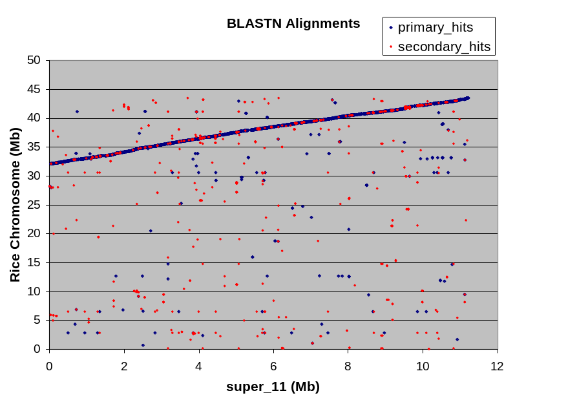
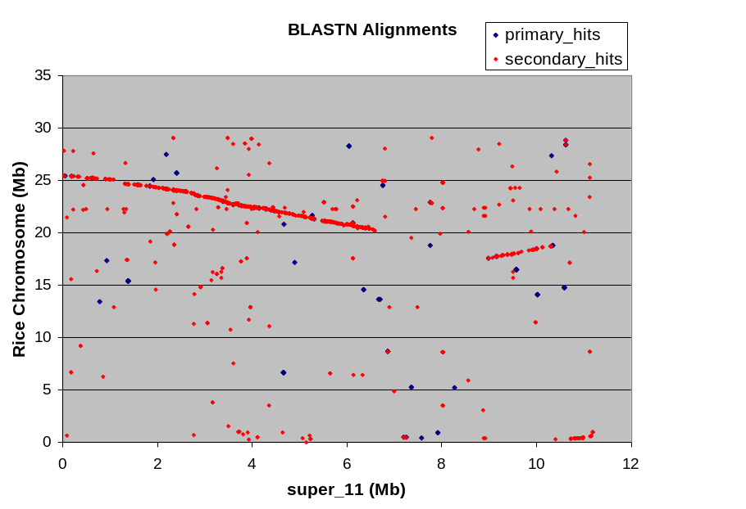
Data Sets
JGI Sorghum contig “super_11”
32 43 Mb
Rice Chr. 1
Skim sequence
6 Mb
Sorghum Chr. 3
~8 Mb
Maize Chr. 8
vs Chr_1
vs Chr_5

Slide 5
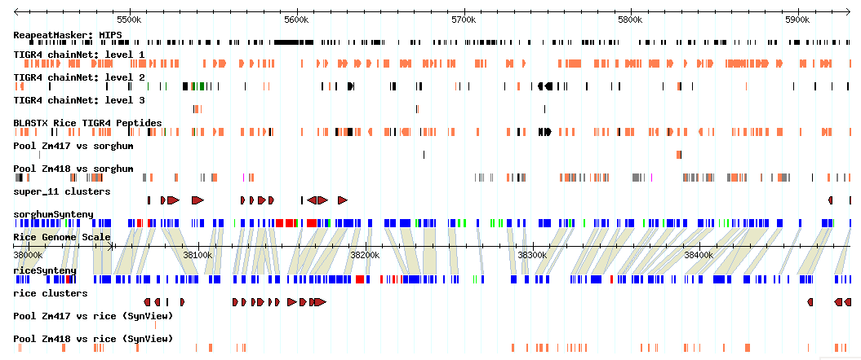
Sorghum Super_11 SynView* Gbrowse
3 Levels of chainNets (chr 1, chr 5, other)
BLASTX
Classified gene predictions (Transposon, With homology, No homology)
Synteny map requiring top level net alignment and protein homology
Paralogous clusters (single-linkage clustering of homologous genes w/in 100 kb)
Maize skim sequence data
*Wang et al. 2006. Bioinformatics 22:2308

Slide 6
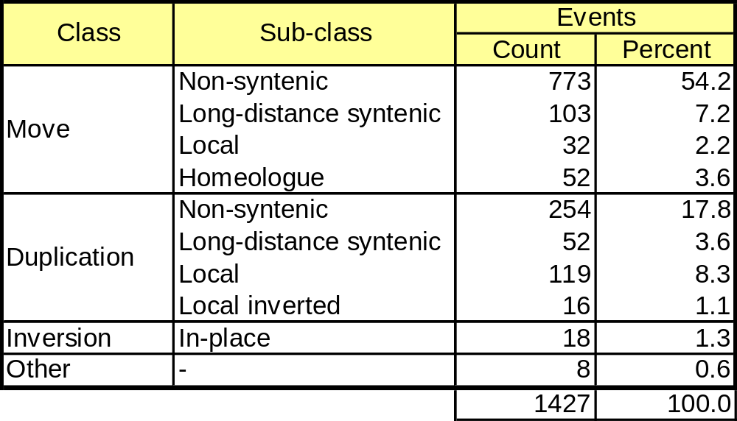
Results
Table quantifies different classes of rearrangement based numbers of rearrangement events over an 11 Mb orthologous region of rice and sorghum.

Slide 7
Conclusions
Non-syntenic gene “movements” account for the largest class (~60%) of rearrangements.
About 5% of these map to the homeologous region of rice chr. 5 and can therefore can be attributed to loss of the orthologous gene in rice, rather than a transposition in sorghum.
The degree to which other rearrangements of this class can be attributed to loss/transposition of the rice orthologue vs transposition in sorghum remains to be determined.

