Slide 1
EnsEMBL Compara Pipelines
Protein Alignments, Gene orthology/paralogy
Whole genome alignments (WGA)
  Pairwise: blastz, translated BLAT
    blastz for closely related pairs of species, tblat for more distantly related pairs of species when expecting to find homologies mainly in coding regions.
  Multiple: MLAGAN, PECAN (needs a more accurate synteny map, currently using mercator)
Notes:
Gene homology analysis already implemented by Will at Sanger

Slide 2
WGA analysis generate whole genome similarity matches between 2 species, which can be viewed from contigview and multiContigview
The Blaszt-net alignments are further used for constructing syntenic blocks between 2 species

Slide 3
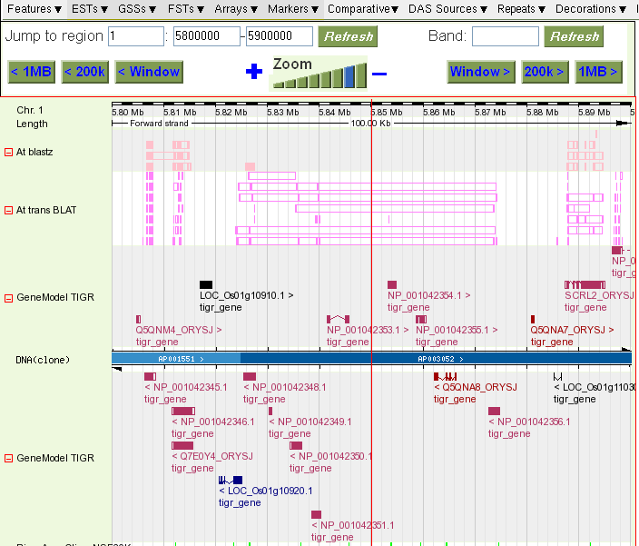
ContigView
Whole genome
similarity matches
between
Oryza sativa japonica and
Arabidopsis thaliana

Slide 4
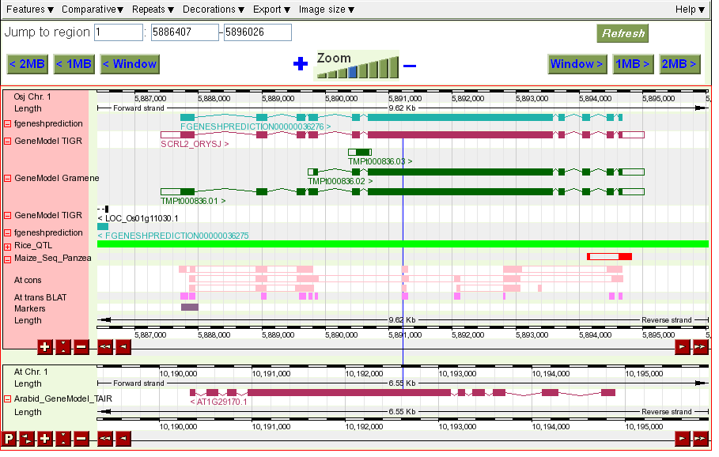
MultiContigView
View orthologous
Genes side by side
Under the context of
Whole Genome
similarity matches

Slide 5
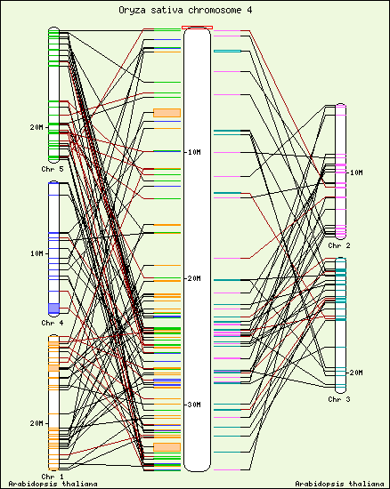
syntenyView
we calculate syntenic regions using blastz-net alignments. We look for stretches where the alignment blocks are in synteny. The search is run in two phases. In the first one, syntenic alignments that are closer than 200 kbp are grouped. In the second phase, the groups that are in synteny are linked provided that no more than 2 non-syntenic groups are found between them and they are less than 3Mbp apart.

