Slide 1
The Gramene Genome Browser;
Visualisation of Annotation on
Plant Genomes
William Spooner
whs@ebi.ac.uk
http://www.gramene.org
Notes:
Gramene is a curated, open-source, web-accessible data resource for comparative genome analysis in the grasses,
As an information resource, the purpose of Gramene is to provide added value to the data that are initially contributed by a variety of species-specific databases and generic data repositories such as Entrez.
The genome browser component of Gramene is a flexible tool for visualising annotations on the sequenced rice genome, and increasingly for physical genome maps from species such as maize.
This talk presents some example browser views, with an outline on how 3rd party data are processed into a viewable format.

Slide 2
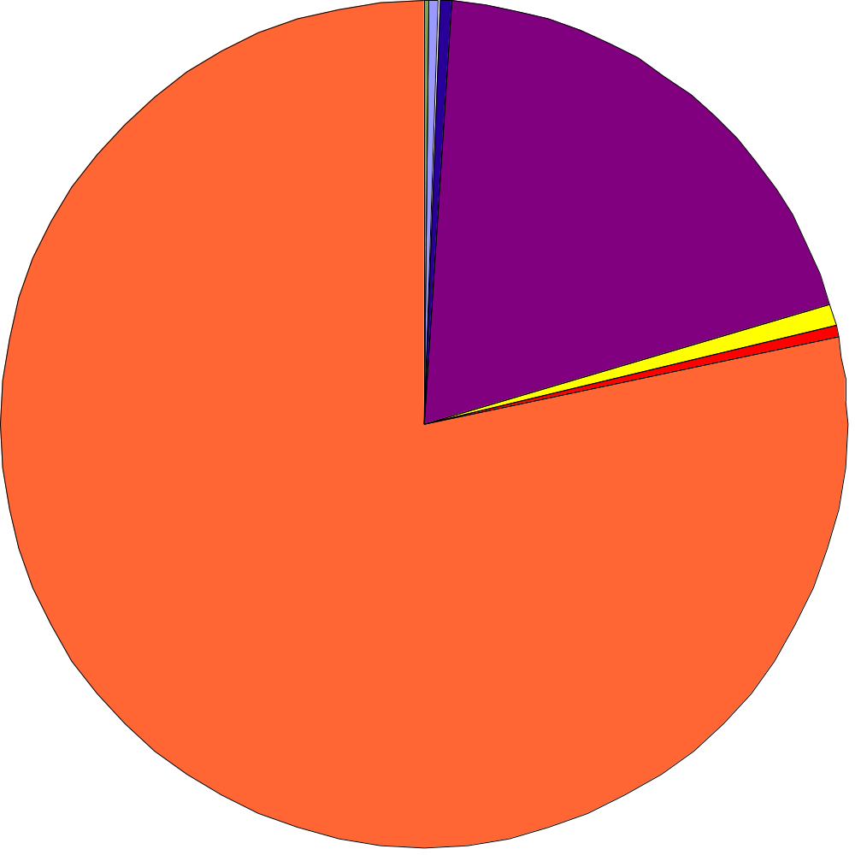
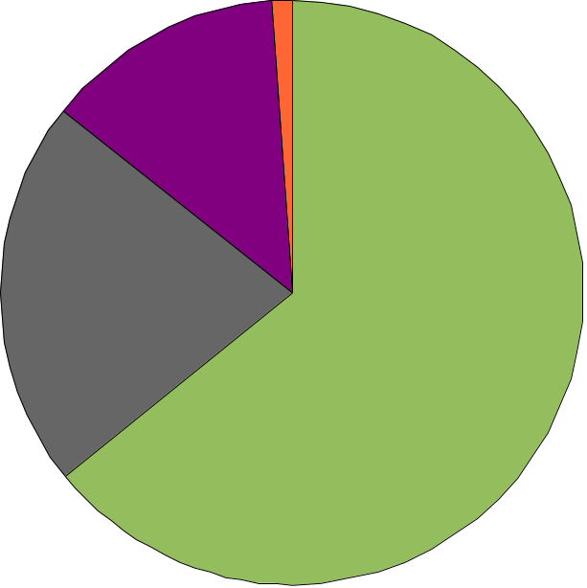
Scope of Gramene
Gramene Mappings
DNA Sequences
(10,000,000)
Sequenced Genes
(50,000)
Gramene Maps
Protein Sequences
(100,000)
Genetic
Maps (40)
Genomic Regions
(2,500,000)
QTL
Maps (120)
DNA Probes
(60,000)
Physical
Maps (25)
Polymorphic
Markers (50,000)
Sequence
Assemblies (2)
Phenotypic Genes/
QTLs (20,000)
Notes:
(The framework for Gramene consists of a number of linear genome maps from various (mainly cereal) species. These maps break down into four main categories;
Genetic recombination maps generated from the analysis of marker polymorphisms between offspring and their parents.
Quantitative trait locii (QTL) maps, a subtype of genetic maps, which indicate the approximate location of phenotypic locii that fall between between two markers
Physical maps; those on which the distance between features can be estimated in numbers of basepairs. The majority of physical maps in Gramene are FingerPrint Contig (FPC) maps generated by the assembly of clones into contigs based on overlapping banding patterns between clones following a restriction digest. A further step involving overgo hybridisation experiments can be used to assign the order and orientation of contigs onto chromosomes
Sequence maps, a subtype of physical maps, which are a representation of the contiguous, assembled genomic sequence of an organism. The two sequence maps in Gramene are from rice Oryza sativa (representing a model monocot organism), and Arabidopsis thaliana (a dicot).
In addition to the maps, the gramene database contains several million 'mappable objects'.
These are dominated in number by expressed sequence tags and genome survey sequences generated by high-throughput sequencing projects, and deposited with the GenBank DNA database. These sequences are readily mapped in-silico to the sequence maps using BLAST, for instance.
A smaller number of gene cDNA and protein sequences are obtained from UniProt, NCBI and TIGR. With the exception of a handful of experimentally validated proteins, these have been predicted from genomic DNA sequences These also mapped to the sequence maps.
Genomic regions are a class of object that are not underpinned by sequences. These include clone libraries and FPContigs that form the building blocks of the physical maps.
Lastly, the DNA probes, polymorphic markers (e.g. RFLPs, SSRs), phenotypic genes and QTLs that form the basis of genetic maps are a small, vital and heavily curated aspect of Gramene.
Although genomic regions and genetic markers cannot be directly mapped to the sequenced genomes, they may be associated with DNA sequences (e.g. clone ends for clones, source EST sequences for RFLPs), and hence their mappings inferred.

Slide 3
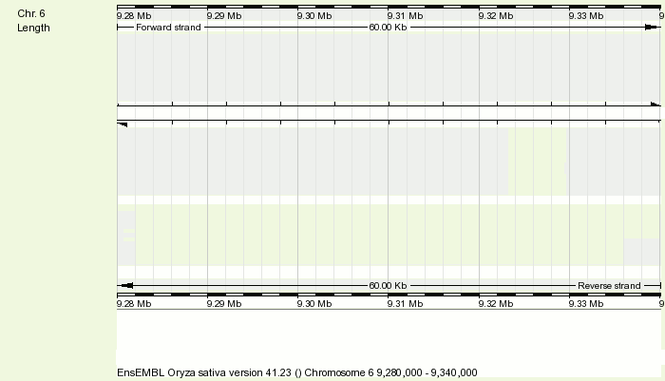
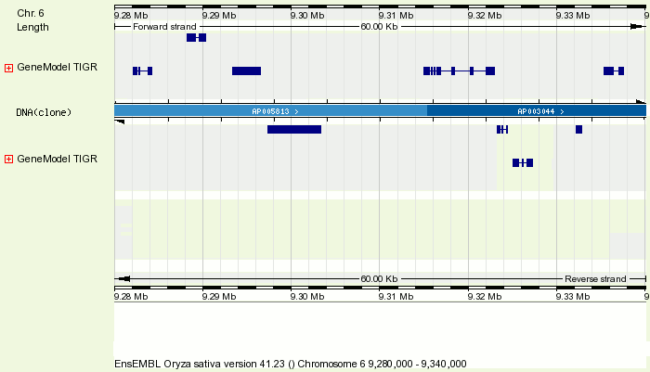
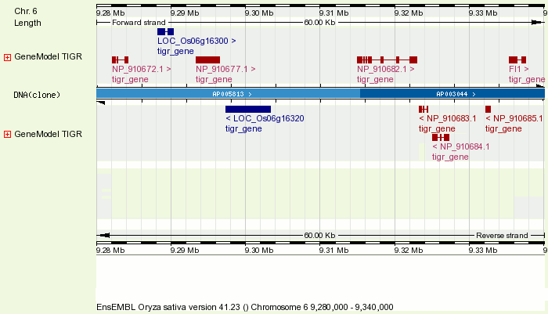
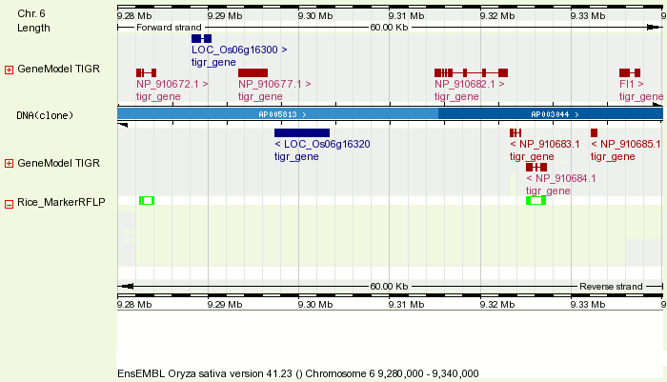
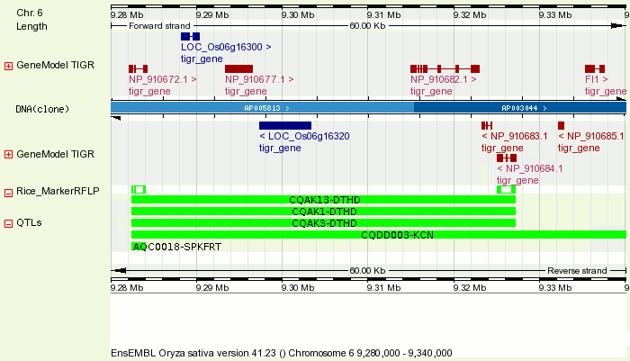
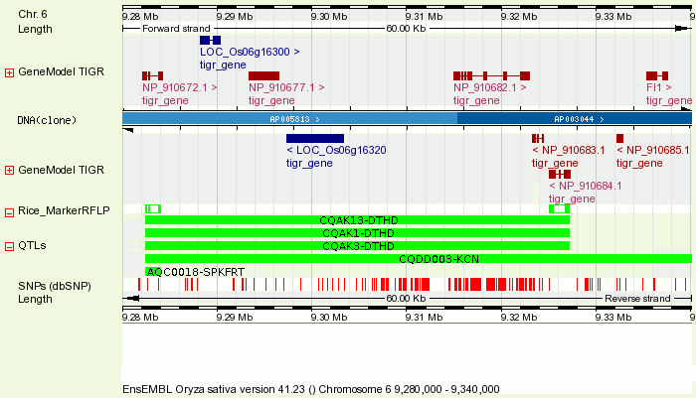
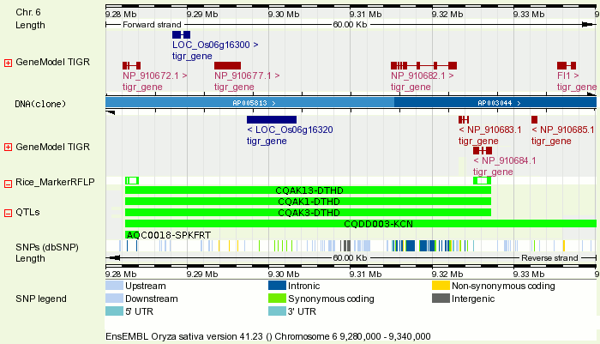
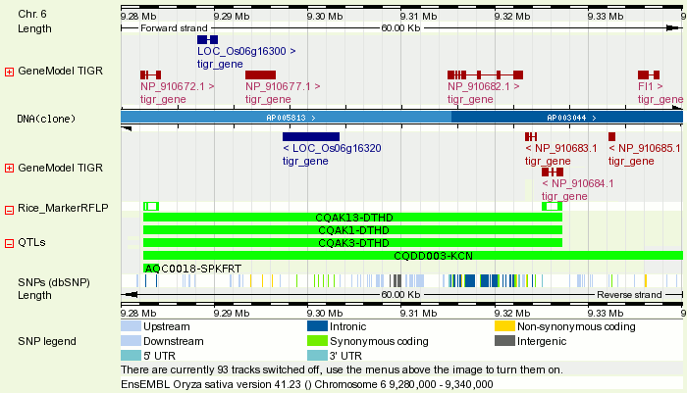
Genome Browser
Notes:
The genome browser used by Gramene based on Ensembl; this is an established, open-source project that is under active development. In addition to the database schema and visualisation tools, there are a number of analysis pipelines to assist in the generation of annotation data.
Taking the rice genome as an example, the first stage for Gramene is to download the TIGR pseudomolecule assembly and associated annotations in XML format. The DNA (clones) and gene model structure data are extracted, and loaded into the Ensembl database,
Next, Ensembl's 'external reference' mapping pipeline is run. This uses BLAST is used to align the public protein/mRNA sequences (e.g. UniProt, UniGene) to gene model sequences. 'Known' sequence identifiers are assigned to gene models on a 'best-in-genome' basis. In a separate step the gene model peptides are analysed using InterProScan to annotate protein domains, and, by proxy, assign GO terms.
In a separate pipeline, public DNA sequences from GenBank (ESTs, GSSs etc) are aligned to the genome using BLAT. The example here shows alignments of two ESTs that have been used in the design of RFLP markers.
The genome alignments are then used to infer the location of other features, e.g. QTLs, that are associated with the markers. In this example, the QTL 'CQAK1-DTHD' has the phenotypic trait of 'days to heading'. This QTL has been associated with the fl1 gene, for which the sequenced gene can be seen at the top left of the image. The QTL belongs to the JRGP Nipponbare/Kassalath map; for which a whole-chromosome over view is presented on the next slide.
The polymorphisms from NCBI's dbSNP database are located on the genome by alignment of SNP flanking sequences using SSAHA. The majority of the SNPs have been called from comparison of the O.sativa japonica genome sequence with that of the O.sativa indica subspecies, although other sources of genomic variation, such as those between cultivated and wild rice, are becoming available.
SNP locations in the regions of gene models are used to infer the genetic consequence of the SNP; (e.g. syn/non-syn) of each SNP.
This last 'track' is a reminder to me to point out that there are almost 100 individual genome browser tracks that may be enabled/disabled using the viewer menus. Examples include EST, cDNA, GSS, Flanking Sequence Tags (FST) and microarray, tracks, organised by species.

Slide 4
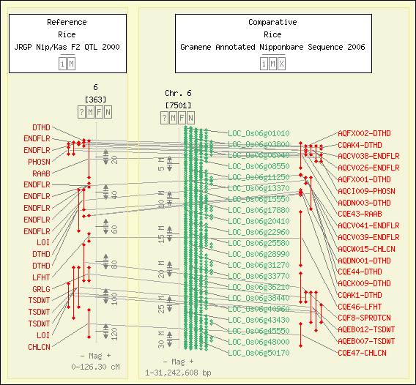
Comparative Map Viewer
Notes:
This Comparative Map View shows an overview of a chromosome 6 from the QTL map (JRGP Nipponbare/Kassalath F2) vs. the sequence assembly map for chromosome 6.
The 'days-to-heading' QTL 'CQAK1-DTHD' shown on the previous slide is located at ~50cM, which corresponds to a location of ~10Mbase on the sequence assembly. Most QTLs are, in reality, much longer than this.

Slide 5
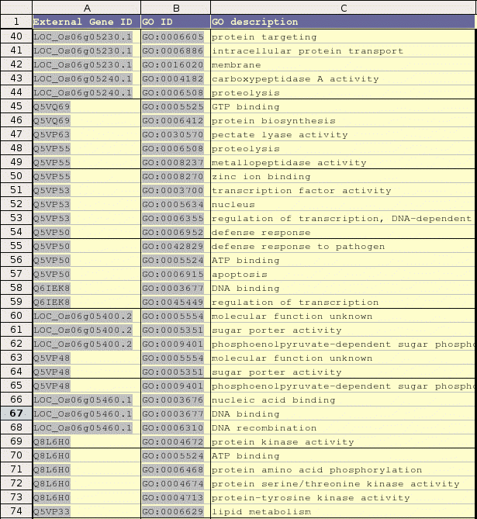
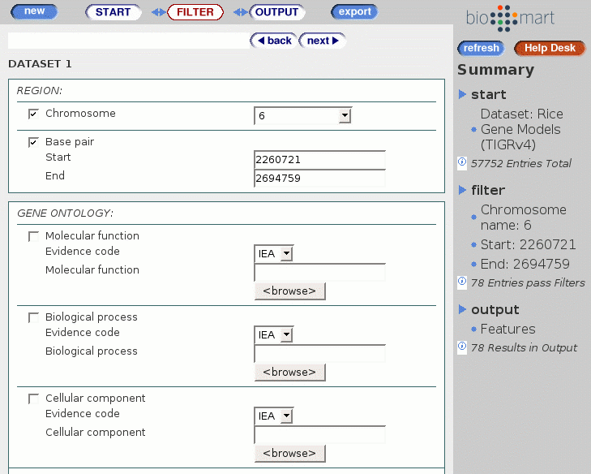
GrameneMart
Notes:
If the genomic coordinates of a given QTL are known, it is a simple task to export all of the gene models in this region. The GrameneMart query interface provides a tool .
In this example a QTL with the 'days to heading' trait spans a 500MBase region on rice chromosome 6. Once these coordinates are entered, there are 78 gene locii in the region.
The GrameneMart export allows the user to specify a number of gene attributes. In this case the associated GO term is displayed. The first gene in the table, for instance, is associated via GO with protein targeting/transport.

Slide 6
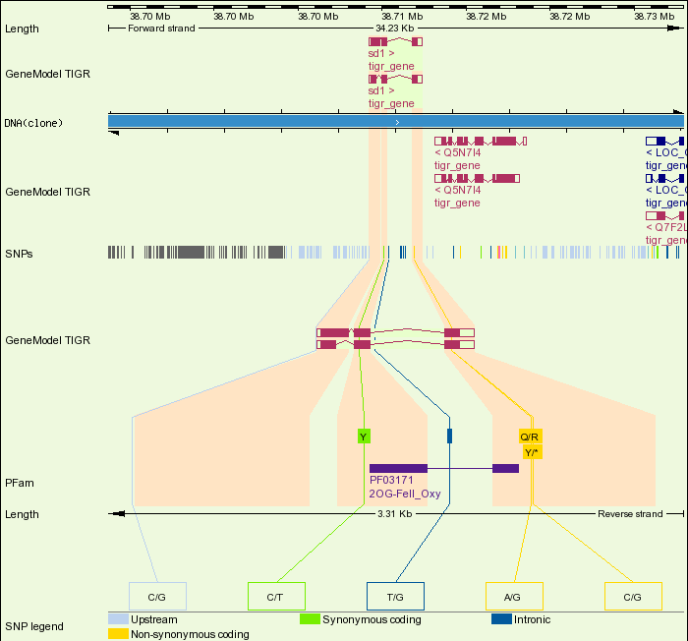
Gene Variation info
Notes:
This slide shows a display that highlights the gene variation info, in particular the consequences of the SNPs on a given gene.
In the image shows an example SNP that lies upstream of the gene, one that falls in an intron, and three SNPs that affect the coding region of the gene. Of these, one causes no coding change (is synonymous), one that changes the peptide (is non-synonymous), and a third that introduces a stop codon within the peptide, potentially causing an incomplete protein product in strains (i.e. indica) that carry the allele.

Slide 7

Physical to Sequence Mapping
O.Rufipogon
Chr. 1
FPContigs
FPContigs
Clones
FPContigs
Clones
Clone Ends
Chr. 1
Chr. 4
O.Sativa
Notes:
So far I have been presenting mappings between sequences and their same-species genome; Oryza sativa. Gramene, however, routinely aligns all available grass sequences and the rice genome. This allows a range of cross-species analyses to be performed.
The following example compares the FingerPrint contig map for the common wild rice, Oryza rufipogon, and the sequence map for cultivated rice, Oryza sativa. The FPC map for rufipogon was prepared, along with maps for eleven other wild rice species, by the Oryza Mapping Project (OMAP).
The mapping of the FPC map to the sequence map starts by alignment of the clone-end sequences from the rufipogon library to the rice genome. These alignments are generated as part of Gramene's standard sequence mapping pipeline.
The clone-end alignments are then processed to infer mapping of clones to the genome. A clone is assigned a location when both of its end sequences align and are within two standard deviation of the mean clone size on the FPC map.
FPContigs mappings to the genome are inferred where three or more overlapping clones on a given contig are located. The start and end of the clones become the start and end points of each region. If a gap exists another region is formed by the clones in that region. Discrete sections of each FPContig are free to map to multiple locations on the genome
In this second example the clone and FPContig mappings are inverted.

Slide 8
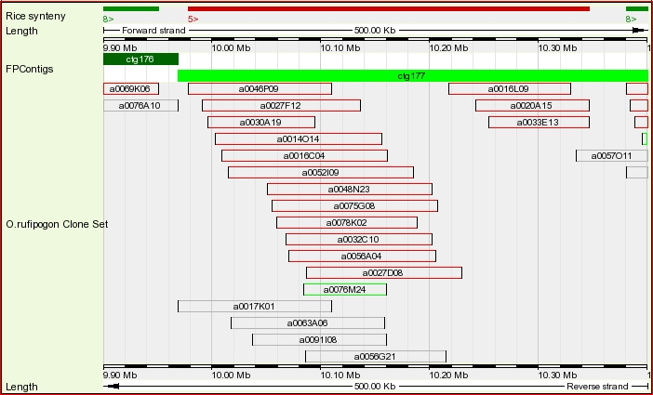
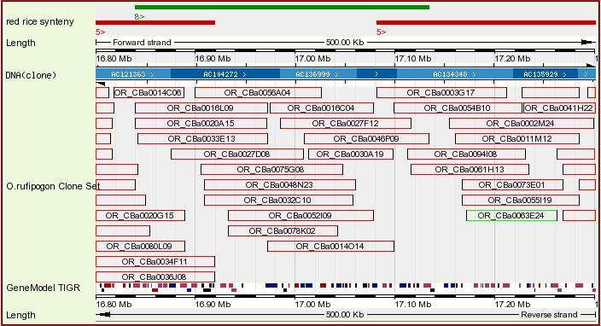
Tiling Path
Overview
O.Rufipogon
Chr 8
O.Sativa
Chr 5
Notes:
Here we have a region of O.rufipogon chromosome 5 displayed in the genome browser with the clone tiling path displayed. There is no sequence underlying this display.
Clones in grey do not have a mapping to the rice genome, those in green have a single mapping unsupported by other clones, and those in red have mappings supported by adjacent clones.
The clones now highlighted in red map to the O.sativa genome on chromosome 5, as show <here>
These highlighted mappings are used to map the region of the FPContig as follows...

Slide 9
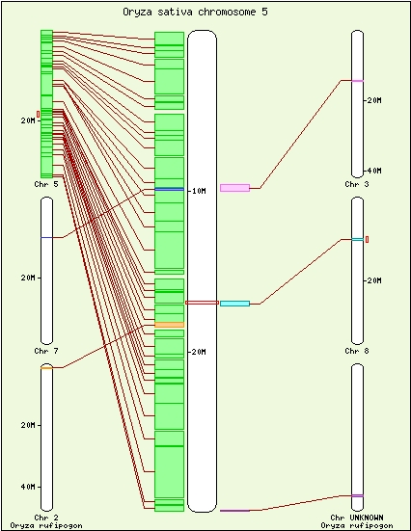
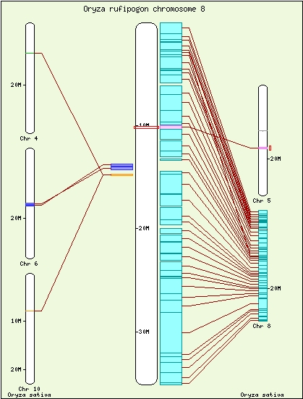
Synteny View; O.sativa-O.rufipogon
Notes:
FPContig regions that are mapped between the FPC map and the rice genome can be viewed on a whole-chromosome level as shown here.
The panel on the left shows synteny between O.sativa Chr5 sequence map and the rufipogon chr8 FPC map. Note that the majority of syntenic blocks are to between sativa and rufipogon Chr8, suggesting a high level of chromosome-wide conservation.
The mapping to shown in detail on the previous slide between sativa Chr5 and rufipogon Chr8 lies about half way down the chromosome. This could either be evidence for a 'true' rearrangement between the genomes, or simply a miss-assembly of this FPContig on the physical map.
The panel on the right centres on rufipogon Chr8. Although there are further isolated regions of local rearrangement, the majority of the chromosome maps to sativa Chr8.

Slide 10
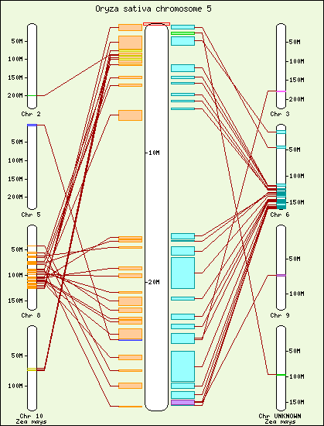
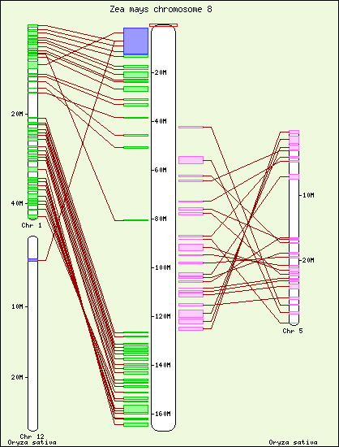
Synteny View; Rice-Maize
Notes:
A similar syntenic analysis to that shown on the previous slide has also been carried out between the rice sequence map and the maize FPContig map.
The chromosome-level conservation between rice and maize is obviously a lot less than that between cultivated and wild rice.
Bonnie – can you fill in something about what the figure tells us about the genome duplication history of rice?

Slide 11
Ensembl Gene Trees - Pipeline
    Run all vs. all BLASTP for longest peptide of each gene model,
    Build gene relationship graphs from homology; connected components form clusters,
    For each cluster, build a multiple sequences alignments using MUSCLE,
    For each aligned cluster, build a phylogenetic tree using PHYML,
    Reconcile each gene tree with a reference species tree using RAP
    From each gene tree, infer gene pairwise relations of orthology and paralogy types.

Slide 12
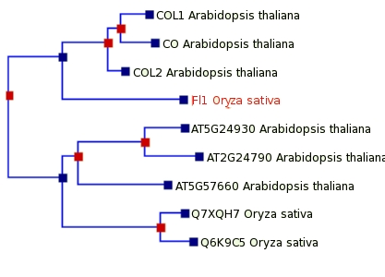

Gene Tree View
Duplication Event
Speciation Event
Paralogs
(in-species)
Orthologs
(one2many)
Paralogs
(cross-species)
Notes:
In addition to comparative genome analysis at the DNA level, Gramene also carries out cross-genome analyses at the protein level.
Gene trees are generated by analysis of homology between rice, arabidopsis and maize gene model proteins.
The gene tree shown encapsulates a family of zinc ion binding genes, each of which encodes the CONSTANS-type zinc-finger domain. Both the rice Fl1 gene and the arabidopsis CO gene are associated with the days to heading phenotype, for which an example QTL was shown earlier.

Slide 13
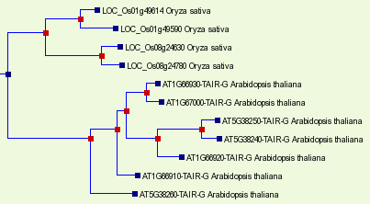
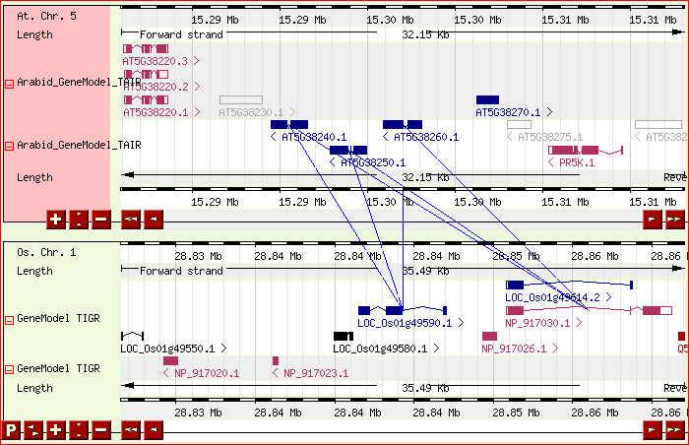
MultiContigView
Notes:
In addition to the trees, orthologs can be viewed side-by-side using the MultiContigView.
In this example a family of protein kinase domain carrying proteins forms clusters of three genes localised within 20kb on arabidopsis chromosome 5, and two genes on rice chromosome 1. Each of the arabidopsis genes is predicted as an ortholog of each rice gene.
The gene tree is shown here, with the three arabidopsis genes indicated by red arrows, and the rice genes by green arrows. The tree suggests that there was an ancestral speciation event, followed by independent duplications in each lineage. However, the localisation of the genes suggests that the duplication may have occurred before the speciation.

Slide 14
Future Species
Rice (japonica)
KEY
Red: existing sequence maps
Wild Rice (x12)
Green: future sequence maps
2-8 Mya
Italic: future physical maps
Wheat
Brachypodium
Sorghum
50 Mya
Maize
12 Mya
Poplar
130-200 Mya
Arabidopsis
Notes:
...this leads me on to my last slide.
The plant community has had a relative lack of assembled genome sequences to date. This situation is likely to improve, however, as the sequences of several species (indicated in green) become available in the next few years.
This new data will be invaluable for increasing the resolution of cross-species analyses within both the DNA and peptide domains.

Slide 15
Acknowledgements
  Gramene
    Sharon Wei
    Chengzhi Liang
    Ken Younes-Clark,
    Noel Yap,
    Liya Ren,
    Pankaj Jaiswal,
    Doreen Ware
    Lincoln Stein
  OMAP
    Bonnie Hurwitz
  Ensembl
    Abel Ureta-Vidal
    Jess Severin
    Juan Chen
    Daniel Rios
    Glenn Proctor
    Patrick Meidl
    James Smith
    Ewan Birney
  NASC
Notes:
I would like to thank etc...

Slide 16
Ensembl Gene Trees; Pipeline
All vs All
(BLASTP)
All vs All
(BLASTP)
Grapher
(BRH/BSR)
Ensembl
Rice
Arabidopsis
Grapher
(BRH/BSR)
Ensembl
Rice
Arabidopsis
Homology
Scores
Peptide of
Longest
Transcript
Homology
Scores
Peptide of
Longest
Transcript
Tree
Builder
(PHYML)
Tree
Builder
(PHYML)
Aligner
(MUSCLE)
Aligner
(MUSCLE)
Families of
Connected
Components
Multiple
Sequence
Alignments
Families of
Connected
Components
Multiple
Sequence
Alignments
Ensembl
Compara
Tree
Reconciliation
(RAP)
Ensembl
Compara
Phylo-
genetic
Trees
Tree
Reconciliation
(RAP)
Phylo-
genetic
Trees
Orthologs
Paralogs
Orthologs
Paralogs

