Slide 1
YIA: Comparative Mapping of Rice, Sorghum, and Maize
NSF Project #0333074
Project Web-Site:
  http://ware.cshl.org/yia/
Collaborators:
  Patricia Klein (Texas A&M)
  Georgia Davis (U. Missouri-Columbia)
  Scott Jackson (Purdue U.)
  Richard McCombie (CSHL)

Slide 2
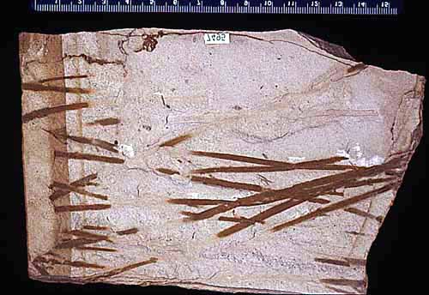
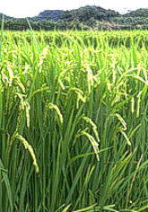
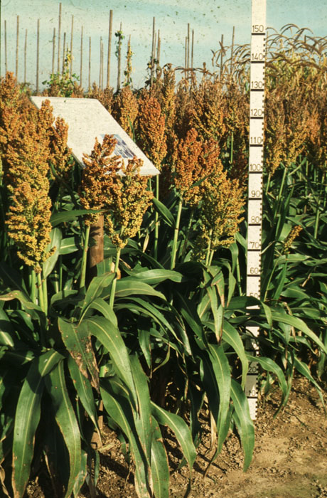
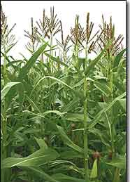
Comparative Mapping in Cereals
Paleopolyploid
Ancestor
~70 MYA whole genome duplication (WGD)
~50 MYA Common ancestor of grasses
~12 MYA maize/sorghum common ancestor
~11 MYA WGD in maize lineage
~3-6 MYA retrotransposon invasion of maize
Massive loss of redundant genes
Retention of 20% duplicates through “neofunctionalization” &
“subfunctionalization”
Different genomes
Different phenotypes
Rice
(n= 12)
430 Mb
Sorghum
(n= 10)
750 Mb
Maize
(n= 12)
2500 Mb
Notes:
Credit sorghum :http://images.google.com/imgres?imgurl=http://www2.mpiz-koeln.mpg.de/pr/garten/schau/Sorghumbicolor/BSorghumbicolor2.jpg&imgrefurl=http://www2.mpiz-koeln.mpg.de/pr/garten/schau/Sorghumbicolor/Sorghum.html&h=700&w=460&sz=141&tbnid=Vk9S-wgcdO17RM:&tbnh=138&tbnw=90&hl=en&start=4&prev=/images%3Fq%3Dsorghum%26svnum%3D10%26hl%3Den%26lr%3D%26client%3Dfirefox-a%26rls%3Dorg.mozilla:en-US:official_s%26sa%3DG
Fossil: http://www.ucmp.berkeley.edu/tertiary/oli/creede/monocotleaf.jpg
Credit Maize: http://www.edp24.co.uk/Content/Campaigns/Cred03/images/Maize.jpg
Credit rice: http://images.google.com/imgres?imgurl=http://www.biologie.uni-hamburg.de/b-online/fo53/reis08.jpg&imgrefurl=http://www.biologie.uni-hamburg.de/b-online/e53/reis.htm&h=236&w=367&sz=38&tbnid=g8q63lHtmdPyKM:&tbnh=75&tbnw=118&hl=en&start=97&prev=/images%3Fq%3Doryza%2Bsativa%26start%3D80%26svnum%3D10%26hl%3Den%26lr%3D%26client%3Dfirefox-a%26rls%3Dorg.mozilla:en-US:official_s%26sa%3DN

Slide 3
Post-Divergence Gene Loss Hypothesis
Grass Progenitor
Differential gene loss & retention after species divergence
To what degree did this happen?
Did this drive speciation?
  (e.g. through genetic isolation)
a
b
c
d
e
duplication
gene loss
Homeologous
pair
a
b
c
e
a’
b’
c’
d’
e’
Speciation
& continued
gene loss
Rice
Sorghum
Chr 1
a
c
e
Chr 3
a
b
c
e
Chr 5
a’
b’
c’
d’
e’
Chr 10
a’
c’
d’
e’
Loss of collinearity at the b and b’ loci
Extant “b” genes are paralogues (70 MYA), not orthologous (50 MYA)

Slide 4
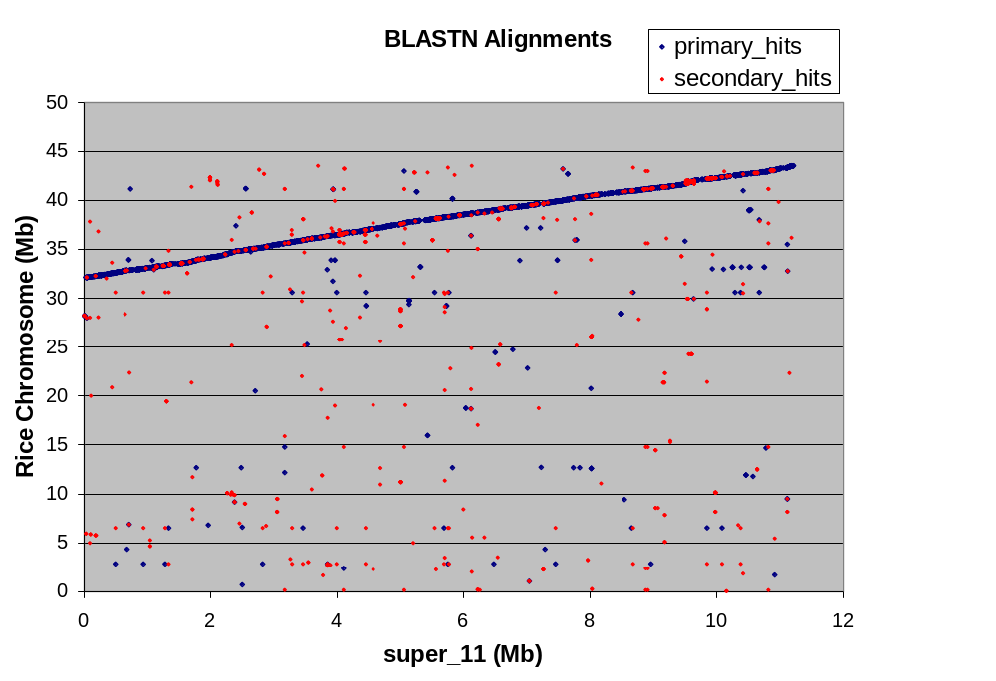
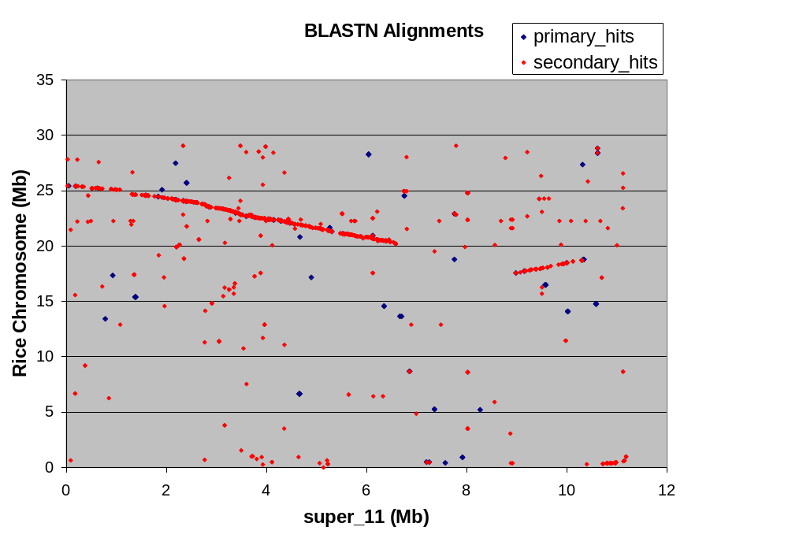
Data Sets
TIGR release 4
32 43 Mb
Rice Chr. 1
JGI 8X contig
11 Mb
Sorghum
Chr. 3
1.3X pooled BAC
skim sequence
6 Mb
Maize Chr. 8
11 Mb sorghum contig vs rice:
Continuous alignment to rice chr. 1 Secondary alignments to rice chr. 5

Slide 5
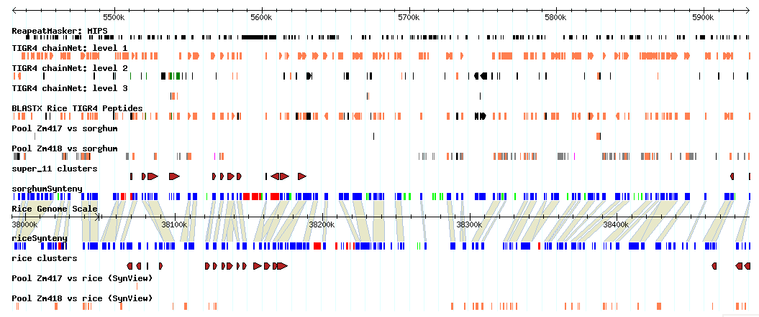
Sorghum Super_11 SynView* Gbrowse
3 Levels of chainNets (chr 1, chr 5, other)
BLASTX
Classified gene predictions (Transposon, With homology, No homology)
Synteny map requiring top level net alignment and protein homology
Paralogous clusters (single-linkage clustering of homologous genes w/in 100 kb)
Maize skim sequence data
*Wang et al. 2006. Bioinformatics 22:2308

Slide 6
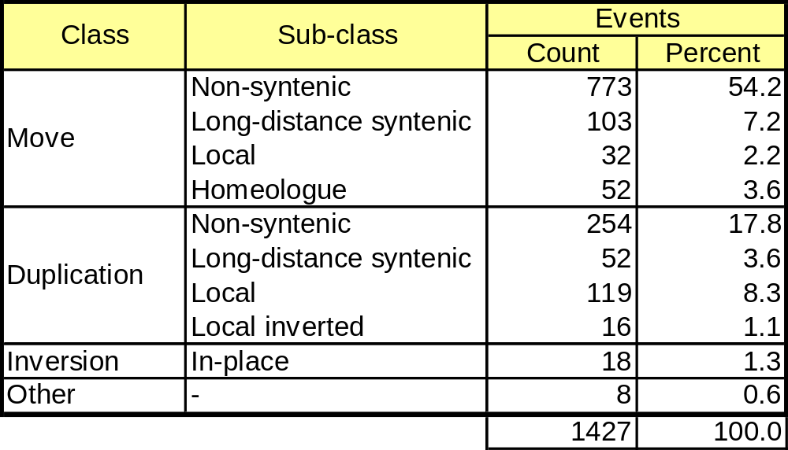
Results
Classes of rearrangement based on BLASTZ/chainNet/netSyntenic analysis of an 11 Mb orthologous region of rice and sorghum.

Slide 7
Conclusions
Post-divergence gene loss hypothesis accounts for only 3-5% of rearrangements that disrupt collinearity
Other rearrangements manifested as gene “movements” between non-homeologous regions account for the largest class (>60%) of rearrangements.
The degree to which this latter class can be attributed to loss/transposition of the rice orthologue vs transposition in sorghum remains to be determined.

