Slide 1




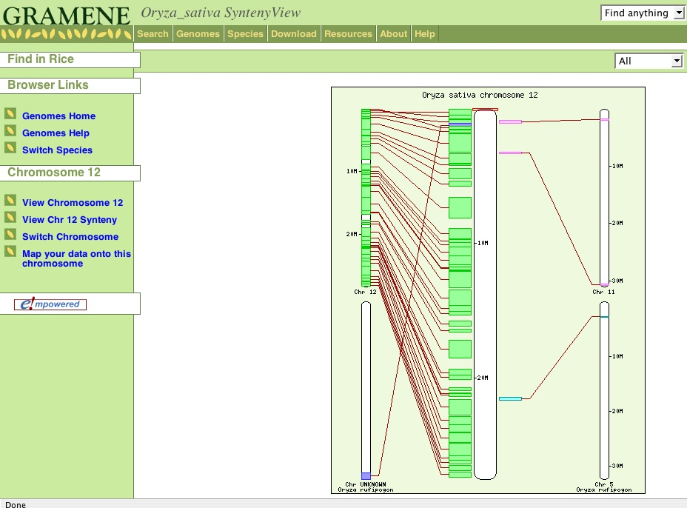
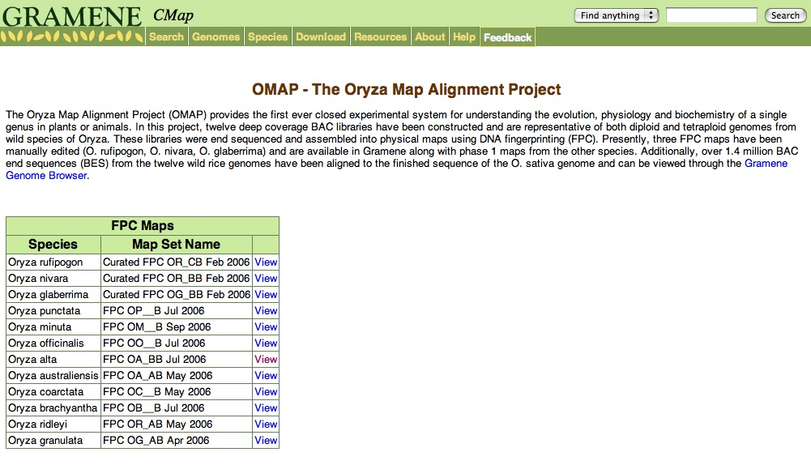
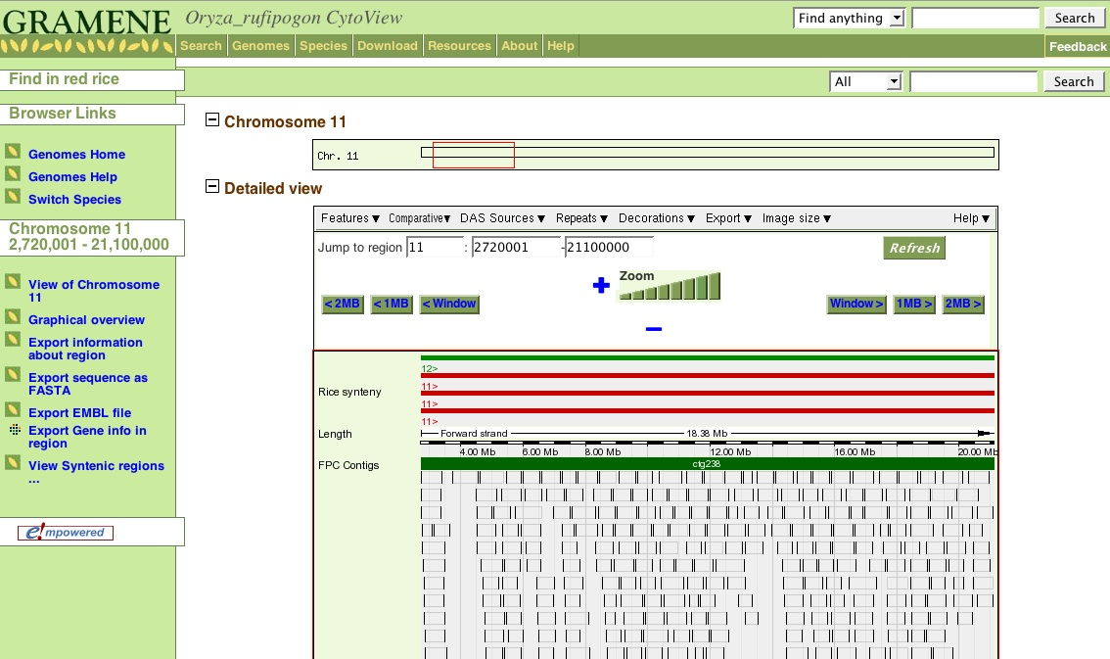
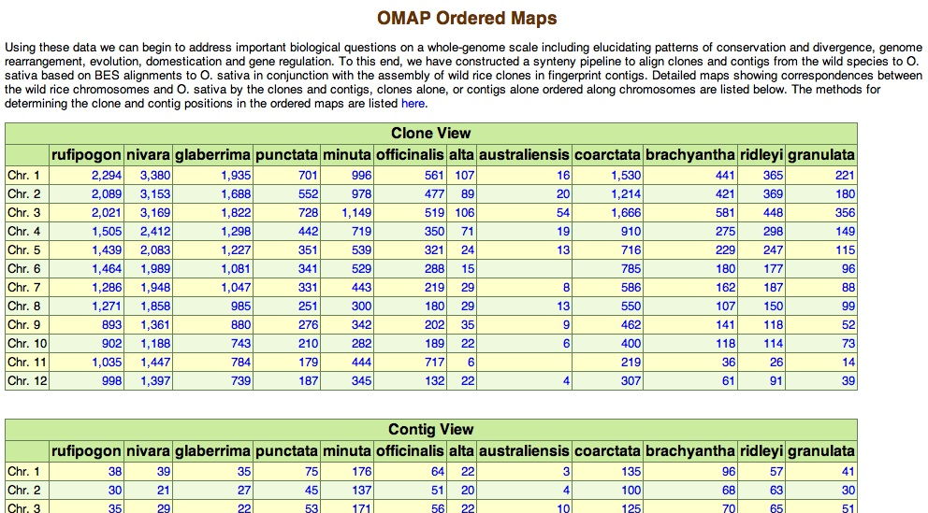
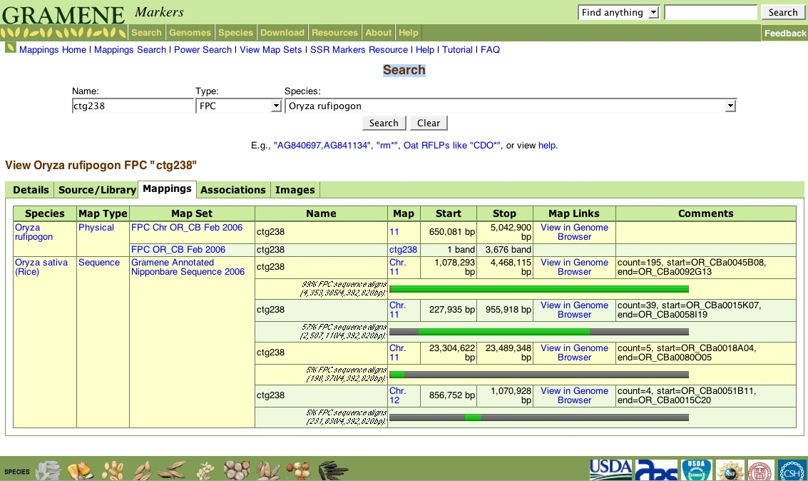
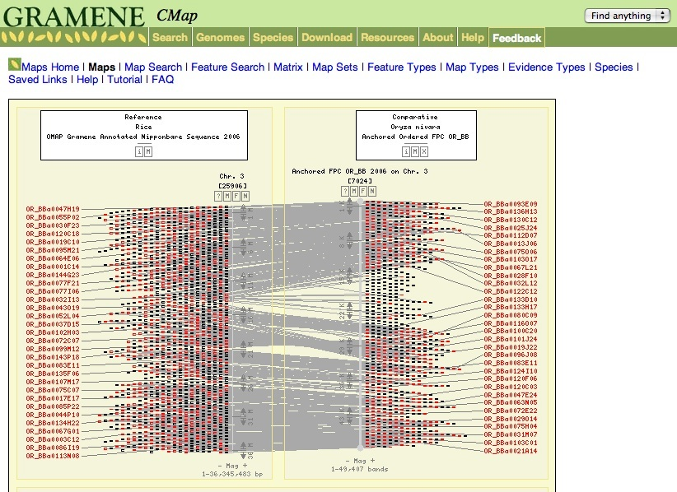
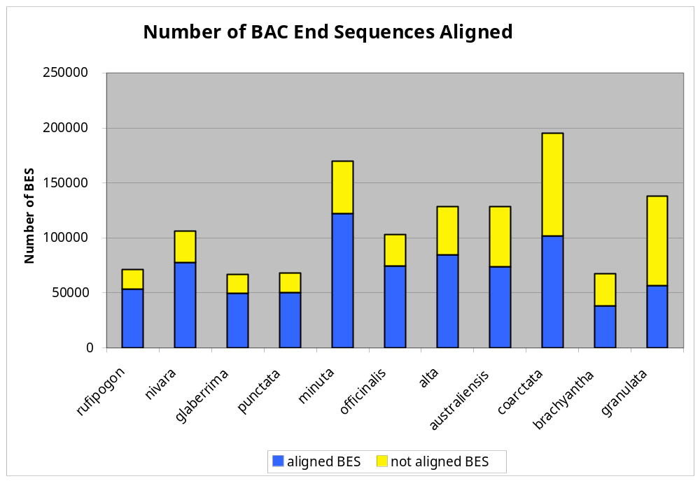
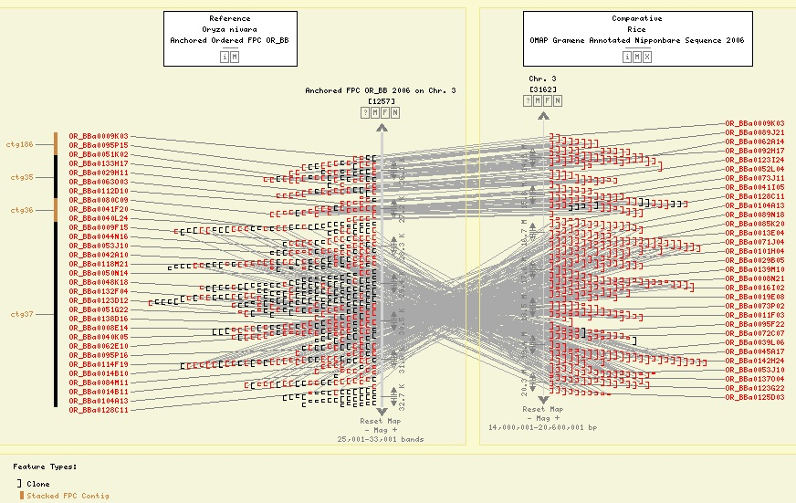
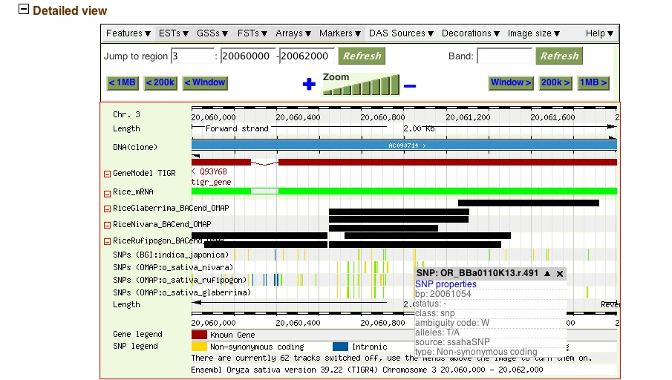
Cross-Species Analysis Between Wild Rice and Cultivated Rice (Oryza Sativa) in the OMAP Project
Bonnie Hurwitz¹, Doreen Ware^{1,4}, Lincoln Stein¹, David Kudrna², Yeisoo Yu², Jose Luis Goicoechea², Kristi Collura², Will Nelson², Phillip San Miguel³, Cari Soderlund², Scott Jackson³, and Rod Wing²
¹Cold Spring Harbor Laboratory, Cold Spring Harbor, NY 11724; ²Arizona Genomics Institute, Department of Plant Sciences and BIO5 Institute, University of Arizona, Tucson AZ 85721;
³Purdue University, West Lafayette, IN 47907; ⁴USDA-ARS NAA Plant, Soil & Nutrition Laboratory Research Unit
Abstract
O. rufipogon Synteny View Chr. 12
The Oryza Map Alignment Project (OMAP) provides the first ever closed experimental system for understanding the evolution, physiology and biochemistry of a single genus in plants or animals. We have constructed twelve deep coverage BAC libraries that are representative of both diploid and tetraploid genomes from wild species of Oryza. These libraries were end sequenced and assembled into physical maps using DNA fingerprinting (FPC). Presently, six FPC maps have been manually edited and over 1.4 million BAC end sequences (BES) from the twelve wild rice genomes have been aligned to the finished sequence of the O. sativa genome. Using these data we can begin to address important biological questions on a whole-genome scale including elucidating patterns of conservation and divergence, genome rearrangement, evolution, domestication and gene regulation. To this end, we have constructed a synteny pipeline to align clones and contigs from the wild species to O. sativa based on BES alignments to O. sativa in conjunction with the assembly of wild rice clones in fingerprint contigs. These data are available on the Gramene website (www.gramene.org) where they can be viewed in either the genome browser or side- by-side with physical maps using the comparative map viewer (CMap). We will describe the methods used in creating the synteny pipeline and its applications in finding patterns of genome rearrangement which can provide key insights into the dynamics of evolution and the impacts of domestication. This work was funded by NSF project #0321678 and USDA ARS.
Figure 5: An example of a synteny view between O. rufipogon and O. sativa. In this view we can see regions from O. sativa chromosome 12 that are syntenic with other chromosomes in O. rufipogon, demonstrating possible rearrangements between the chromosomes.
OMAP Resources in Gramene
OMAP Start Page
O. rufipogon Chr. 11 CytoView
The Comparative Map Viewer (Cmap)
  Ordered FPC Maps
  Curated and Phase 1 FPC maps
  View multiple species side-by-side
The SyntenyViewer
  View blocks of synteny between O. rufipogon and O. sativa chromosomes
The Gramene Genome Browser
  Over 1.4 million OMAP BES mappings
  View single nucleotide variations between the wild rice AA genomes and O. sativa
Figure 1. The OMAP start page offers an entry point to the OMAP data in Gramene. The OMAP FPC maps, Ordered maps and Genome Browser are all linked to this page.
Figure 6: A Detailed view of the previous region where we can see synteny between chromosomes 11 and 12. The BES evidence is listed in the bottom portion of the display.
Pipeline Overview
OMAP Ordered Maps
O. rufipogon Contig View
We have constructed a synteny pipeline to align clones and contigs from the wild species to O. sativa by combining data from the BES alignments to O. sativa and fingerprint contigs. Using these data we are able to construct syntenic blocks between chromosomes from the wild species and O. sativa.
The pipeline consists of 6 steps:
Upload FPC maps and GSS BES read data to the Gramene mappings database
Align BES to the O. sativa genome
Determine the best alignments for each clone
Assemble the clone positions to determine the regions where the contig is found to align
Create blocks of synteny between selected wild rice species and O. sativa
Utilize the data to create visualizations in CMap, the Genome Browser, and SyntenyView as part of Gramene
Figure 2: The ordered maps display syntenic clones and contigs ordered along the chromosomes and displayed side-by-side with chromosomes from O. sativa.
Figure 7: From the detailed view, we can click on a contig and see more information about the contig. In this example, we see that contig 238 shows synteny with both chromosomes 11 and 12 from O. sativa. The display shows the portion of the contig that is homologous to the given region.
Pipeline Detail
O. nivara Chr. 3 Ordered Map
BAC End Sequence Alignment Statistics
AA Genomes
Ratio of Genome Size to O. sativa:
O. rufipogon 1.02
O. nivara 1.04
O. glaberrima 0.82
O. punctata 0.98
O. minuta 2.01
O. officinalis 1.52
O. alta 2.33
O. australiensis 2.23
O. coarctata 2.98
O. brachyantha 0.79
O. granulata 2.00
Step 1: The OMAP FPC maps for the wild rice species are loaded into the Gramene 'mappings' relational database such that the data model captured the locations of FPContigs on chromosomes, and clones on FPContigs. Next, all BES were loaded into the 'mappings' database, and cross references were made between the BES entries and their parent clones. Pairs of clone end reads could therefore be readily identified.
Step 2: BES were aligned to the O.sativa pseudomolecules (TIGR v4 assembly) using blat. The standard blat parameters were used, and the alignments from the top 10 scoring hits loaded into the database.
Step 3: Mappings between clones and the O. sativa genome were inferred where both BES of a given clone aligned and were within two standard deviations of the mean clone size. The mean clone size was determined by examining the band counts for the clones in the FPC map and extrapolating the clone size in base pairs using an estimated band size of 1195 bp. The BES for a clone could map in either the same or different orientations to account for possible inversions, but could not be mapped to different chromosomes or to regions on the same chromosome that fell outside of the expected clone size region (+/- 2 std dev. from the mean clone size). Clones could map to multiple regions of the genome if the score for the hits in the region were the same yielding multiple top hits.
Step 4: FPContig mappings on the genome were inferred where three or more overlapping clones on a given contig were located. The start and end of the clones became the start and end points of each region. If a gap existed, another region was be formed by the clones in that region. Discrete sections of each FPContig were free to map to multiple locations on the genome.
Step 5: We created syntenic blocks for a select set of curated wild rice species (O. rufipogon, O.nivara, and O. glaberrima) by using sections of FPContigs located on the O.sativa pseudomolecules, we directly anchored syntenic regions between the assemblies in the respective genome databases.
Step 6: We exported the data from our Gramene mappings database to create tracks in the Genome Browser, maps and correspondences to related maps in the CMap viewer and as whole-chromosome overviews from the Browser's SyntenyView application.
Figure 3: An ordered map from O. nivara Chr. 3 shown side-by-side with a Chr. 3 map from O. sativa. In this view we can see structural rearrangements between the chromosomes. For, example a large scale inversion can be seen in the center of this chromosome.
Total BES aligned: TIGR V4 787,398 (62%)
Total clones aligned: TIGR V4 530,077 (81%)
Figure 8: Overall, we found more than 60% of the BES aligned representing about 80% of the clones. The AA genomes showed the highest percentage of BES aligned which was expected based on the phylogeny.
O. nivara Chr. 3 Inversion
A Detailed View of the Genome Browser
Figure 4: A large scale inversion between O. nivara and O. sativa is shown on chromosome 3.
Figure 9: The genome browser provides tracks showing the alignments of the BES for all of the OMAP species in addition to showing detailed information regarding the variations in the wild species with respect to O. sativa.

