Slide 1
Project Objectives
Pilot project to develop a common set of standardized and controlled vocabulary (ontology) terms to describe anatomy and developmental stages for rice, maize and Arabidopsis.
Apply the vocabulary to the task of describing the localized expression of the genes and phenotypes in experimental and agronomically important plants, such as grasses, legumes, mustards, tomatoes and their relatives and some tree species as well.
Develop an infrastructure to support plant comparative genomics to discover patterns of similarities and dissimilarities involved in plant development.
Impart training to collaborators from other model organism databases.
Community outreach to involve plant researchers, breeders, and systematists in development and application of vocabularies.

Slide 2
Why do we need controlled vocabularies ?
There is tremendous variation in the way in which phenotypes, gene expression and protein localization are described. In addition, the nomenclature used to describe anatomy and growth stages varies across taxa.
  For example: A plant that flowers late can be described in many ways (late flowering, delayed flowering, flowers at 36 days after sowing).
To make meaningful comparisons within and across different databases, we need a shared descriptive language that is uniformly applied to the data.
Integration of plant ontology in databases like TAIR, NASC, Gramene and MaizeGDB has helped plant biologist to make useful queries:
    What genes are expressed in the same tissues or organs as my gene of interest?
    When and where are homologous genes expressed in different plants?
    What genes are expressed in both monocot and dicot flowers?
    What genes are expressed in maize leaves but NOT in Arabidopsis or rice?
    What mutants in other plants have similar phenotypes to my mutant?

Slide 3
How does it work ?
In POC database we have ontologies describing the following plant biology concepts, that are required for consistent annotation of protein, gene and phenotype expression.
  Plant Structure (e.g. inflorescence, leaf, xylem, pollen)
  Growth and development stages:
    Whole plant growth stages (e.g. vegetative stage, flowering, ripening)
    Plant structure development stages (e.g. flower development stages, leaf development stages)

Slide 4
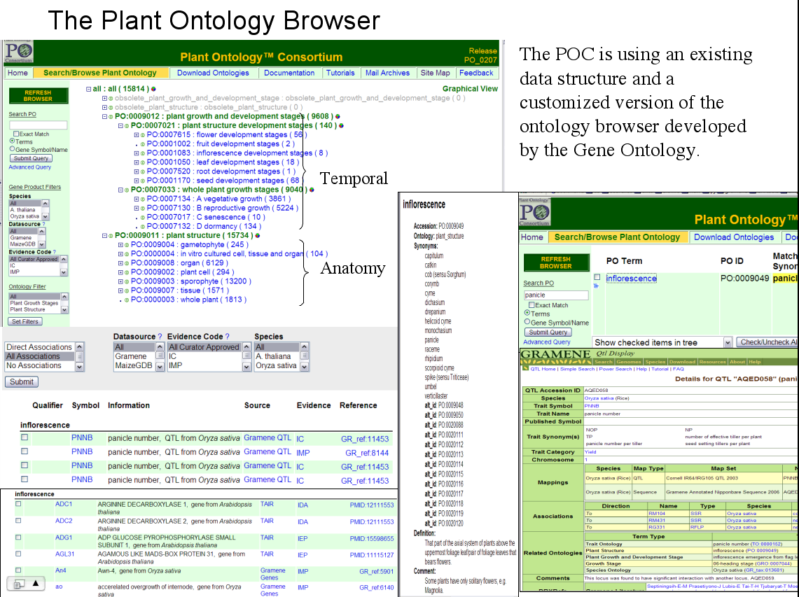

Slide 5
Project Summary
18 database releases (2004-2007)
Ontologies released with an emphasis on rice, maize and Arabidopsis
  1092 total ontology terms
  817 Plant structure terms
  273 Plant growth and plant part developmental stage terms
Annotations
  31949 total associations
  15814 unique objects (genes, QTL and germplasm)
Annotation source
  6086 gene associations from TAIR (Arabidopsis)
  1897 germplasm associations from NASC (Arabidopsis)
  21371 gene and QTL associations from Gramene (Rice)
  2595 gene associations from MaizeGDB (Maize)

