Slide 1
Evidence Based Gene Build Using Proteins and cDNAs
Chengzhi Liang
11/08/26

Slide 2
Source Data
Rice genome (TIGRv4): 372M
SwissProt proteins (April, 2007)
  Rice: 1100
  Other: 280k
GenBank mRNAs
  Full-length cDNA: 35K
  EST: 1.1m
Maize mRNAs:
  cDNA 16K
  EST 1.1M
Final genes: 44520 (75606 transcripts)

Slide 3
Gene Build Strategy
Remove redundancy
  keep high confident, remove low confident genes
Combine compatible mappings
Keep all high confident alternative mappings
Keep low confidence mappings in empty regions
Sanity check on GC content, AA usage
Label TE-related genes

Slide 4
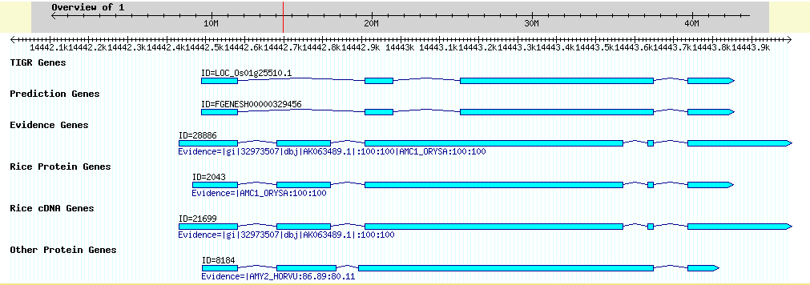
Gene Build Example

Slide 5
Transcript Coverage Comparison
 | Full transcripts | Partial transcripts | Missing transcripts | Nucleotide coverage
Evidence vs. TIGR | 38.0% | 48.1% | 13.8% | 73.0%
Evidence vs. Fgenesh | 14.5% | 70.8% | 14.7% | 49.0%
Evidence vs. T+F | 37.8% | 50.1% | 12.1% | 74.4%
TIGR vs. Evidence | 40.0% | 19.3% | 40.7% | 48.4%
TIGR vs. E+F | 82.0% | 17.1% | 0.9% | 97.0%
The percentage means the transcripts in the first set covered (or not covered) in the second set
Partial transcripts also include alternative transcripts
T+F: TIGR+Fgenesh,
E+F: Evidence+Fgenesh
The results showed that TIGR set is similar to Evidence genes + Fgenesh

Slide 6
Exon Coverage Comparison
 | Full exons | Partial exons | Missing exons
Evidence vs. TIGR | 62.4% | 23.1% | 14.5%
Evidence vs. Fgenesh | 42.7% | 36.1% | 21.2%
Evidence vs. T+F | 63.5% | 23.7% | 12.9%
TIGR vs. Evidence | 49.6% | 13.0% | 37.5%
TIGR vs. E+F | 91.2% | 7.6% | 1.2%
Percentage means the exons in first set covered (or not covered) by the second set
Partial exons also include alternative exons
T+F: TIGR+Fgenesh
E+F: Evidence+Fgenesh

Slide 7
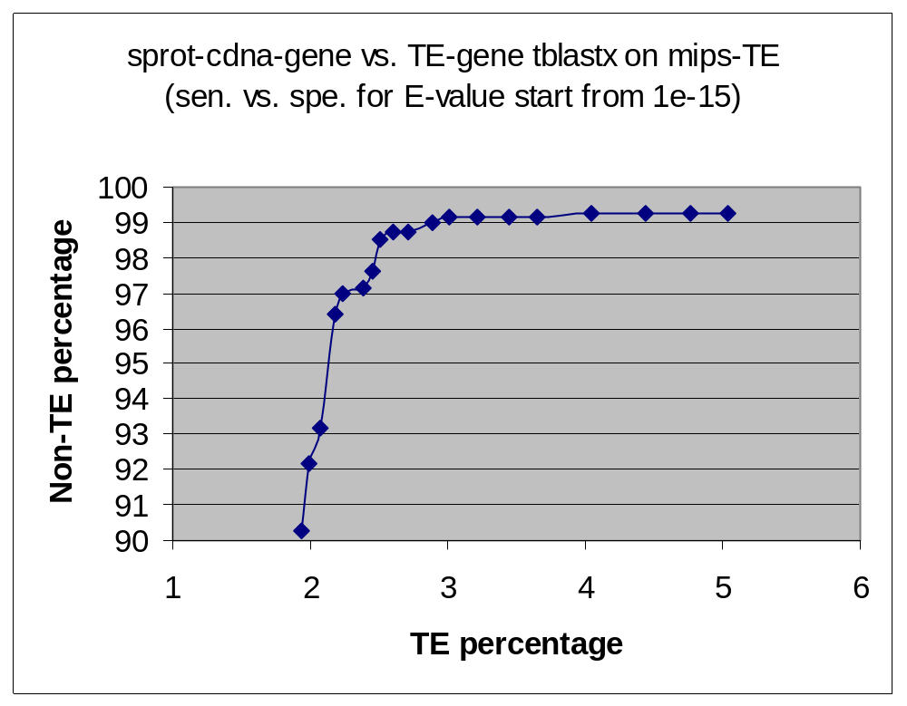
Identifying TE-related genes
Non-TE:
803 cDNA genes with
SwissProt protein
support (100% identity)
TE:
9026 evidence based
genes blastn hit
to TIGR rice repeat lib
transposons
E<=1e-50
Cutoff for identifying TEs
E=1e-26
sensitivity: 97%
specificity: 99.13%
1e-26
1e-19

Slide 8
Summary
~45000 rice genes were obtained based on same species or cross-species proteins, cDNAs, and ESTs
The genes were checked against mips plant transposon library to identify TE related genes (at E-value cutoff 1e-20, ~20% are TE related)
The genes were compared with TIGR gene set and Fgenesh set, basically Gramene set + Fgenesh is a superset of TIGR set
TIGR set missing many genes (5-10%) in Gramene evidence gene set with high confidence evidence support

