Slide 1

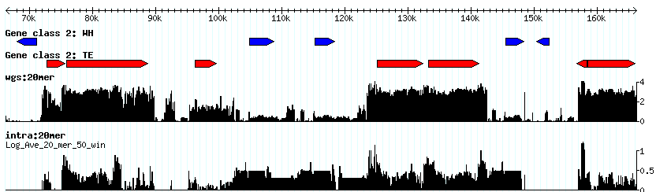
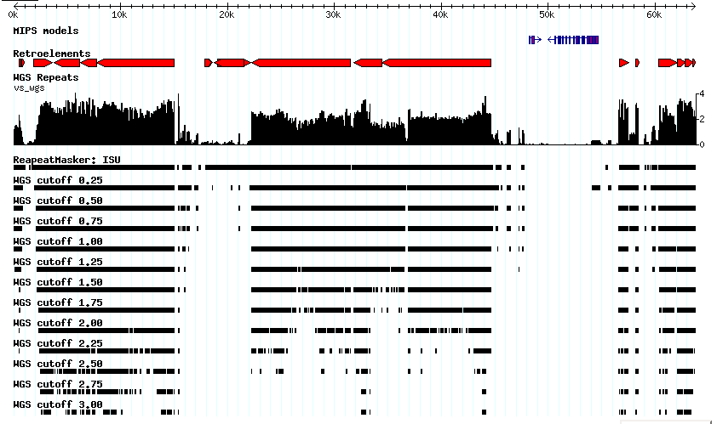
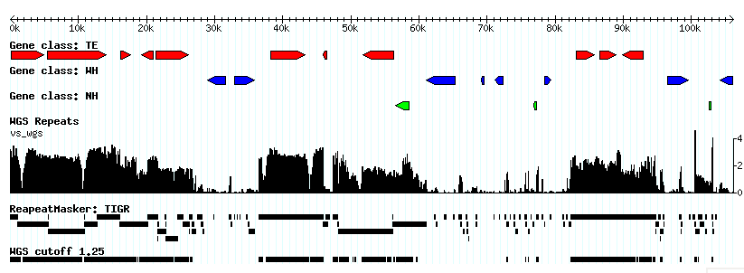
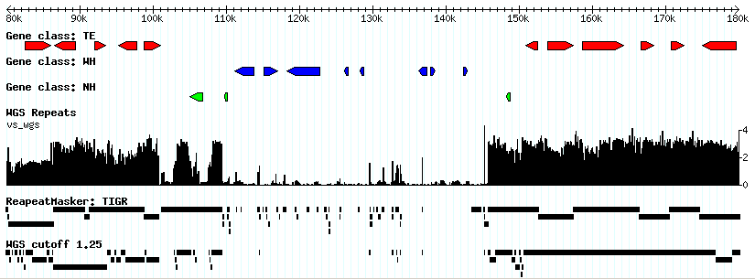
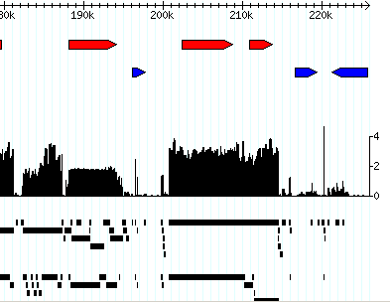
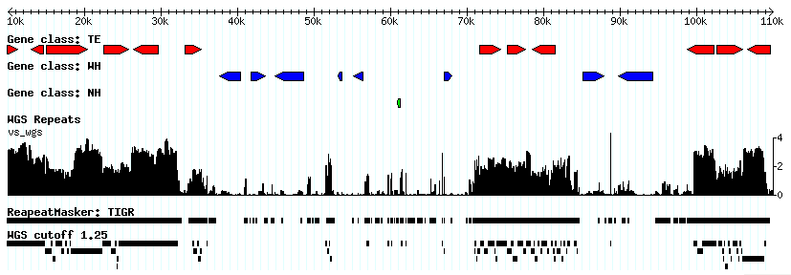
Using Mathematically-defined Repeats to
Annotate the Maize Genome
Apurva Narechania¹, Joshua Stein¹, Shiran Pasternak¹, Stefan Kurtz³, and Doreen Ware^{1, 2}
¹ Cold Spring Harbor Laboratory, 1 Bungtown Road, Cold Spring Harbor, NY11724, USA
² USDA-ARS NAA Plant, Soil & Nutrition Laboratory Research Unit, USA
³ Center for Bioinformatics, University of Hamburg, Germany
Workflow
Summary
Annotation of 674 BACs
Suffix Array = persistent index against which query sequences can be measured for their constituent repeats.
A substantial portion of the maize genome, estimated at 60-70%, is repetitive, comprising mostly retrotransposable elements that inserted within the past 6 million years. Such high repeat content will present challenges to the efficient sequencing, assembly, and annotation of the maize genome. Since there is no guarantee that current libraries of manually-curated repeats are comprehensive, one of the primary challenges will be to identify novel repeats as the project progresses. We are investigating an approach based on mathematically defined repeats that provides user control over desired repeat thresholds and does not require a pre-established repeat library. Using the 0.45 X whole genome shotgun sequence prepared by the DOE Joint Genome Institute as a relatively non-biased representation of the maize genome, we computed the frequency of all constituent k-mers. With this index, sequenced BAC clones were subsequently annotated/masked for repetitive content using the program Vmatch. We demonstrate that this method is highly effective at identifying sequences harboring known classes of retroelements and distinguishing these from low-copy genic regions. In addition to supporting BAC sequence annotation, the k-mer method can also be used to guide sequence finishing projects by focusing attention on relatively non-repetitive regions. This study provides a proof-of-concept for the detection of repetitive sequence in the absence of annotated repeat databases, and should therefore prove useful in the future sequencing projects of novel genomes. This work was funded by the NSF/DOE/USDA Sequencing The Maize Genome project (NSF #0527192).
Classification of 18,367 gene models:
Generate suffix array index of sequence database (e.g. a whole genome shotgun sequence) with mkvtree.
Fragment query sequences (e.g. a BAC) in silico according to a user input oligomer size.
Query suffix array with vmatch to tabulate repeat frequency along length of query sequence.
Sequence Database
(WGS, Chrom)
Query Sequence
(BAC)
NH 2,128
TE 12,845
WH 3,394
mkvtree
Desired oligomer size
mkvtree
Ab initio prediction by Fgenesh (monocot)
Classified models by BLASTP to GenBank NRAA
TE = Homology to known transposable element-encoded protein*
WH = Significant alignment to non-TE
NH = No significant hits
Database index
(suffix array)
BAC oligomer
fragments
BAC index
(suffix array)
vmatch
vmatch
*TE defined based on definition line and manual screen of frequently hit proteins
Repeats to Database
Repeats to Self
K-mer Level Discrimination of Gene Classes
Desired window size
Summed masking over all models over range of repeat level thresholds
www.vmatch.de
Integrated Repeats
to Database
Integrated Repeats
to Self
Using a cutoff of 1.25:
75% masking of TE
35% masking of NH
5% masking of WH
Whole Genome vs Intra-BAC Repeat Level
Gene-enriched Sequences Also Enriched in Unique K-mers
Genes
Retroelements
Genome Repeat Frequency
Local Repeat Frequency
Comparison of K-mer and RepeatMasker
Tandem cluster of pentatricopeptide-repeat genes
BACs were masked using RepeatMasker with the Iowa State maize repeat library (http://magi.plantgenomics.iastate.edu/repeatdb.html) and Compared to BACs masked by the JGI WGS K-mers at the log 1.25 threshold.
Retroelements highly repetitive in 0.45X whole shotgun sequence of maize (JGI).
Signature of PPR protein cluster stands out when using local repeat frequency (450 Kb region).
Dot-plot of masked coding regions in non-TE models shows greater masking using RepeatMasker
Modulating Repeat Level Threshold
Control the level of sequence masking according to user preferences.
More permissive cutoffs may lead to finishing TE-like elements.
More stringent cutoffs may mask high-copy gene families.
Low copy TE’s not detected.
20-mer sequences in various fractions of the maize genome were queried for frequency within the JGI WGS sequence.
Methyl-filtered, high Cot, and ESTs are enriched in unique sequences, all peaking at approximately one copy per read. EST sequences appear the least repetitive.
ClassI repeats (retroelements) and ClassII repeats (DNA transposons both appear bimodal. Among ClassI repeats the more repetitive population is enriched in gypsy while the other is enriched in copia (p_{chi-sq}= 1.9e-57). ClassII repeats show no significant differences (p_{chi-sq}= 0.15).
Increasing rlevel cutoffs
Bin % Gene Coverage (exons + introns)
Bin % Gene Coverage (exons + introns)
Repetitive K-mers Conserved Across Maize Cultivars
Repetitive regions can be detected in cultivars McC and MO17 using the k-mer frequencies of B73, despite local differences in retroelement insertions. The Bronze locus is shown in the three cultivars.
* Sequence Sources: Maize GDB EST reads; TIGR high Cot reads; TIGR Methyl-filtered reads
* The 100 Randomly selected BACs were from Haberer et al. (2005). Plant Physiol. 139:1612-24.
AF448416 B73
A B C D E F G H
20-mer Frequencies in Maize, Rice, and Sorghum
Single Copy K-mers Across K-mer Sizes
AF391808 McC
1 2 3
HelA HelB
AY664416 Mo17
A: S/T kinase
B: Bronze1
C: Sesquiterpine cyclase
D: Ribosomal protein
E: Hypothetical protein
F: Ring-H2 zinc finger protein
G: Unknown protein
H: Ubiquitin conjugating enzyme
1: Beta-glucuronidase?
2: Dipeptidyl aminopeptidase?
3: LRR repeat?
Generated 20-mer statistics across four grass genomes (indica, japonica, sorghum, and maize) using 1 million randomly selected WGS reads from each set.
The 20%uniq plot shows the fraction of unique 20mers at a given repeat threshold
The 20%mers plot displays the fraction of total 20mers at a given repeat threshold.
Maize and sorghum are much more repetitive than their rice counterparts, and appear to have more complex genomes.
Lai, J. et al. (2005). Proc Natl Acad Sci USA 102:9068-73.

