Slide 1
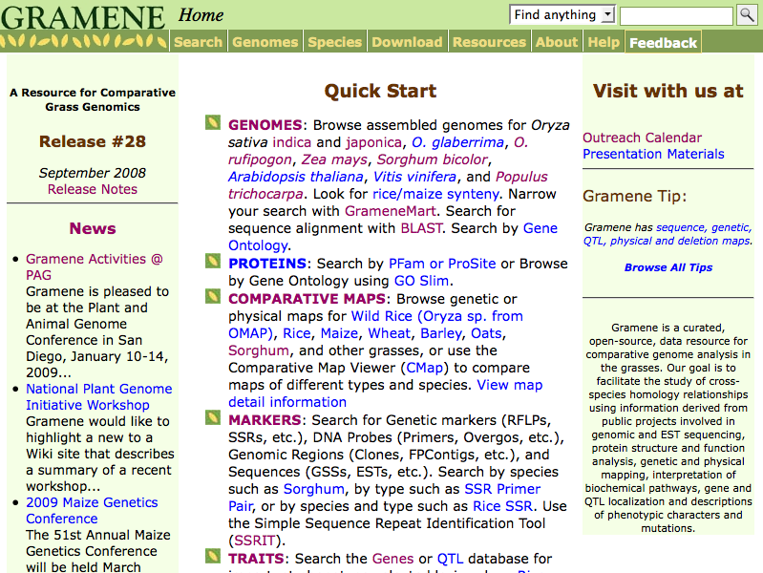
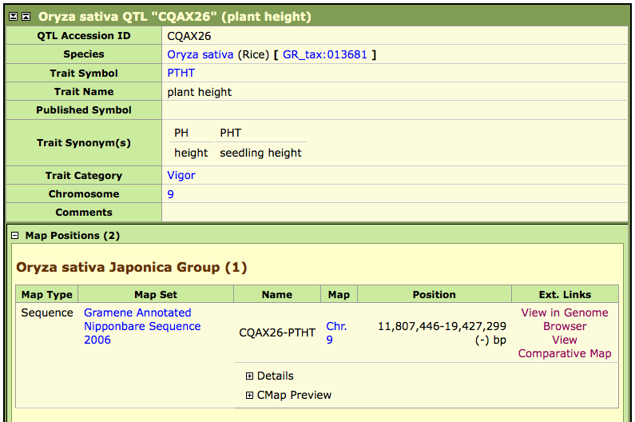
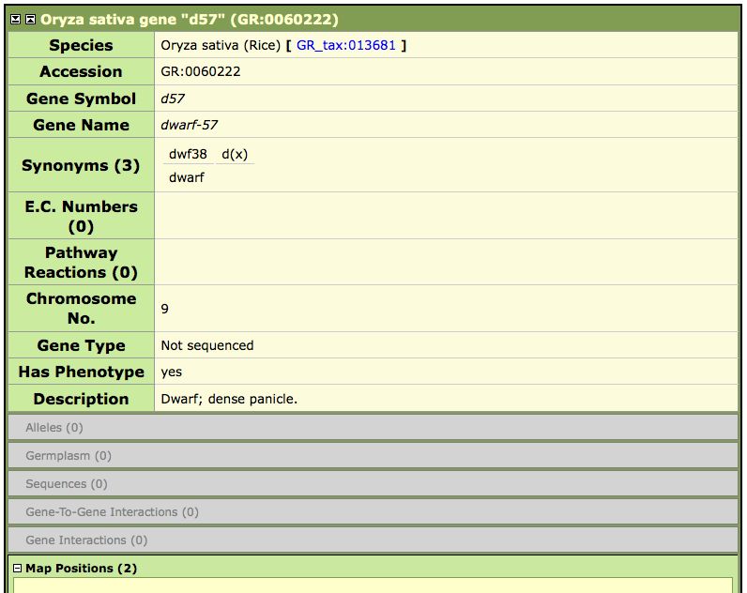
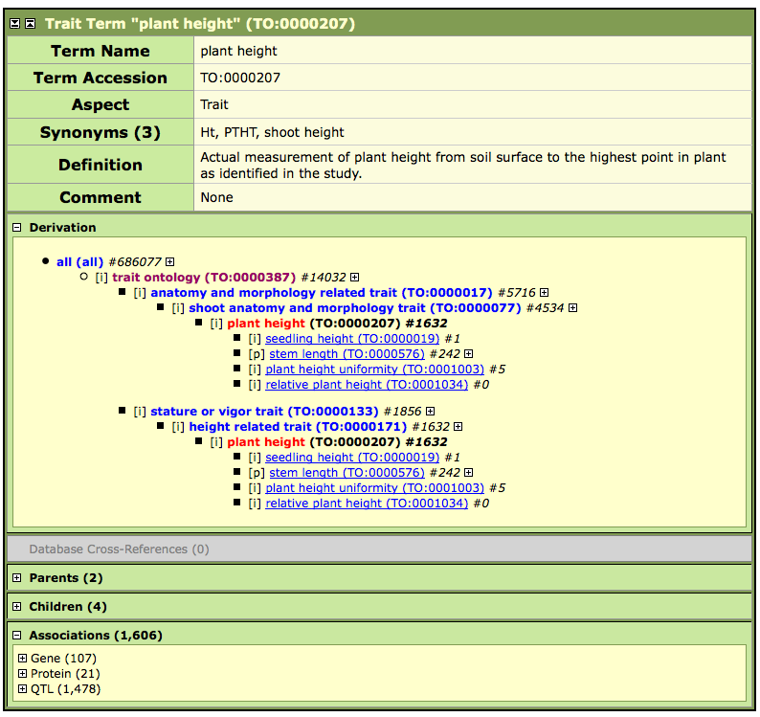
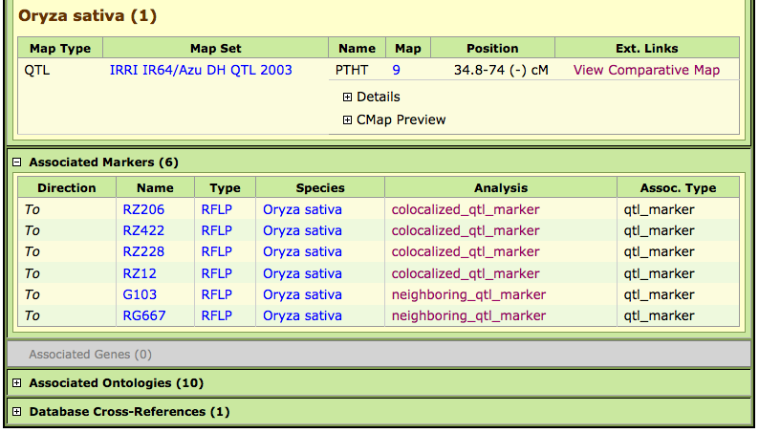
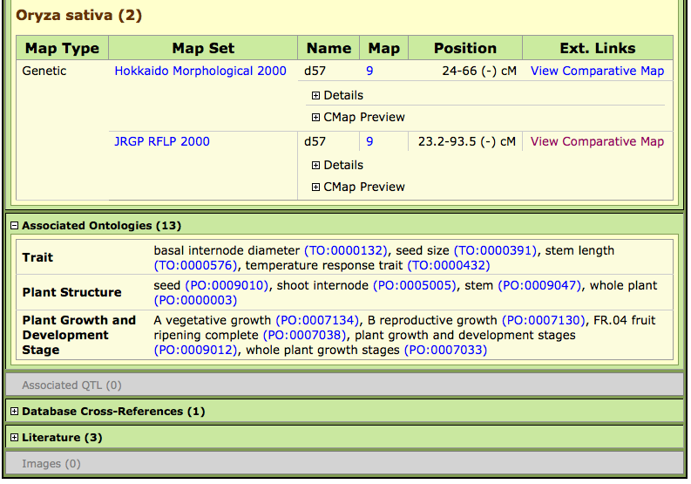
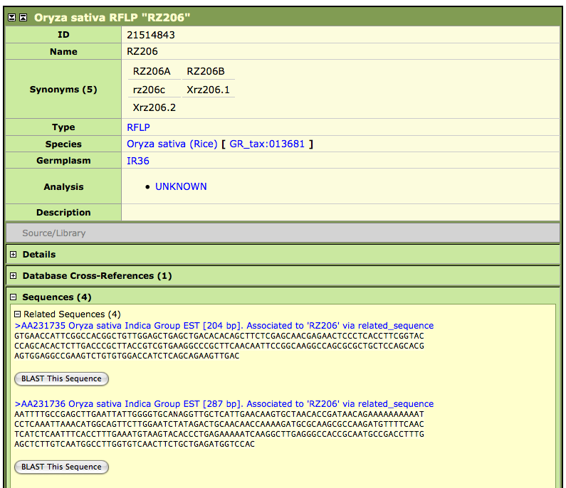
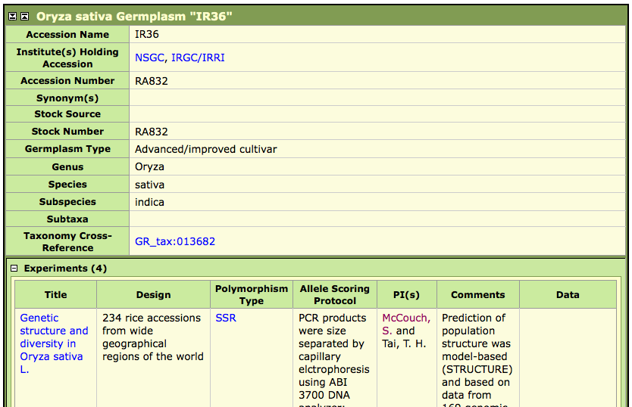
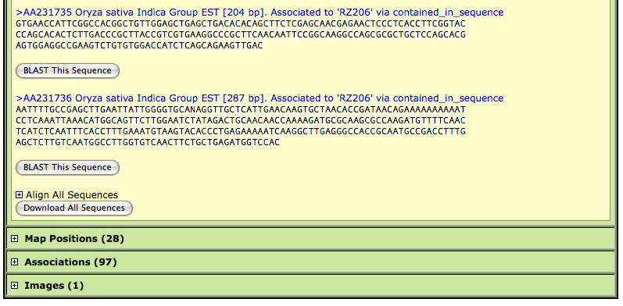
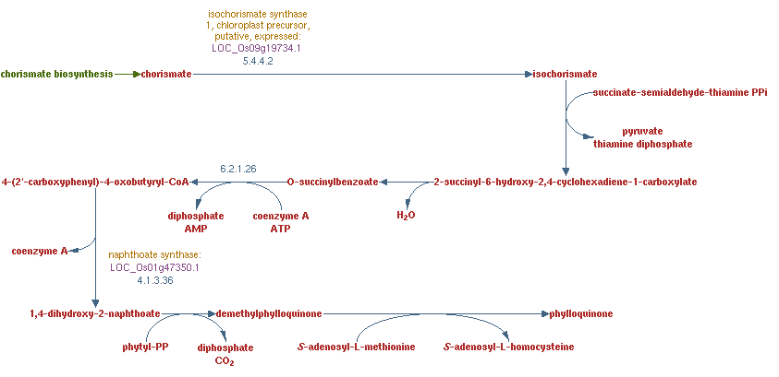
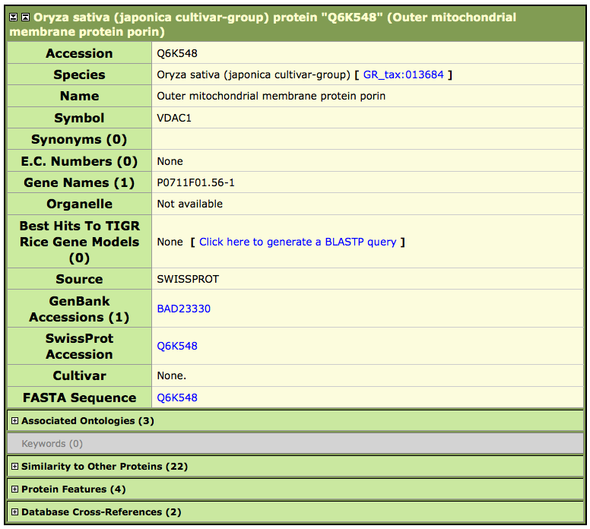

P793
Gramene: A Resource for Comparative Grass Genomics
Immanuel Yap¹, Shulamit Avraham^{2,} Edward S. Buckler^{3,4}, Terry M Casstevens³, Pankaj Jaiswal⁵, Chengzhi Liang², Susan R McCouch¹, Junjian Ni¹, Dean Ravenscroft¹, Liya Ren², Will Spooner², Lincoln Stein², Isaak Y Tecle¹, Jim Thomason², Chih-Wei Tung¹, Doreen Ware^{2,4}, Sharon Wei², Ken Youens-Clark²
  1 Department of Plant Breeding and Genetics, 240 Emerson Hall, Cornell University, Ithaca, NY, 14853, USA
  2 Cold Spring Harbor Laboratory, 1 Bungtown Rd, Cold Spring Harbor, NY, 11724, USA
  3 Institute for Genomic Diversity, Cornell University, Ithaca, NY, 14853, USA
  4 USDA-ARS NAA Plant, Soil & Nutrition Laboratory Research Unit, Cornell University, Ithaca, NY, 14853, USA
  5 Dept of Botany and Plant Pathology, 3082 Cordley Hall, Oregon State University, Corvallis, OR, 97331, USA
ABSTRACT
Gramene is a curated, open-source, web-accessible data resource for comparative genome analysis in cereal crops and other model plants. The database provides agricultural researchers and plant breeders with expertly-curated biological and genomic information. It integrates publicly-available data on maps, sequences, genes, genomes, proteins, markers, QTL, biochemical pathways, genetic diversity and relevant literature. Searches are driven by the use of ontologies (controlled vocabularies) for genes, plant anatomy and growth stages, traits, and environments. Full database releases are made twice a year. Gramene is a collaborative effort between Cold Spring Harbor Laboratory, the Department of Plant Breeding and Genetics at Cornell University and various national and international projects dedicated to cereal genomics and genetics research. Visit us at URL:http://www.gramene.org.
QTL
Find quantitative trait loci for rice, sorghum, pearl millet, foxtail millet, and wild rice. QTL from MaizeGDB and GrainGenes have also been imported.
Genes
Information about genes and alleles associated with important phenotypes and functions. Rice genes have been curated in-house. Other genes have been imported from MaizeGDB and GrainGenes.
Ontology
Find keywords for plant structure, growth stages, traits, gene function, processes, cellular components, environments and taxonomy. Link to associated data in genes, QTL, maps, and proteins.
CMap
Comparative Map Viewer
Search, view, and compare mapped genes, markers, QTL, and clones on various types of maps (including genetic, physical, sequence, and QTL). View correlations and genetic colinearity within and between species.
Markers
Find marker information, synonyms, library information, map positions, sequences, associated markers.
Diversity
Repository for allelic variation of SSR, SNP, and RFLP in rice, maize, and wheat germplasm.
Ensembl Genome Browser
Browse assembled genomes and their associated gene models. Further cross-genome analyses provide data on syntenic blocks and gene homologs between japonica, O. rufipogon, maize, and arabidopsis.
Pathways
The RiceCyc database integrates the latest genomic data with functional descriptions of metabolic pathways.
Proteins
provides collective information on Swissprot-Trembl protein entries from family Poaceae.
Visit us at the Plant Genome DB Outreach Consortium Booth in the Exhibit Hall
See also our Training Tutorial W519: Using Gramene (Tue, Jan 13, 3:50 - 6:00 pm, California Room)
Other posters:
P791 Plant Comparative Genomics at Gramene
P814 Using the Simple Semantic Web Architecture and Protocol to Provide Bioinformatics Access to Gramene’s QTL Resources
Gramene is a collaboration between Cold Spring Harbor Laboratory, Cornell University, and Oregon State University.
Funded by a PGI grant from the National Science Foundation, an IFAFS grant from the USDA-CSREES, and was previously supported by a Cooperative Agreement from the USDA-ARS.

