Slide 1
Maize-Rice Synteny Analysis and the Maize Diversity Project
Wei Zhao
June 2007

Slide 2
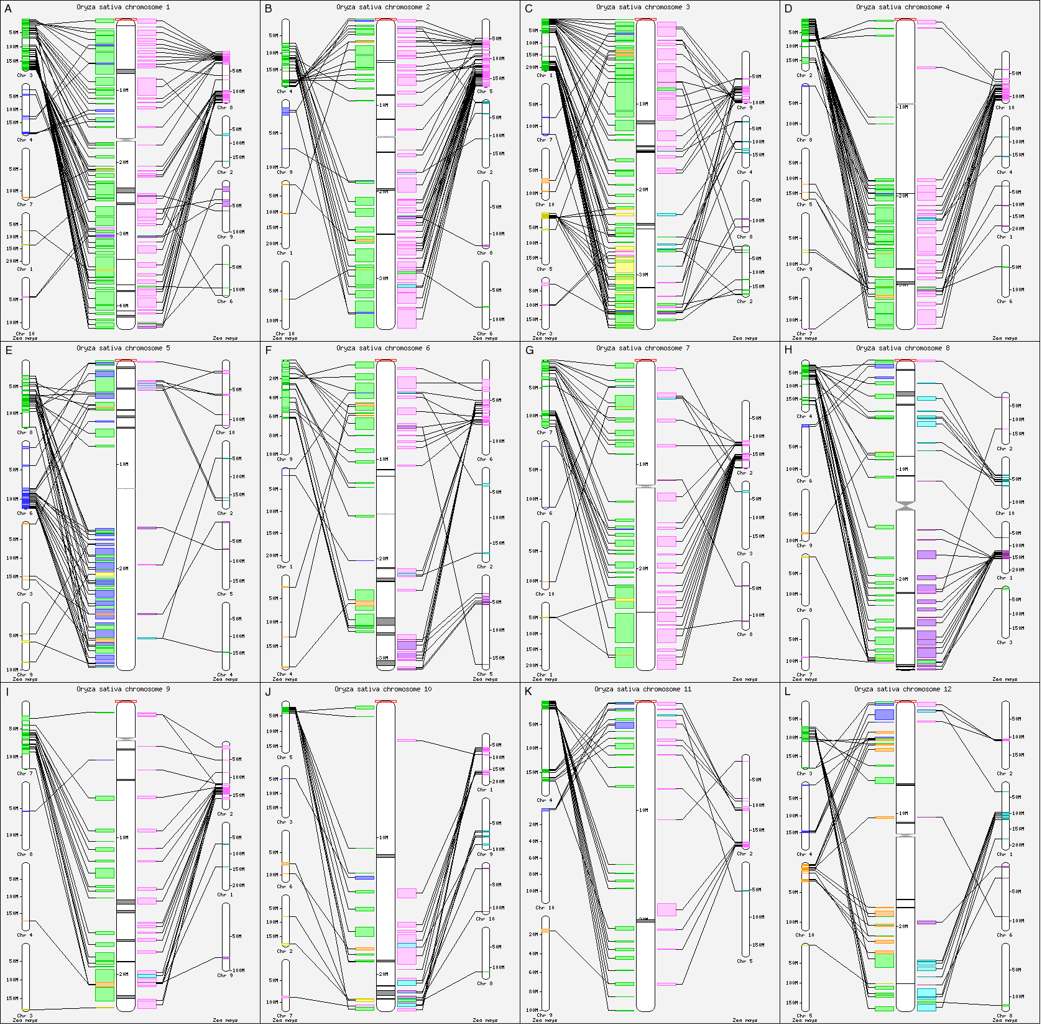
Syntenic Regions Identified between Maize and Rice

Slide 3
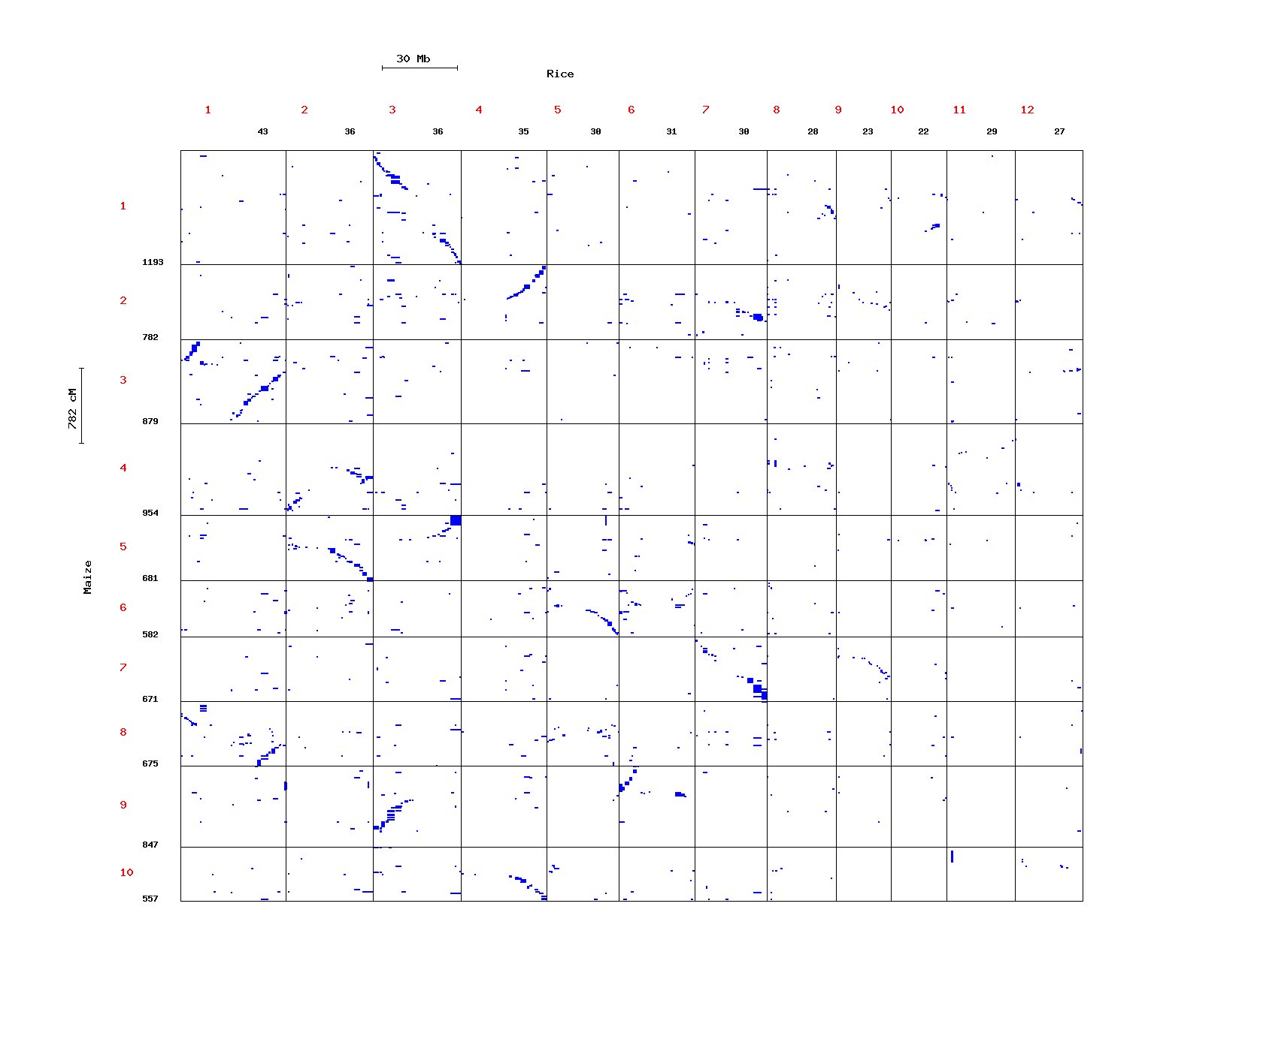
Syntenic Regions Identified between Maize and Rice

Slide 4
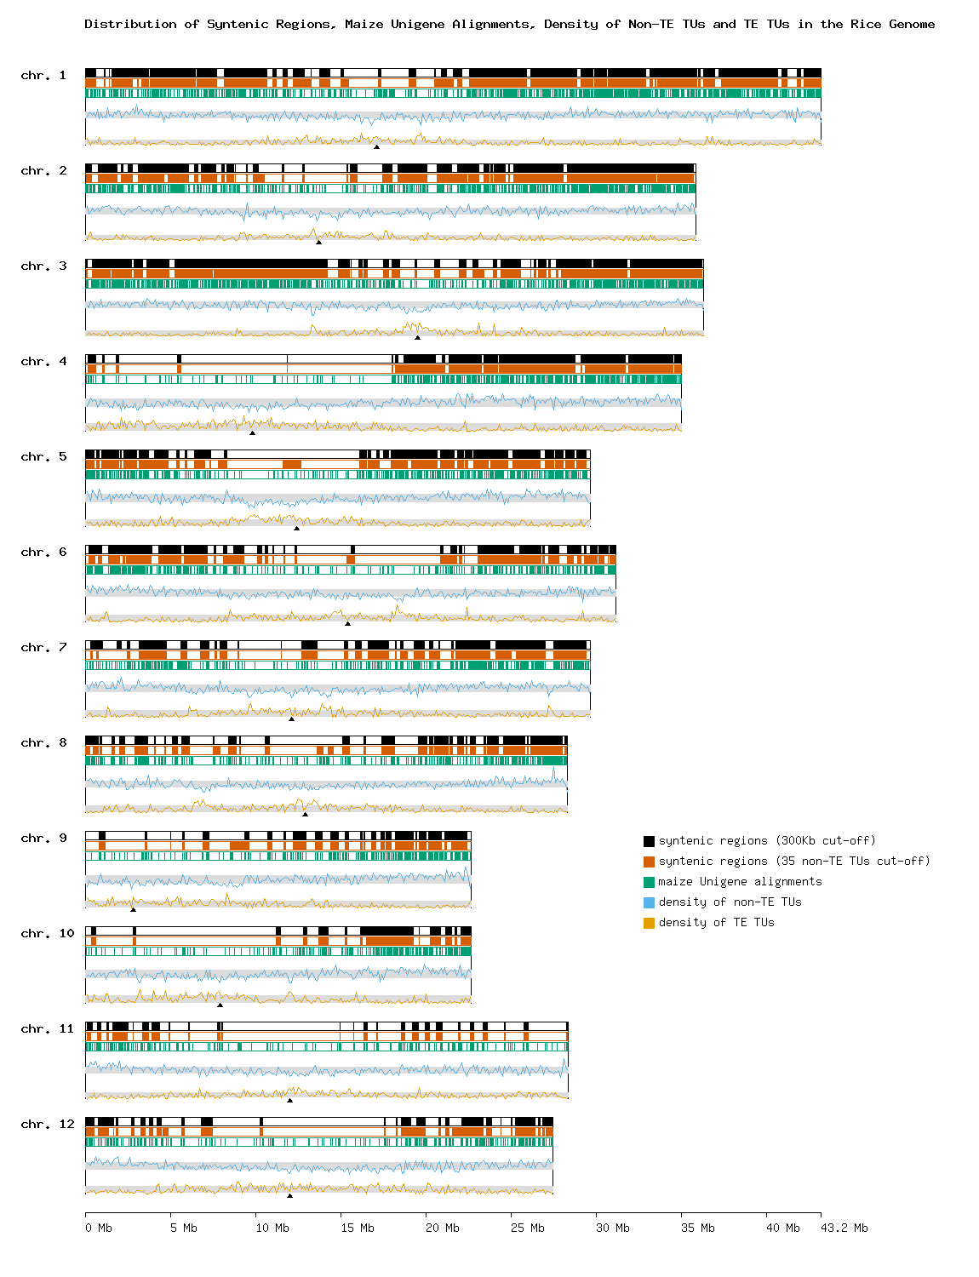
Non-Syntenic Regions are TE-rich

Slide 5
Expansion of Paralogous Regions in Maize has been Asymmetrical

Slide 6
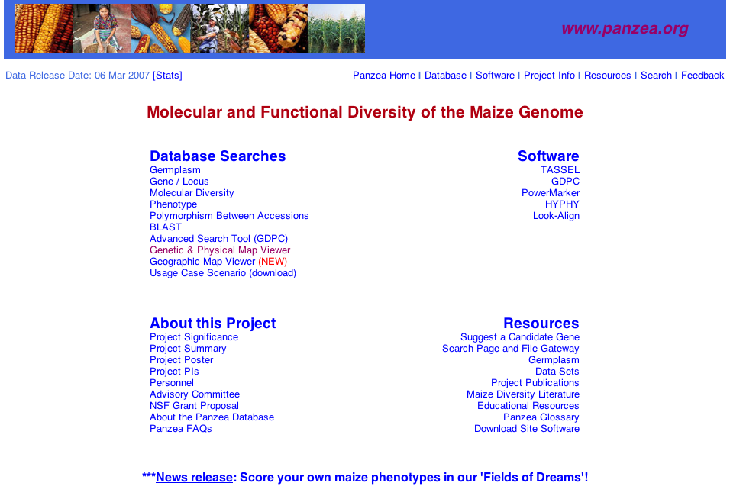
The Panzea Web Site

