Slide 1
TASSEL 3.0 / 4.0 www.maizegenetics.net/tassel
Terry Casstevens¹, Peter Bradbury^{2,3}, Zhiwu Zhang¹ , Yang Zhang¹, Edward Buckler^{1,2,4}
¹ Institute for Genomic Diversity, Cornell University, Ithaca, NY
² USDA-ARS
³ Cornell Theory Center, Cornell University
⁴ Dept. of Plant Breeding and Genetics, Cornell University

Slide 2
TASSEL
Tools for phenotype to genotype analysis
Specialty is association mapping of structured populations

Slide 3
TASSEL : Tools for Genetic Research
Association Analysis (General Linear Model; GLM and Mixed Linear Model; MLM)
Genomic Selection (Ridge Regression)
Linkage Disequilibrium Analysis
Missing Data Imputation (genotype and phenotype)
SNP Extraction, filtering, numericalization, formatting (Hapmap, Plink, Flapjack, and Phylip)
Diversity Analysis
Kinship and Principal Component Analysis

Slide 4
What’s New in TASSEL?
 | 2.1 | 3.0
Marker Number | 1000s | 1,000,000s
PCA | ✓ | ✓
Genotypic Imputation |  | ✓
LD Analysis | ✓ | ✓
Sliding Windows |  | ✓
GLM | ✓ | Simpler Interface & Faster
MLM | ✓ | Faster & More Data
EMMA | ✓ | ✓
3PD & Compression |  | ✓
Pipeline | ✓ | Many Improvements
TASSEL can now handle millions of SNPs and it 1000X faster for key association analyses.

Slide 5
GLM/MLM for GWAS
Unequal
relatedness
Phenotype on individuals
Population
structure
Unequal
relatedness
Y = Q (or PCs) + Kinship + residual
(fixed effect)
(random effect)
Mixed Linear Model (MLM)

Slide 6
New algorithms for MLM
EMMA: Convert optimization on two dimensions (genetic and residual variance components) to one dimension (their ratio), faster. By Kang et al (2007, Genetics)
Compression: To group individuals into group to reduce size of MLM equations. Better speed and better power. By Zhang et al (2010, Nature Genetics)
P3D/EMMAx: Population parameters (such as variance components) optimized only once and fixed in screening SNPs, Faster. By Zhang et al (2010, Nature Genetics, named as P3D) and Kang et al (2010, Nature Genetics, named EMMAx).

Slide 7
Demonstration
How to start?
TASSEL Graphic User Interface (GUI)
Data formats
GLM as example

Slide 8
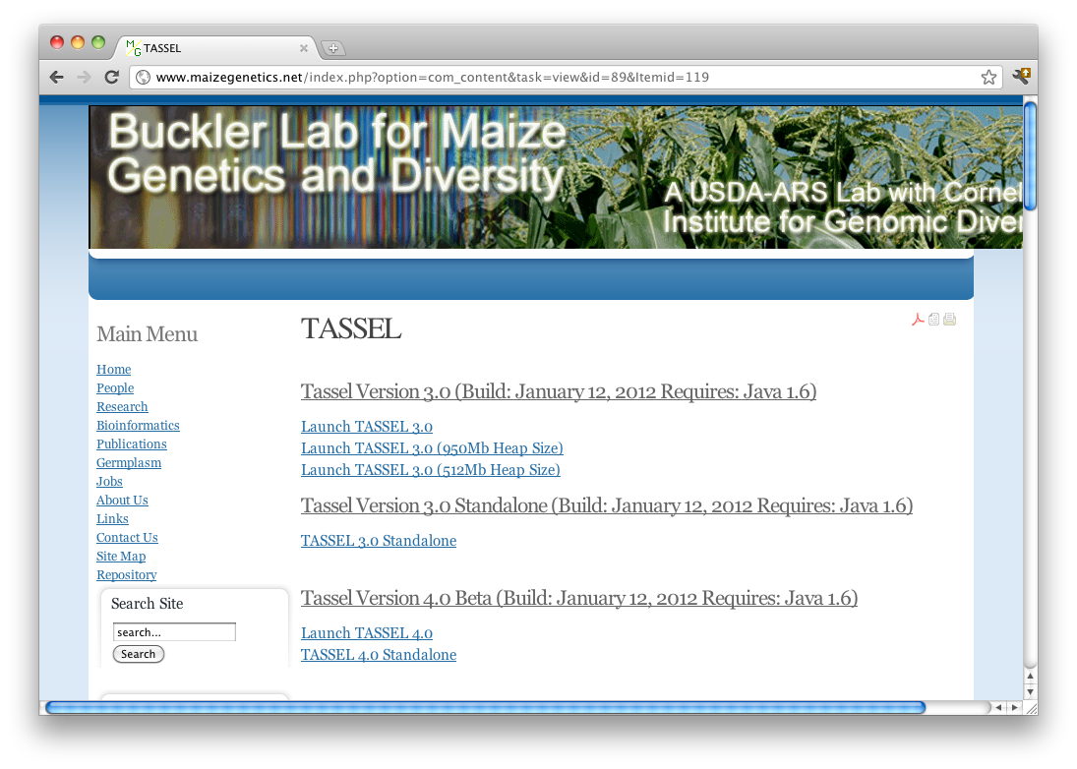
www.maizegenetics.net/tassel

Slide 9
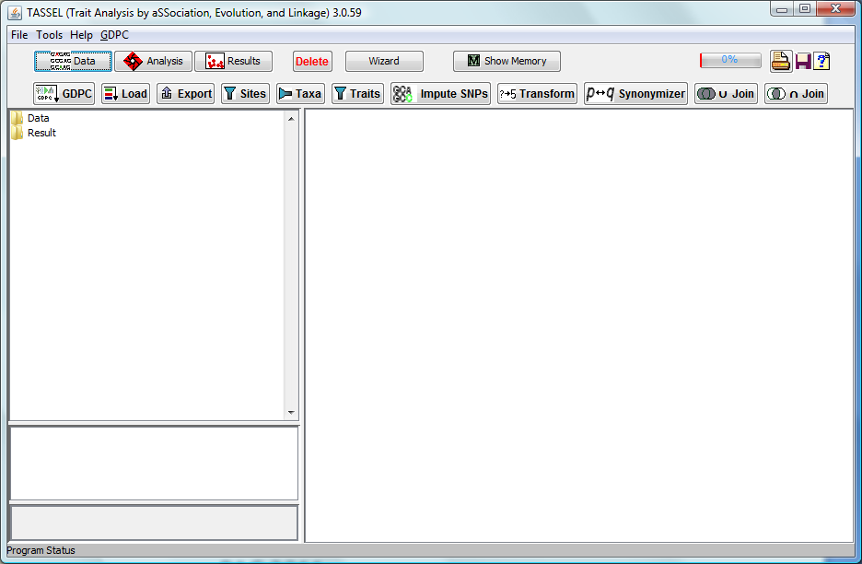
Phenotype
Population structure
Kinship
Association?
Genotype

Slide 10
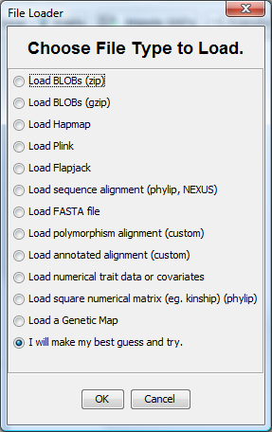
Click
Here
1
2
3

Slide 11
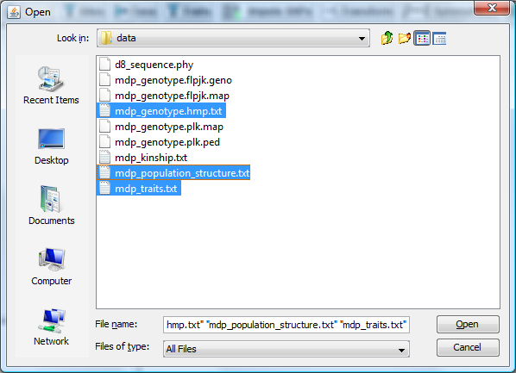
Click
While
Holding
<ctrl>
1
2
3
4

Slide 12
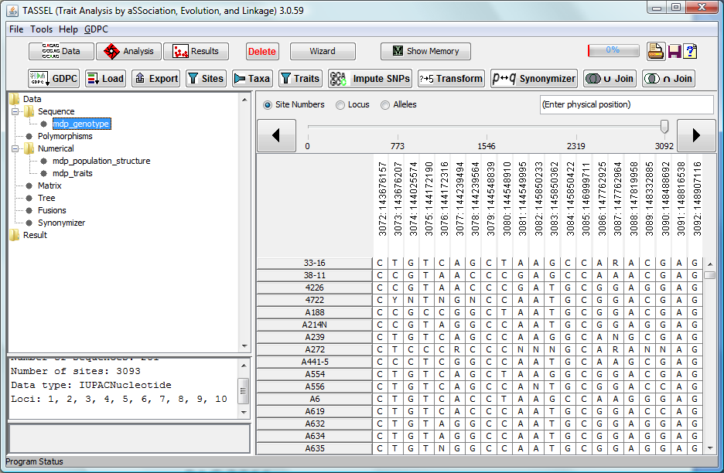

Slide 13
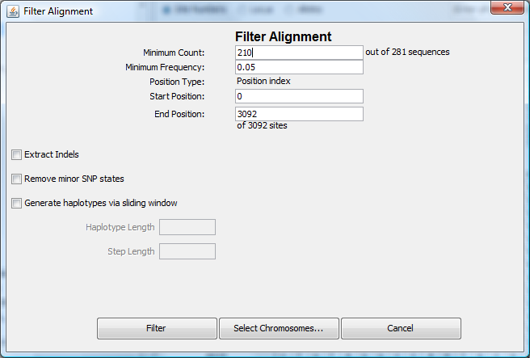
1
2

Slide 14
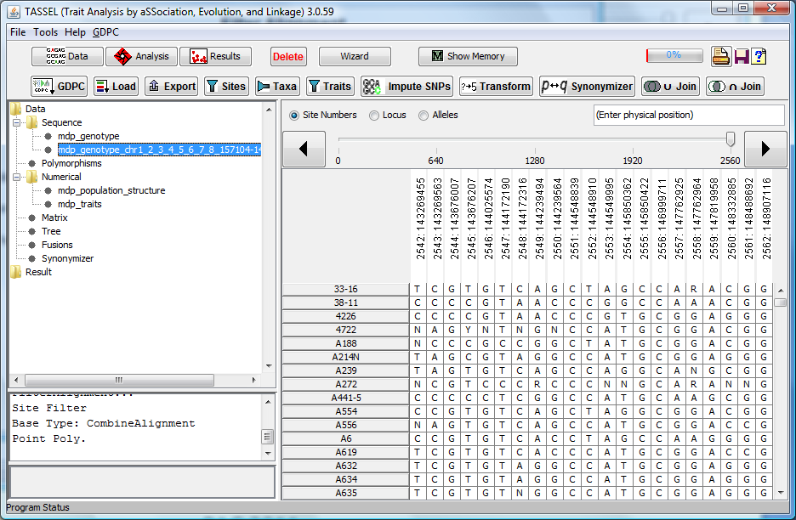

Slide 15
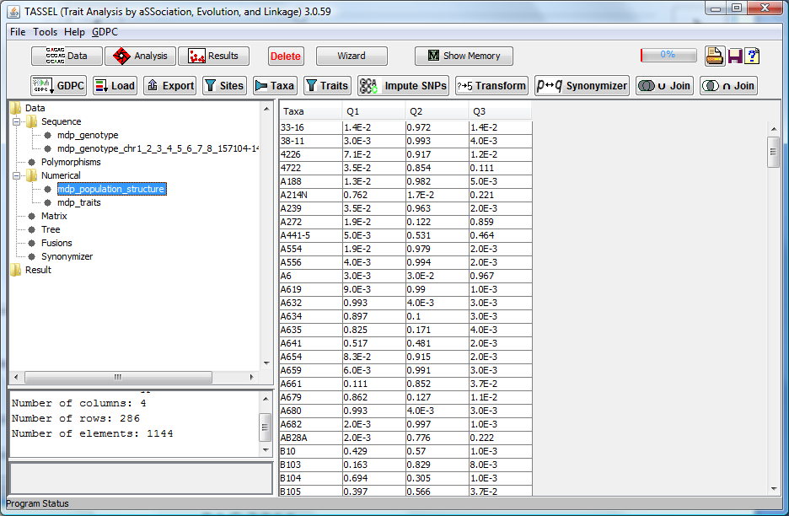

Slide 16
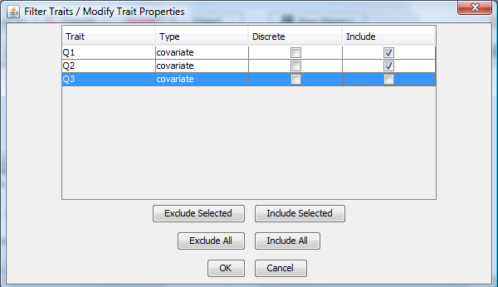
1
2
3

Slide 17
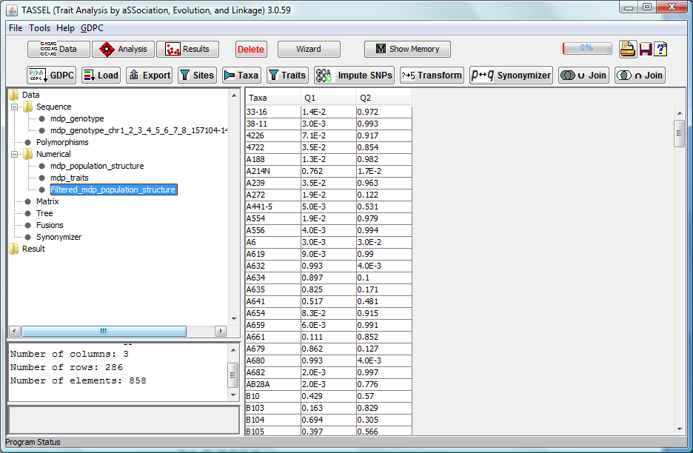

Slide 18
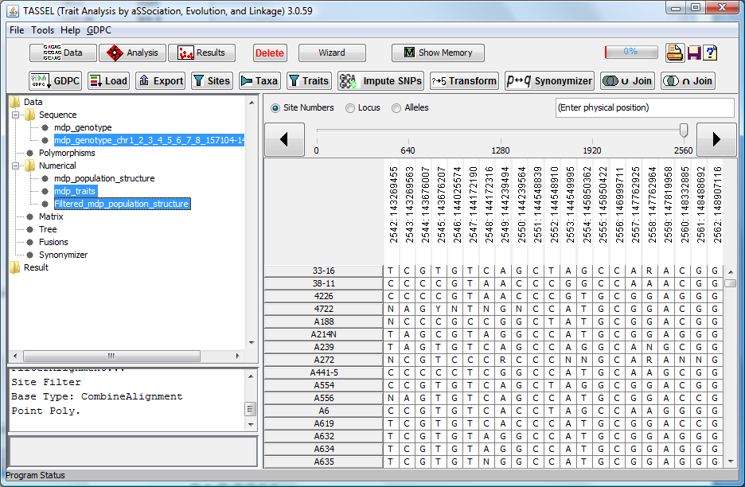
1
Click
While
Holding
<ctrl>
4
2
3

Slide 19
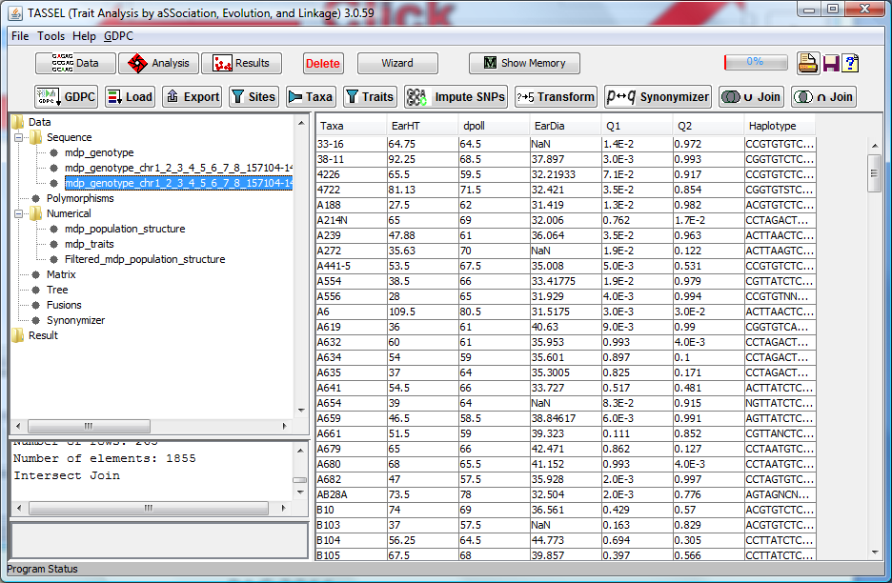

Slide 20
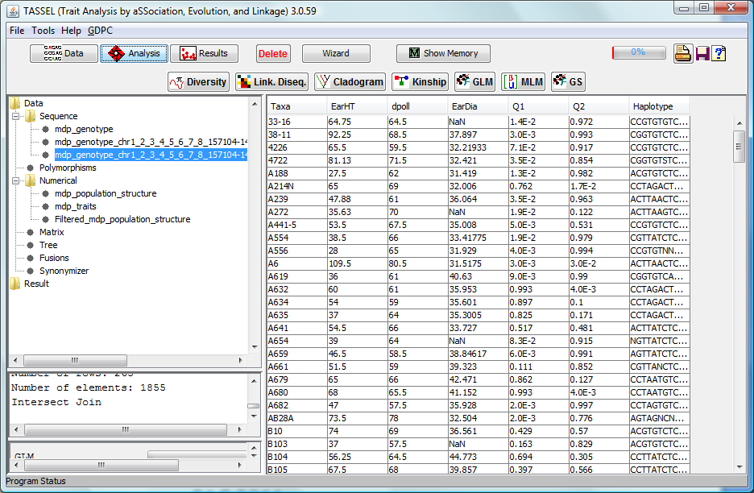
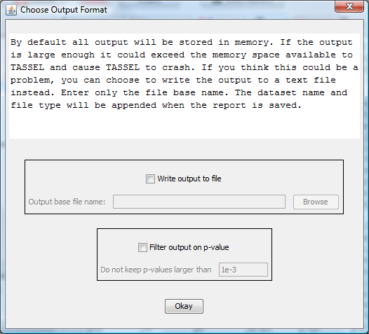
1
2
3

Slide 21
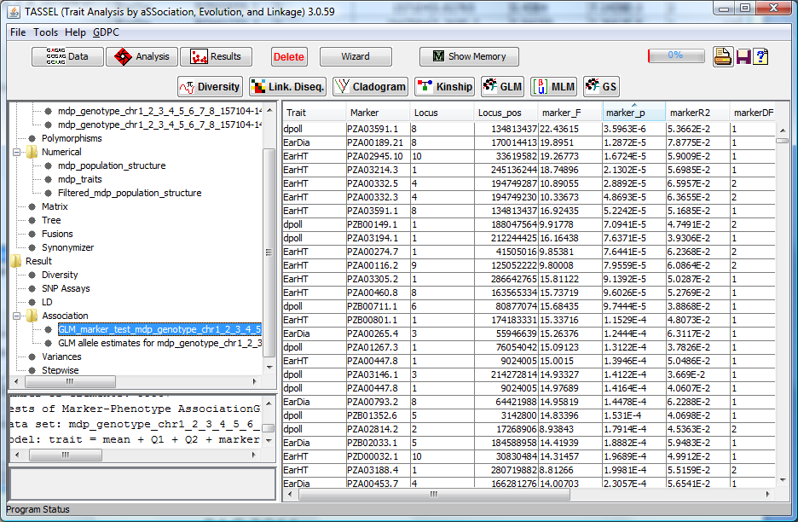
2
1

Slide 22
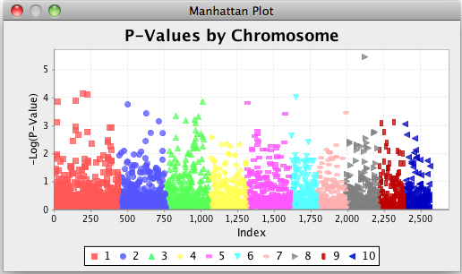
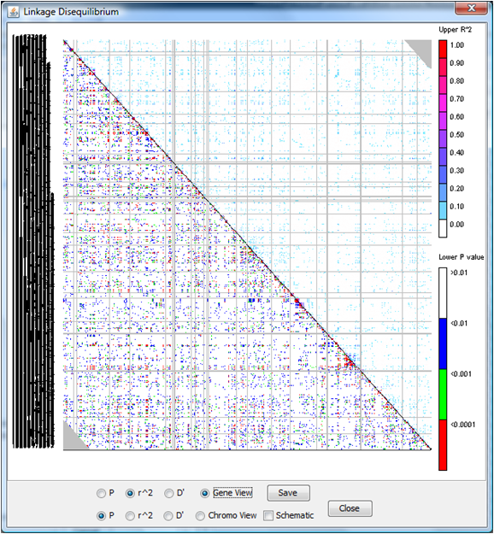
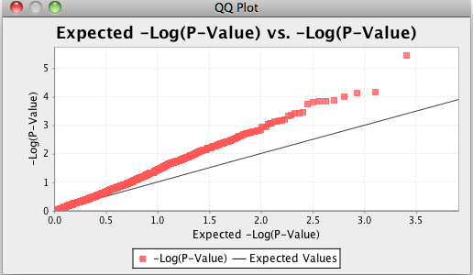
Visualization Tools
Manhattan
Plots
LD Plots
QQ Plots

Slide 23
Tassel Pipeline www.maizegenetics.net/tassel/docs/TasselPipelineCLI.pdf
Automates Complex Analyses.
Don’t need to write Java Code.
Threaded (Pipeline segments run simultaneously).
Works from web site Tassel launch.
Works from Command Line Interface.
Can produce same graphs as GUI.
XML Configuration Files

Slide 24
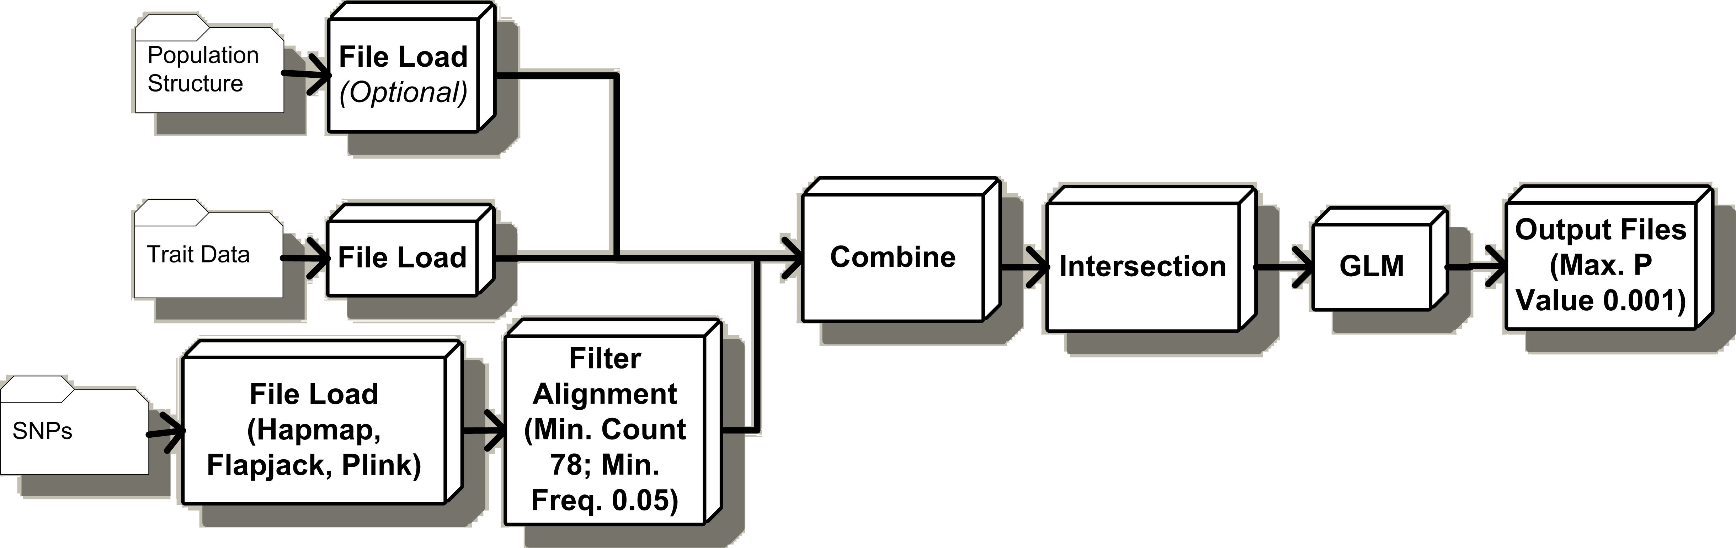
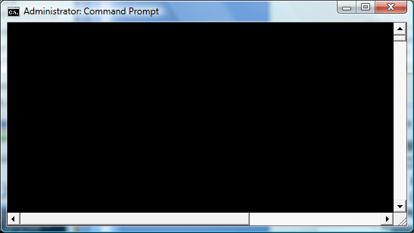
Example Pipeline: GLM Analysis
java -classpath "%CP%" -Xms128m -Xmx1024m net.maizegenetics.pipeline.TasselPipeline -fork1 -h "mdp_genotype.hmp.txt“ -filterAlign -filterAlignMinCount 78 -filterAlignMinFreq 0.05 -fork2 -r "mdp_traits.txt" -fork3 -q "mdp_population_structure.txt“ -combine4 -input1 -input2 -input3 -intersect –glm -glmOutputFile glm_output -glmMaxP 0.001 -runfork1 -runfork2 -runfork3
Evaluated
2.4 Billion
GLM Analyses in 14 CPU Hours!

Slide 25
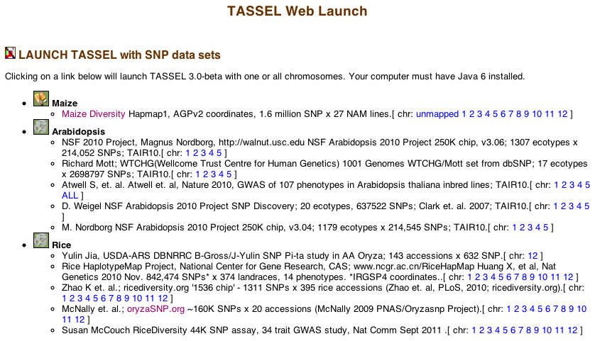
www.gramene.org/diversity/tassel_launch.html

Slide 26
TASSEL 4.0 – It’s All About the Bits!
TASSEL 4.0 introduces the next major improvements since TASSEL 3.0! Our new design puts emphasis on Efficiency, Performance, and Consistency. This is accomplished largely due to our bit-wise data storage and analysis algorithms.
1.6 Million LD Calculations Executes 30 times faster in TASSEL 4.0!
Distance Matrix for 1320 Taxa Executes 25 Times faster in TASSEL 4.0!

Slide 27
Join the TASSEL Community
~3000 Users
TASSEL Documentation, Tutorial Data Sets
http://www.maizegenetics.net/tassel
Discussion Group: http://groups.google.com/group/tassel
Source Code:
https://sourceforge.net/projects/tassel
Visit Poster 993 (TASSEL 4.0: Faster, Larger Diversity Analysis: It’s All About the Bits)
Email developers listed on the poster

