Slide 1
Gramene
Resources for Integrated Plant Genomics
“It’s Not Just For Grasses Anymore”
William Spooner
wspooner@cshl.edu @wspoonr
http://www.gramene.org
Notes:
It’s just over 10 years since the first Gramene release in March 2001.
Over the last 10 year Gramene has produced;
- An integrated database of plant genomics data; 17 completed/partially completed genomes, 50M DNA sequences and associated genetic markers, 30M genomic variants, population alleles and increasingly phenotypic associations.
- Workflows/protocols/methods for data integration; numerous workflows, pipelines.
Software for visualisation of the integrated data; cMAP, Ensembl (reuse existing software), and reporting (Gramene, BioMart) …

Slide 2
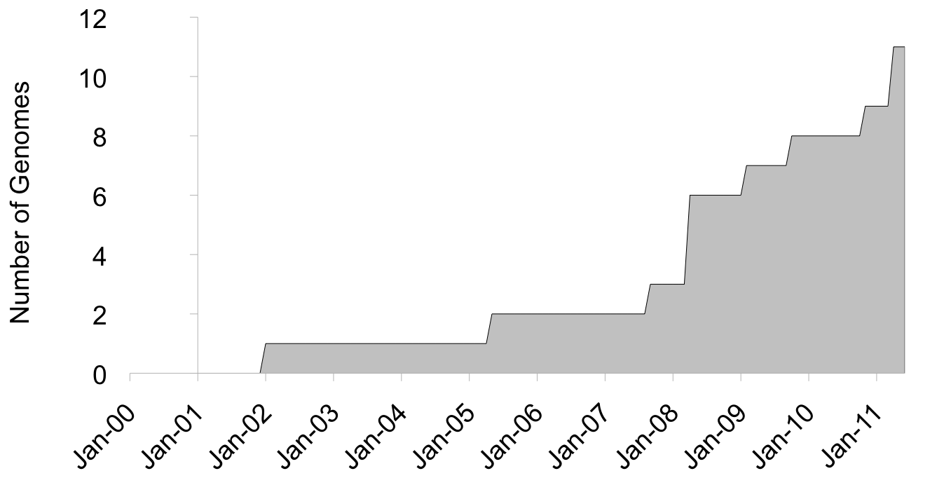
Sequenced Plant Genomes
[11 in Gramene]
Maize
O.glab.
Physco.
Brachy.
A.lyrata
P. patens
Sorghum
Z. mays
B. distachyon
Poplar
Grape
A. lyrata
Rice I.
P. trichocarpa
S. Bicolor
V. vinifera
Arabidopsis
Rice J.
O. Sativa I
A. thaliana
Strawberry
8 Published, not in Gramene:
Chlamy.
Cocoa
Papaya
Caster
13 Unpublished but available:
Columbine, tomato, potato, monkey flower, rose gum tree, cassava, peach, medicago, orange, clementine, banana, date palm, foxtail millet.
Cucumber
Apple
Soybean
50+ projects underway, and climbing?
Notes:
How Gramene has grown over the years
Specis lists from CoGe wiki.

Slide 3
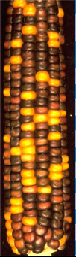
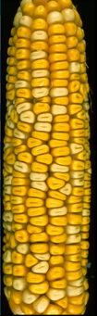
‘Omics in Gramene
Species 1
Species 2
Species 3
Species 4
Reference
G1
G2
G3
G4
Interactome
Reference
G1
G2
G3
G4
Epigenome
Reference
T1
T2
T3
T4
Transcriptome
Phylogenomics
Reference
G1
G2
G3
G4
Genome
Compara. Genomics
Pop-A
Pop-B
Variome
G1a
G1b
G1c
G1c
Genomic Association
Phenotypes
Functional Insight
Notes:
Gradual move away from genetic mapping, increase focus on whole genomes

Slide 4
Genome-scale datasets
Clade | Species | Genome | Transcr-iptome | Variome | Pathways
Monocots | O. sativa J
 | O. sativa I
 | O. glaberrima
 | B. distachyon
 | S. bicolor
 | Z. mays
Eudicots | A. thaliana
 | A. lyrata
 | P. trichocarpa
 | V. vinifera
Bryophytes | P. patens

Slide 5
Comparative genomics datasets
O.sativa J | O.sj
O.sativa I |  | O.si
O.glaberrima |  |  | O.gl
S.bicolor |  |  |  | S.bi
B.distachyon |  |  |  |  | B.di
A.thaliana |  |  |  |  |  | A.th
A.lyrata |  |  |  |  |  |  | A.ly
V.vinifera |  |  |  |  |  |  |  | V.vi
P.trichocarpa |  |  |  |  |  |  |  |  | P.t
P.patens |  |  |  |  |  |  |  |  |  | P.pa
Gene trees (CGT)
Pairwise alignment (blastz)
Multiple alignment (EPO)
Synteny blocks (DAGChain)
Notes:
Genomes in isolation are all very well. Gramene, integrates

Slide 6
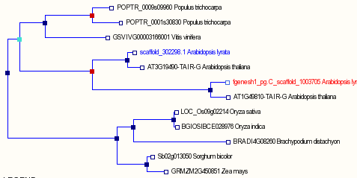
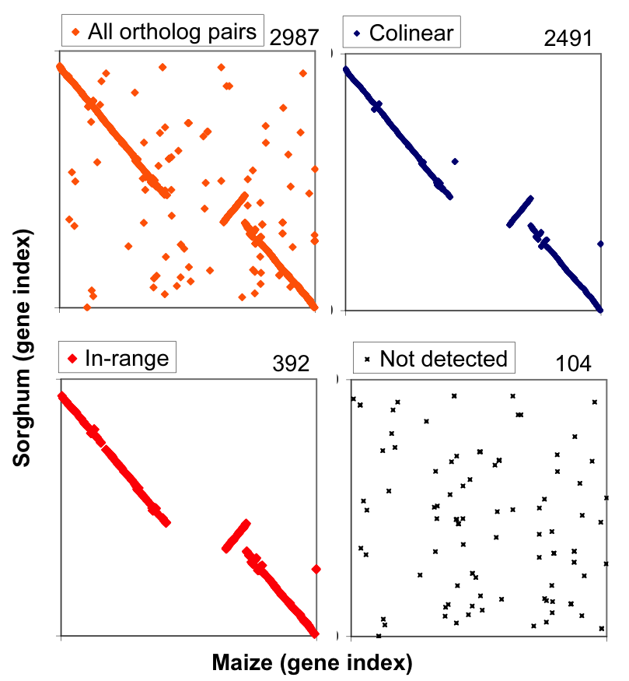
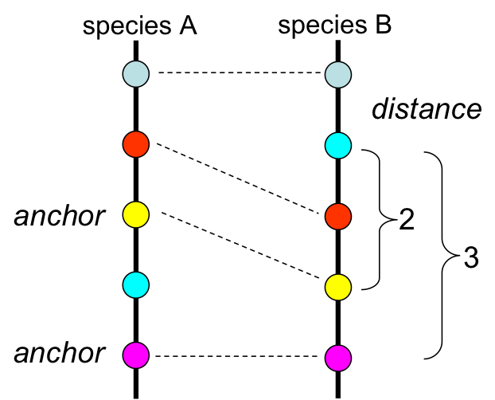
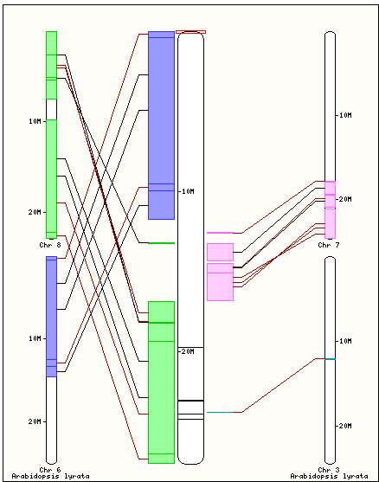
Data integration to generate datasets
Synteny Detection
Tandem Duplicate Detection
Adjacent paralogs with <3 intervening unrelated genes
GeneTree Orthologs
Collinear mappings
Map
Species | Clusters | Genes | Largest | Function
Rice (J) | 2519 | 7054 | 24 | Phytosulfokine receptor-like
Sorghum | 2182 | 5927 | 19 | Chalcone-stilbene synthase like
Maize | 1871 | 4564 | 22 | Domain of unknown function
Arabidopsis | 1738 | 4581 | 28 | ECA1 gametogenesis related family
Notes:
Using GeneTrees to generate new data
Tandem Duplicate Detection
Adjacent paralogs with no more
than 2 intervening unrelated gene
Increase gene dosage
Diversifying selection
Often species-specific

Slide 7
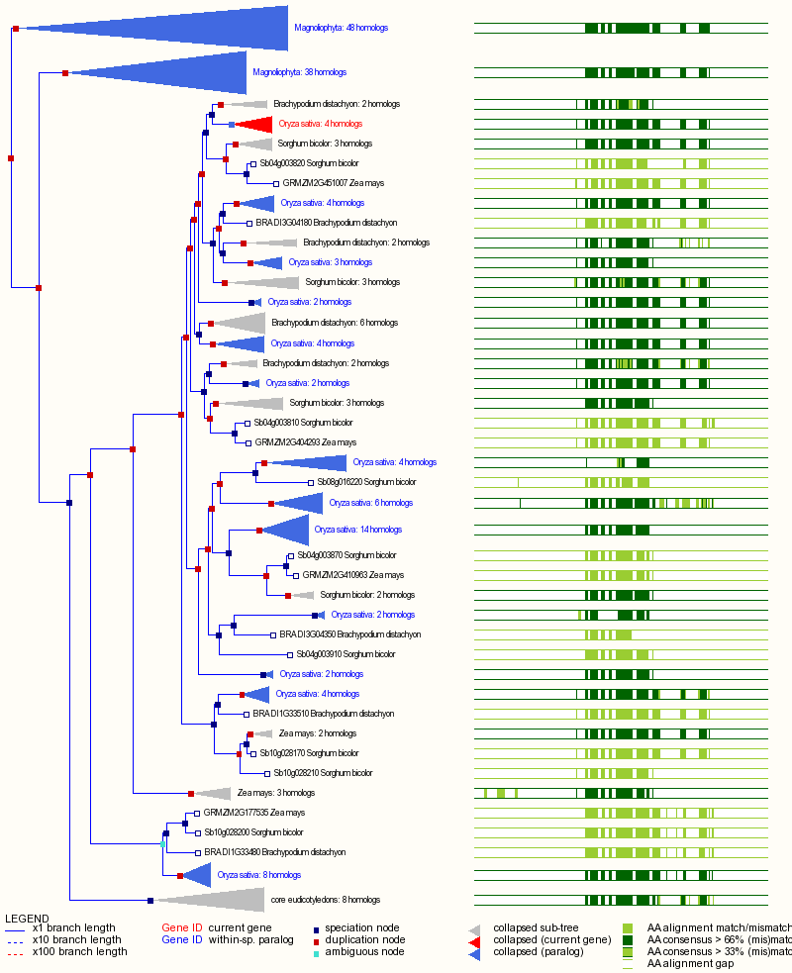
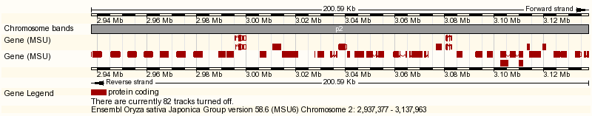
Data integration to infer biology
TODO merge with slide 6
LRR-Kinase species-specific expansions
Tandem Duplicate Detection
  Adjacent paralogs with no more
  than 2 intervening unrelated gene
  Increase gene dosage
  Diversifying selection
  Often species-specific
LRR-Kinase cluster in rice
Species | Clusters | Genes | Largest | Function
Rice japonica | 2519 | 7054 | 24 | phytosulfokine receptor-like (LRR-kinase receptor)
Sorghum | 2182 | 5927 | 19 | Chalcone-stilbene synthase like
Maize | 1871 | 4564 | 22 | DUF1754 (domain of unknown function)
Arabidopsis | 1738 | 4581 | 28 | ECA1 gametogenesis related family
Notes:
Using GeneTrees to provide biological insight

Slide 8
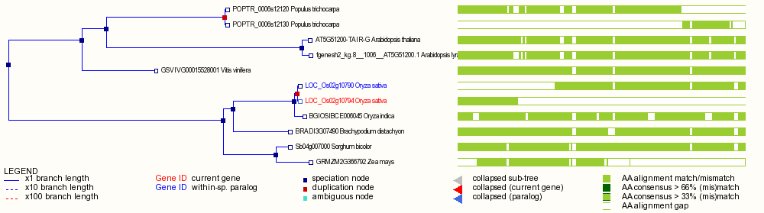
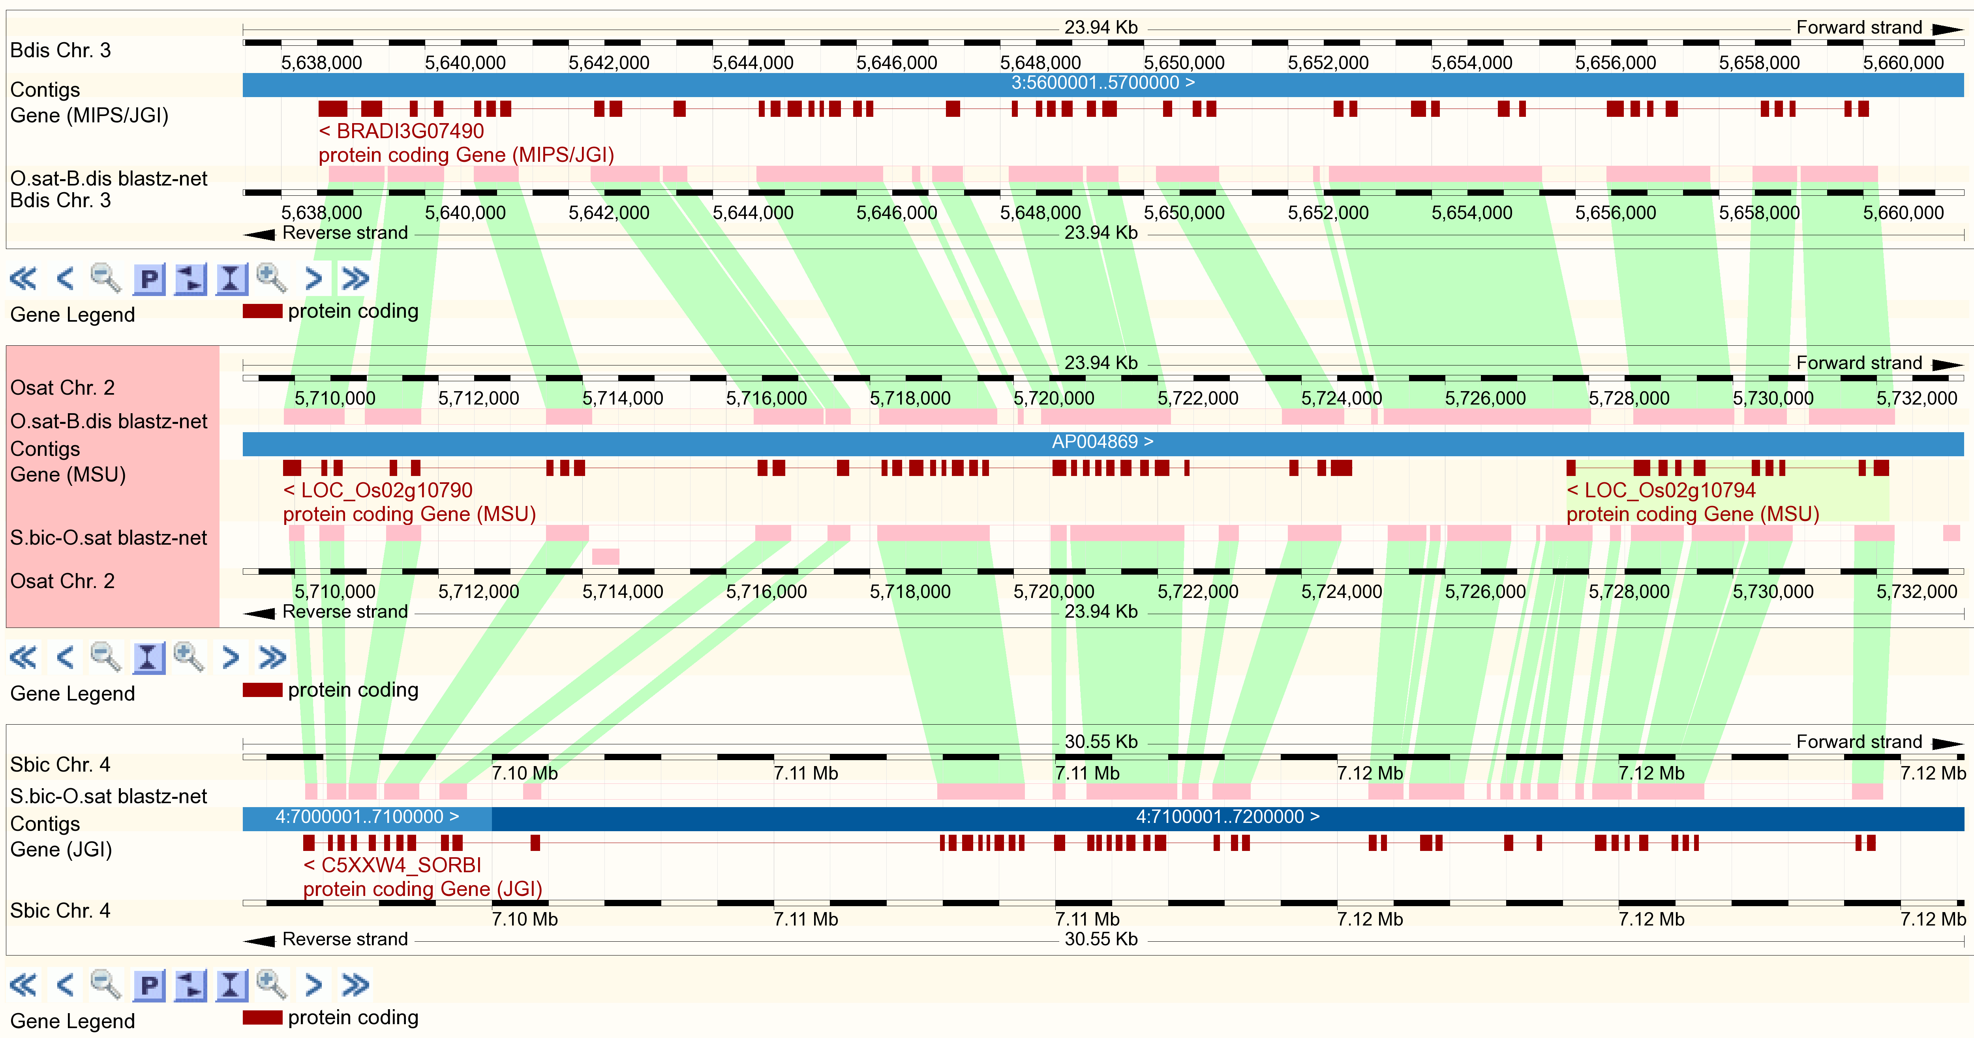
Data integration to QC datasets
Automated Detection of Split Genes
Species | SplitGenes
Populus trichocarpa | 1181
Sorghum bicolor | 1087
Oryza sativa Japonica | 916
Vitis vinifera | 520
Oryza sativa Indica | 365
Zea mays | 280
Arabidopsis lyrata | 202
Arabidopsis thaliana | 137
Brachypodium distachyon | 101
Genome alignment confirms inconsistent annotation
Notes:
Using GeneTrees to QC existing data
Classification developed by Ensembl
Contiguous split paralog: Non-overlapping, nearby (<1 Mb), same strand
Putative split paralog: Non-overlapping, different regions (e.g. scaffolds)

Slide 9
Variome datasets
Add diagram showing overlap between datasets for arabidopsis
Rice | 160,000 SNPs x 21 varieties (incl. Nipponbare ref.) from OryzaSNP
Maize | 1.6 million SNPs x 27 NAM founder lines from Panzea
Arabidopsis | 2010 Project SNP Discovery: 637,522 SNPs x 21 ecotypes (incl. Col-0 ref.)
 | 2010 Project 250K SNP chip genotypes v3.04, 214,000 SNPs x 1179 ecotypes
 | 1001 Genomes/WTCHG SNPs from dbSNP, 2.7 million SNPs, 17 ecotypes
Grape | 71K SNPs (Myles et al.)
Add info about populations
Notes:
Functional consequences of polymorphism

Slide 10
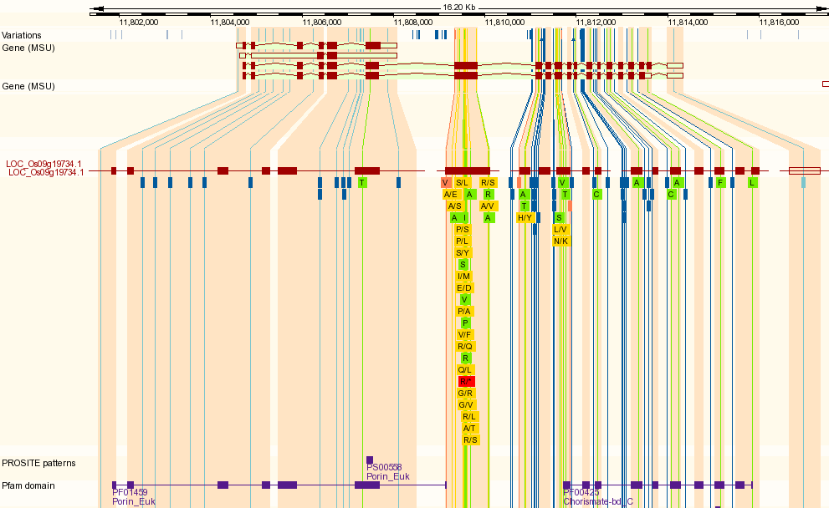
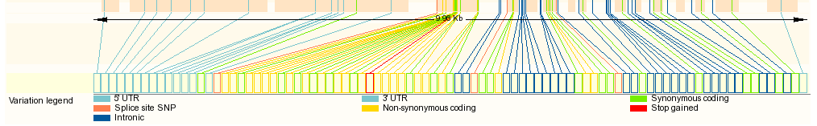
Functional consequences of polymorphism
TODO: Add ‘expanded’ panels zooming in on points to note

Slide 11
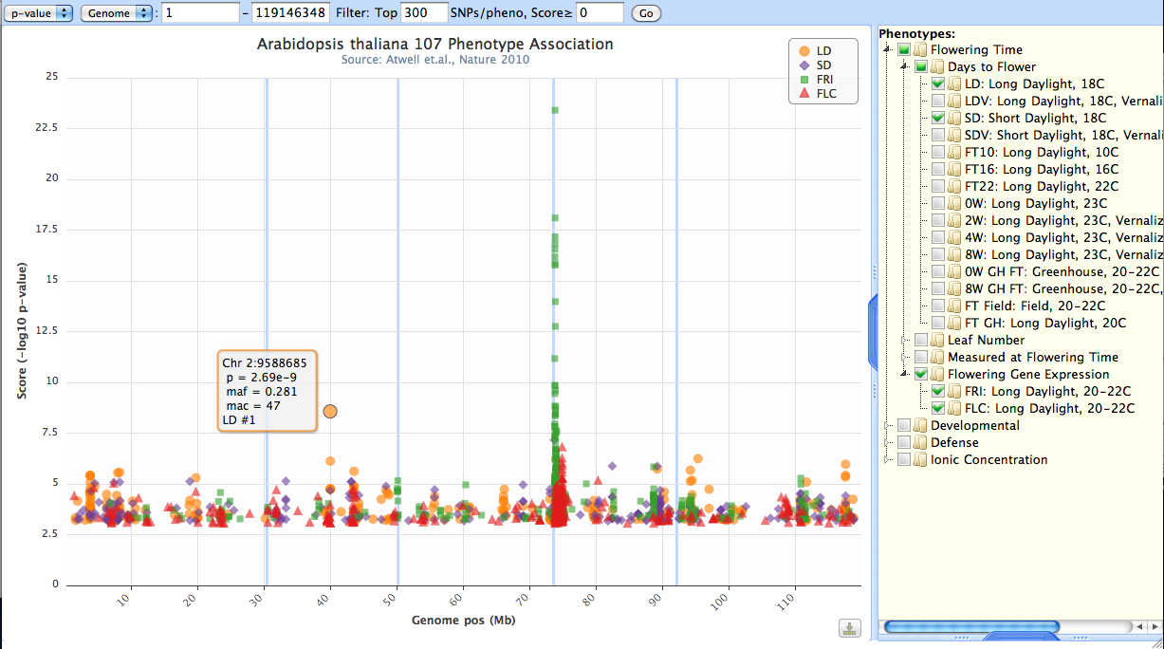
Phenotypic Association: Combining Genome-Wide Studies
Notes:
Preliminary work on the visualization of genome-wide association studies.
Future may include formal GWAS meta-analysis

Slide 12
Integrating 3rd Party Data
TODO: Schematic images and browser screenshot
Web Services
  Distributed Annotation Server (DAS) serving Ensembl genes as well as Gramene markers, sequences, and QTL
  Gramene Mart integration with Galaxy
  Public MySQL server
  Diversity data via Tassel and GDPC
  Subversion for code access
Notes:
Ken do we have any information on access of the mySQL servder

Slide 13


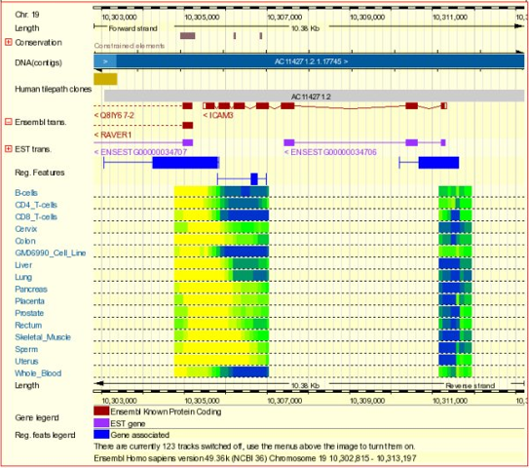
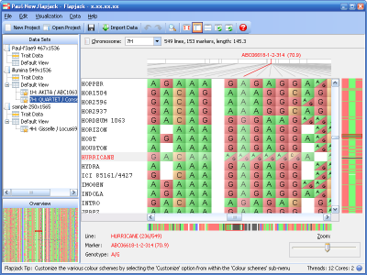





Integrating 3rd Party Data
User
User
DAS Server
DAS
Web Services
Tassel
DAS client
server
client

Slide 14
Infrastructure Collaborations
TODO: Need input from Doreen
Ensembl Genomes
  Over last 2 years
  Data/software sharing; avoid duplication
Reactome
Atlas

Slide 15
Acknowledgements
CSHL
  Doreen Ware
  Ken Younes-Clark
  Josh Stein
  Marcela Monaco
  Jim Thomason
  Sharon Wei
  Aaron Chua
Oregon State
  Pankaj Jaiswal
  Palitha Dharmawardhana
Cornel
  Susan McCouch
  Ed Buckler
  Genevieve DeClerck
  Charles Chen
  A. S. Karthikeyan
  Terry Casstevens
  Jon Zhang
Ensembl Genomes
  Paul Kersey
  Dan Staines
  Paul Derwent
  Andy Yates

