Slide 1
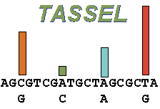
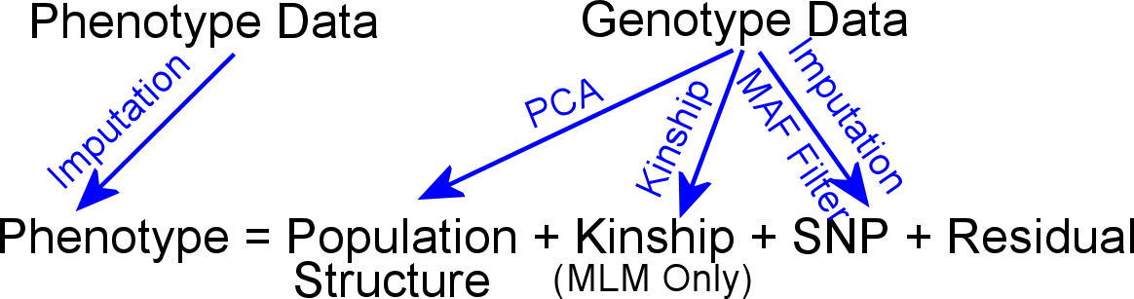
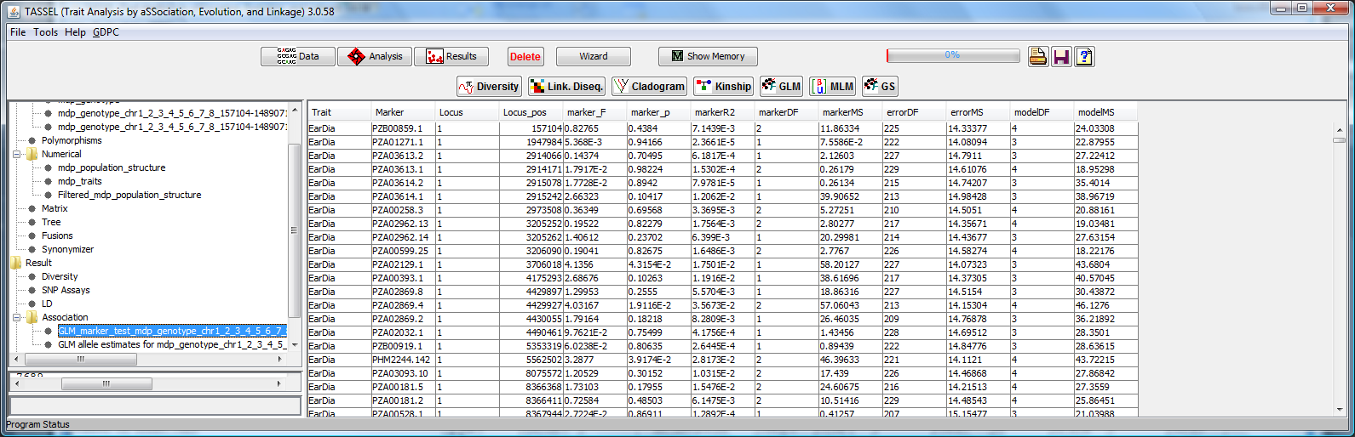
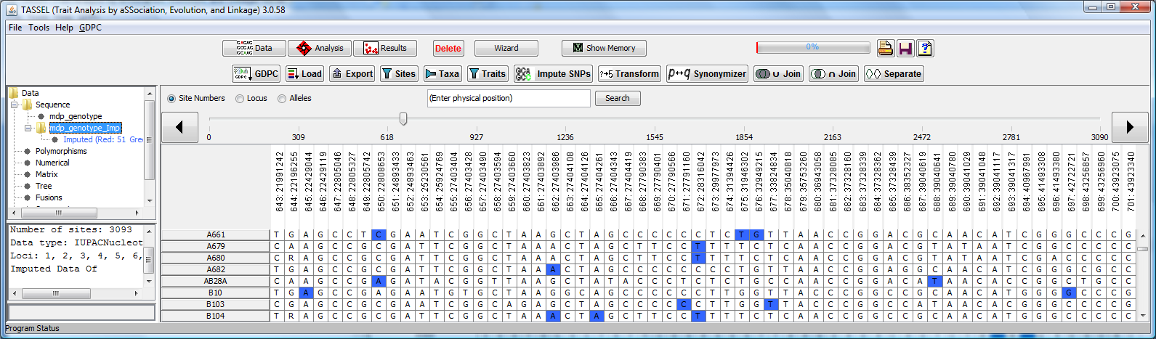
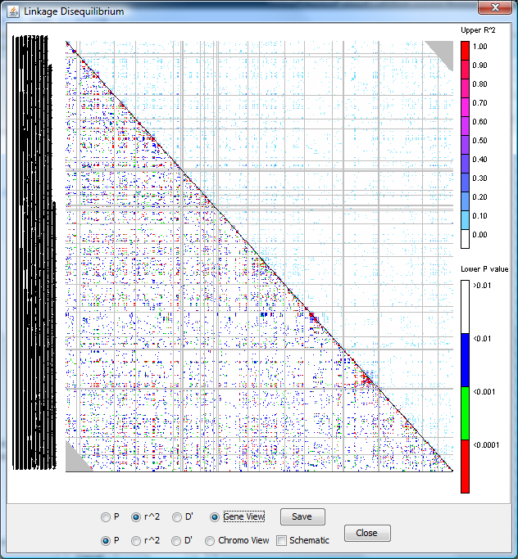
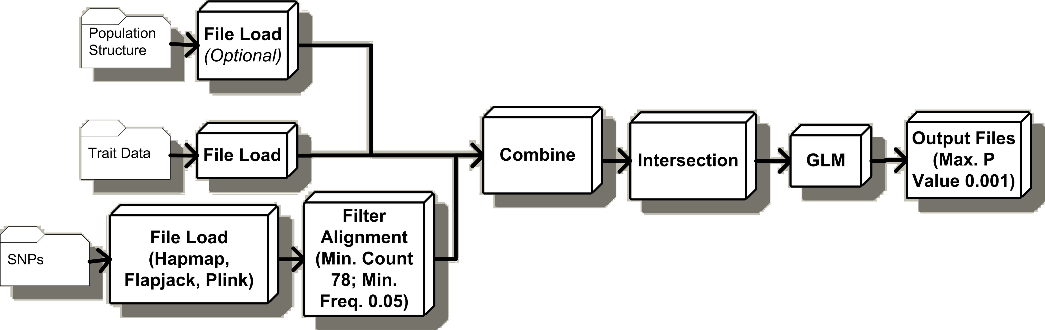
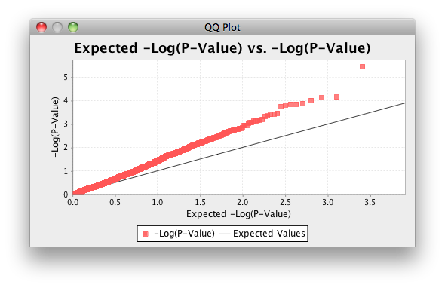
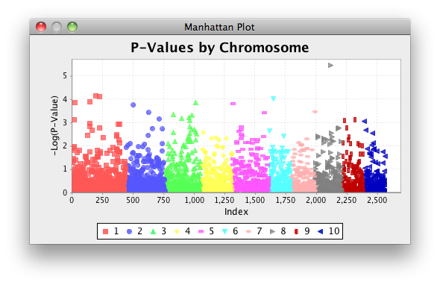


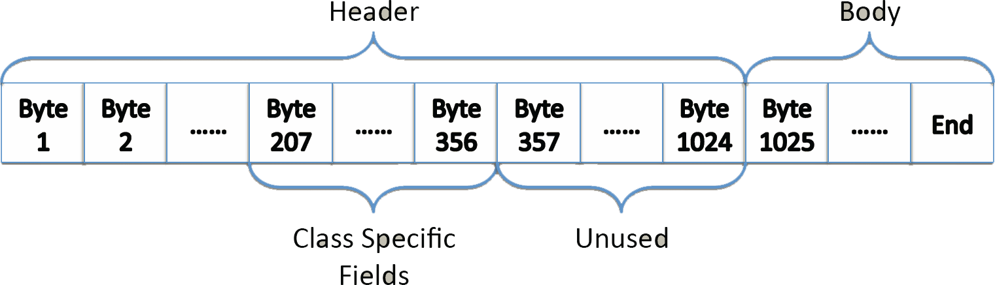


TASSEL 3.0: Designed to Handle Millions of SNPs
Terry Casstevens¹, Peter Bradbury^{2,3}, Zhiwu Zhang¹ , Yang Zhang¹, Edward Buckler^{1,2,4}
¹ Institute for Genomic Diversity, Cornell University, Ithaca, NY ² USDA-ARS ³ Cornell Theory Center, Cornell University ⁴ Dept. of Plant Breeding and Genetics, Cornell University
http://www.maizegenetics.net/tassel
Check out the Gramene Demo (C905), and the other Gramene posters: P228, P797, P235, P892/C892, P807
Introduction
For the past two years, the Trait Analysis by aSSociation, Evolution and Linkage (Tassel) software has been undergoing major design improvements leading to the release of version 3.0. Speed and memory efficiency have been important foci so that it can now handle millions of SNPs and conduct powerful tests with them much more rapidly than general purpose analysis packages.
Tassel is Java software that evaluates genotype and trait associations with the tools of population and quantitative genetics. Tassel can handle data sets commonly encountered in the plant community, e.g., replicated trials, inbred lines, and complex structured pedigrees. Tassel also has the latest, statistically powerful approaches for association mapping in complex populations including both General Linear Model (GLM) and Mixed Linear Model (MLM).
There have been several significant improvements since Tassel version 2.1... 1) New Data Structure Design supporting GDPDM 4.0 significantly improving memory efficiency.; 2) Improved algorithms for GLM and MLM analysis; 3) Alignment Viewer; 4) User Friendly Wizard; 5) Progress Monitoring w/ ability to cancel tasks; 6) Importing/Exporting Hapmap, Flapjack, Plink data formats; 7) Auto-loading and analysis execution from web site startup.; 8) Improved Error Messages; 9) Improved Automated Pipeline.
TASSEL is an open source project (sourceforge.net/projects/tassel).
TASSEL provides both Mixed Linear Model (MLM) and General Linear Model (GLM) for Genome-Wide Association Studies (GWAS). MLM implements algorithms to improve statistical power and computation speed:
EMMA: Efficient Mixed Model Algorithm to improve computation speed to estimate variance components (ratio). The algorithm was developed by Kang et al (2007, Genetics)
Compression: Individuals in the standard MLM are replaced by their corresponding groups. The algorithm was developed by Zhang et al (2010, Nature Genetics) to improve statistical power and speed.
P3D/EMMAx: The population parameters in MLM, such as variance components (ratio) are estimated only once. These Population Parameters Previously Determined (P3D) are fixed to screen SNPs (could be millions) to improve performance. This algorithm was simultaneously discovered by Zhang et al (2010, Nature Genetics, named as P3D) and Kang et al (2010, Nature Genetics, named EMMAx).
LD Analysis
Tassel Pipeline: Command Line Interface to Tassel functions that can be combined to perform complex automated analyzes.
(www.maizegenetics.net/tassel/docs/TasselPipelineCLI.pdf)
Example Pipeline: GLM Analysis: Using this, we evaluated 2.4 Billion GLM Analyses in 14 CPU Hours
QQ and Manhattan Plots
java -classpath "%CP%" -Xms128m -Xmx1024m net.maizegenetics.pipeline.TasselPipeline -fork1 -h "mdp_genotype.hmp.txt" -filterAlign -filterAlignMinCount 78
-filterAlignMinFreq 0.05 -fork2 -r "mdp_traits.txt" -fork3 -q "mdp_population_structure.txt" -combine4 -input1 -input2 -input3 -intersect –glm
-glmOutputFile glm_output -glmMaxP 0.001 -runfork1 -runfork2 -runfork3
GDPDM Data Compression with BLOBs
Compression by several orders of magnitude
Genotype alleles, marker IDs, positions, and imputation data as well as genotype-phenotype association statistics are divided up by chromosome, converted from ASCII to binary format, and inserted into the Gramene Diversity GDPDM. Header information varies, depending on the type of data is being stored. Data packing with GDPDM BLOBs achieves a 200-fold increase in storage efficiency. See full BLOB specifications at www.maizegenetics.net/gdpdm.
For example,
100,000 SNPs x 100 maize lines
(Data points: 100,000 SNP positions, 10,000,000 allele calls = 10,100,000)
100,000 SNPs x 10 chromosomes = 10 position database records
100 maize lines x 10 chromosomes = 1000 allele call database records
Compress data into GDPDM BLOBs
10,100,000 records 1010 records
Number of DB records is reduced by 10⁴
Thanks to NSF and USDA-ARS for their support.
January 12, 2011

