Slide 1
Quick Search, Markers & Maps
Ken Youens-Clark

Slide 2
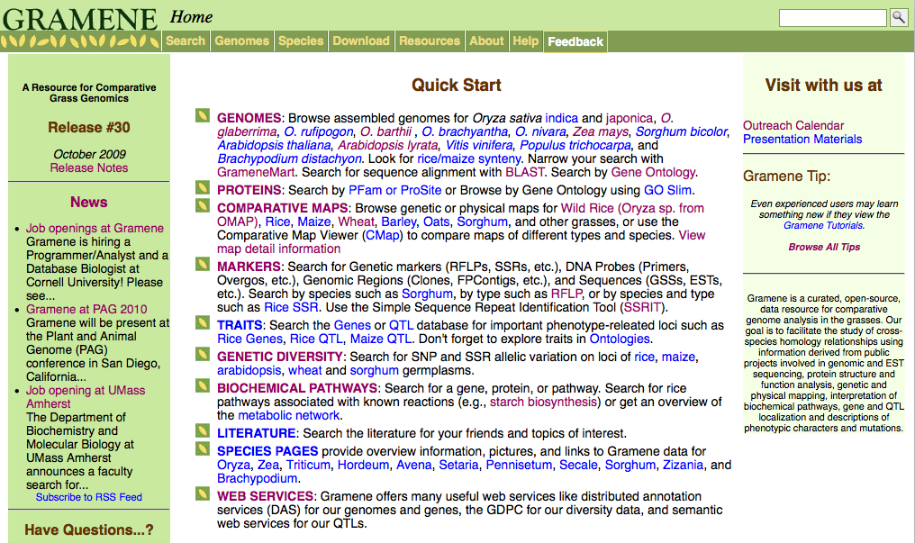
Quick search box

Slide 3

Quick search

Slide 4
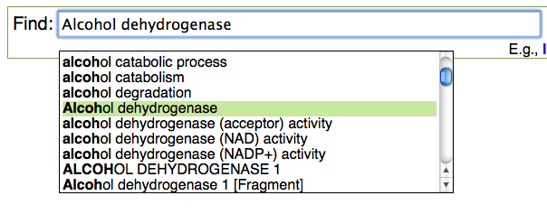

Auto-suggestions

Slide 5
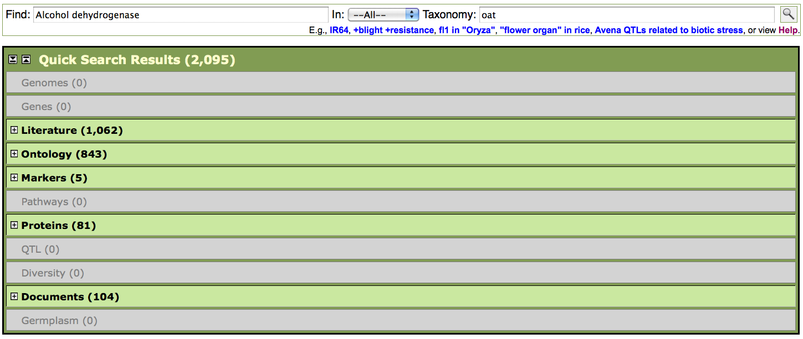
Search results

Slide 6
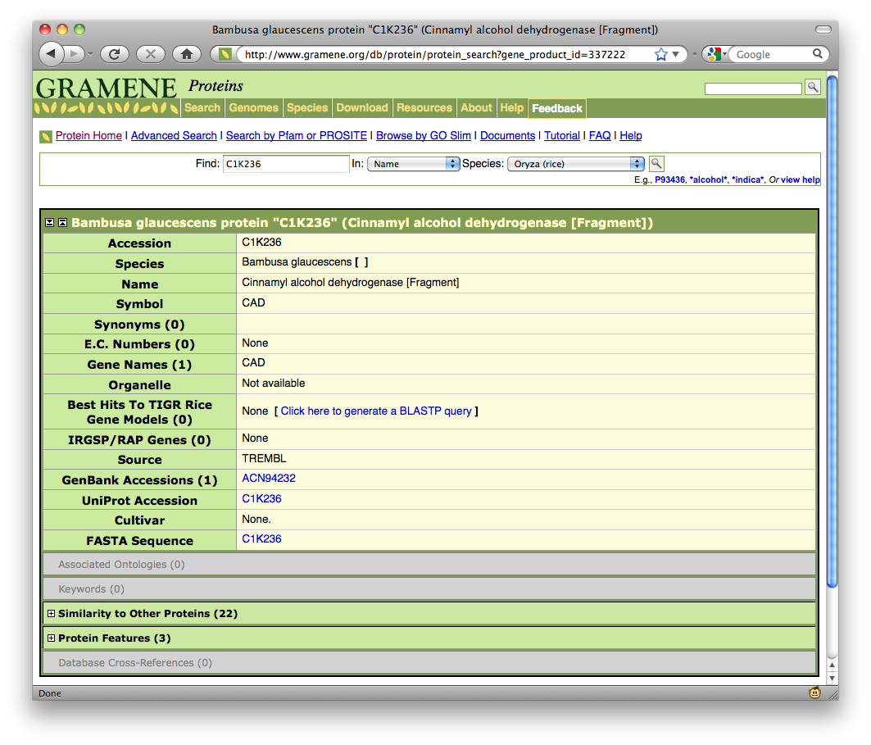
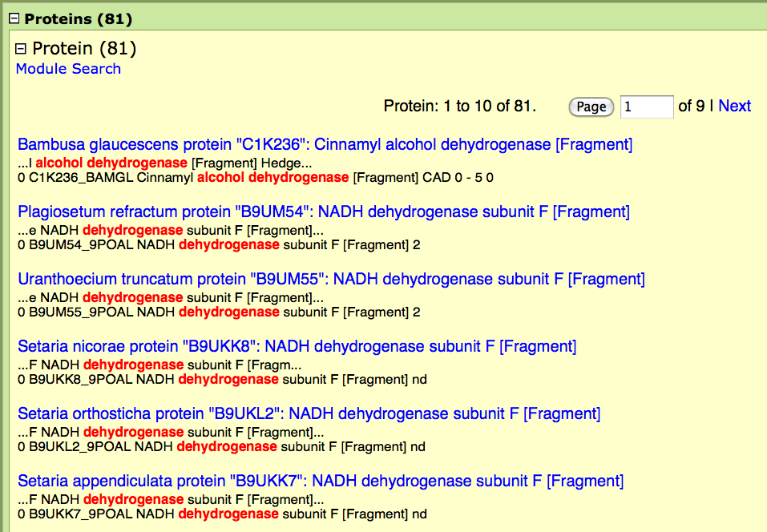
Module results

Slide 7
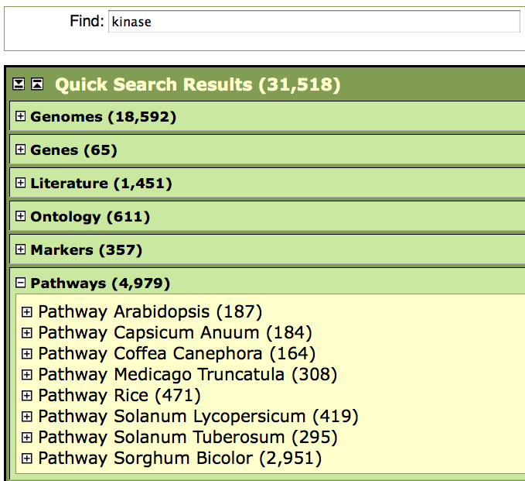

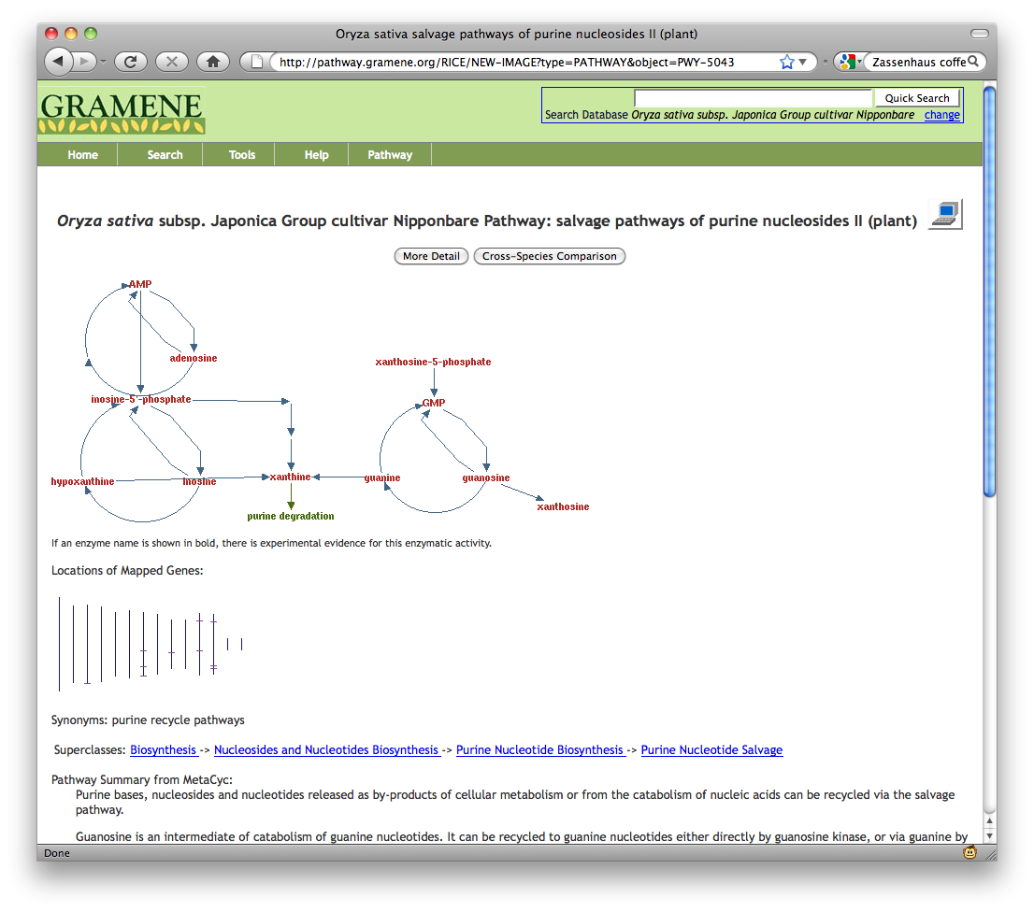
Kinase

Slide 8
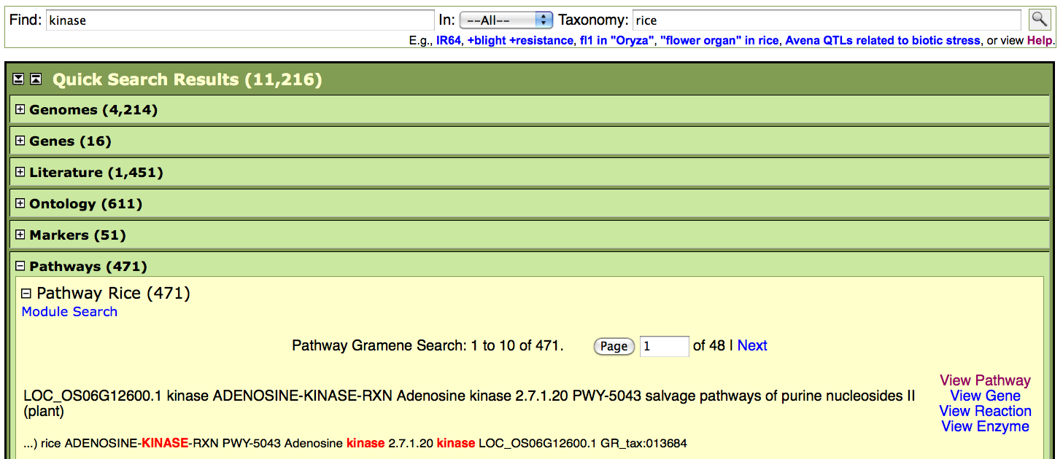
Kinase in rice

Slide 9
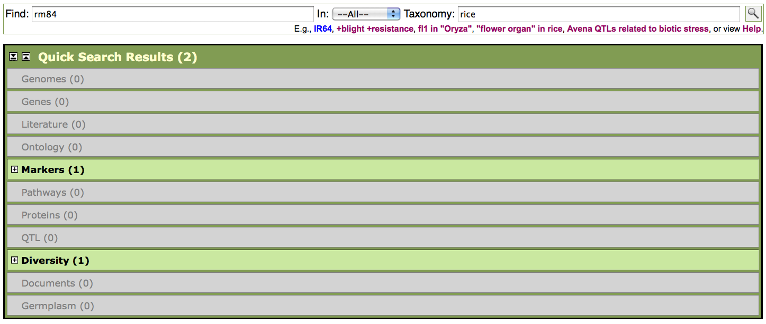
Markers search

Slide 10
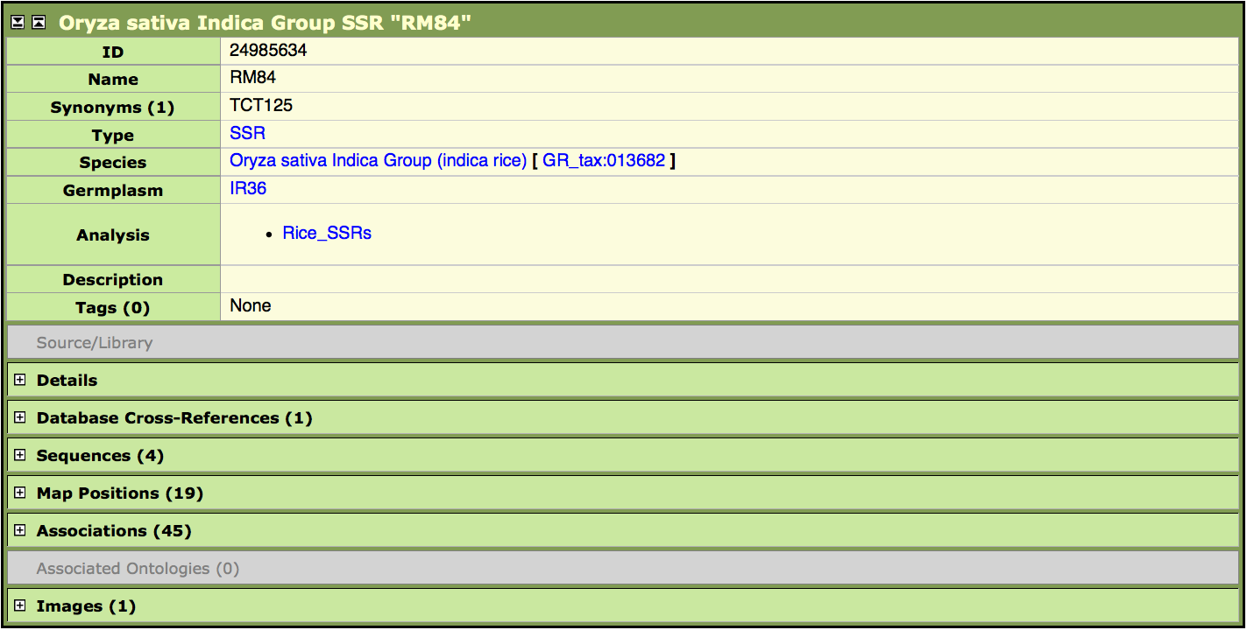
Marker/sequence view

Slide 11
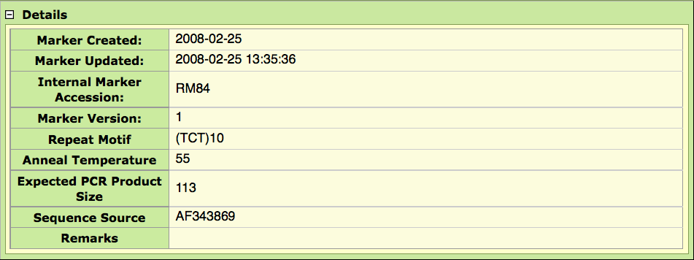
Details

Slide 12

Database cross-references

Slide 13
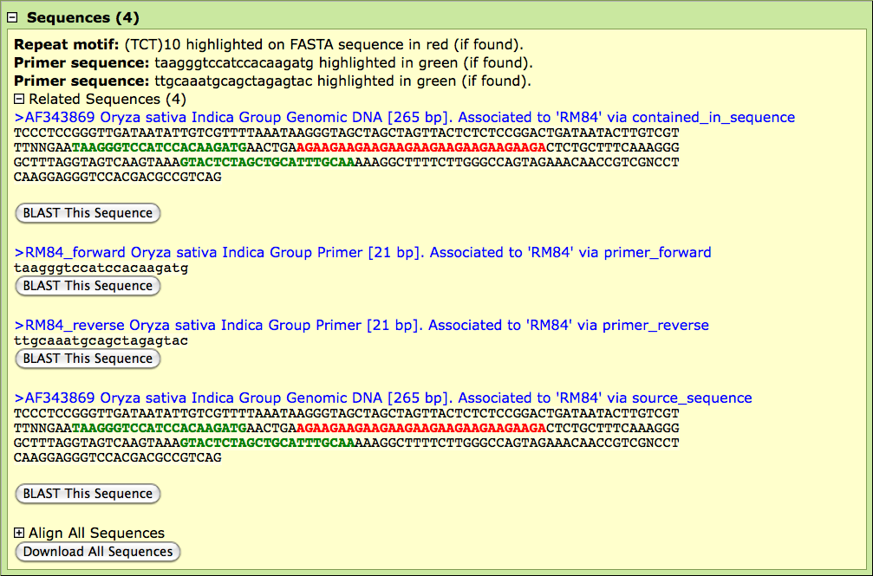
Sequences

Slide 14

Associations

Slide 15
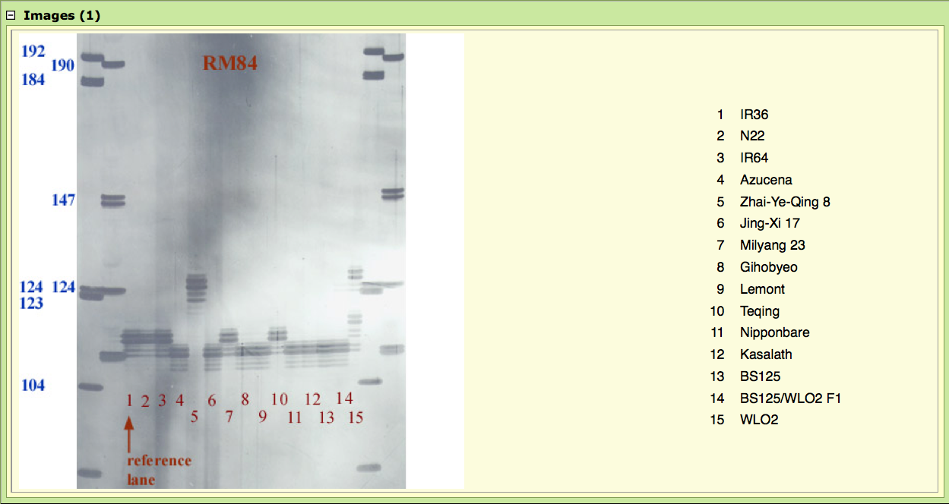
Images

Slide 16


Map positions

Slide 17
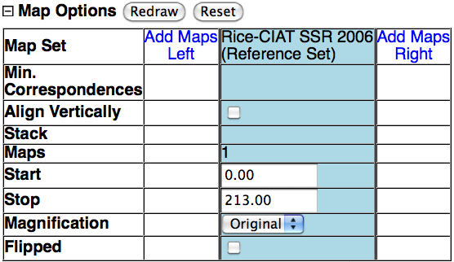
Adding maps

Slide 18
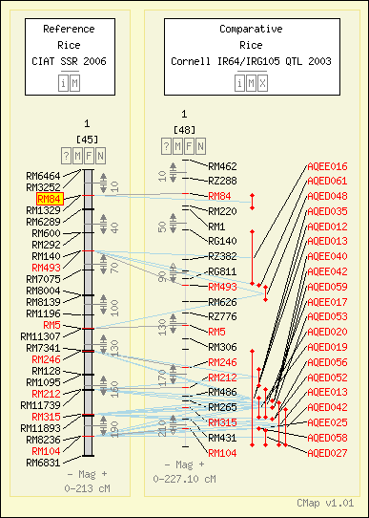
Map added to the right

Slide 19
CMap entry points
Search for a feature
Select a map set and map(s)
Correspondence matrix

Slide 20
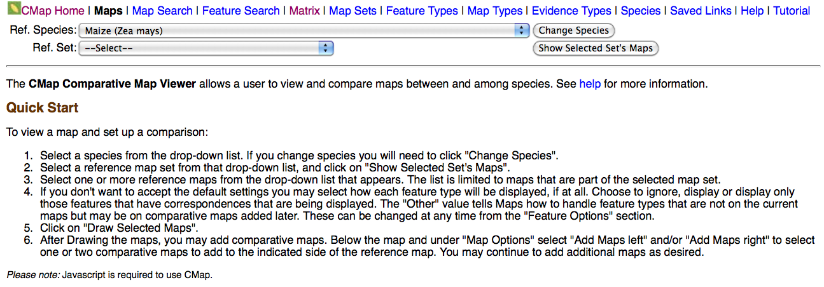
Map selection

Slide 21
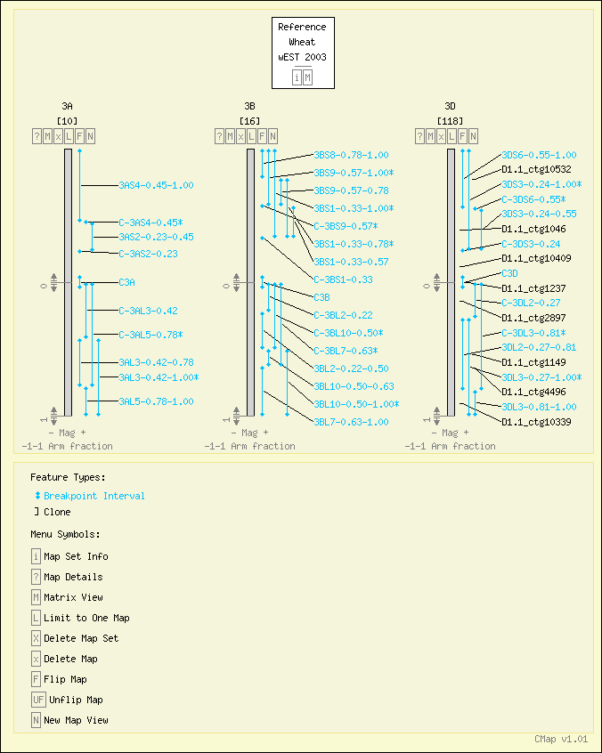
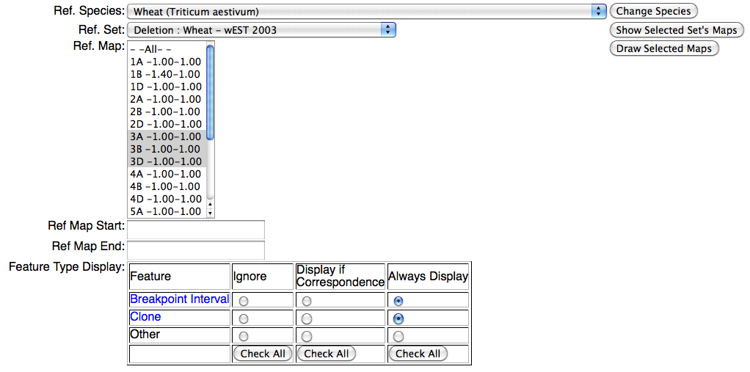
Map selection

Slide 22

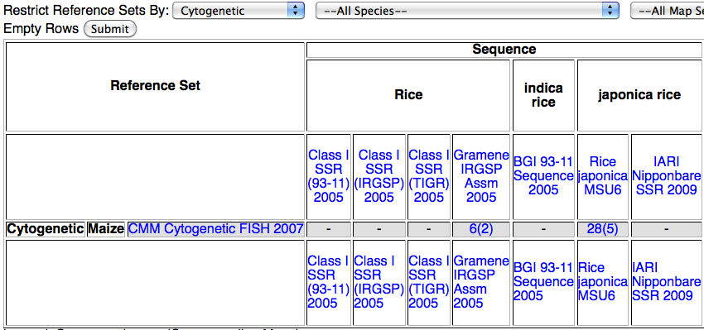
Matrix

Slide 23

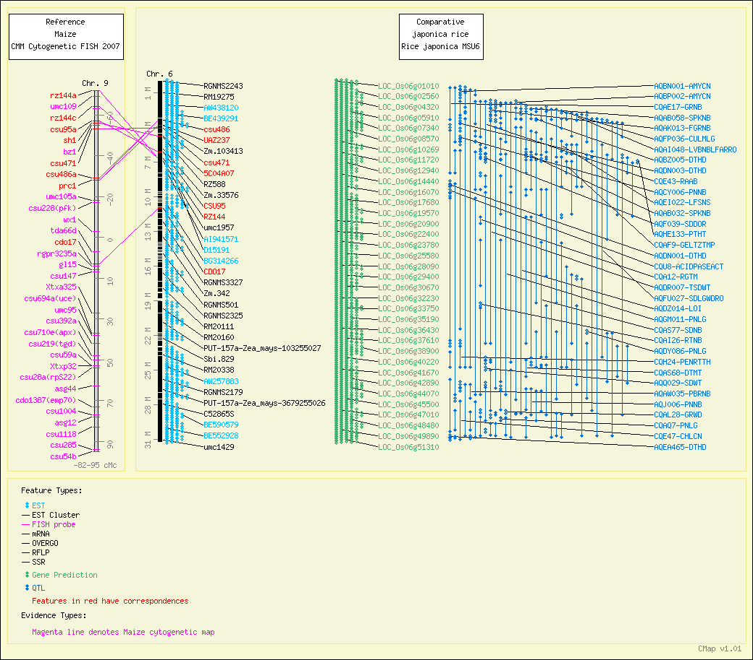
Matrix

