Slide 1
Gramene Ontology and Pathway Databases
Palitha Dharmawardhana
palitha@oregonstate.edu

Slide 2
Gramene Ontology Database
Provides a collective resource of structured controlled vocabularies (Ontologies) for knowledge domains and their associations to various objects such as QTL, phenotypes, proteins and genes.
Knowledge Domains:
  Plant Ontology (PO)
    Plant Structure (morphology, organs, tissue and cell types) and Development*
    Growth stages (plant growth and developmental stages)
  Trait Ontology (TO)
    Plant traits and phenotypes
  Gene Ontology (GO)
    Molecular function
    Biological process
    Cellular component
  Environment Ontology (EO)
  Gramene's taxonomy ontology (GR_tax)
Associations:
  Useful to quickly find genes, proteins, QTL and map sets of interest.

Slide 3
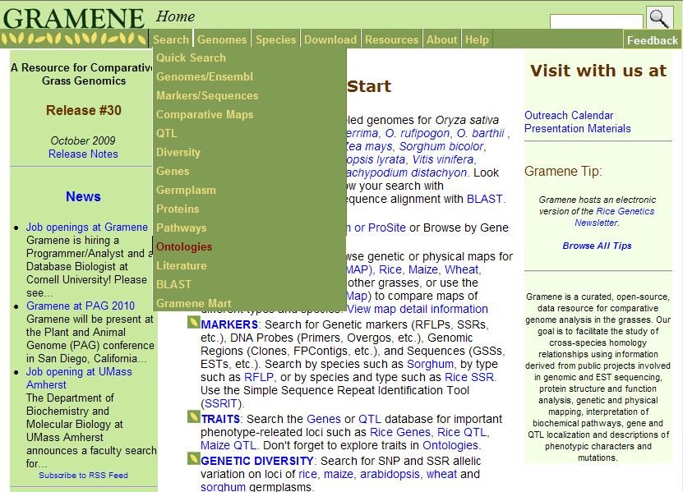

Slide 4
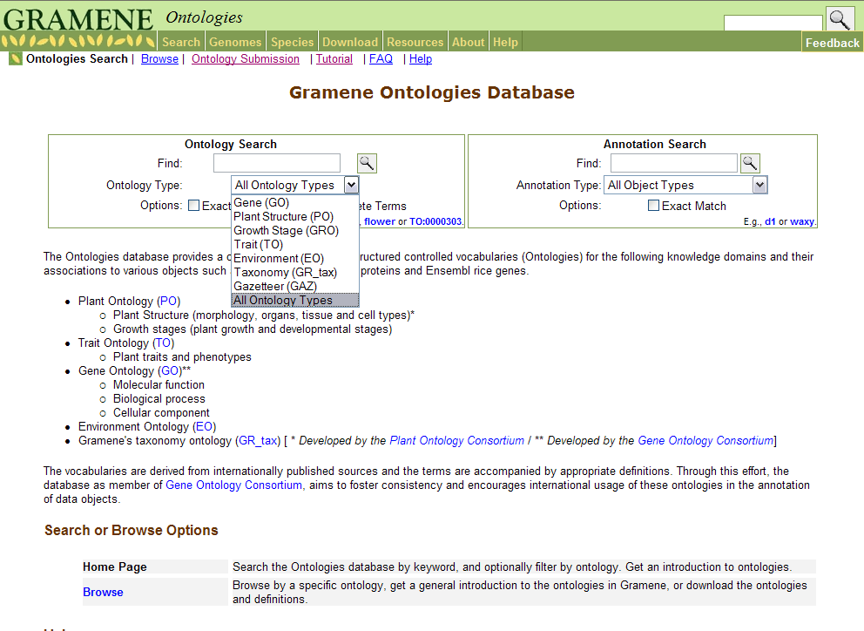
Gramene Ontology Entry Page
Type term or # (option- to limit a search on specific ontology type)

Slide 5
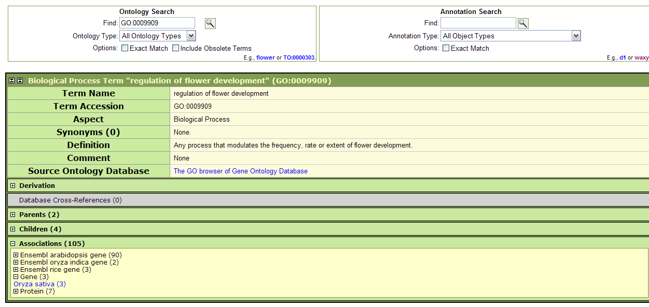
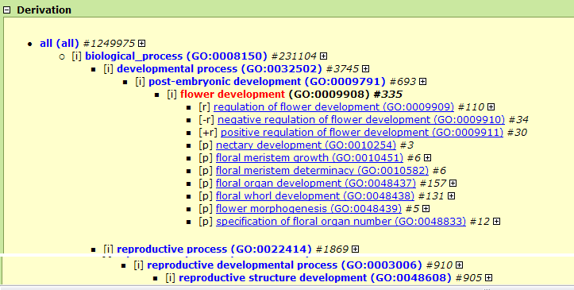
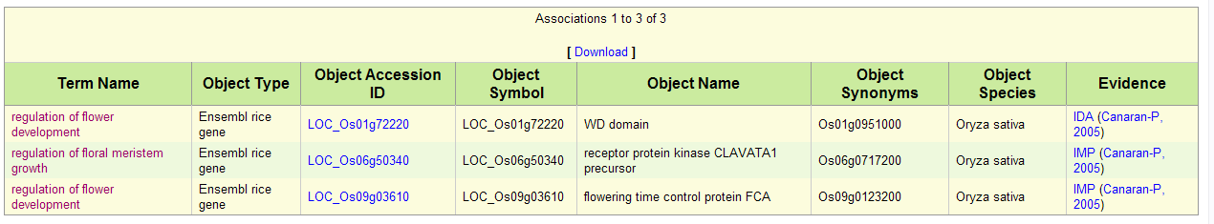

Slide 6
Ontology associations provide a quick way of linking to and finding genes, proteins, QTL and map sets of interest.

Slide 7
Gramene Pathways Database

Slide 8
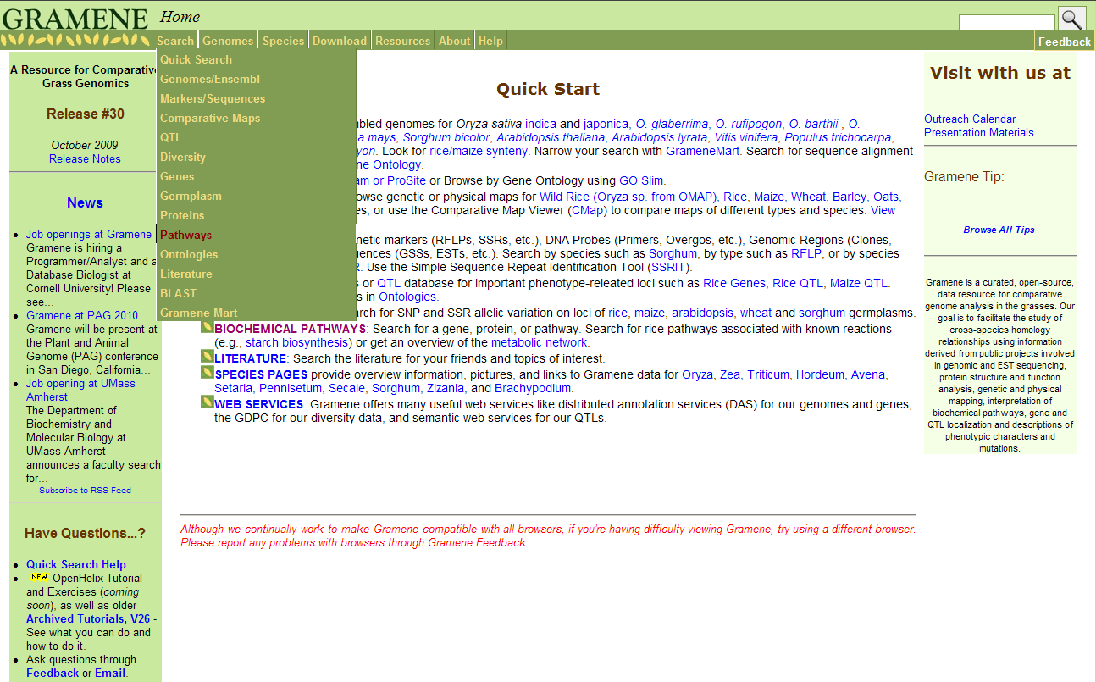
Gramene Home Page
Click here to open the Pathways module

Slide 9
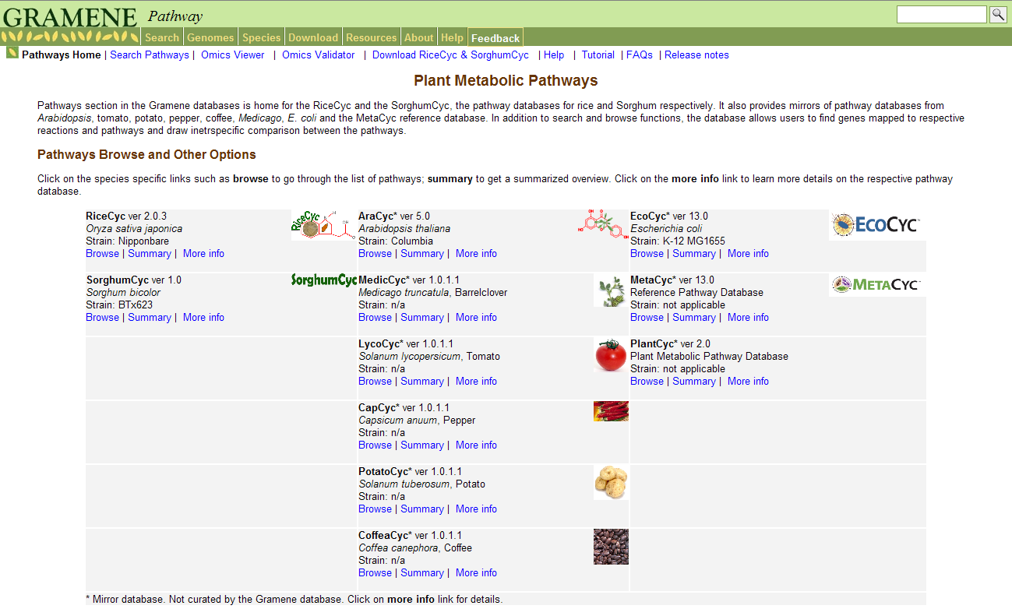
Gramene Pathways
Pathways developed & curated by Gramene
3 reference pathway databases
6 species specific pathways are mirrored

Slide 10
Pathway Page Navigation Options
Connects to
Search pathways
Omics viewer
Omics validator
Downloads
Help
Tutorials
etc.
Connects to
pathways specific to the species

Slide 11
Pathway Page Navigation Options

Slide 12
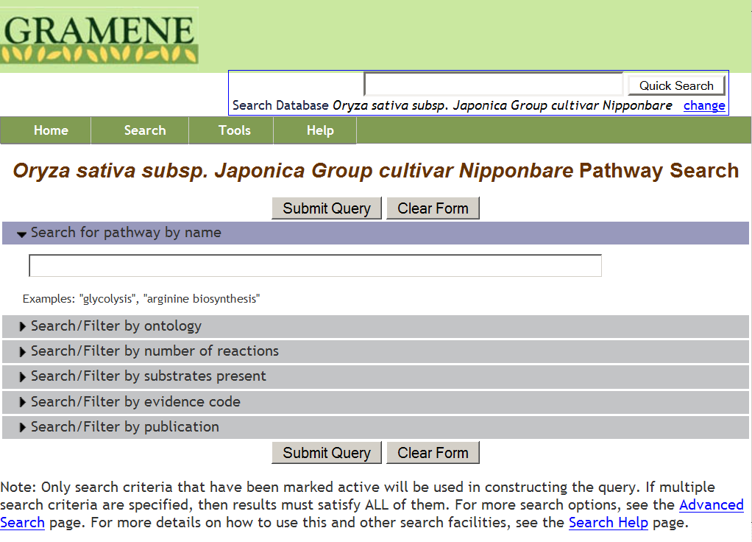
Pathway Search Options
Search by pathway name
Search by pathway ontology
Search by substrate names in pathway

Slide 13
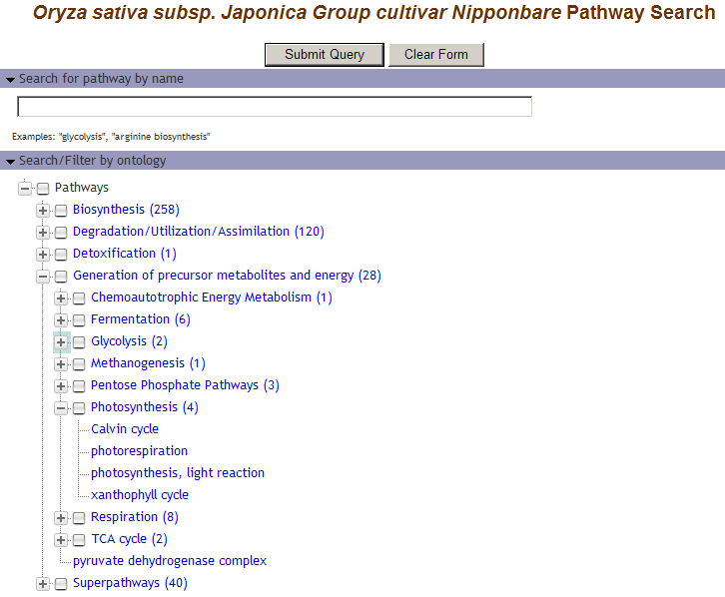
Search by Pathway Ontologies

Slide 14
Pathway Page Navigation Options
Connects to
pathways specific to the species

Slide 15
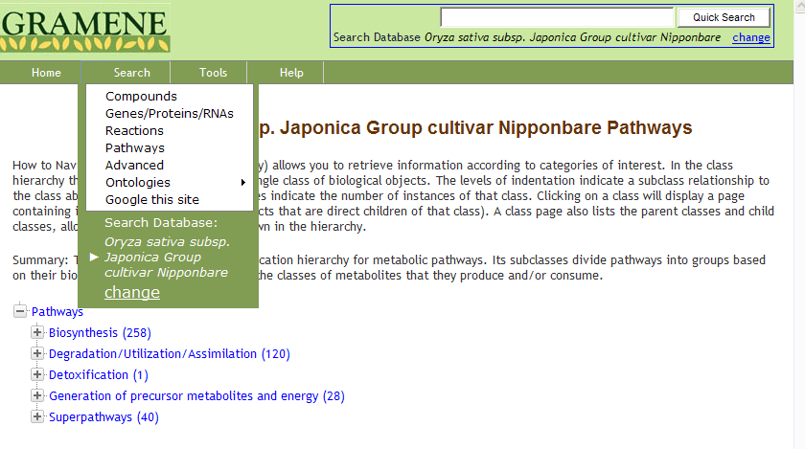

Slide 16
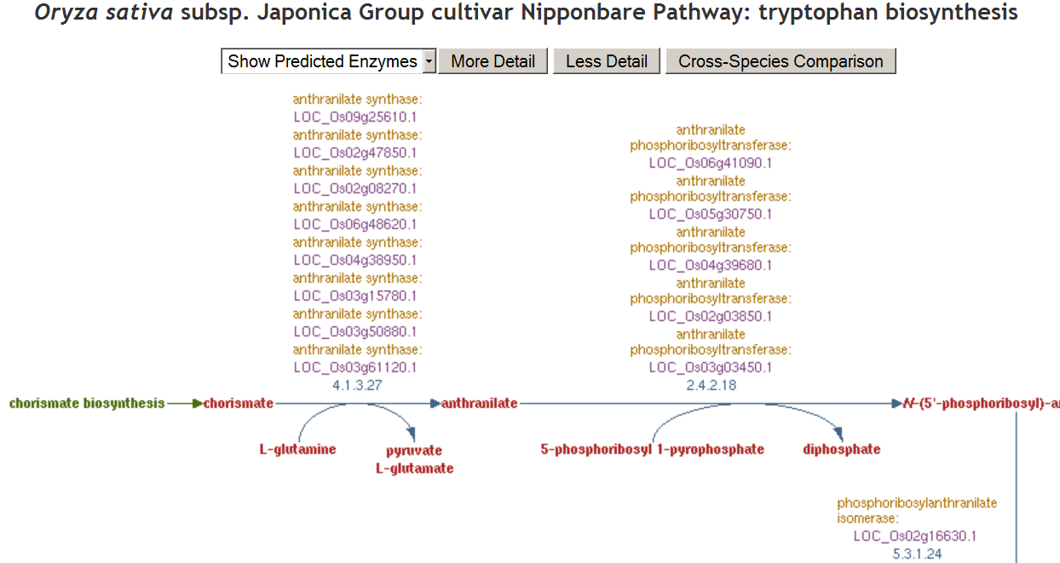
Pathway Information
Click for more detailed views of the pathway
Click on individual genes, enzyme or compound for detailed reports
Click on reaction line to get reaction page

Slide 17
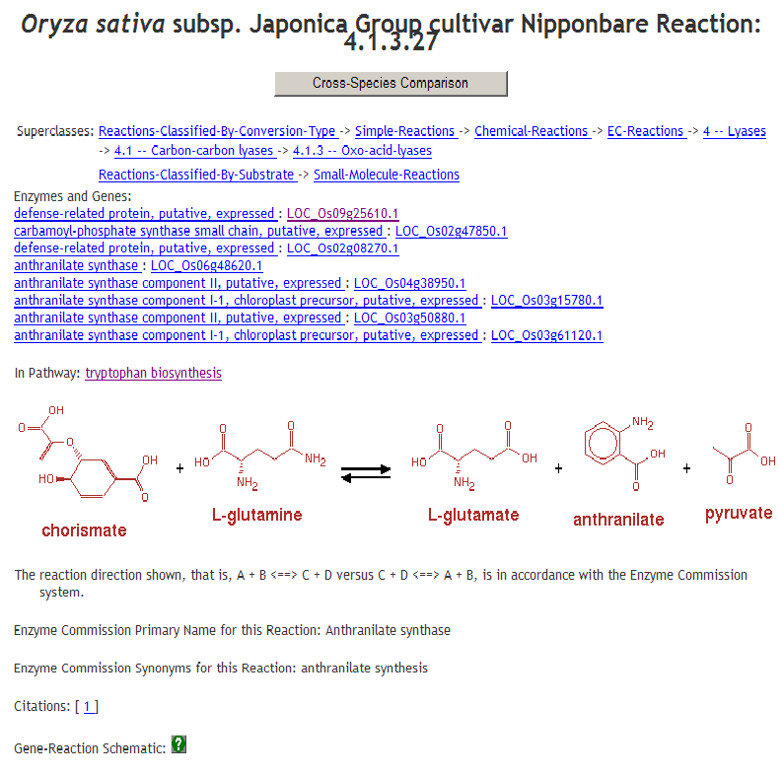
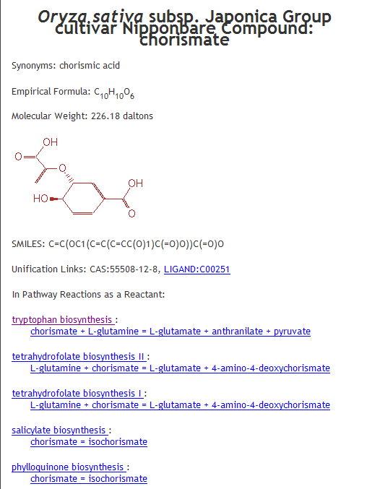
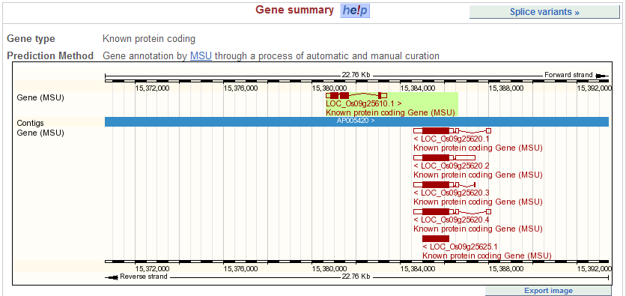
Links to information on: Genes, Proteins, Reactions, Compounds etc.

Slide 18
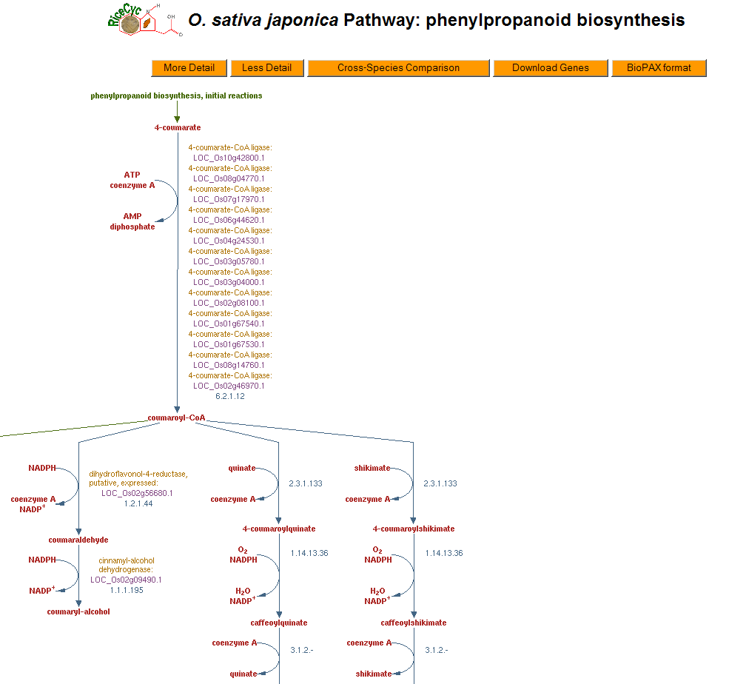
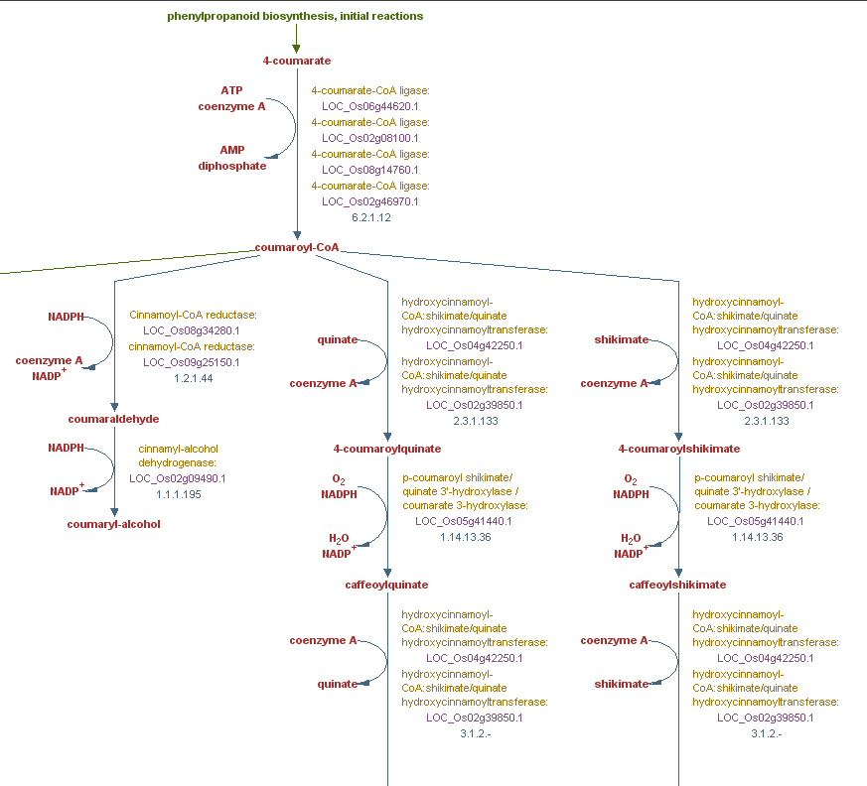
Ongoing Pathway Curation
Curated pathways are updated with each Gramene release
Your contribution to pathway curation is welcome
Curated pathway

Slide 19
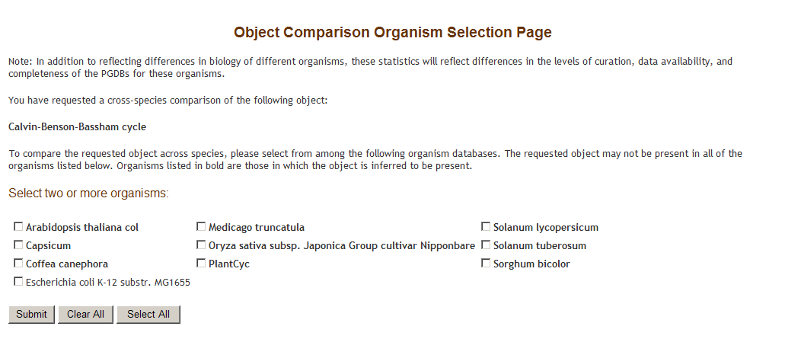
Interspecific Comparison
Select species for pathway comparison

Slide 20
Paint Your Expression Data On Pathways

Slide 21
Pathway Page – Omics viewer & validator

Slide 22
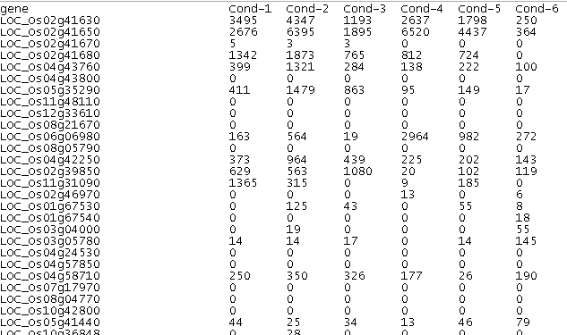
Load your expression data as a tab delimited file

Slide 23
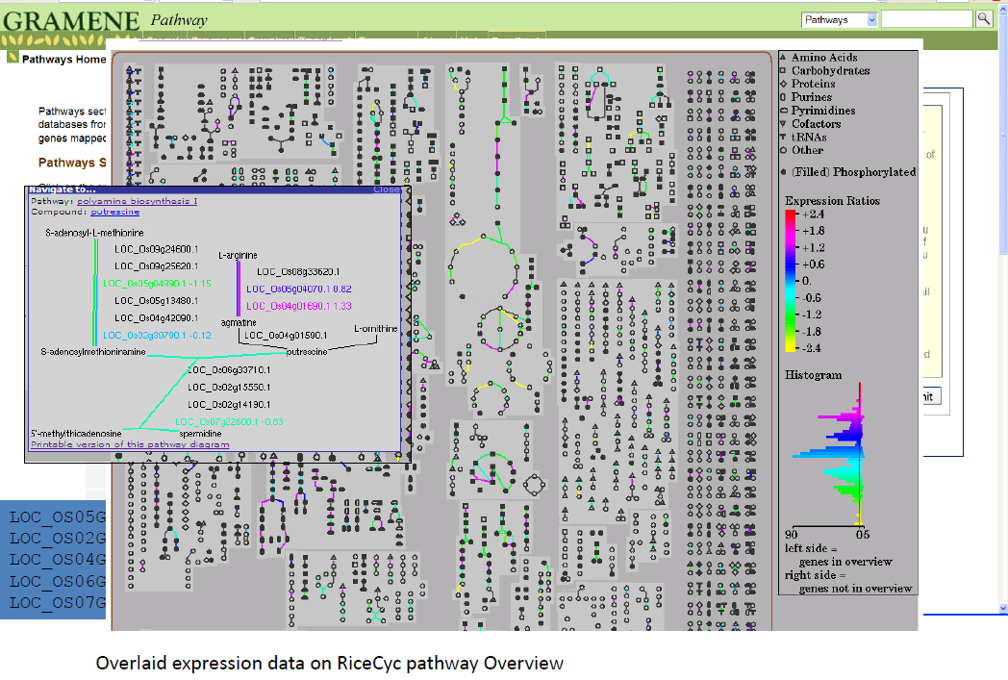

Slide 24
Pathways – Help and Tutorials

Slide 25
Thank you

