Slide 1


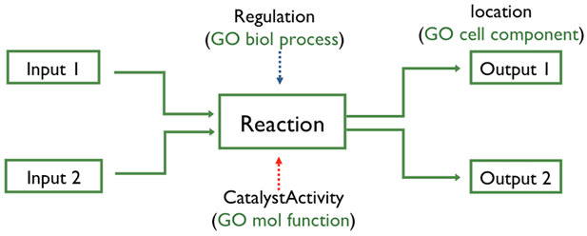

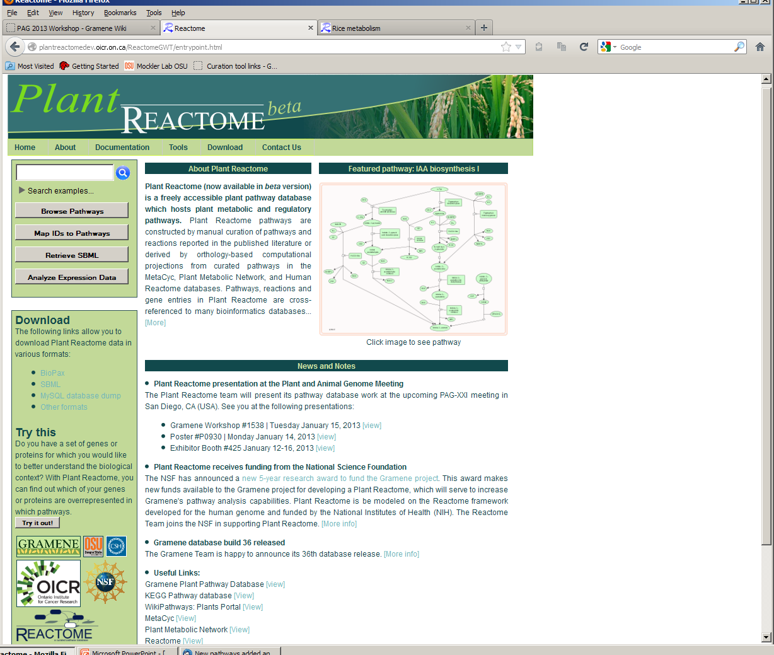
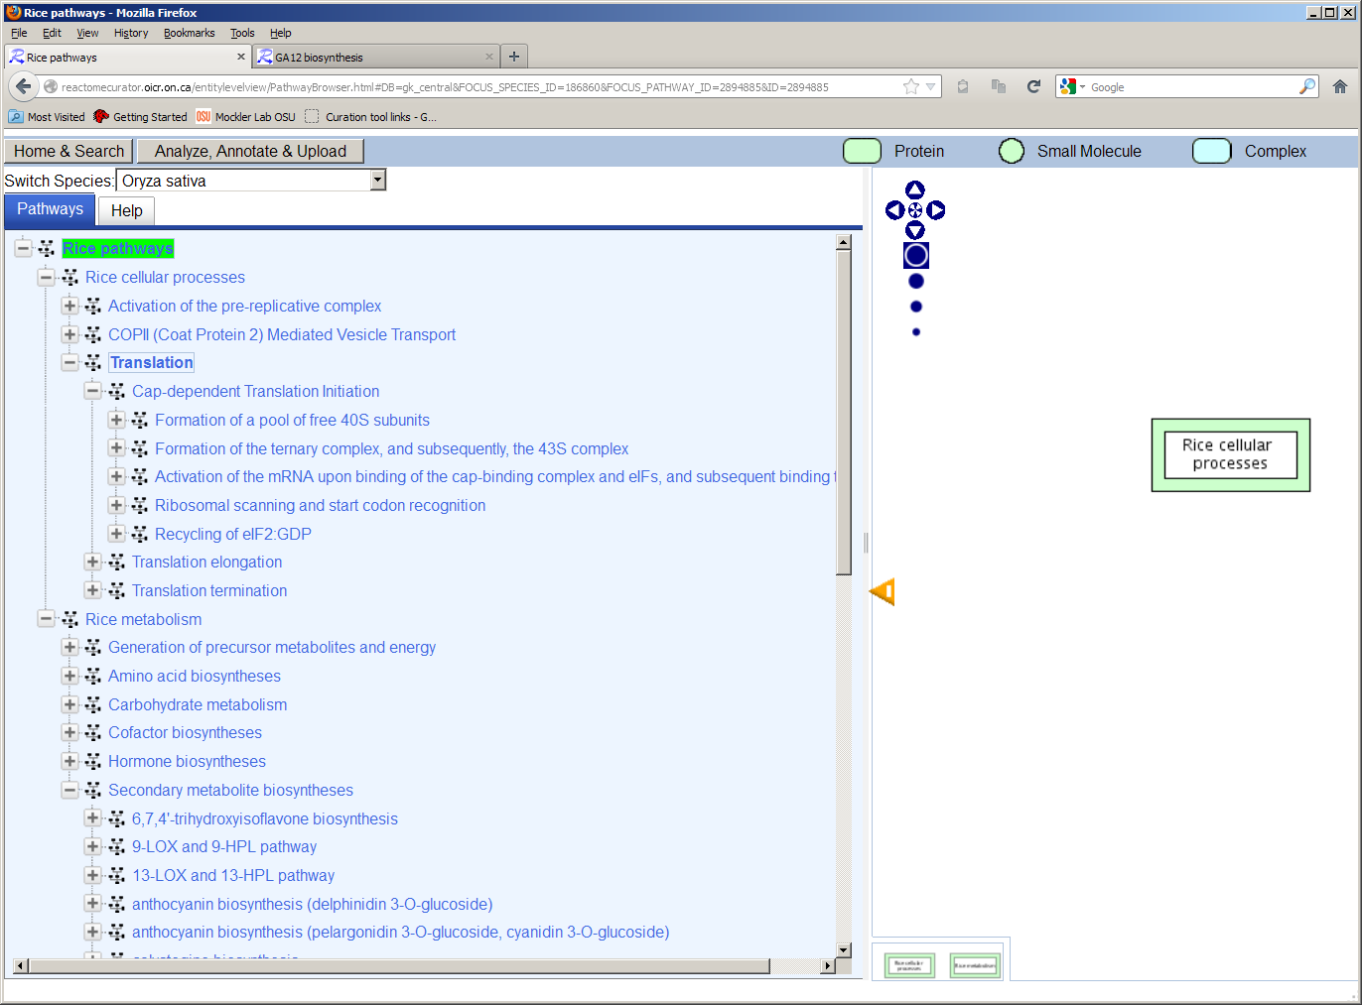
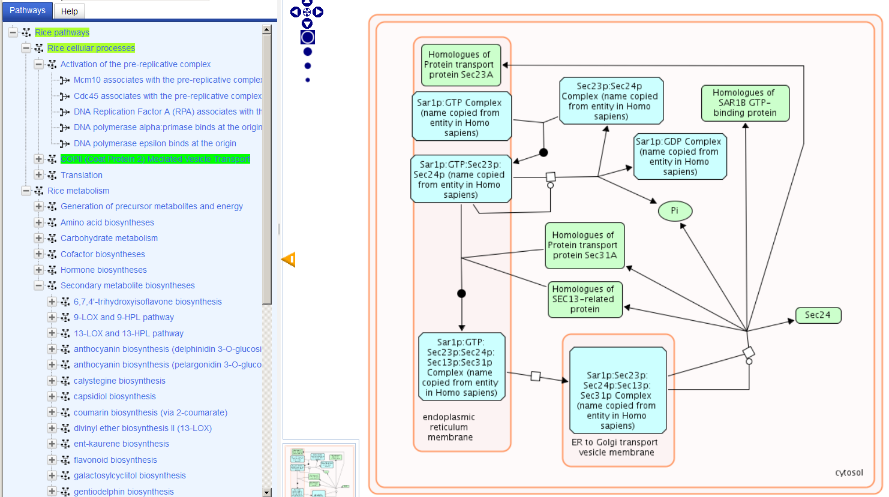
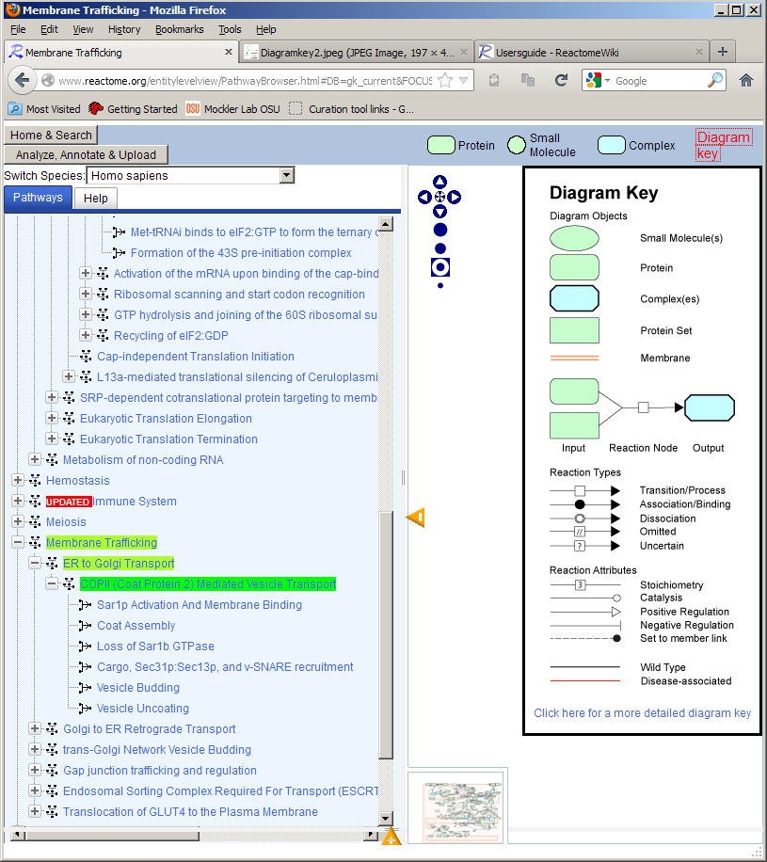
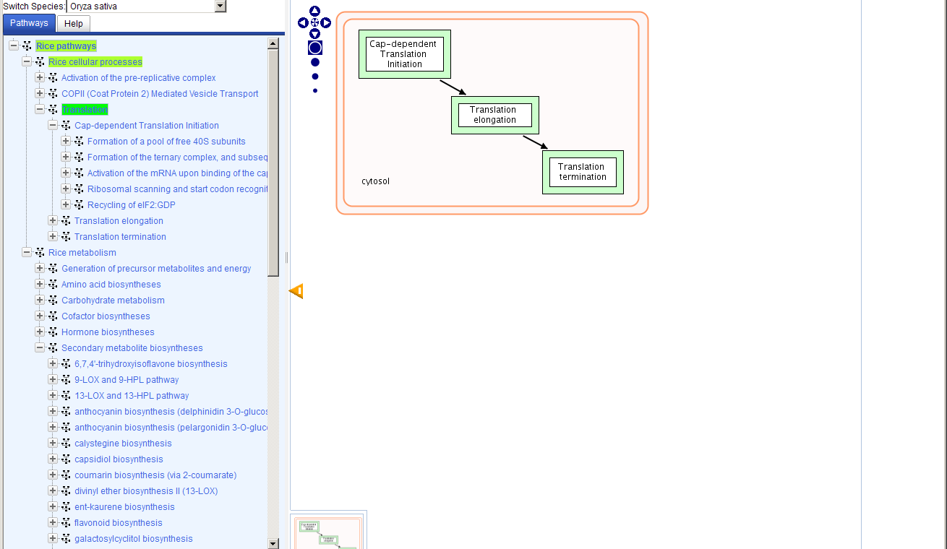
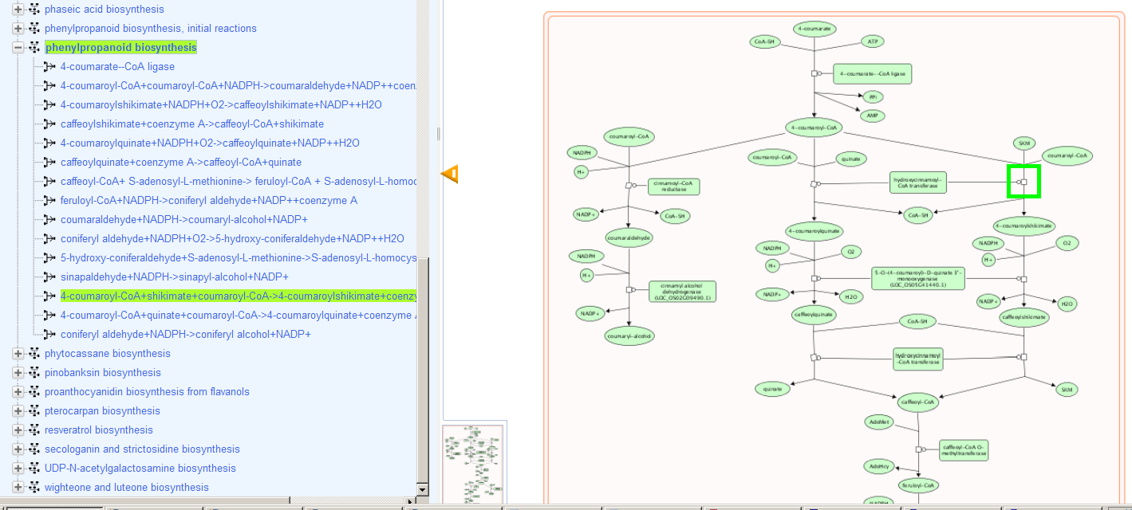
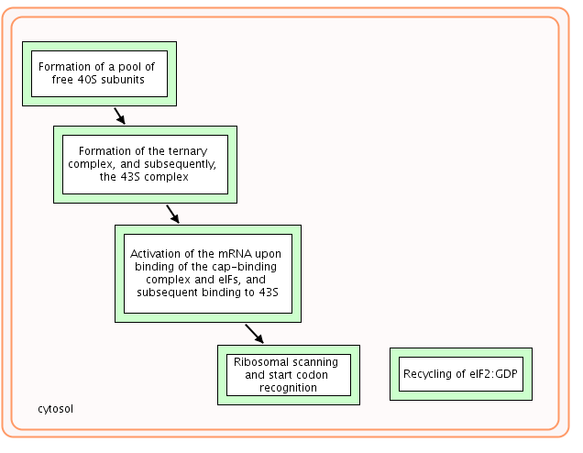
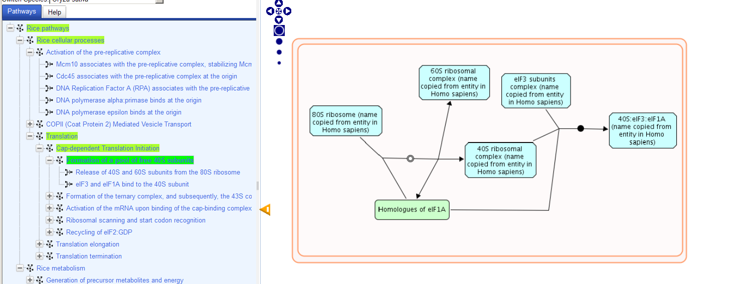
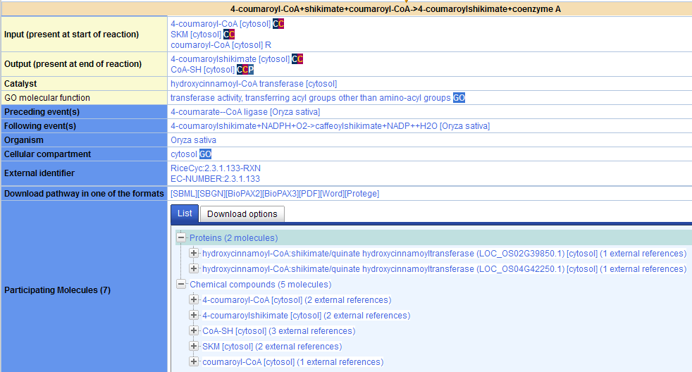






Plant Reactome: Metabolic and regulatory networks for plants
Palitha Dharmawardhana ¹, Justin Preece ¹, Vindhya Amarasinghe ¹, Guanming Wu ²,, Dylan Beorchia¹ , Kindra Amoss¹, Sushma Naithani ¹, Peter D'Eustachio ³, Hardeep Nahal ^{4,5}, Marcela K. Monaco ⁶, Nick Provart ^{4,5}, Henning Hermjakob ⁷, Lincoln Stein ², Doreen Ware ^{6, 8}, Pankaj Jaiswal ¹
¹¹ Department of Botany and Plant Pathology, Oregon State University, Corvallis, OR, 97331, USA; ² Ontario Institute for Cancer Research, Toronto, ON, M5G0A3, Canada; ³ NYU School of Medicine, Dept. of Biochemistry, New York University, New York, NY, 10012, USA; ⁴ Department of Cell and Systems Biology, University of Toronto, Toronto, Ontario, M5S1A1, Canada; ⁵ Centre for the Analysis of Genome Evolution & Function, University of Toronto, Toronto, Ontario, M5S1A1, Canada; ⁶ Cold Spring Harbor Laboratory, Cold Spring Harbor, NY, 11724, USA; ⁷ European Bioinformatics Institute, Hinxton, Cambridge, CB10 1SD, UK; ⁸USDA ARS NAA, Robert W. Holley Center for Agriculture and Health, Ithaca, NY, 14853
Abstract
Reactome data model
Gramene, in collaboration with the Reactome project (www.reactome.org), has developed a new platform for the comparative analysis of plant metabolic and regulatory networks. Here we present the first public version of the Plant Reactome, initially featuring rice as a reference species. Future releases will include Arabidopsis and maize pathways. To date, the Gramene database portal (www.gramene.org) has presented MetaCyc-based pathway databases for rice, sorghum, maize and Brachypodium, along with mirrors of similar databases for other species-specific reference genomes, such as AraCyc. The Plant Reactome will strengthen and extend MetaCyc based capabilities in pathway analysis. In addition to browsing and searching pathways, reactions, compounds and gene products, this new database and accompanying web application provide tools for pathway overrepresentation analysis, inter-species comparison and overlaying of expression and gene-gene interaction data. Pathways, reactions and gene entries in the Plant Reactome provide external links to Uniprot, PIR, ChEBI, PubChem, PubMed and the Gene Ontology (GO). To construct the Plant Reactome, we converted RiceCyc data to conform to the Reactome data structure. This initial conversion was followed by the addition of a small set of signaling and regulatory pathways based on gene orthology and known projections of curated Human Reactome pathways. The computational projections were enhanced with a substantial manual curation effort to improve biological relevance and a customized web application was implemented to host the data. We expect the Plant Reactome to become a primary investigative source for plant pathways, network analysis and community curation.
Depicts biological processes as a set of connected reactions and events
It can represent many events and states in biological processes
In addition to classical biochemical reactions, changes in state, such as binding, activation, translocation, degradation and regulation can be represented
Reactions are connected to form pathways
Plant Reactome Home Page
Upcoming developments
Include additional metabolic and regulatory rice pathways
Enable more Reactome analysis tools:
Gene expression overlay
Interaction analysis
Enrichment analysis
Reactome BioMart
Species comparison
Add Arabidopsis pathways into the Plant Reactome
Add gene interactions using web APIs
Provide homology based pathways for other plant genomes
Rice pathway types
Plant Reactome –Exploring Rice pathways
Depiction of Cellular Compartments of reactions and pathways: COPII (Coat Protein 2) Mediated Vesicle Transport
Conversion of rice pathways to the Reactome platform
In support of the Gramene project's efforts to integrate and expand plant-specific regulatory, signaling, and metabolic pathways, we have converted rice pathway data drawn from the curated metabolic network for rice, RiceCyc (developed by Gramene). Data was exported in the BioPAX Level 2 format and then imported into the Reactome database schema using a modified version of the Reactome BioPAX importer. Based on gene orthology predictions generated by Ensembl’s Compara pipeline, we imported additional pathways -- such as cell cycle and DNA repair -- projected from sequence similarity to well curated human pathways.
Regulatory processes: Cap-dependent translation initiation
Reaction details and download options: Phenylpropanoid biosynthesis
Pathway group
Pathway Data Sources:
RiceCyc v3.1 (hosted by the Gramene project) http://pathway.gramene.org/gramene/ricecyc.shtm
Human pathway projections from http://www.reactome.org/ for Oryza sativa
Over 500 curated and projected pathways – 100 pathways released in beta version
Pathway group
Pathway
Contact us at: reactome-curator@gramene.org
Supported by National Science Foundation (Grant No. 0703908 and 1127112.)

