Slide 1
Web Usage and Stats

Slide 2
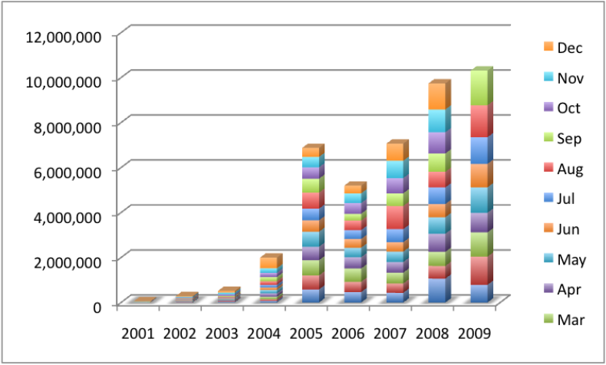
Page Requests by Year per Month
2001 - 2009
Notes:
By Analog

Slide 3
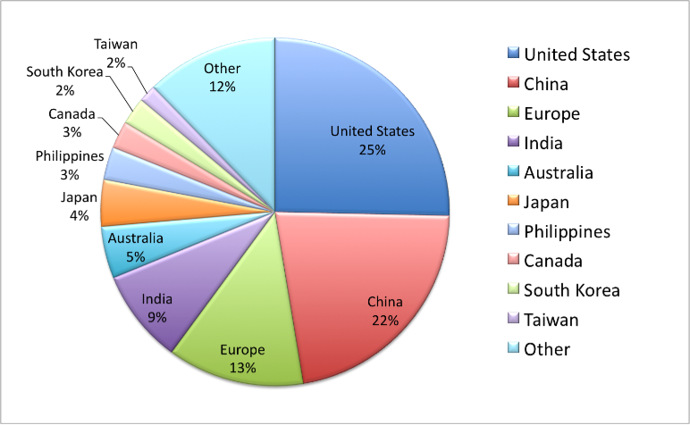
Top Countries - Visits%
Sep 2008 – Sep 2009
Notes:
By Google analytics – all EU countries extracted from the "Other" and combined with the "UK" slice

Slide 4
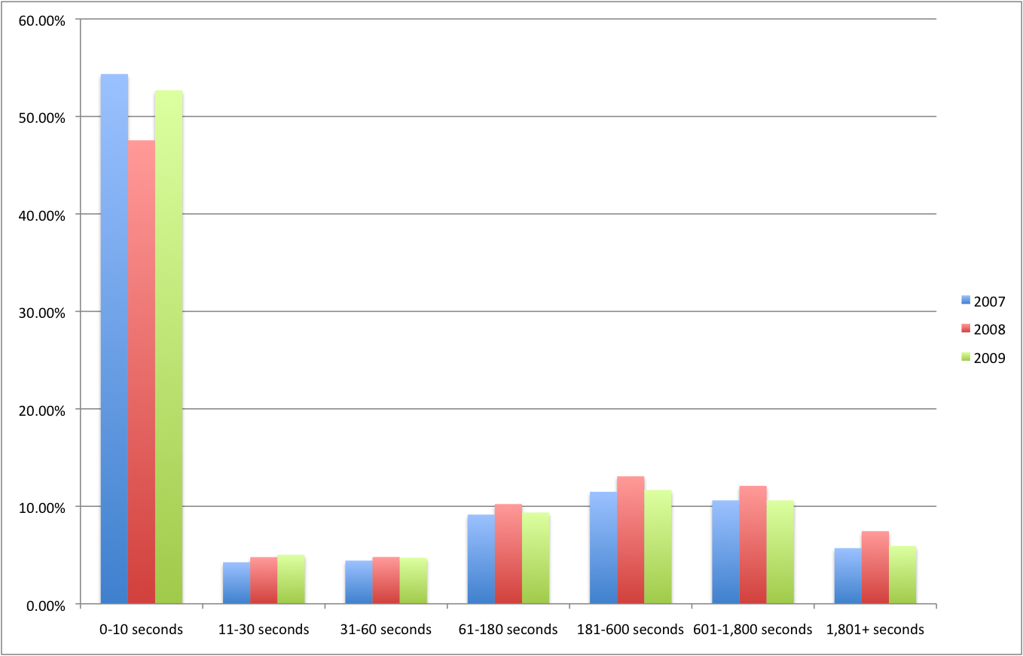
Duration of Visit

Slide 5
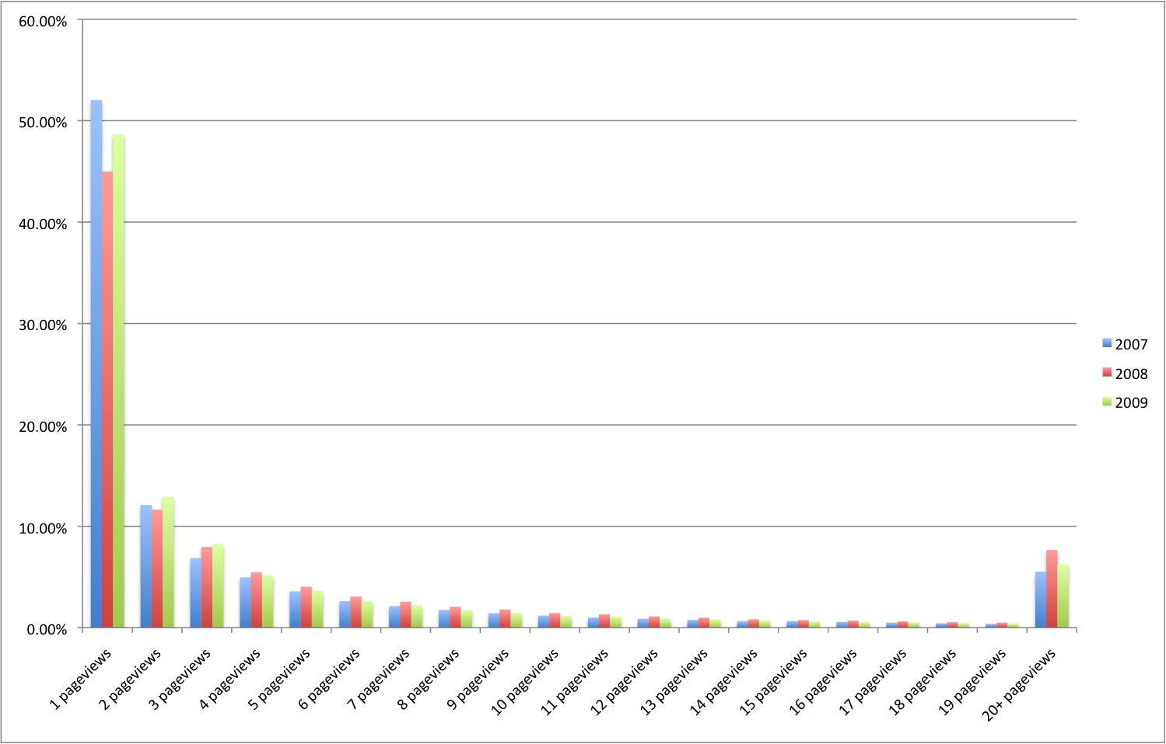
Depth of Visit
Notes:
Depth of visit shows pageviews in the visit against the percentage of visits with this many pageviews – per year.

Slide 6
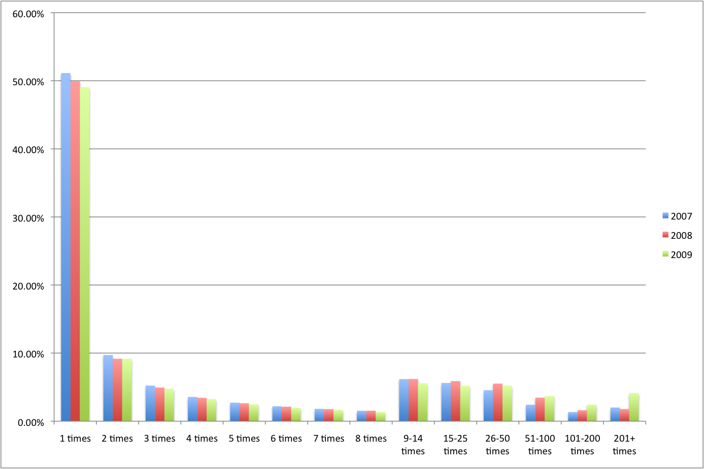
Visitor Loyalty
Notes:
From Google Analytics
You can see that the number of visitors who visited the site 50 times and up has increased along the years.

Slide 7
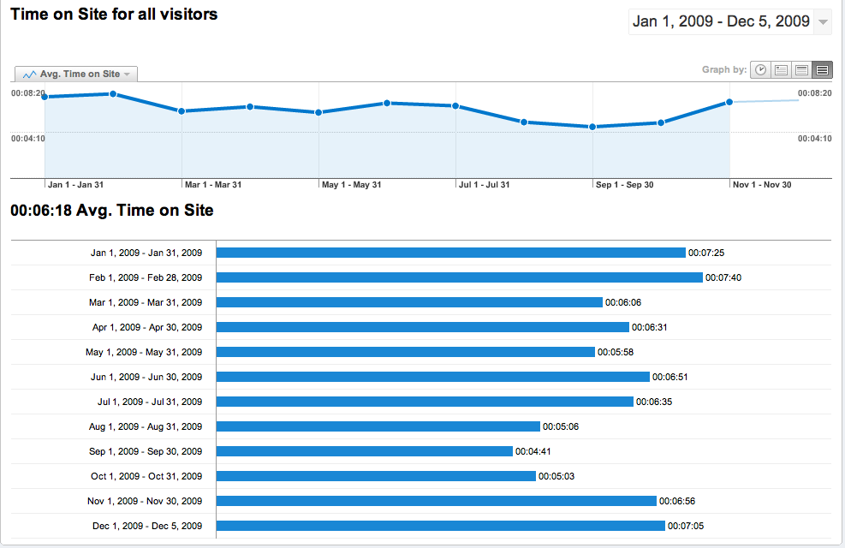
Time on Site

Slide 8
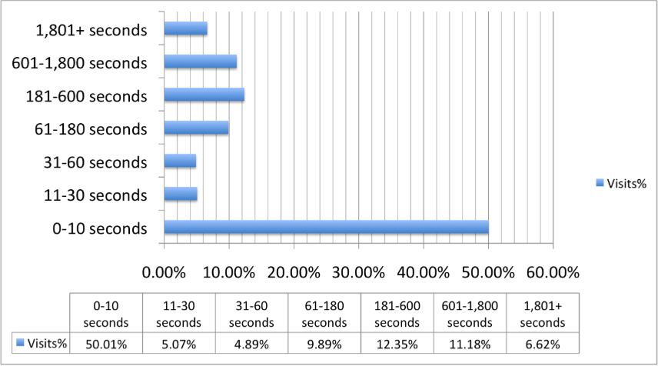
Duration of Visits
Notes:
By Google Analytics

