Slide 1
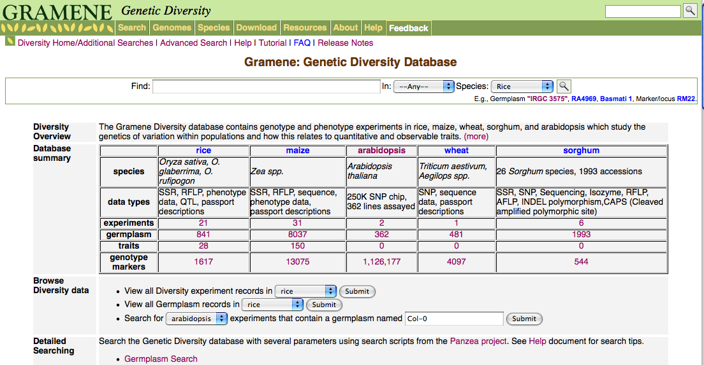
Diversity module
New Diversity home page in development:
http://dev.gramene.org/db/diversity/diversity_view
  Increases Diversity transparency and browsability
  Will provide more options for how search the db
  “Database summary” table provides easy access to all the diversity db’s primary data.
  To do: links to Ensemble tracks;

Slide 2
Diversity data
-rice-
Currently: 21 experiments
  841 germplasm, 28 traits, 1617 markers
Pending: 5 QTL experiments
  still curating: assigning TO ids; validating new germplasm against existing germplasm in diversity_rice
Projected for Build 30:
  26 experiments (21 + 5 QTL)
  44K rice chip, ~400 lines – genotype and phenotype data
  Additional QTL experiments?
Projected for Build 31:
  600K rice chip!
  ?

Slide 3
Diversity data
-arabidopsis-
Currently: 2 experiments (250K chip)
  362 germplasm, 0 traits, 1,126,177 SNP markers (248,584 on chip)
Projected for Build 30:
  Genotype data for additional lines? (1300 lines expected)
  Flowering time data for 250K chip?
Projected for Build 31:
  1001 Genomes Project (complete sequences for 1300 above lines) -- ??

Slide 4
Diversity data
-maize-
Currently: 31 experiments
  8037 germplasm, 150 traits, 13075 markers
Projected for Build 30:
  Millions of SNPS
  more NAM data
Projected for Build 31:
  ?

Slide 5
Diversity data
-wheat and sorghum-
Currently:
  wheat: 481 germplasm, 0 traits, 4097 markers
  Sorghum: 1993 germplasm, 0 traits, 544 markers
Projected for future builds:
  wheat: ?
  Sorghum: Diversity data from Kresovich et. al.?

