Slide 1
TASSEL 4.0 www.maizegenetics.net/tassel
Terry Casstevens¹, Peter Bradbury^{2,3}, Zhiwu Zhang¹ , Yang Zhang¹, Edward Buckler^{1,2,4}
¹ Institute for Genomic Diversity, Cornell University, Ithaca, NY
² USDA-ARS
³ Cornell Theory Center, Cornell University
⁴ Dept. of Plant Breeding and Genetics, Cornell University

Slide 2
TASSEL 4.0 – Improved Design!
Efficient Bit Storage Data Structures
High Performance Bit-wise Algorithms
Consistent Handling of Genotype Data (i.e. SNPs, Haplotypes, etc.)
Supports Heterozygote Diploid Allele Data.
1.6 Million LD Calculations Executes 30 times faster in TASSEL 4.0!
Distance Matrix for 1320 Taxa Executes 25 Times faster in TASSEL 4.0!

Slide 3
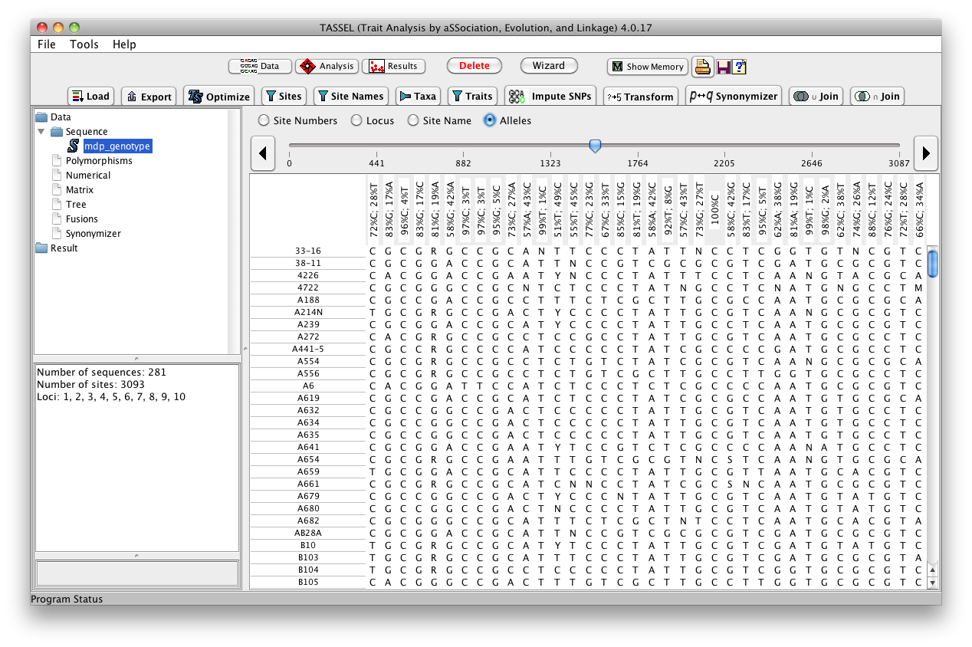

Slide 4
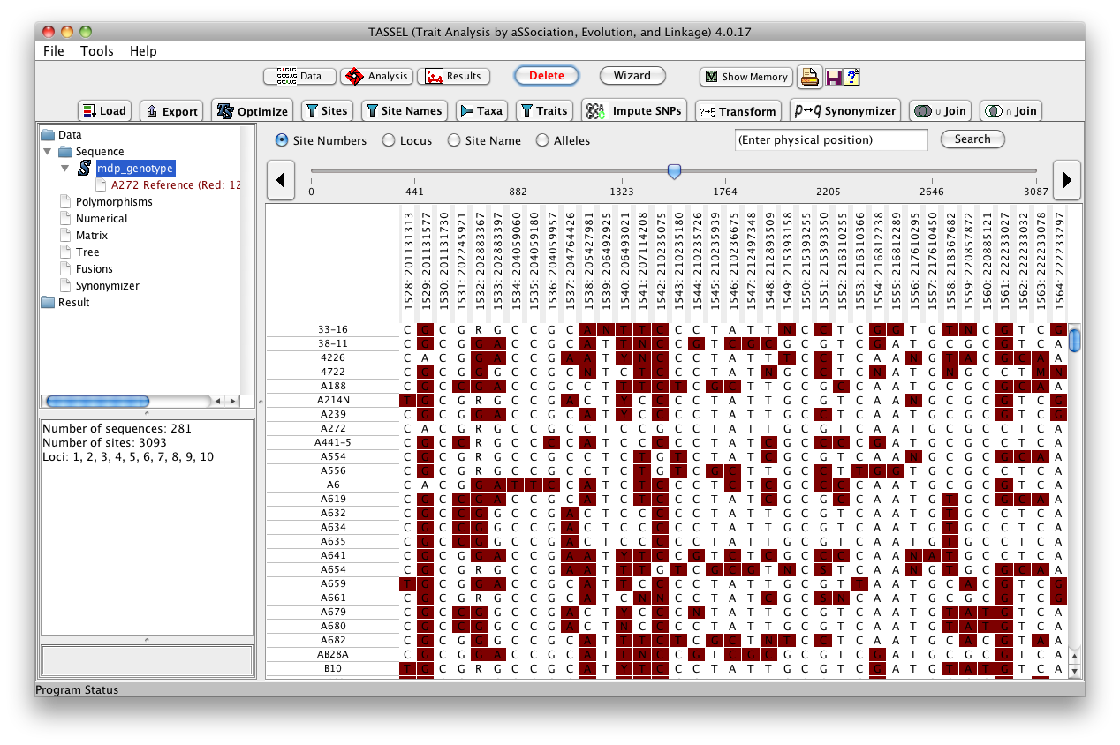

Slide 5
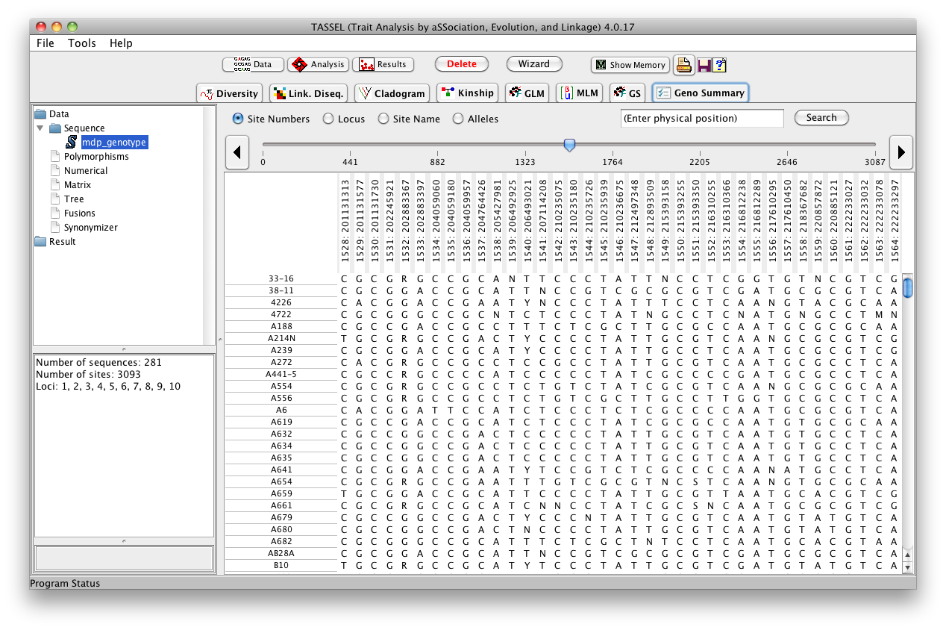
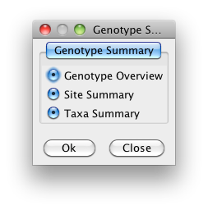

Slide 6
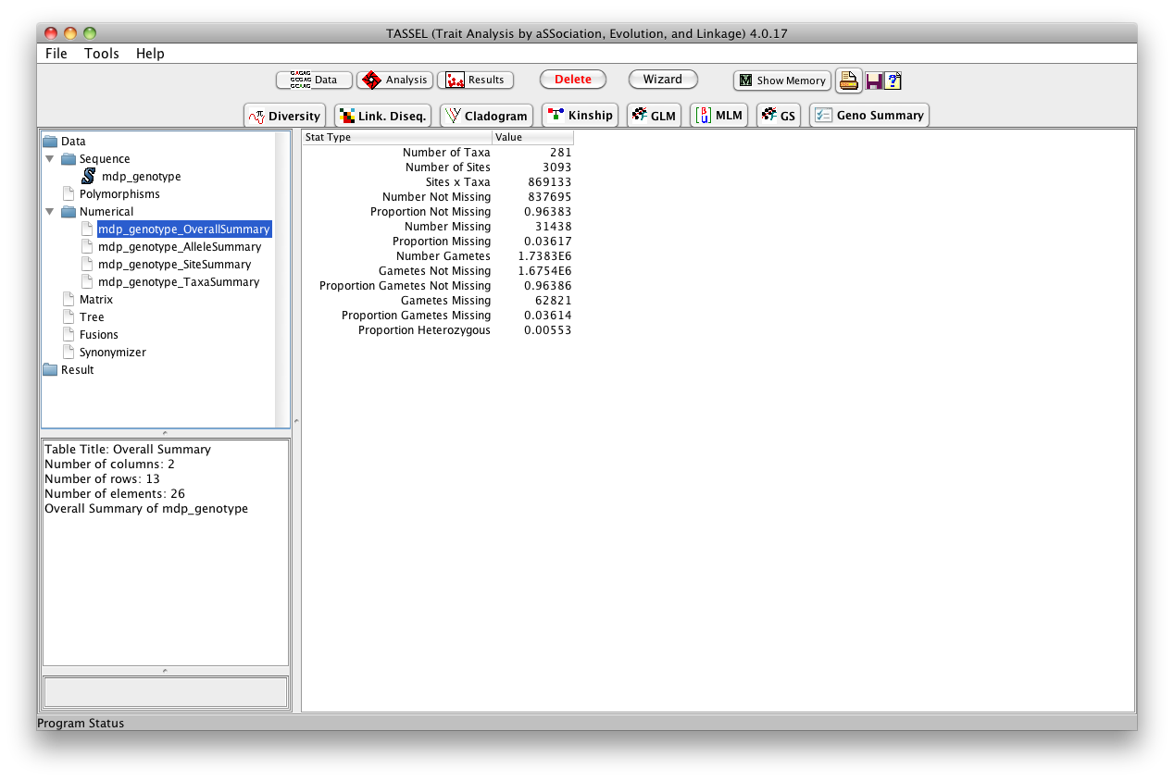

Slide 7
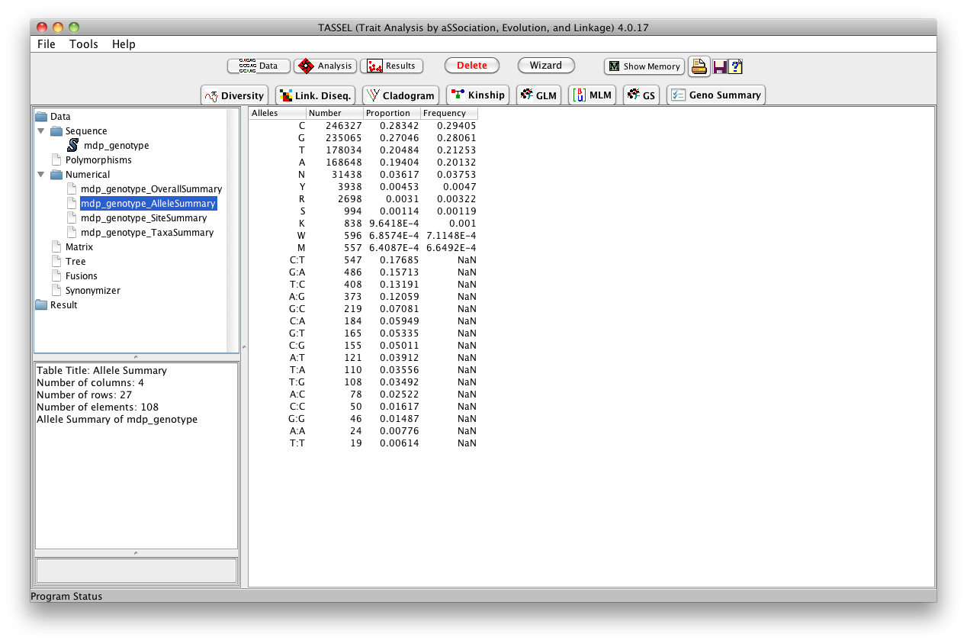

Slide 8
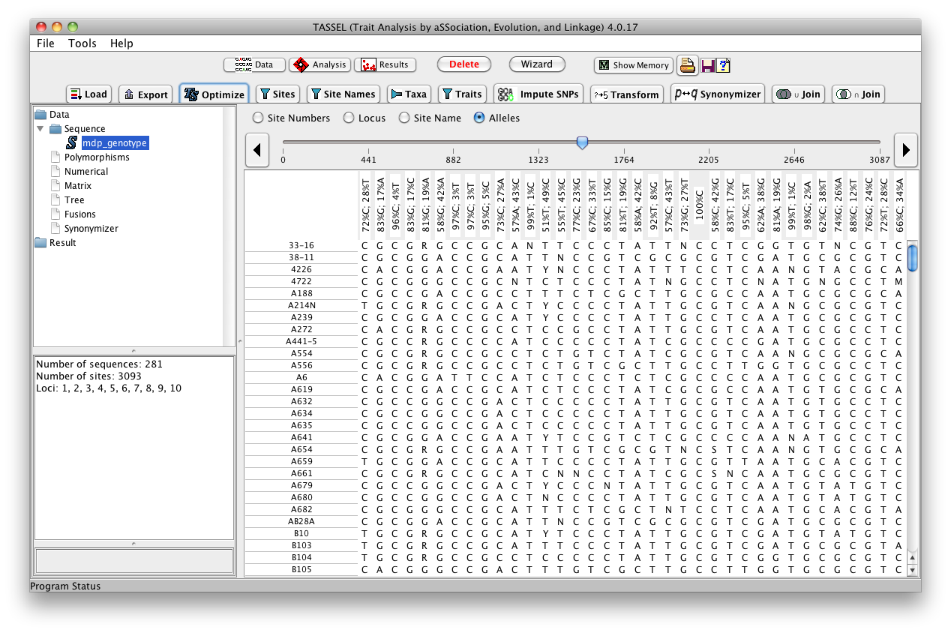
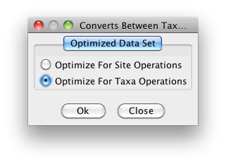

Slide 9


Slide 10
