Slide 1
Large-Scale Duplications In the Arabidopsis Genome
Ware Plant Group Journal Club
6/21/2007

Slide 2
Introduction
Polyploidy is common in flowering plants
  Have > 2 homologous sets of chromosomes
  Maize, wheat, Brassicas, coffee, peanut, banana, apple, …
  Can form when diploid gametes are formed accidentally
  Manifests as a whole genome duplication (WGD)
Sequencing projects are revealing previously unknown ancient polyploidy events
  Ancient polyploids have returned to a diploid state through extensive genome rearrangement and gene loss

Slide 3
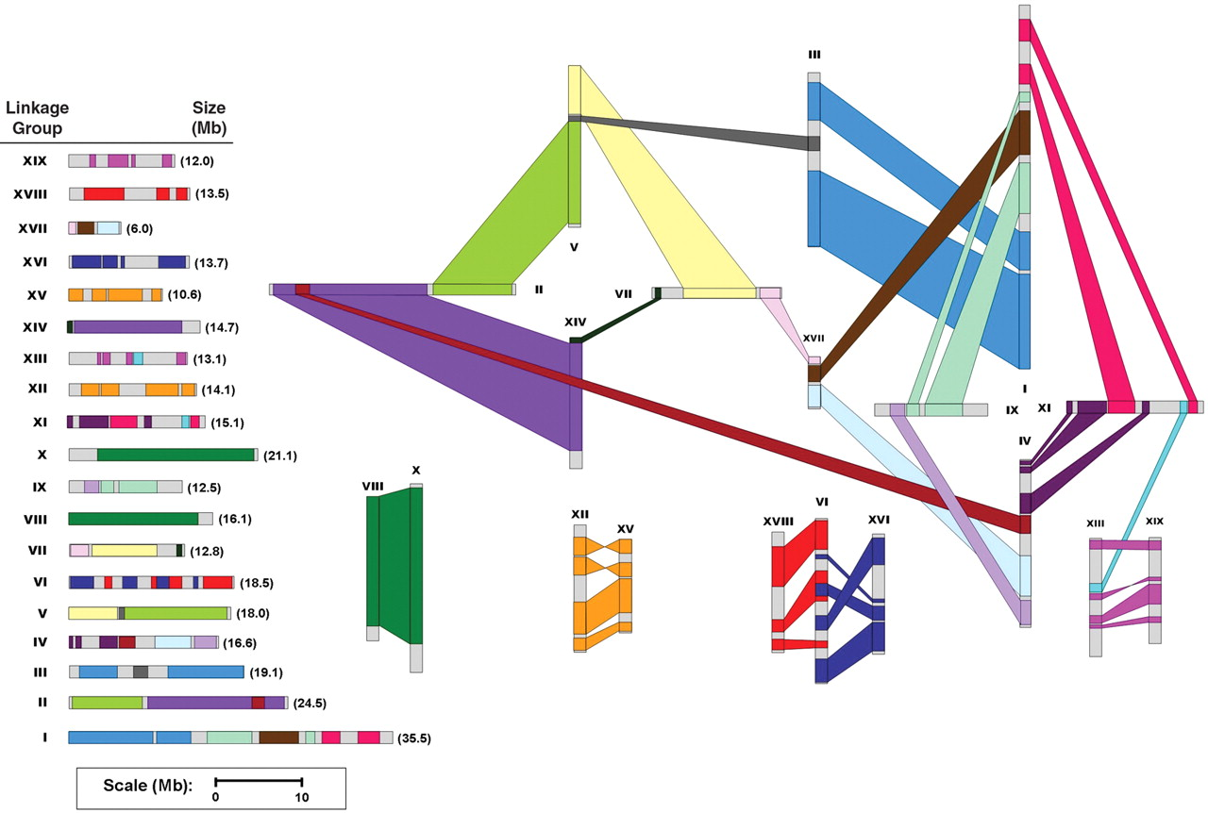
WGD in Poplar
G. A. Tuskan et al., Science 313, 1596 -1604 (2006)
Notes:
Fig. 2. Chromosome-level reorganization of the most recent genome-wide duplication event in Populus. Common colors refer to homologous genome blocks, presumed to have arisen from the salicoid-specific genome duplication 65 Ma, shared by two chromosomes. Chromosomes are indicated by their linkage group number (I to XIX). The diagram to the left uses the same color coding and further illustrates the chimeric nature of most linkage groups.

Slide 4
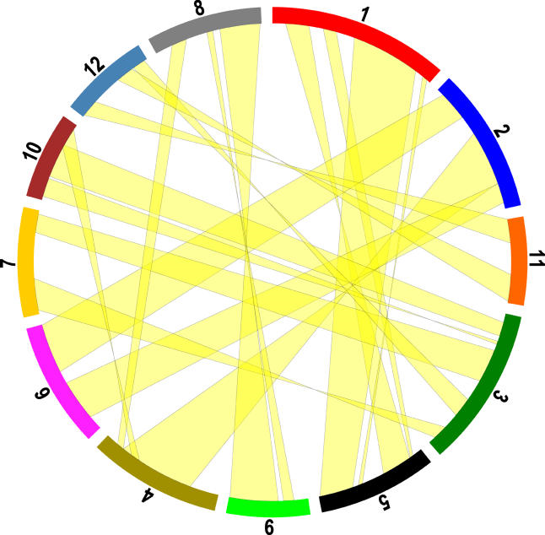
WGD in Rice
Yu J., et al. 2005. PLoS Biol. February; 3(2): e38

Slide 5
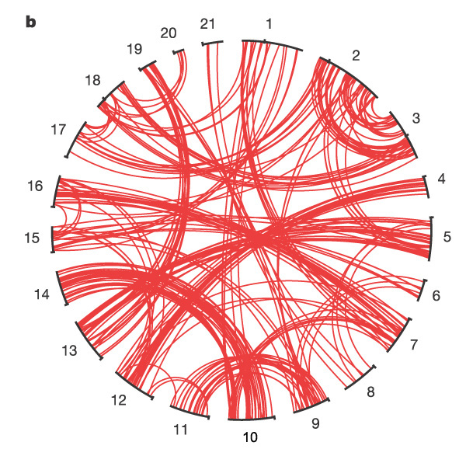
WGD in Teleost Fishes
Jaillon O, et al. Nature 431, 946-957

Slide 6
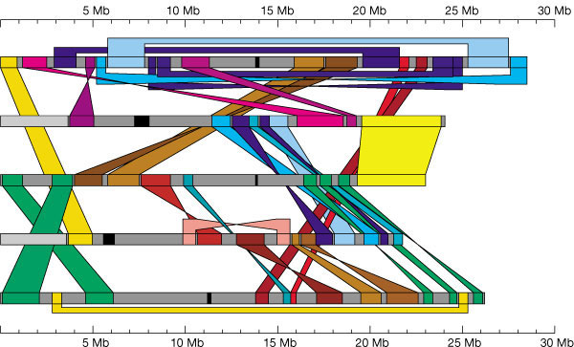
Duplicated Regions in Arabidopsis
The Arabidopsis Genome Initiative. Nature 408, 796-815
A whole genome duplication event?
Multiple independent segmental duplications?
Notes:
Individual chromosomes are depicted as horizontal grey bars (with chromosome 1 at the top), centromeres are marked black. Coloured bands connect corresponding duplicated segments. Similarity between the rDNA repeats are excluded. Duplicated segments in reversed orientation are connected with twisted coloured bands. The scale is in megabases.

Slide 7
Extensive Literature
Vision TJ, Brown DG, Tanksley SD. The origins of genomic duplications in Arabidopsis. Science. 2000 Dec 15;290(5499):2114-7. PMID: 11118139
Blanc G, Barakat A, Guyot R, Cooke R, Delseny M. Extensive duplication and reshuffling in the Arabidopsis genome. Plant Cell. 2000 Jul;12(7):1093-101. PMID: 10899976
Simillion C, Vandepoele K, Van Montagu MC, Zabeau M, Van de Peer Y. The hidden duplication past of Arabidopsis thaliana. Proc Natl Acad Sci U S A. 2002 Oct 15;99(21):13627-32. Epub 2002 Oct 8. PMID: 12374856
Ziolkowski PA, Blanc G, Sadowski J. Structural divergence of chromosomal segments that arose from successive duplication events in the Arabidopsis genome. Nucleic Acids Res. 2003 Feb 15;31(4):1339-50. PMID: 12582254
Ermolaeva MD, Wu M, Eisen JA, Salzberg SL. The age of the Arabidopsis thaliana genome duplication. Plant Mol Biol. 2003 Apr;51(6):859-66. PMID: 12777046
Raes J, Vandepoele K, Simillion C, Saeys Y, Van de Peer Y. Investigating ancient duplication events in the Arabidopsis genome. J Struct Funct Genomics. 2003;3(1-4):117-29. PMID: 12836691
Blanc G, Hokamp K, Wolfe KH. A recent polyploidy superimposed on older large-scale duplications in the Arabidopsis genome. Genome Res. 2003 Feb;13(2):137-44. PMID: 12566392
Consensus: One to several large scale duplication events in the evolutionary past of Arabidopsis

Slide 8
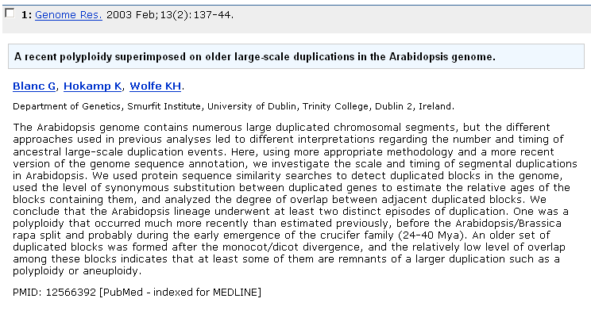
Why I Chose this Paper
Very clearly written and logically presented
Uses methods that I am currently working with

Slide 9
Characteristics of a WGD
How to distinguish WGD from multiple independent segmental duplication events?
Different pairs of sister regions originating from a single large-scale duplication event must have been formed simultaneously
  Thus have the same age.
A single large-scale duplication followed by rearrangement should not show overlap between adjacent duplicated regions.
Multiple segmental duplications:
Whole genome duplication:
a’
a’
a
a
b
b
b’
b’
Might show overlap
Might have different age
No overlap
Same age

Slide 10
Defining Sister Duplicate Blocks
Two chromosomal segments sharing similar genes in the same order
All-vs-all protein alignment (ssearch34) on 25,542 seq’s
  Removed TE (788)
  Removed tandemly duplicated genes (retaining longest) (2960).
Linked 2 similar genes if:
  E-value < 1e-20
  E-value < 1e20 times value of best non-self hit
  At least 50% of longest sequence is aligned
  Skip families if number of member > 20
Sister duplicated regions can have a maximum of 30 unduplicated genes between 2 duplicated genes
Defined “sm” as number of duplicate gene pairs linking two sister regions

Slide 11
Results
Found 108 block pairs having 6 or more duplicated genes (sm ≥ 6)
Statistical significance:
  Re-ran algorithm with 1000 different randomly shuffled gene maps
  Mean number of block pairs with sm ≥ 6 in randomized genomes was < 1 (mean 0.24, SD 0.71)
The 108 block pairs cover 71% of the genome.
Involve 5826 distinct duplicated genes (23% of proteome)
Largest block contains 283 duplicate genes

Slide 12
Dating Duplications Using Ks
copy 1
Gene
Duplication Divergence
copy 2’
Two kinds of mutations in protein coding sequences:
  Nonsynonymous: changes amino acid sequence.
  Synonymous: does not change amino acid sequence (silent).
Example: 1st and 2nd codons have synonymous changes
  copy 1: CTT GTC CAT (Phe-Val-His)
  copy 2: CTC GTA TAT (Phe-Val-Tyr)
Natural selection generally acts on protein sequences
  So, synonymous changes are largely free from selection and accumulate changes in a neutral manner at a rate similar to the mutation rate
Ks is defined as the number of synonymous nucleotide substitutions per synonymous site
  Absolute date –using a calibrated clock
  Relative date (The higher the Ks, the longer ago sequences diverged).

Slide 13
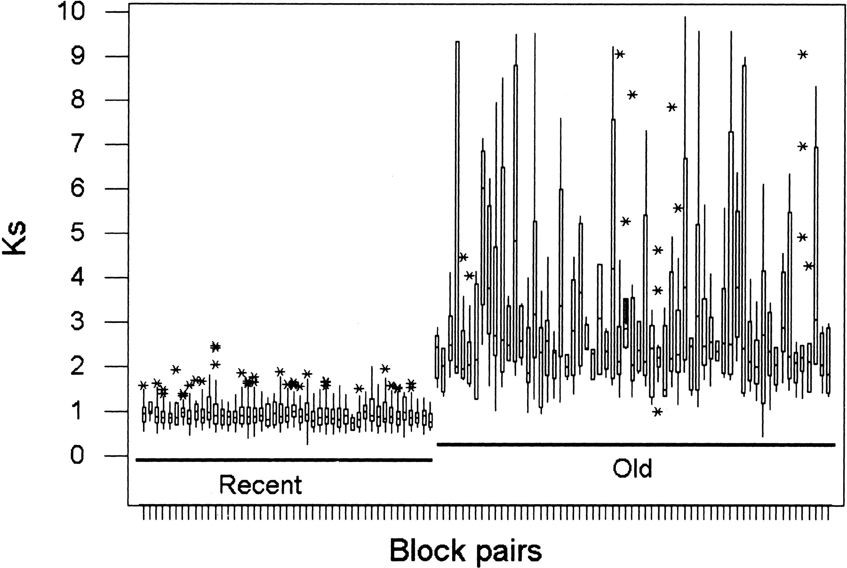
45 “Recent” Blocks and 63 “Old” Blocks
Ks distribution in each block:
extreme
*
middle 50%
75th percentile
median
25th percentile
Plot shows Ks distribution for duplicate genes in each block
Recent: median Ks range 0.72 - 0.99
Old: median Ks range 1.82 - 6.03
Notes:
Figure 2. Box plots of Ks values (Yang 1999 ) estimated from duplicated genes located in sister regions. The central box depicts the middle 50% of the data between the 25th and 75th percentile for each pair of duplicated blocks, and the enclosed horizontal line represents the median value of the distribution. Asterisks outside of the main bodies of data indicate extreme values.
Guillaume Blanc et al. Genome Res. 2003; 13: 137-144

Slide 14
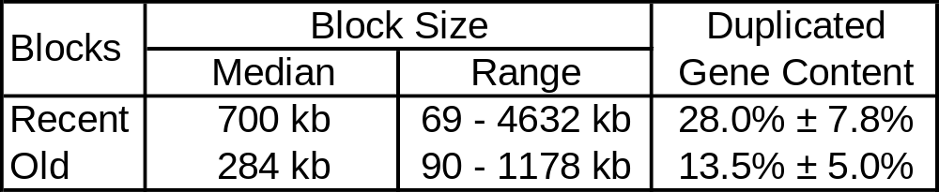
Characteristics of Recent and Old Blocks
The older the duplicated region is, the shorter it is, and the less it shares duplicated genes with its partner.
Consistent with progressive gene loss an rearrangement over time.

Slide 15
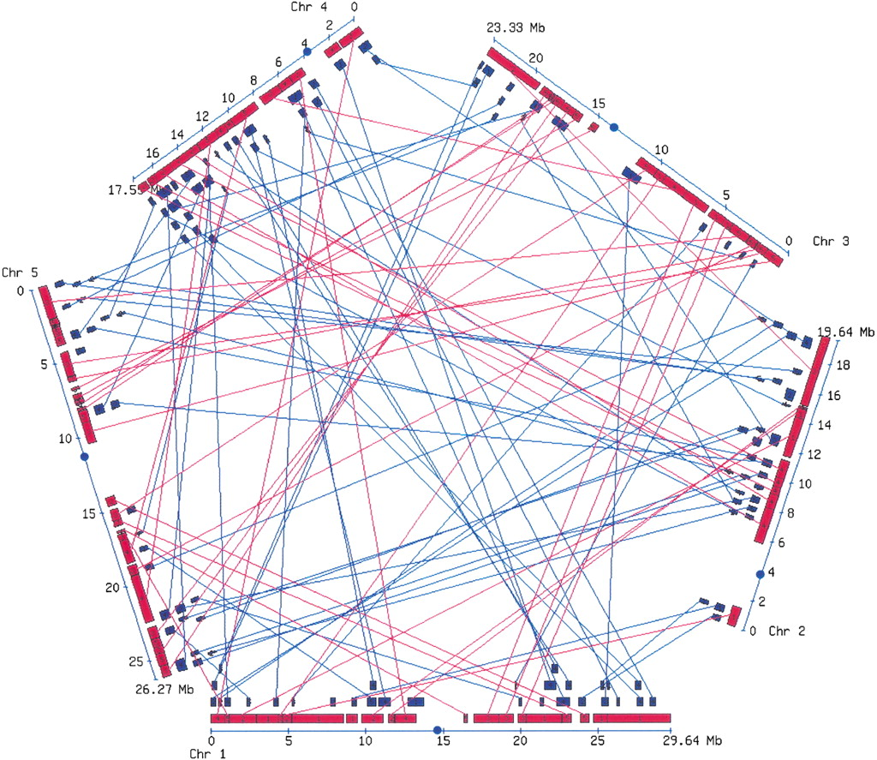
Map of Duplicated Regions
Red = “recent” blocks
Blue = “old” blocks
Recent blocks
  Cover 70% of the genome.
  No overlap (0.15%)
Old blocks
  Cover only 26% of the genome
  Substantial overlap (25%)
Recent blocks formed by a single polyploidy (WGD) event
Notes:
Figure 1. Map of duplicated regions identified in the Arabidopsis genome. Red and blue colored boxes depict recent and old sister regions, respectively, as defined by the analysis of the level of synonymous substitutions between duplicated genes. Lines link paired blocks. Centromeres are shown as circles. An interactive version of this map is available at http://wolfe.gen.tcd.ie/athal/dup.
Guillaume Blanc et al. Genome Res. 2003; 13: 137-144

Slide 16
Reconstructing Ancestral Gene Order
Problem: older duplicate blocks are obscured by rearrangements and gene losses that occurred following the recent polyploidy event.
Walked from top of chr 1 to bottom of chr 5, merging duplicate blocks
chr 1
a b d e h
1 2 3
i j l n q
*
*
x
x
chr 2
4 5 6
a b c d f g h
i k m o p q
7 8 9
chr 3
a b c d e f g h
1 2 3
i j k l m n o p q
4 5 6
7 8 9
Ancestral pseudo-genome (20,187 genes)
Notes:
For each pair of recent sister regions, we used the order of the dupld

Slide 17
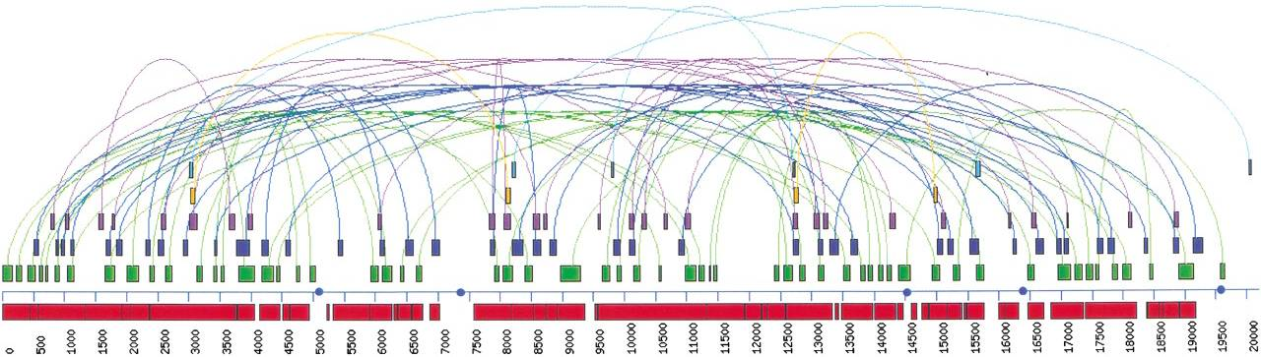
Duplicated Regions in Pseudo Ancestral Genome
Repeated block detection program
68 block pairs with sm ≥ 7 (covers 49% of reconstructed genome)
Average of 13.3% ± 4.0% duplicate genes within blocks
Could not sub-divide into distinct age classes because of high variance in Ks
Is this the result of large-scale duplications or random independent duplication events, or both?
  Overlap (2533 genes) is significantly lower than would expected for independent events, based on 10,000 simulations of random independent duplications (mean overlap 3587 genes SD 471; P=0.0053).
At least some of the old blocks were formed by ancient polyploidy-type event(s).
Notes:
Figure 3. Map of duplicated regions identified in the Arabidopsis pseudo ancestral genome. The vertical line represents a single chromosome containing 20,187 genes ordered according to a procedure that merged the recent blocks (see text) to approximate the ancestral Arabidopsis genome before the last polyploidy event. Red boxes depict the sections of the pseudo genome corresponding to merged sister regions. Other shaded boxes at right represent duplicated regions identified in the pseudo ancestral genome (colors are used for clarity and do not depict any age classification). Curved lines link paired regions, and circles depict the regions corresponding to the centromeres in the real genome.

Slide 18
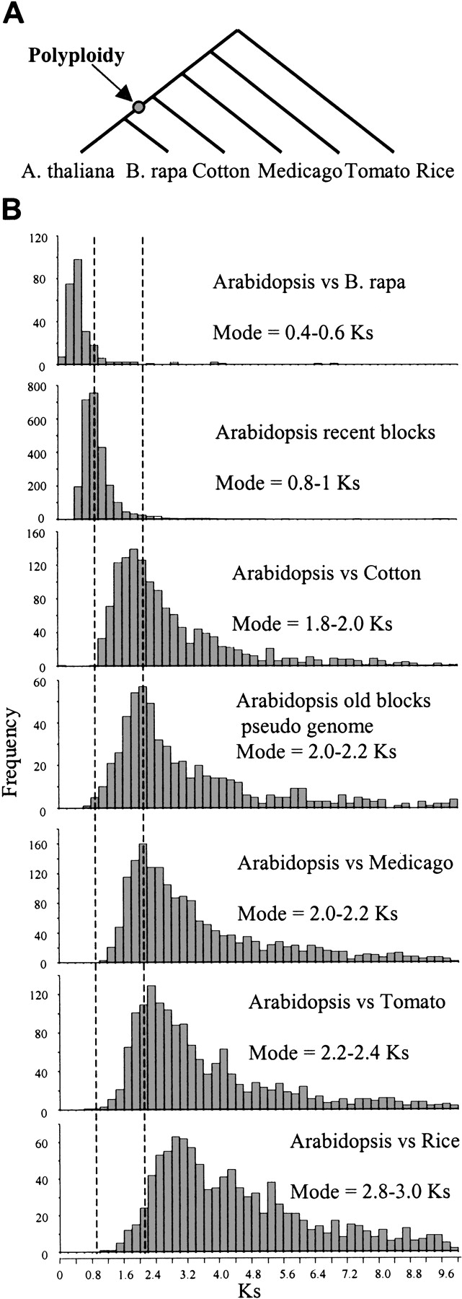
Chronology of Duplication Events
Compared distribution of Ks values from duplicate blocks to sets of orthologues from various species.
Recent WGD occurred prior to Arabidopsis-Brassica speciation
Most older duplications after the Arabidopsis-rice split
Notes:
Figure 4. Position of the duplication events in the tree of life. (A) Phylogenetic relationships between the analyzed plant species. The arrow marks the probable position of the recent large-scale duplication event identified in this analysis. (B) Distribution of Ks values obtained from sets of orthologous sequences between Arabidopsis and selected plant species and between paralogous sequences in recent and old Arabidopsis blocks. The numbers of sequences orthologous to Arabidopsis are 252 for Brassica rapa, 1358 for cotton, 1741 for Medicago, 1465 for tomato, and 1026 for rice. The paralog Ks distributions are for 2617 and 576 gene pairs occurring in recent duplicated blocks, and blocks identified in the pseudo ancestral genome, respectively. The vertical lines depict the positions of the modes of the distributions obtained from Arabidopsis paralogous genes.

Slide 19
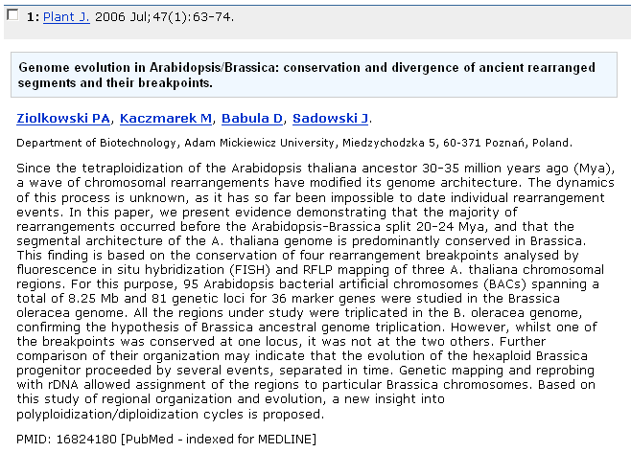
Recent Literature Confirms Duplication Prior to Arabidopsis-Brassica Split
Majority of rearrangements and segmental architecture are conserved in Brassica

Slide 20
Final Notes
This work did not make use of whole genome DNA-DNA alignments
Did not use phylogenetic trees

