Slide 1
Gramene:
Trait, QTL, gene, protein and homology
Charles Chen
PAG Gramene workshop 2010

Slide 2
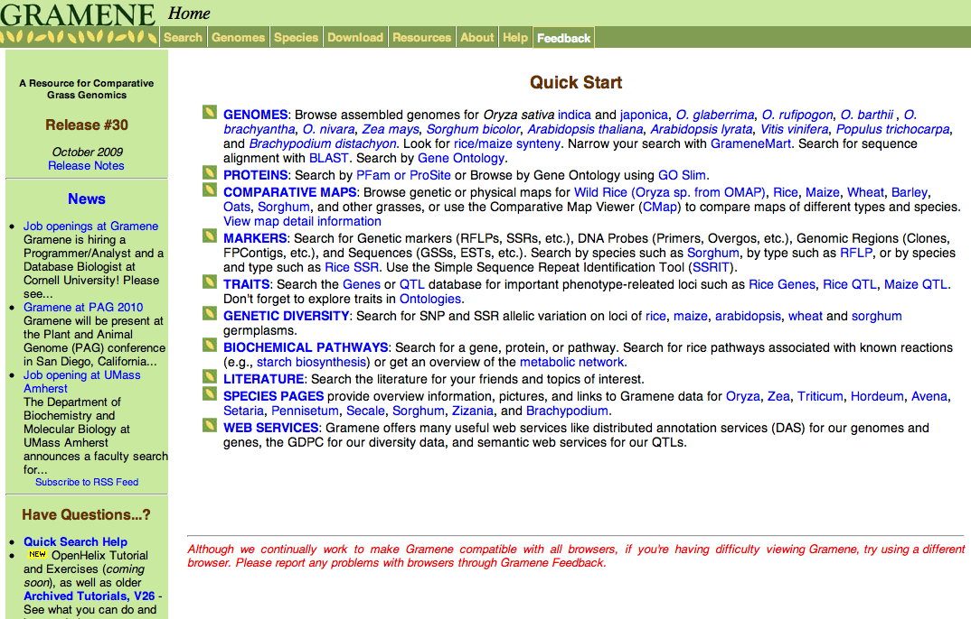

Slide 3
General genetic questions in biology:
- how many are they?
- where are they?
- and, what do they do?
- What is the genetics underlying grain weight variation in rice?

Slide 4

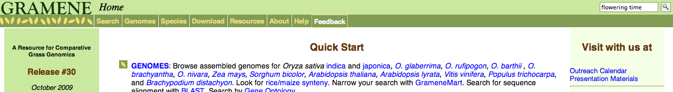
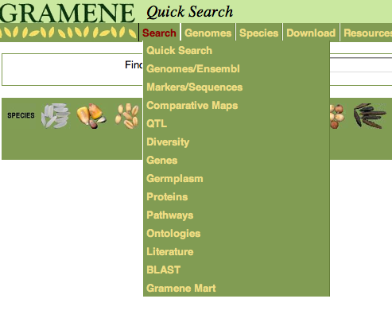
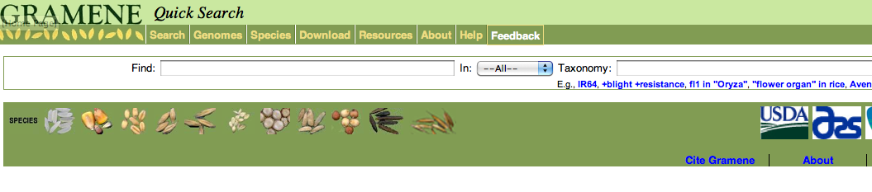
Quick search

Slide 5
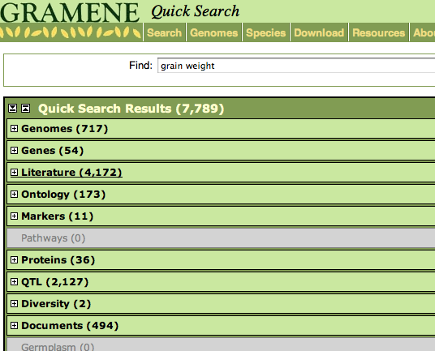
What is grain weight all about?

Slide 6
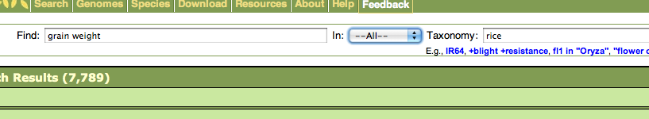
How many are they, where are they and how much do we know about grain weight variation in rice?

Slide 7
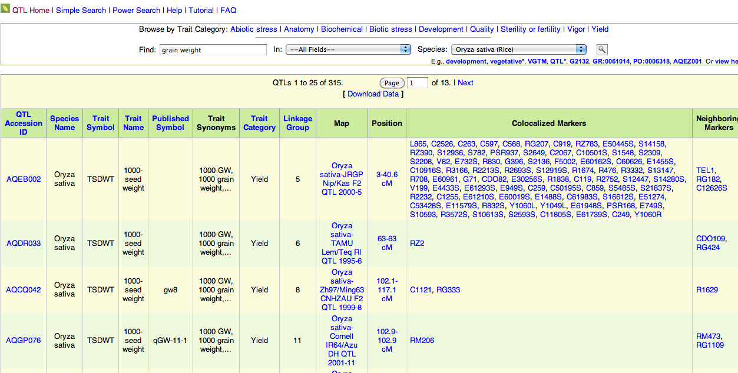

Slide 8
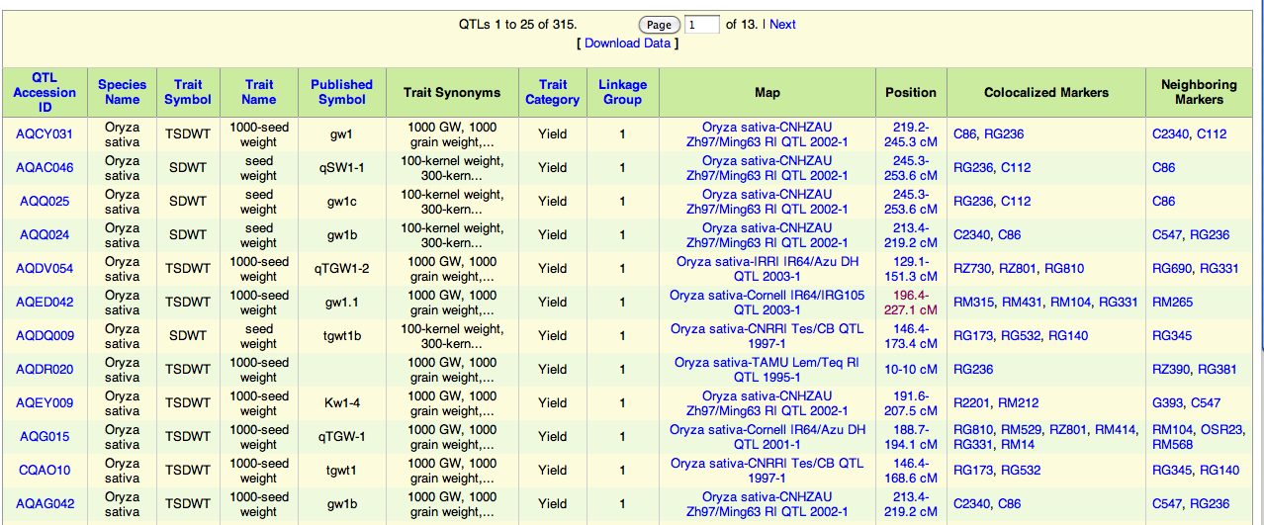
How many are they, where are they and how much do we know about them on rice chromosome 1?
Data download
Data sorted by LG 1

Slide 9
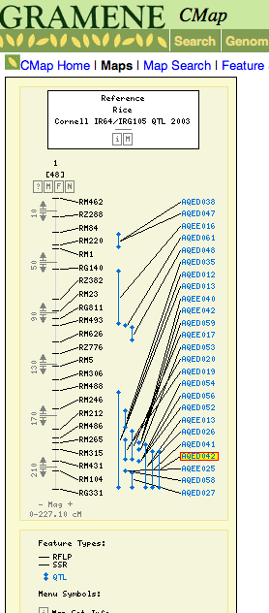
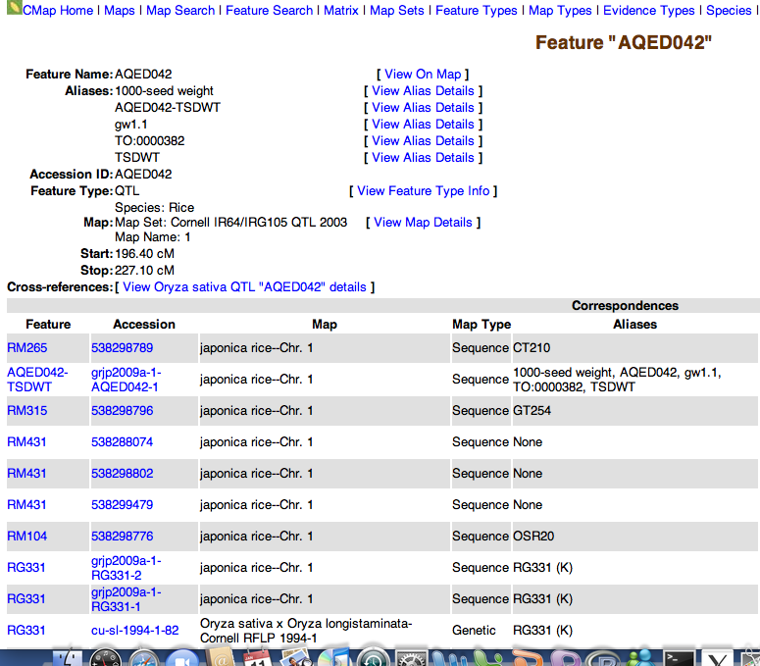
This QTL is franked by marker RM315 and marker RM104

Slide 10
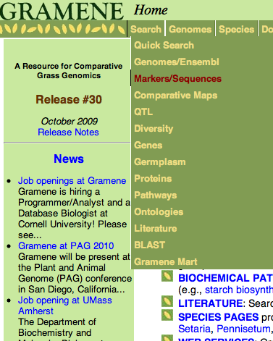
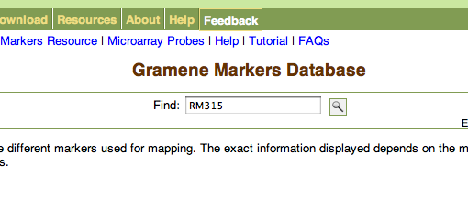
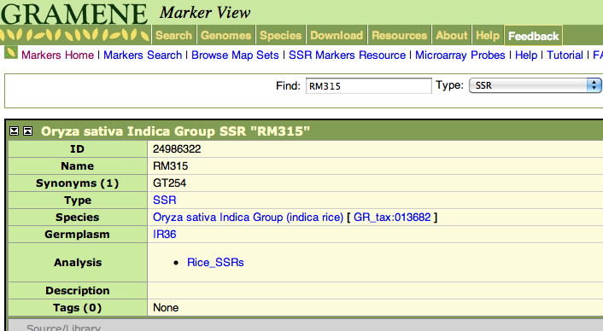
What are the rice genes residing within the region franking by marker RM315 and RM104?
RM315

Slide 11
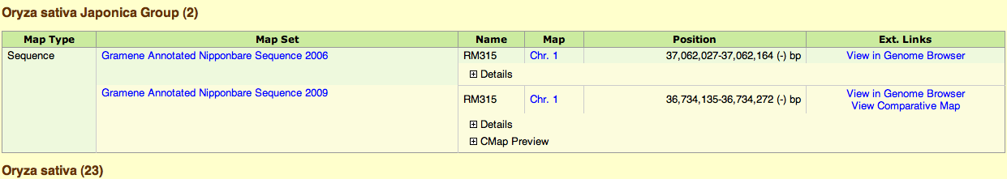
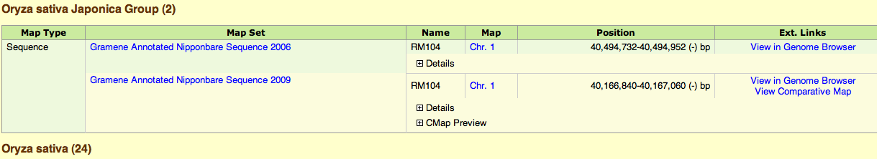
Get physical position of RM315
Do the same for marker RM104 and, write them down

Slide 12
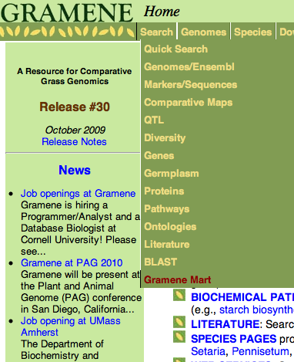
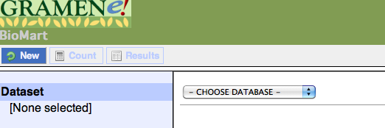
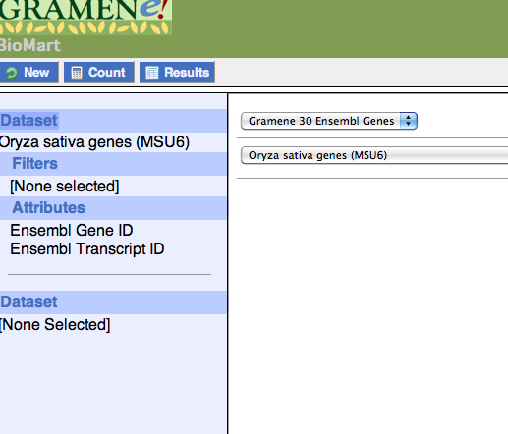
Click Gramene Mart
Look for rice data

Slide 13
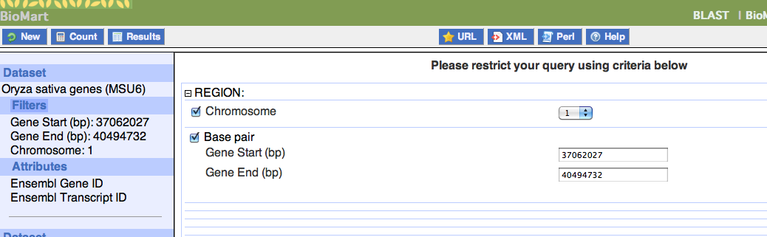
Enter the map positions of markers

Slide 14
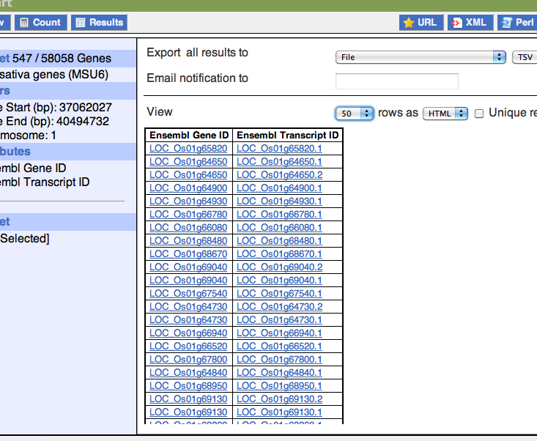
547 rice genes found in between RM 315 and RM104
Notes:
What are the biological questions when people come to Gramene? The genetic questions of biology- how many genes, where are they and how to find them, what does each of them do …

Slide 15
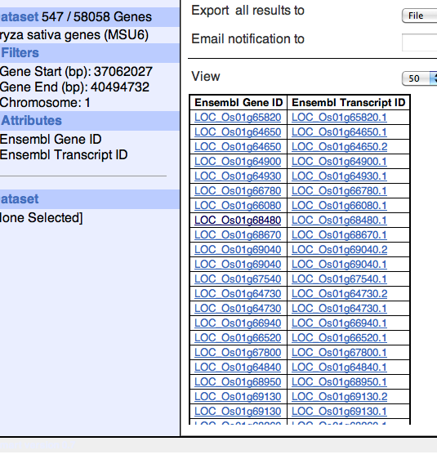

What do those 547 genes do?

Slide 16
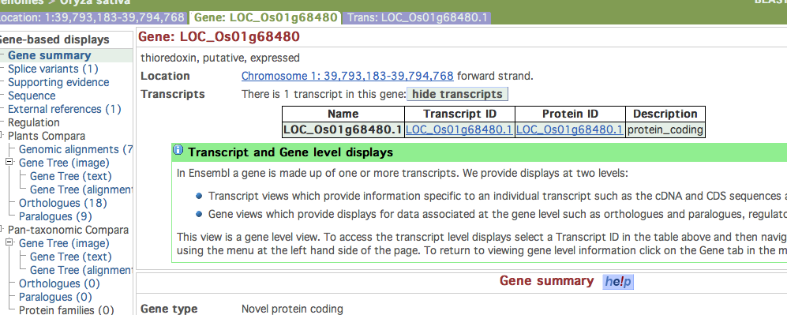
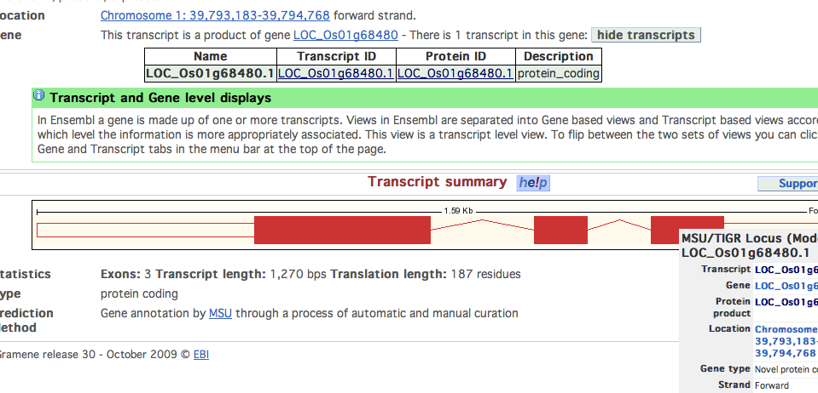

Slide 17
Transcript summary

Slide 18
If we currently have no clear knowledge about LOC_Os1g68480.1, what else do you know about it in other species?
Gene tree
Orthology and paralogy of the gene

Slide 19
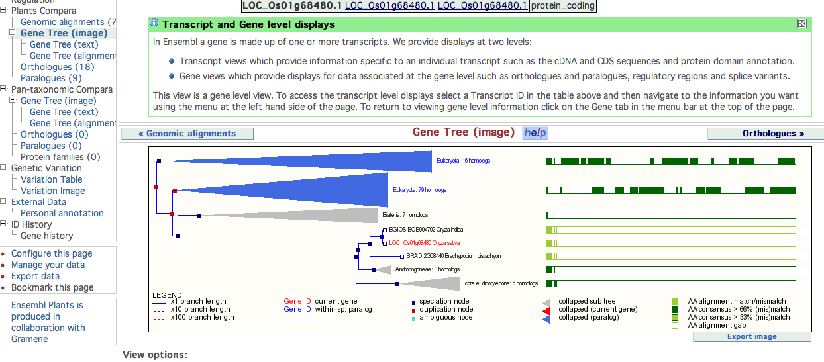


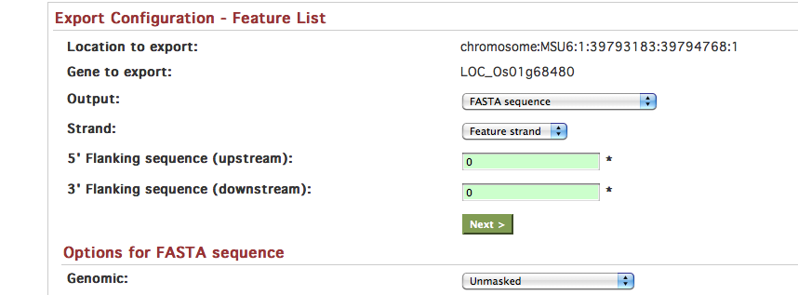

Slide 20

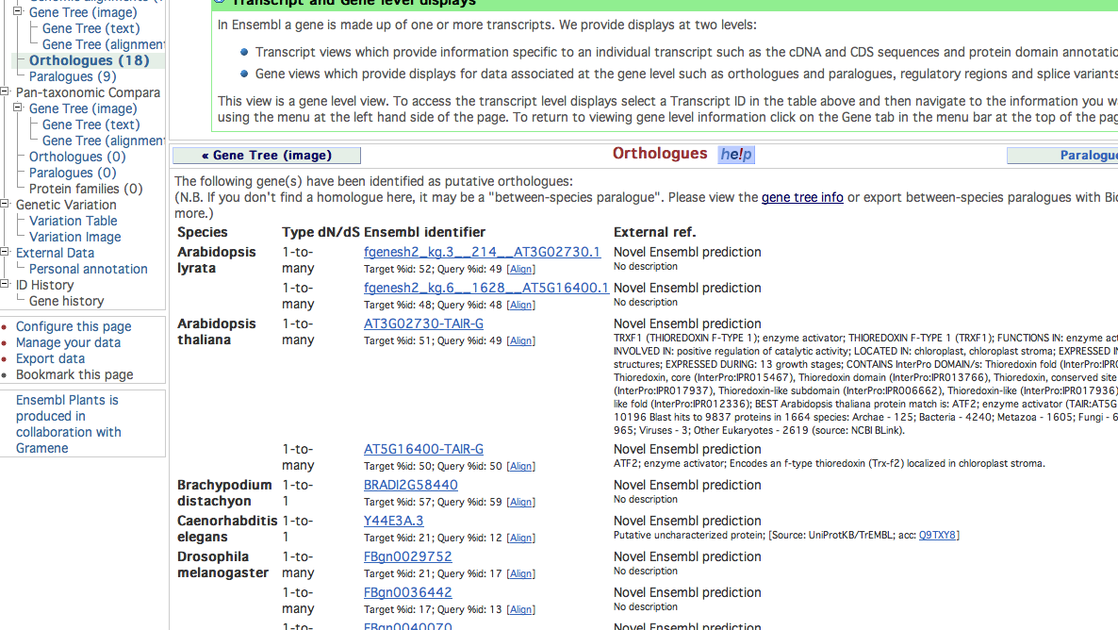

Slide 21
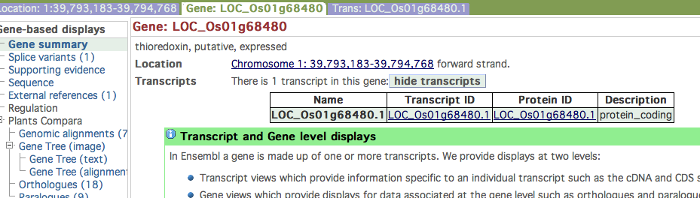
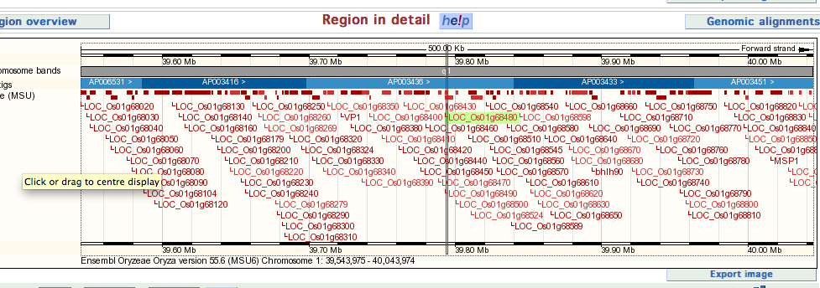

Slide 22
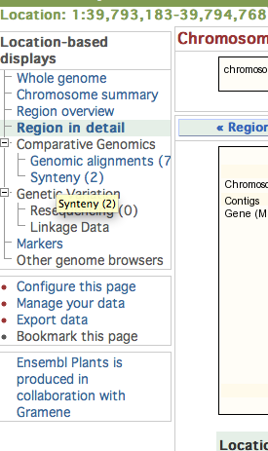
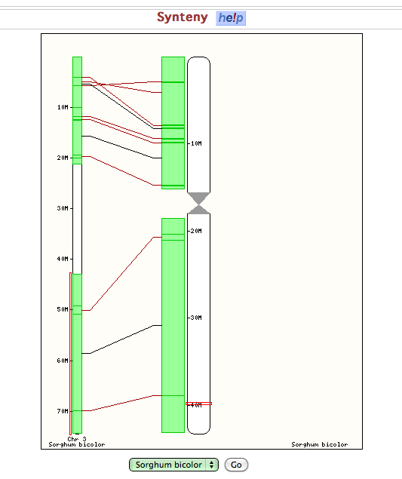
Clink Synteny
change species

Slide 23


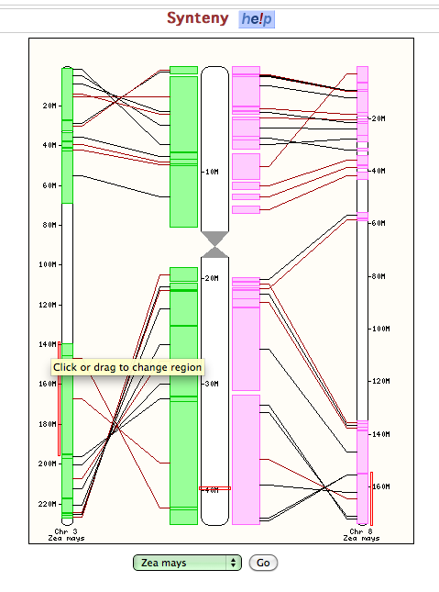
change species
Chr 3 in maize
Chr 8 in maize

Slide 24
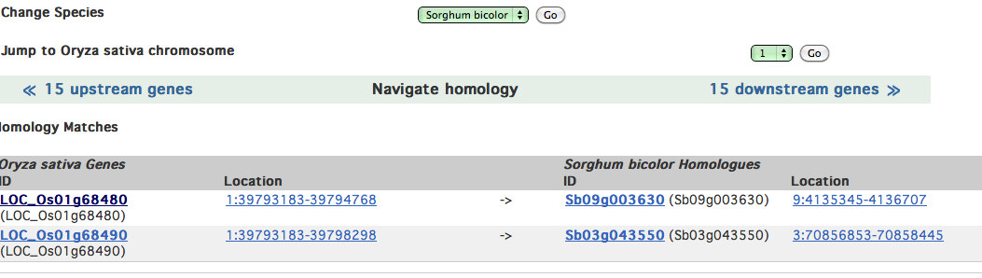
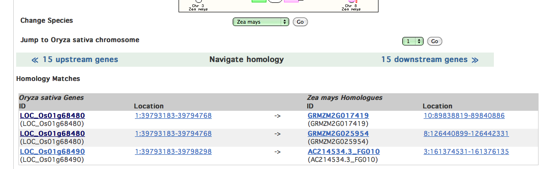
Any homologue to other closely related species?
Sorghum
Maize

Slide 25
Question?
or … Feedback on www.GRAMENE.org

Slide 28
Gramene tutorial PAG 2010- genetics
For a given trait, where are the genes/qtls commonly involoved
in rice, maize and sorghum? In term of chromosome positions
How frequent the genes/qtls are mapped on the same location
In different populations/germplasms?
If comparative maps are available, transfer map information from
One line to another –
are the same genes/qtls contributing to the same trait in different lines ?
Pleiotropic issues in genes versus close linked genes
Where are qtls, genes and rait of interest,

