Slide 1
Maize Browser and Annotation Pipeline
Shiran Pasternak

Slide 2
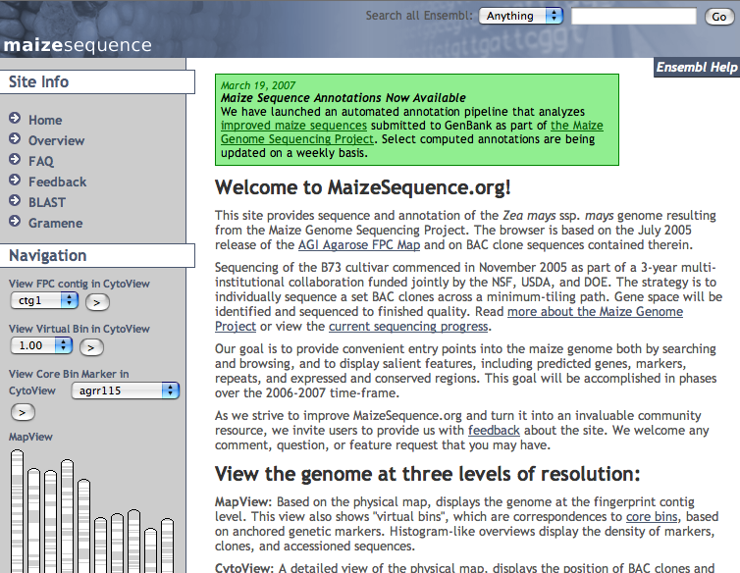
Browser: Homepage
Universal search
BACs, genes,markers, etc.
Global navigation panel

Slide 3
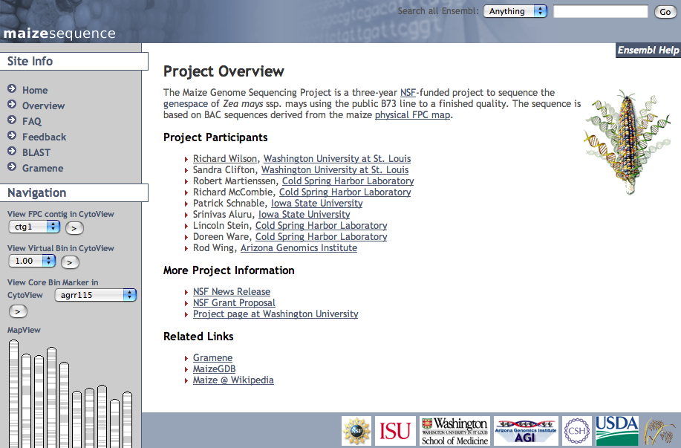
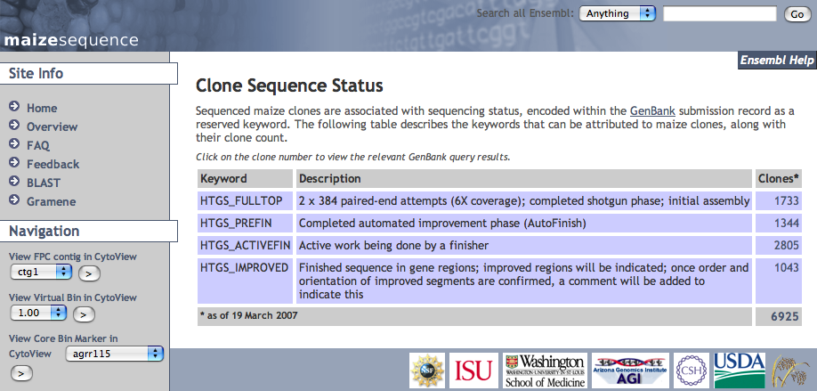
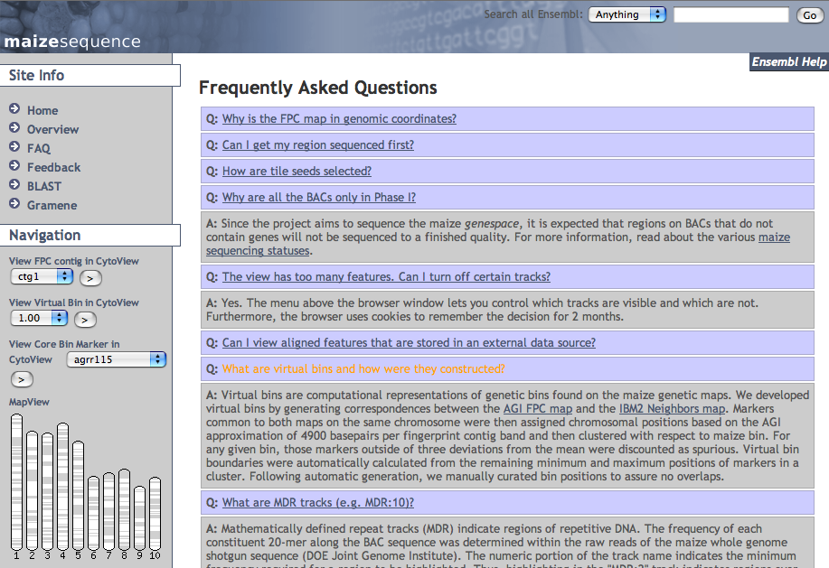
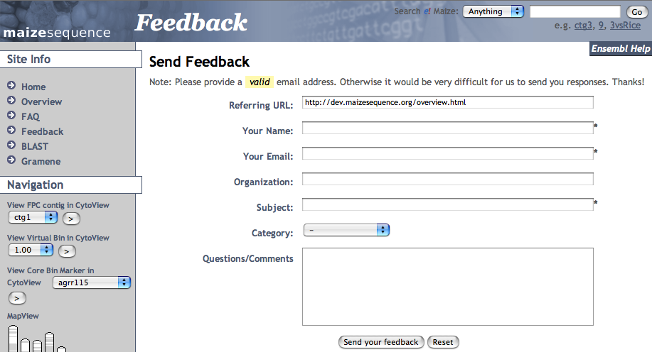
Browser: Project Information

Slide 4
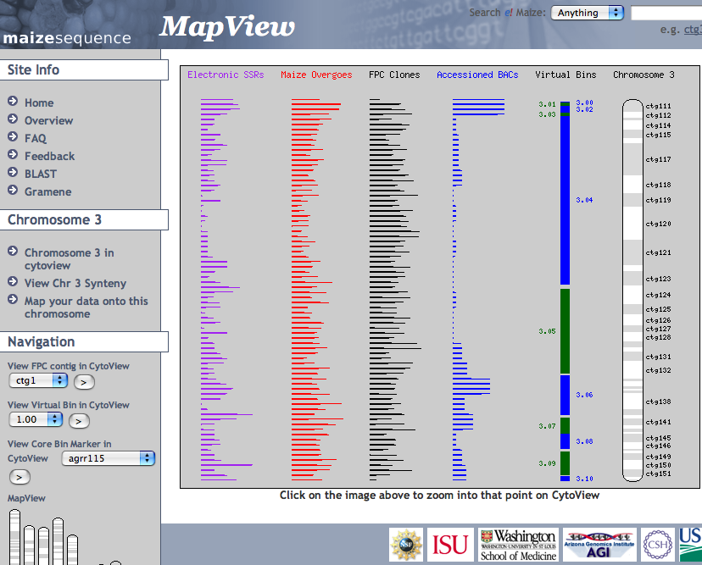
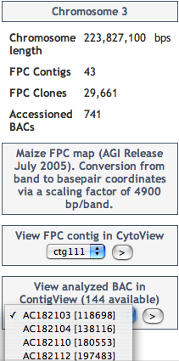
Browser: MapView
Chromosome Statistics

Slide 5
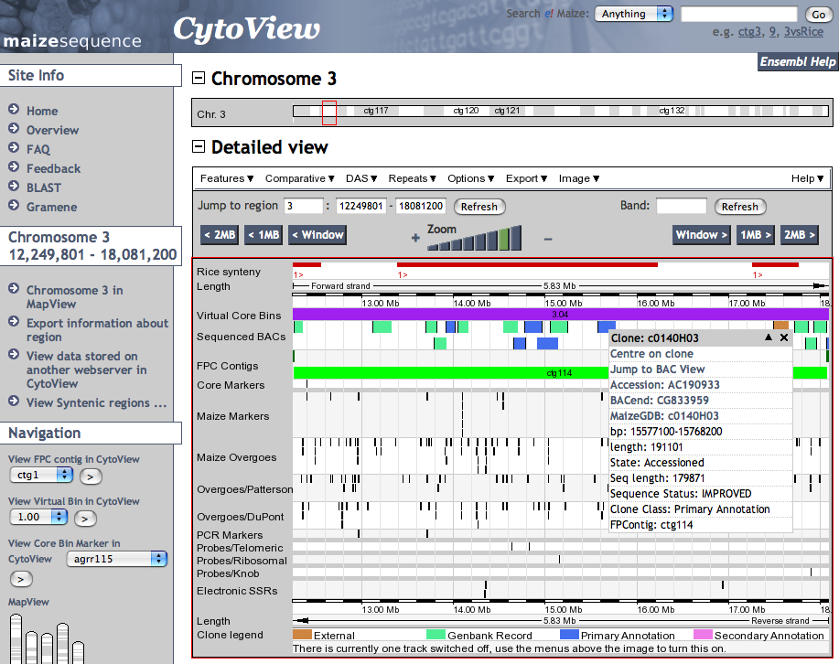
Browser: CytoView
Analyzed Sequenced Clones
FPC Markers

Slide 6
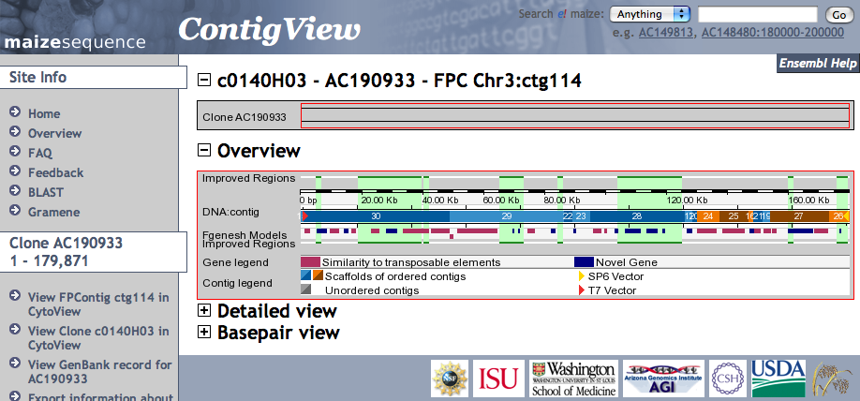
Browser: ContigView
Improved Sequences
BAC Contig Scaffolds
Clone-End Contigs

Slide 7
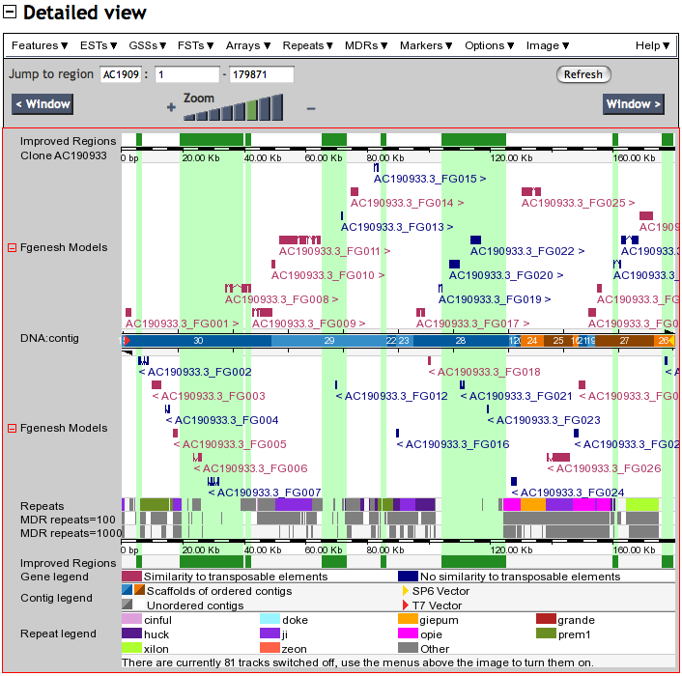
Browser: ContigView Details
Improved Sequences
Gene Models
TE Classification
BAC Contig Scaffolds
MIPS RepeatMasker
Mathematically-Defined Repeats

Slide 8
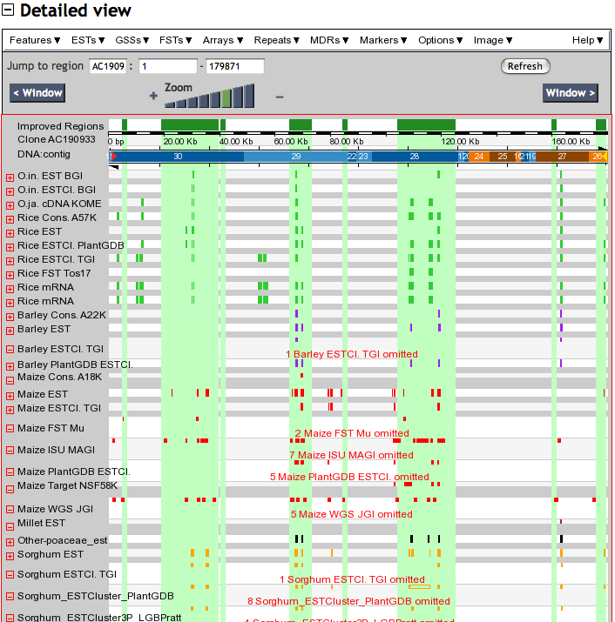
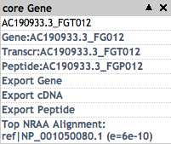
Browser: Cereal Alignments

Slide 9
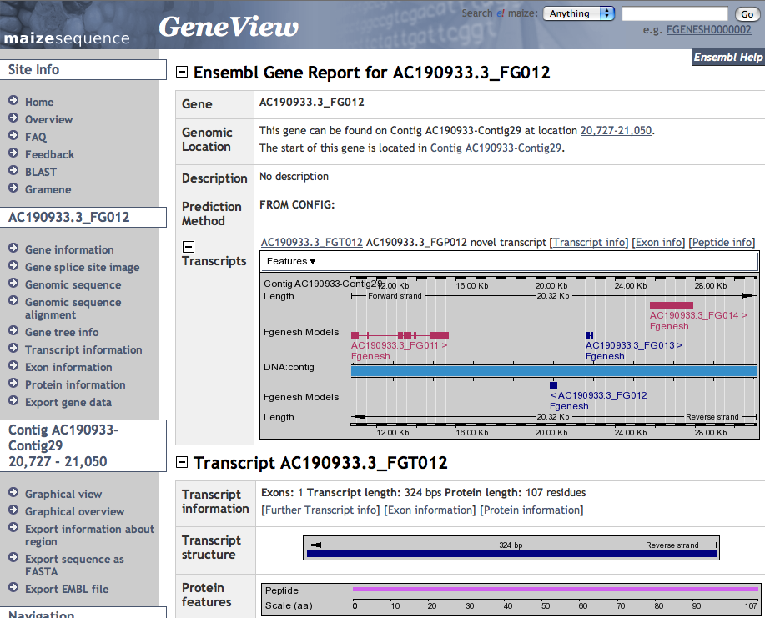
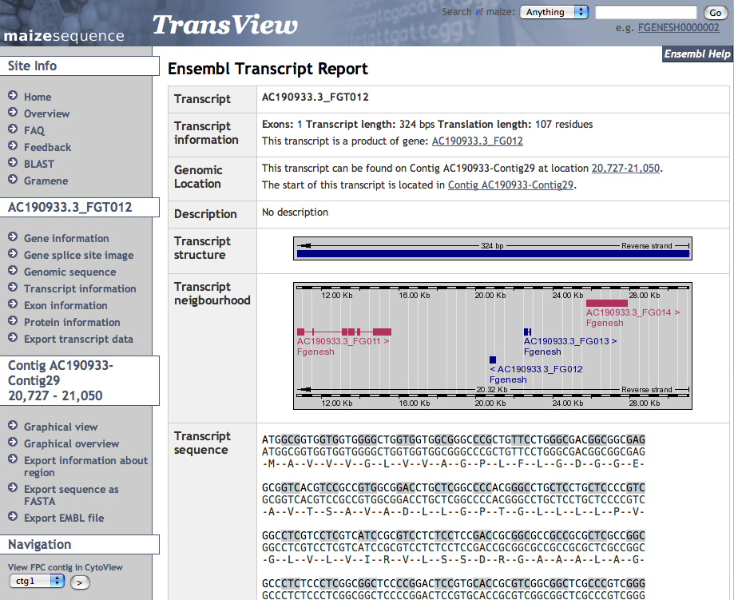
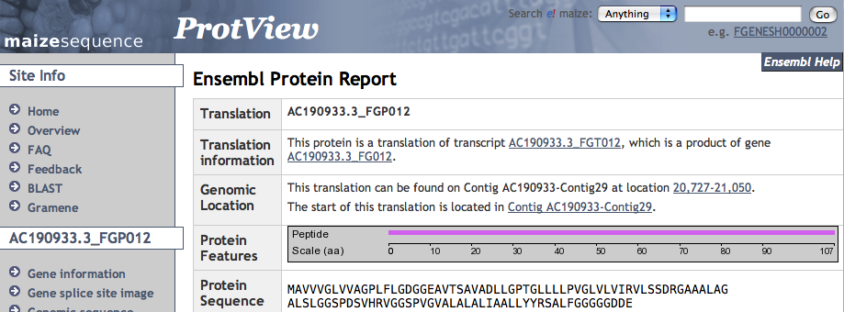
Browser: GeneView

Slide 10
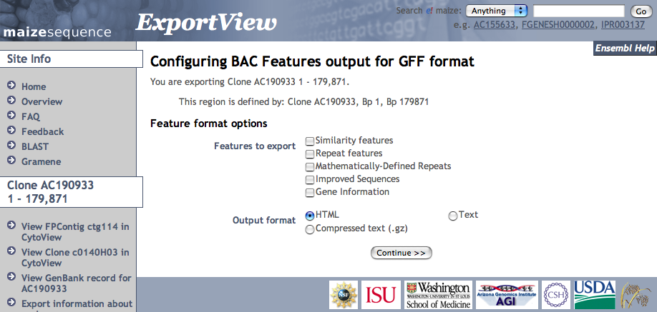
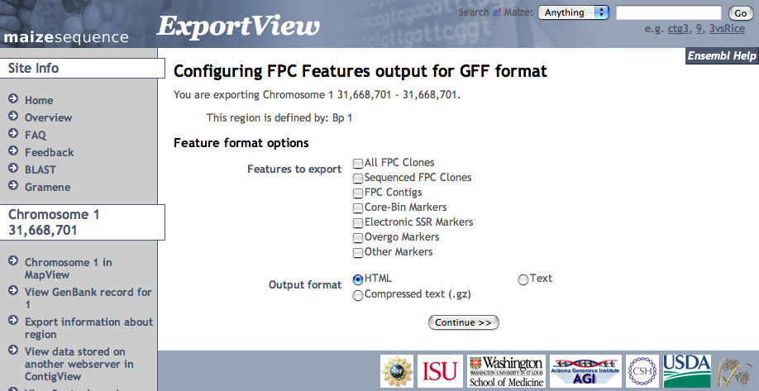
Browser: ExportView
Export FPC Features
Export BAC Features and Sequences

Slide 11
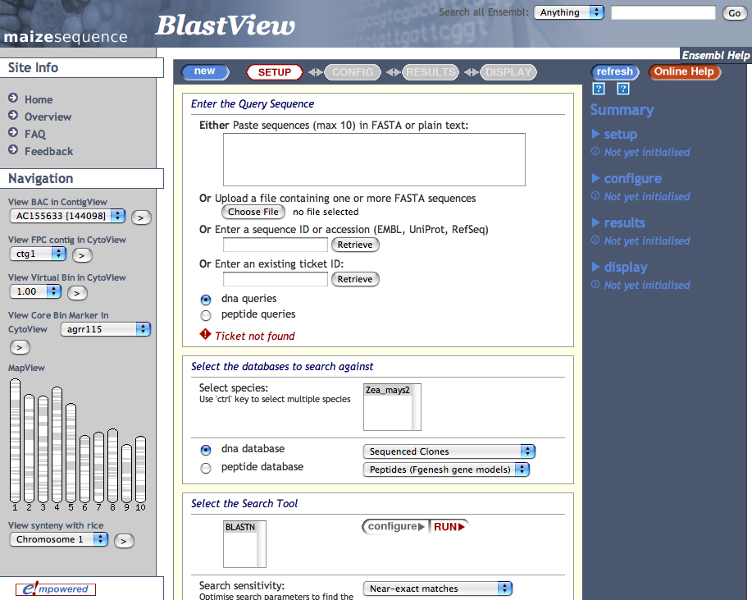
Browser: BLAST

Slide 12
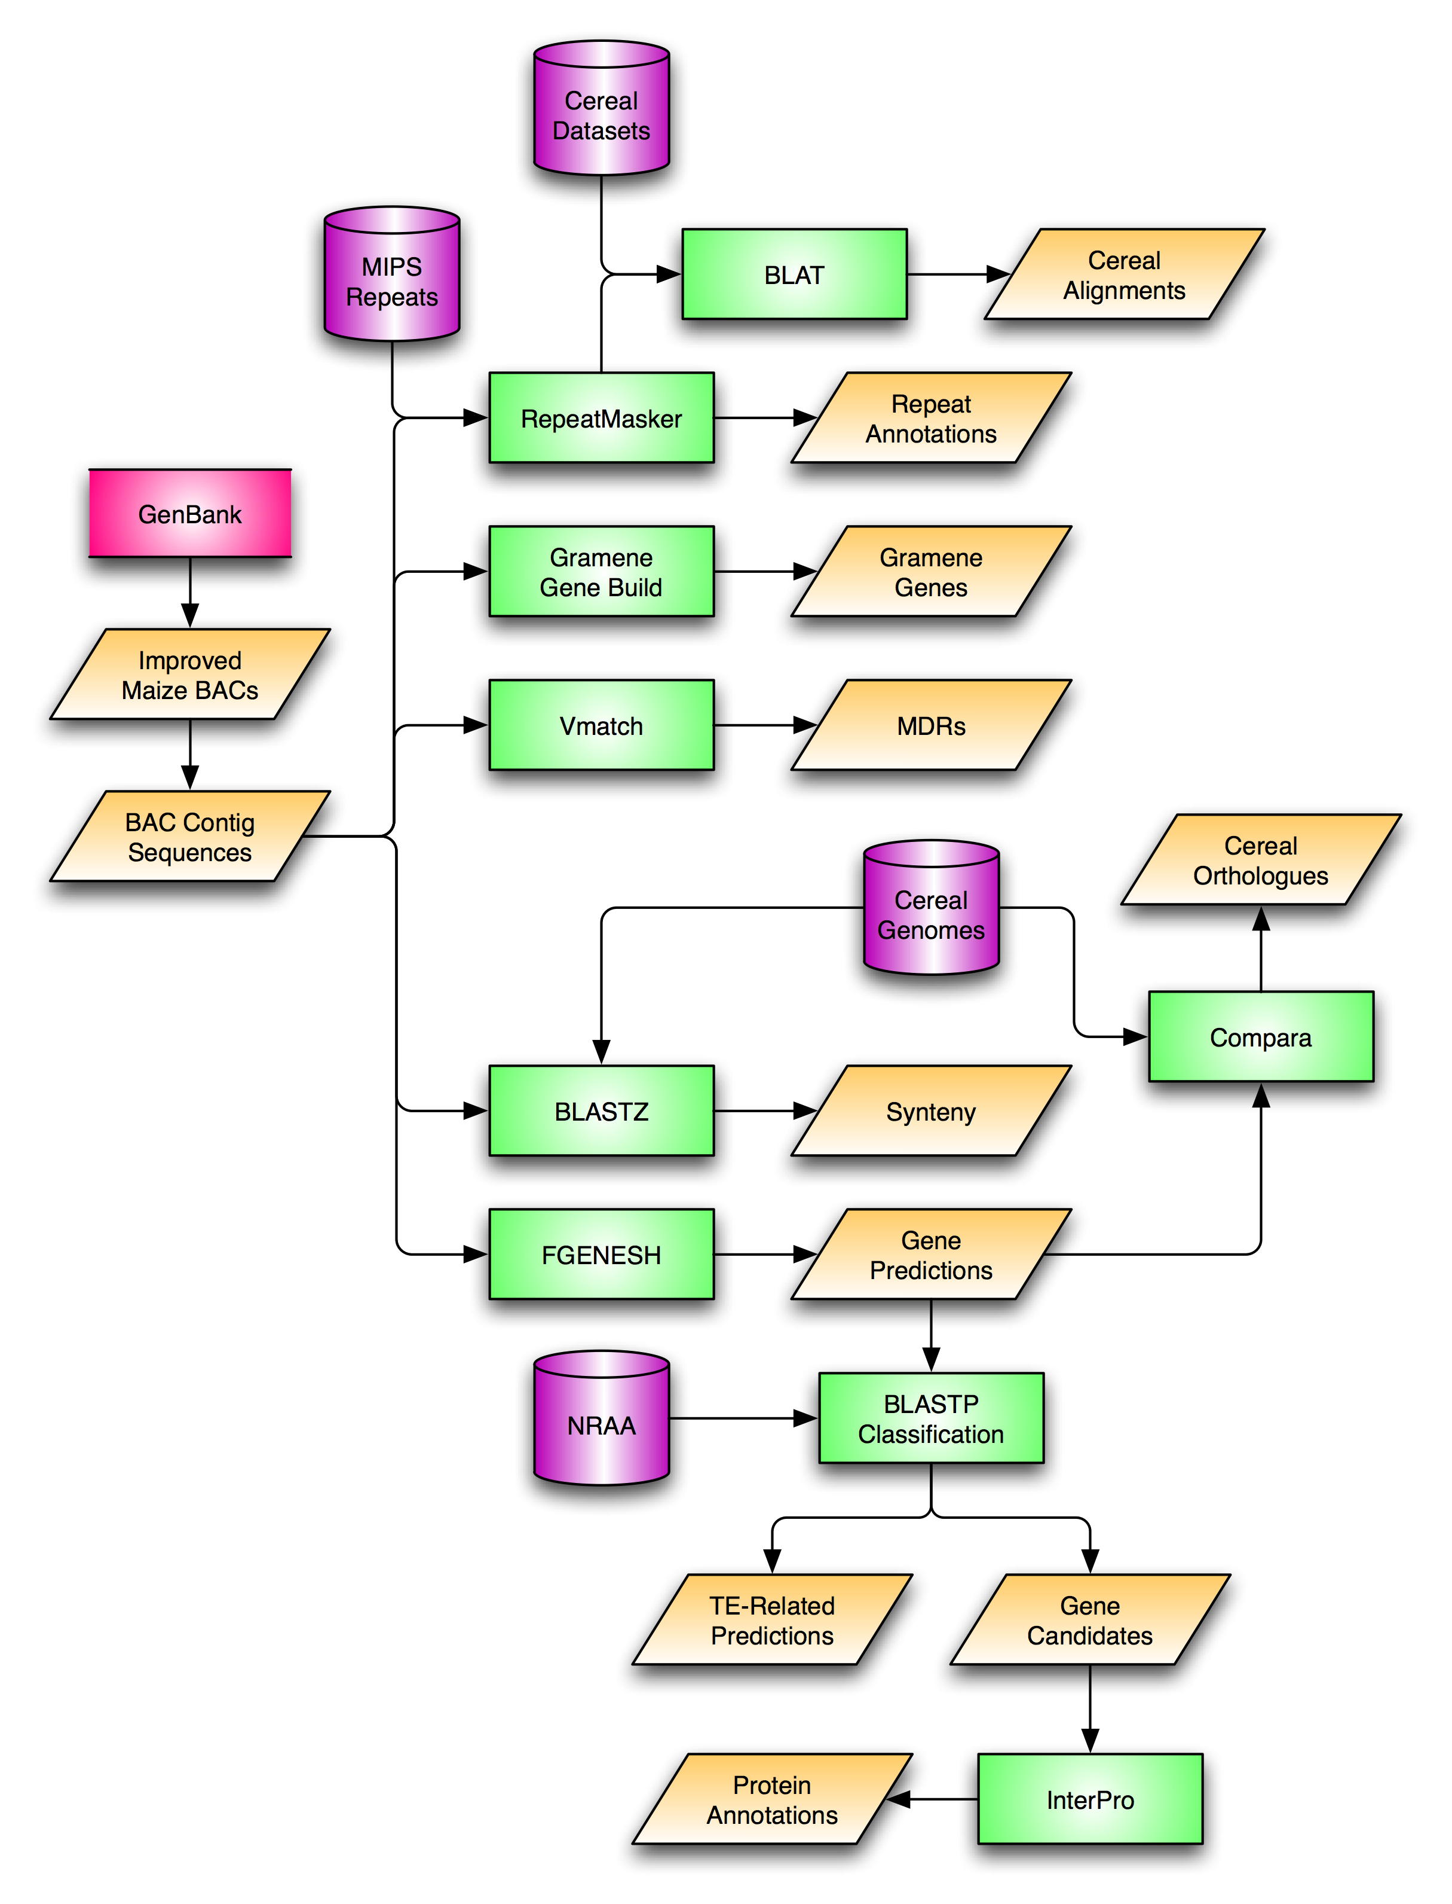
BAC Annotation Pipeline

Slide 13
Timelines for Maize Browser Improvements
May, 2007
  Improve existing maize BLAST
Summer, 2007
  Peptide Annotation
    InterPro and Compara analysis
  Data Access and Distribution
    BAC Notification
    Streaming Data Updates
  Additional Maize Data Sets
    Gramene annotations
    Distributed annotations
Fall, 2007
  Enhanced browser views
    BAC sequence maps anchored in FPC map
  Whole Genome Alignment
Winter, 2007/2008
  Evidence-Based Gene Builds
  Sorghum Whole Genome Alignment
  FPC and BAC map integration
    Improved FPC assembly and annotations using BAC sequence maps

