Slide 1
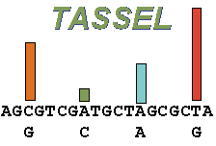
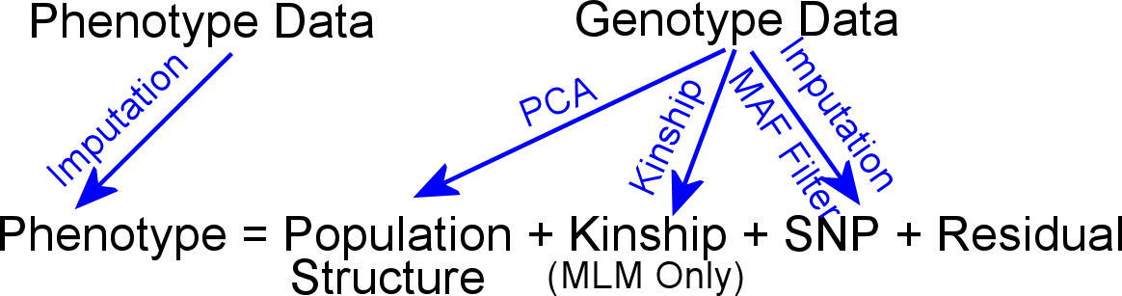
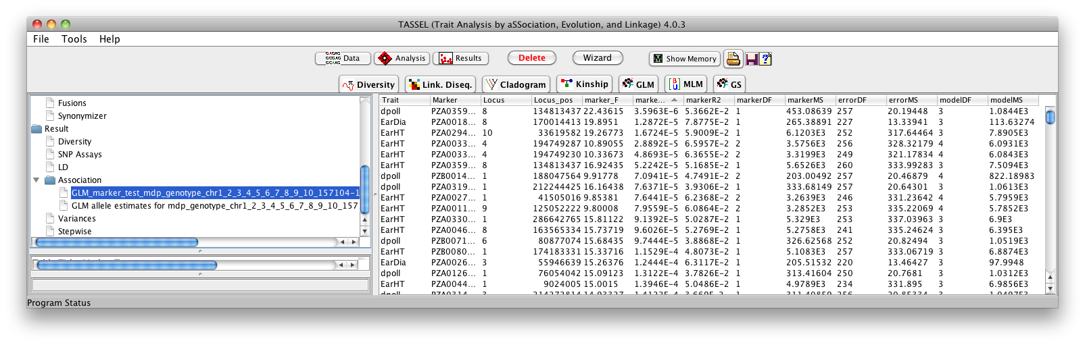
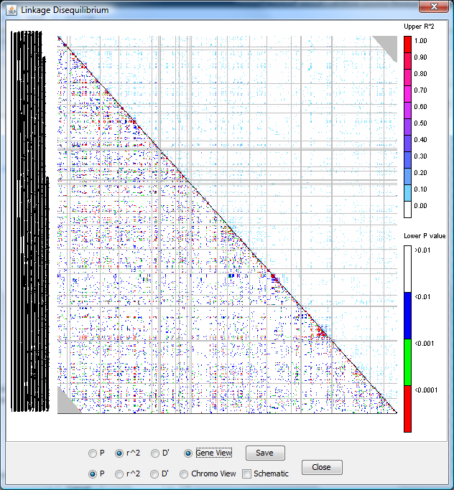
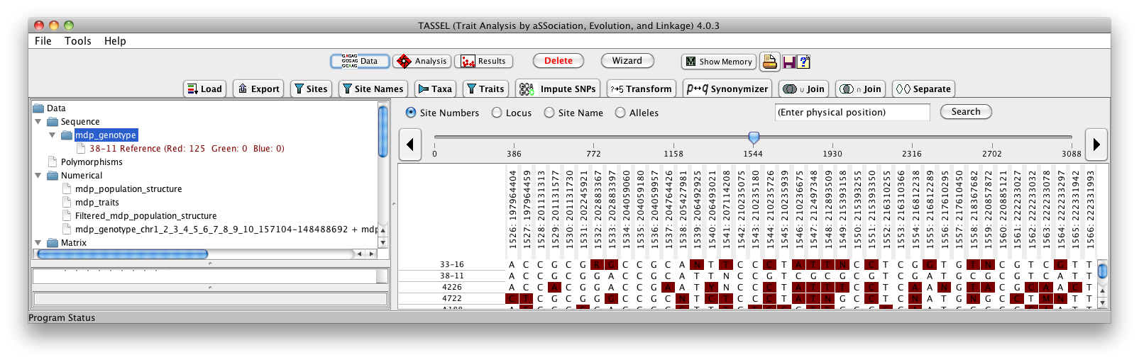
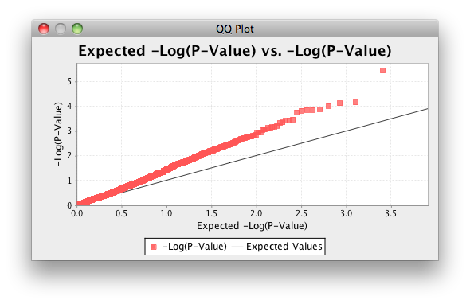
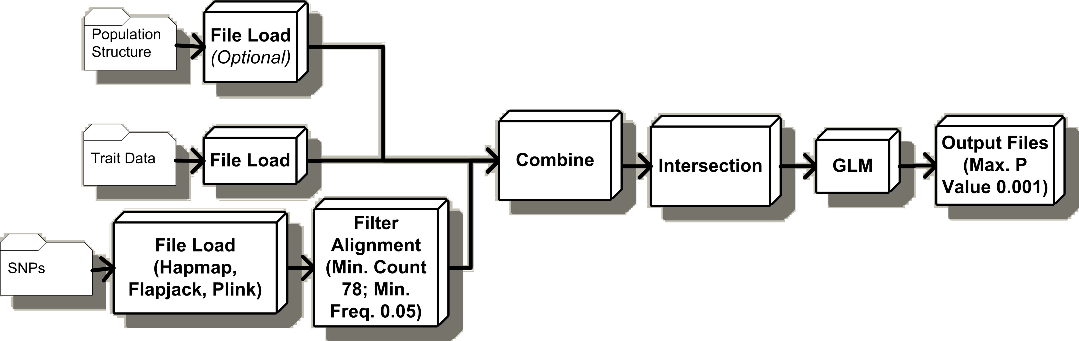
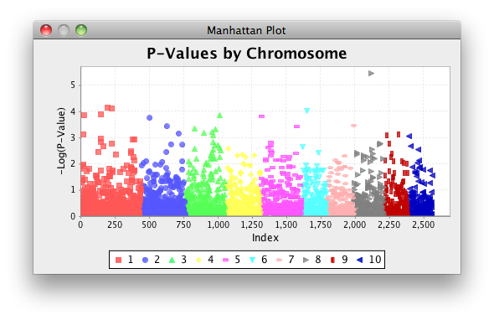




TASSEL 4.0: Faster, Larger Diversity Analysis
Terry Casstevens¹, Peter Bradbury^{2,3}, Zhiwu Zhang¹ , Yang Zhang¹, Edward Buckler^{1,2,4}
¹ Institute for Genomic Diversity, Cornell University, Ithaca, NY ² USDA-ARS ³ Cornell Theory Center, Cornell University ⁴ Dept. of Plant Breeding and Genetics, Cornell University
http://www.maizegenetics.net/tassel
Check out the Gramene Workshop Tuesday 3:50 pm Gramene posters: P0952, P0951, P0858, P0856, P0942
Introduction
Once again, the Trait Analysis by aSSociation, Evolution and Linkage (TASSEL) software team has been designing another major release. Currently in beta release, TASSEL 4.0 will raise the bar regarding high-throughput analysis. TASSEL 4.0 can handle data sets of one trillion SNPs. The new bit-wise algorithms will process these data sets faster than ever before.
TASSEL is Java software that evaluates genotype and trait associations using the tools of population and quantitative genetics. TASSEL can handle data sets commonly encountered in the plant community, e.g., replicated trials, inbred lines, and complex structured pedigrees. TASSEL also has the latest and statistically most powerful approaches for association mapping in complex populations including both General Linear Model (GLM) and Mixed Linear Model (MLM).
There have been several significant improvements since TASSEL version 3.0: 1) a new data structure design facilitating bit-wise algorithms; 2) better support of diploid, heterozygous sequences; 3) consistent handling of all genotypic data sets (i.e. SNPs, text); 4) user friendly improvements to the Alignment Viewer and Filtering Dialogs; 5) and the introduction of XML configuration files for the TASSEL Pipeline.
TASSEL is an open source project (sourceforge.net/projects/tassel).
It’s All About the Bits!
TASSEL 4.0 introduces the next major improvements since TASSEL 3.0! Our new design puts emphasis on Efficiency, Performance, and Consistency. This is accomplished largely due to our bit-wise data storage and analysis algorithms.
1.6 Million LD Calculations Executes 30 times faster in TASSEL 4.0!
Distance Matrix for 1320 Taxa Executes 25 Times faster in TASSEL 4.0!
TASSEL provides both Mixed Linear Model (MLM) and General Linear Model (GLM) for Genome-Wide Association Studies (GWAS). MLM implements algorithms to improve statistical power and computation speed:
EMMA: Efficient Mixed Model Algorithm to improve computation speed to estimate variance components (ratio). The algorithm was developed by Kang et al (2007, Genetics)
Compression: Individuals in the standard MLM are replaced by their corresponding groups. The algorithm was developed by Zhang et al (2010, Nature Genetics) to improve statistical power and speed.
P3D/EMMAx: The population parameters in MLM, such as variance components (ratio) are estimated only once. These Population Parameters Previously Determined (P3D) are fixed to screen SNPs (could be millions) to improve performance. This algorithm was simultaneously discovered by Zhang et al (2010, Nature Genetics, named as P3D) and Kang et al (2010, Nature Genetics, named EMMAx).
LD Analysis
QQ and Manhattan Plots
Tassel Pipeline: Command Line Interface to Tassel functions that can be combined to perform complex automated analyzes.
(www.maizegenetics.net/tassel/docs/TasselPipelineCLI.pdf)
Example Pipeline: GLM Analysis: Using this, we evaluated 2.4 Billion GLM Analyses in 14 CPU Hours
<TasselPipeline>
<fork1>
<h>../TASSELTutorialData/data/mdp_genotype.hmp.txt</h>
<filterAlign>
<filterAlignMinFreq>0.05</filterAlignMinFreq> …
Thanks to NSF and USDA-ARS for their support.
January 12, 2012

