Slide 1
Variation Detection in Wild Rice Species
Blastz to find BES alignments to rice chromosomes
Crossmatch to get a detailed alignment with quality scores in regions defined by blastz
Variation discovery based on the quality score and variation in a given base and in neighboring bases

Slide 2
OMAP Variation Data Statistics
 | SNV | INSDEL | Rate of SNV/kb | Rate of INSDEL/kb
O. rufipogon | 259,080 | 44,201 | 12.2 | 1.5
O. nivara | 336,242 | 63,092 | 13.2 | 1.6
O. glaberrima | 295,325 | 47,954 | 15.9 | 2.0
O. punctata | 728,910 | 165,345 | 71.5 | 11.4
TOTAL | 1,619,557 | 320,592
* SNV - single nucleotide variation
* INSDEL - insertion or deletion
Notes:
Consequence of the SNPs in TIGR gene models. This figures shows the consequence of the SNPs in TIGR Gene transcripts. In the AA genomes the majority of SNPs appear to be upstream of the genes. In punctata, a BB genome the majority of SNPs are falling within genes as synonymous coding or intronic. This is most likely due to the higher degree of similarity in genes between punctata and O. sativa, rather than non coding sequence. Whereas the AA genomes have similarity in both coding and non coding regions.
Table and gene diagram

Slide 3
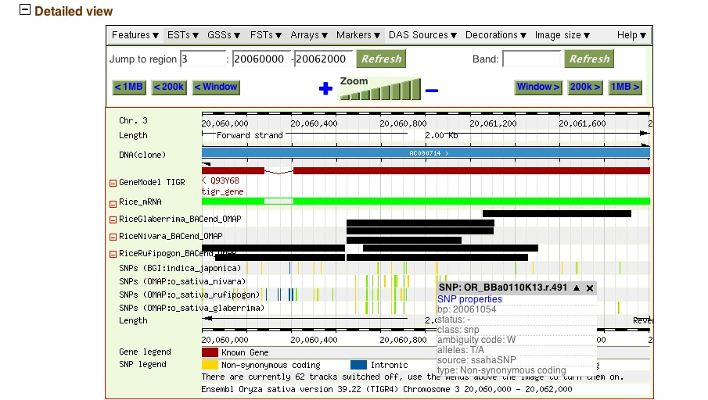

Variations in context with OMAP BES and O. sativa genome are available in the Genome Browser
Notes:
Figure 9: The genome browser provides tracks showing the alignments of the BES for all of the OMAP species in addition to showing detailed information regarding the variations in the wild species with respect to O. sativa.

Slide 4
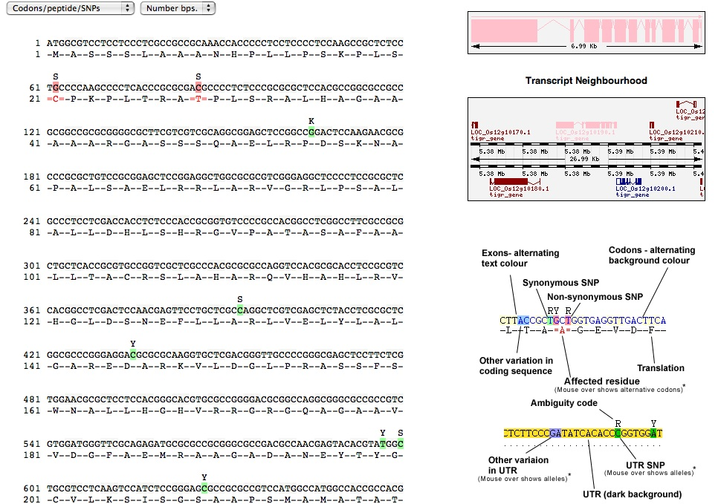
Drill down to the Transcript SNP View
Notes:
Representation of SNPs in a transcript in Gramene. The variation data will be released to Gramene in 2006.

Slide 5
Finding Rearrangements between Wild Rice Species and O. sativa
Genomes of wild rice are not currently available for direct comparison
To circumvent this, we optimally map paired wild rice BES to the rice genome to identify sites of structural variation
The power of this approach stems from the stability and packaging constraints for BAC vectors (insert size ~ 150kb)
We expect an insert size with a tight distribution around the mean insert size
The presence of multiple discordant paired reads by size or orientation can be used to identify regions of expansion, contraction or inversion

Slide 6
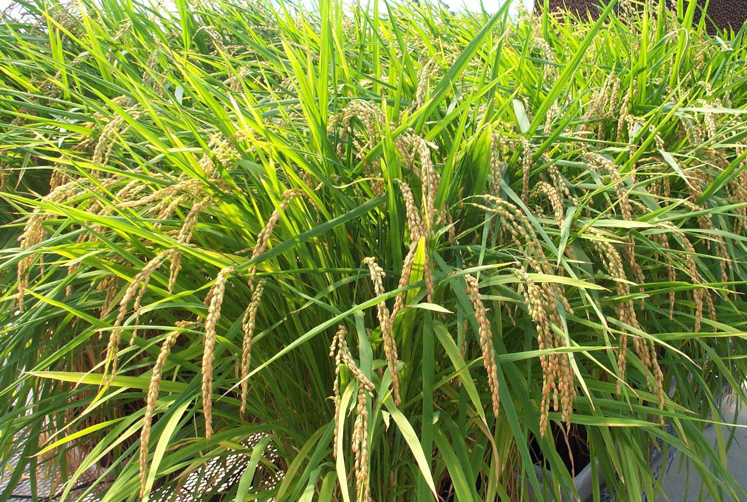
Types of Rearrangements Detected
Contraction
  Region in the wild rice is shorter than rice
Expansion
  Region in the wild rice is longer than rice
Inversion
  Region in the wild rice is inverted as compared to rice
The Oryza Map Alignment Project
The Golden Path to Unlocking the Genetic Potential of Wild Rice Species
OMAP
.org
University of Arizona Cold Spring Harbor Laboratory Purdue University

Slide 7
BES-F
IRGSP CHR 3 pseudomolecule
BES-R
164 kb
BES-F
BES-R
139 kb
OMAP BAC clone
Contraction
Expansion
BES-F
IRGSP CHR 3 pseudomolecule
BES-R
95 kb
BES-F
BES-R
138 kb
OMAP BAC clone

Slide 8
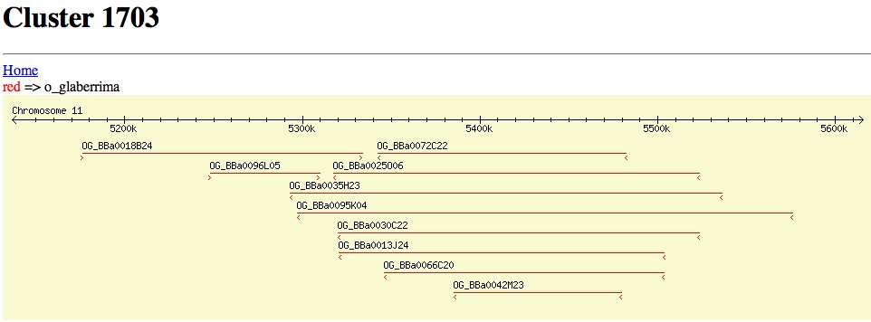
Inversion
Notes:
In this region on chromosome 11, we can see clones that share a discordant pattern. In this case the clones have BES that are too far apart or too close together and have the same orientation when mapped to the genome. If these O. glaberrima clones were similar to O. sativa the BES would fall within an expected range based on the overall clone sizes for the library from CHEF gel size analysis and would be in opposite orientations (for the forward and reverse read). If we imagine inverting the region in the center, we can see that we would be able to reconstruct the region to be similar to O. sativa, where each BES pair fall within a reasonable clone distance and the BES pair matches in opposite orientation. This is an example of an inversion.

Slide 9
Putative Rearrangements
 | insertions | deletions | inversions
Oryza rufipogon | 232 | 175 | 40
Oryza nivara | 397 | 190 | 53
Oryza glaberrima | 92 | 267 | 47
Oryza punctata | 100 | 71 | 54
total | 821 | 703 | 194

Slide 10
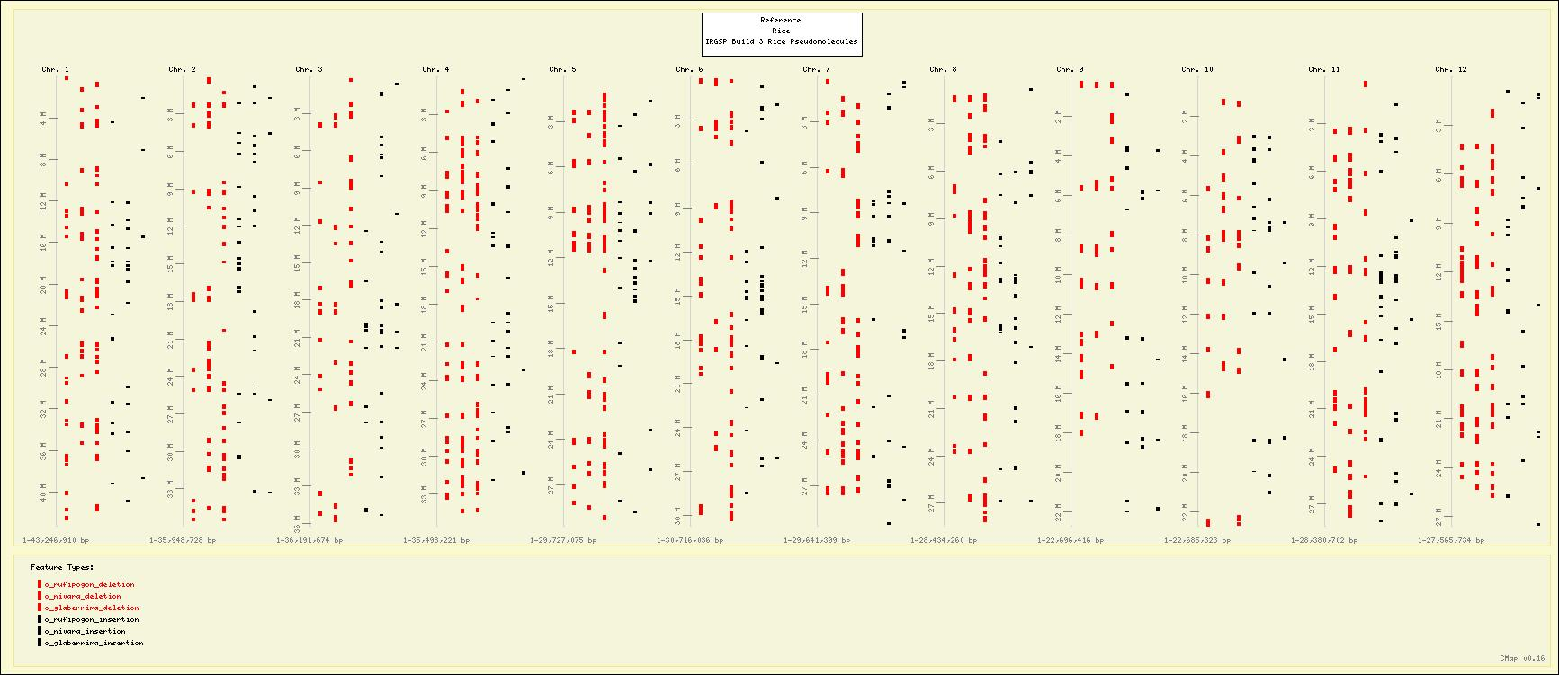
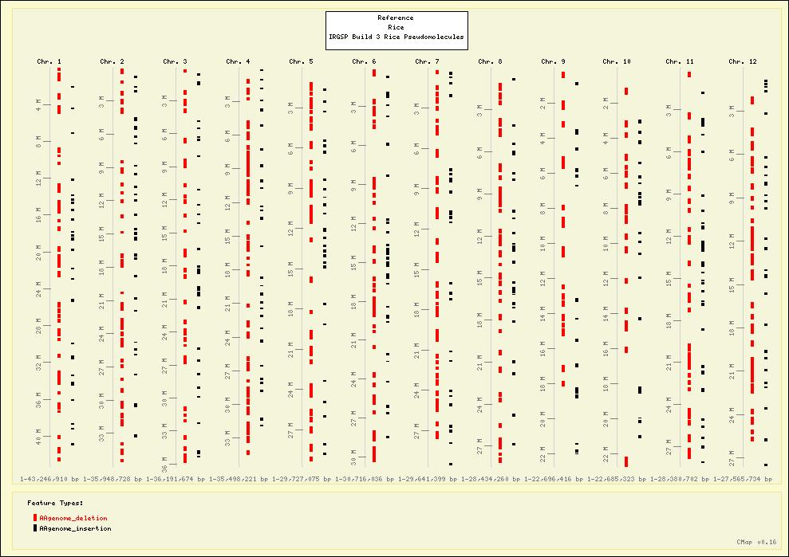
Confirmed expansion and contraction regions of O. rufipogon, O. nivara and O. glaberrima aligned to O. sativa pseudomolecules
contractions
expansions
Lanes aligned to each chromosome, left to right: contractions (red) in O. rufipogon, O. nivara, O. glaberrima and expansions (black) in O. rufipogon, O. nivara, O. glaberrima.

Slide 11
Phylogenomic analysis of 10 diploid species of Oryza
Bonnie Hurwitz
Doreen Ware
Lincoln Stein
Mike Sanderson
OMAP (PIs: Rod Wing, Lincoln Stein, Scott Jackson, Cari Soderlund)

Slide 12
Notes:
As a first step we plan to do our analysis on the AA diploid genomes, followed by the BB genomes until we reach the most distantly related species O. granulata. By doing our analysis in this way we will be able to learn from our alignments of more closely related species and adjust parameters as we move to more distantly related species. Additionally we will do most of our SNp analysis on the AA genomes since they are more closely related and we believe they will be the most informative.

Slide 13
Identify wild rice BES in O. sativa genes
Create exon sequences for each species based on overlapping BES
Perform an all vs all blast search for wild rice exons
Remove exons in gene families or duplications
Create alignments of orthologous exons where four or more species overlap with 70% identity and coverage
Infer trees

Slide 14
Maximum parsimony bootstrap trees by chromosome

Slide 15
NJ tree for entire alignment with branch lengths estimated

Slide 16
Lineage sorting of ancestral polymorphisms?
O. sativa
OR CB
OR BB
OG BB
OB AB

Slide 17
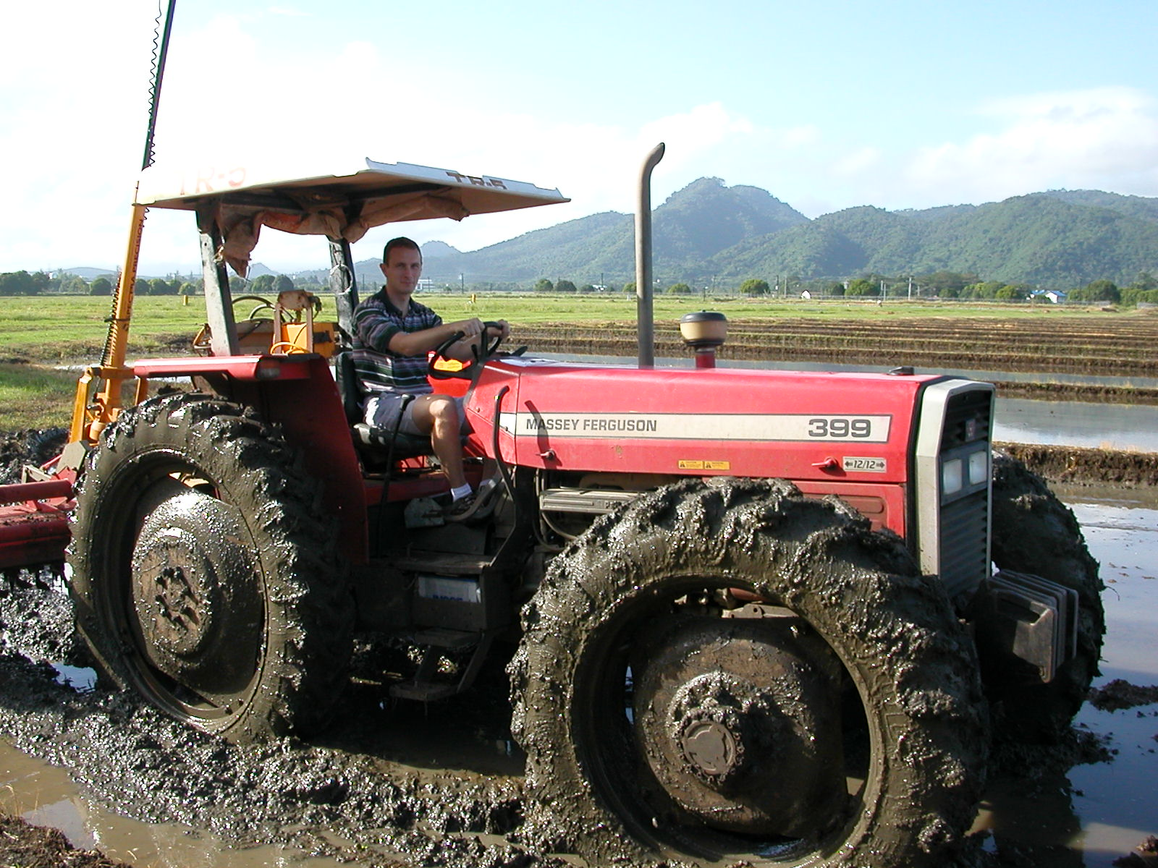
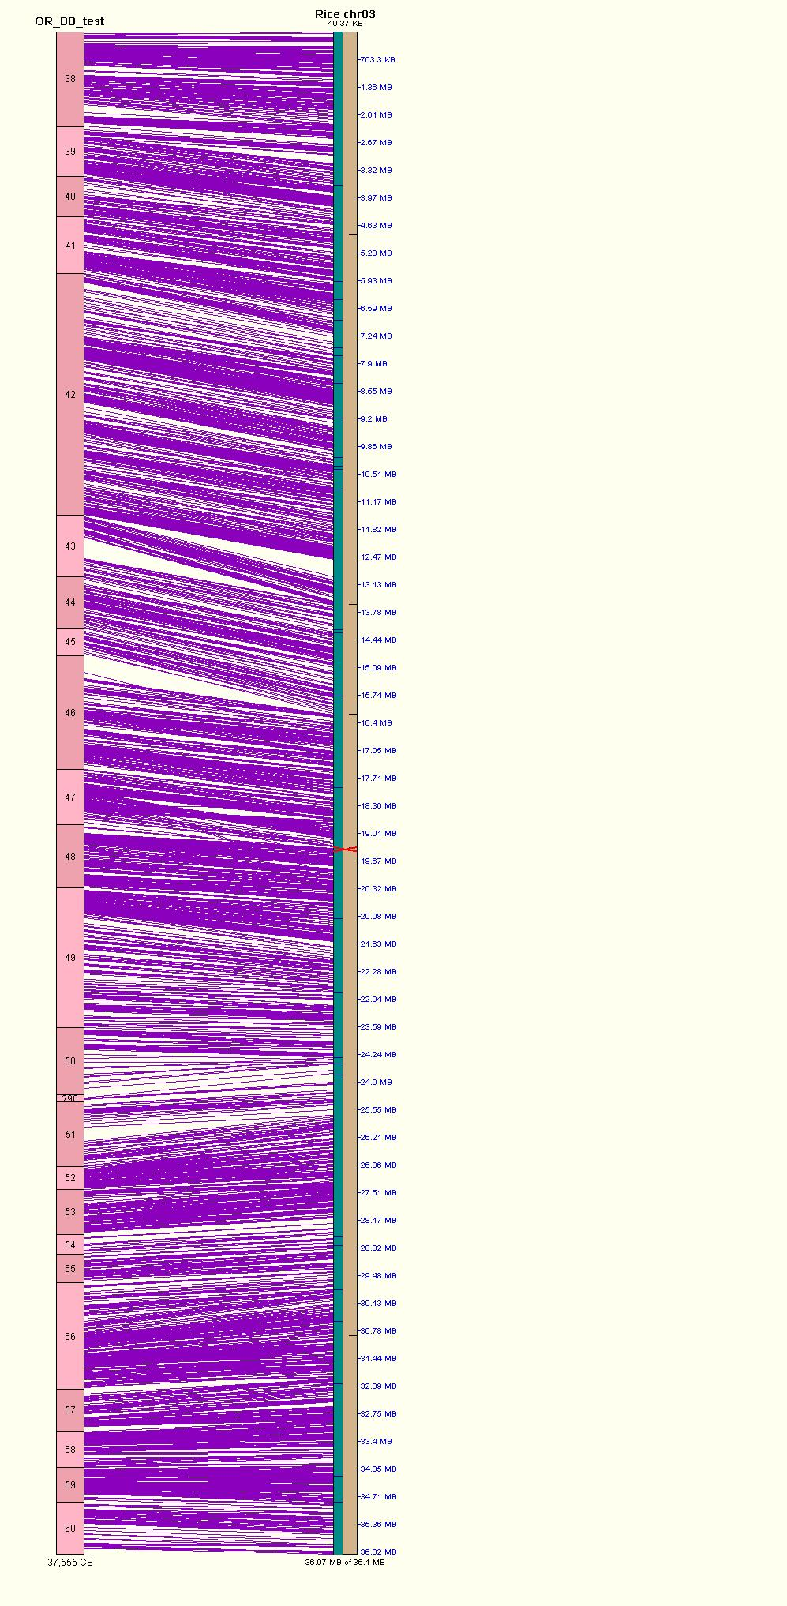
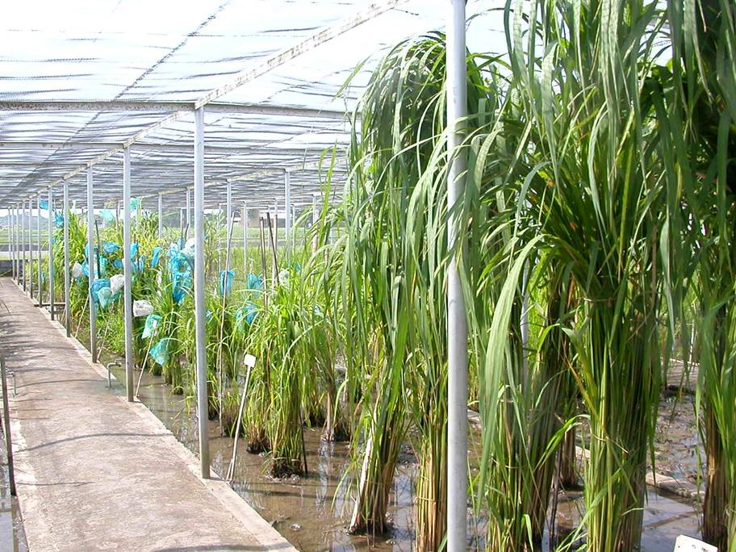
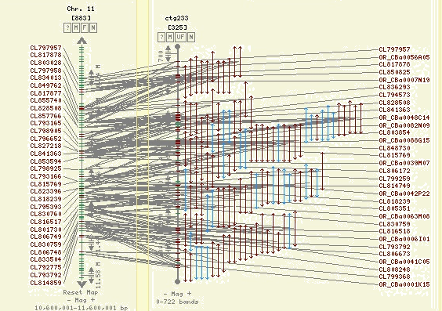
Oryza Map Alignment Project - Team
AGI
Purdue
OMAP
CSHL
AGCoL

