Slide 1
Ensembl Compara Overview
Comparative genomics:
  Whole genome alignments
  Synteny regions
Comparative proteomics:
  Orthologue predictions
  Paralogue predictions
  Protein family clusters
Sources:
  http://pre.ensembl.org/info/data/compara/homology_method.html
  ensembl-compara/scripts/pipeline/README-genetree
  loadGeneTreeSystem.pl
  Correspondence with Albert Vilella at EBI

Slide 2
Homologue Relationships
Orthologues :
any gene pairwise relation where the ancestor node is a speciation event
Paralogues :
any gene pairwise relation where the ancestor node is a duplication event

Slide 3
Homologue Relationships
time
A
Ancestor
Duplication
A 1
Inparalogues
A 2
Speciation
Inparalogues
H 2
Duplication
M 1
H 1
Orthologues
Outparalogues
M 2
M 2’
Inparalogues

Slide 4
Orthologue / Paralogue Prediction Algorithm
Load longest translation for each gene
All-vs-All WUBLASTP+SmithWaterman
Build graph of gene relationships based on:
  Best Reciprocal Hit (BRH)
    “Best” is a simple sort of score, %identity, %positivity
  Blast Score Ratio (BSR)
    score/maximum self-score
    Default threshold for clustering is 0.33
Extract gene families by single linkage clustering (PAFCluster.pm)
Multiple sequence alignment: MUSCLE
  Edgar RC "MUSCLE: a multiple sequence alignment method with reduced time and space complexity" BMC Bioinformatics 2004 Aug 19;5:113.
  Faster than CLUSTALW but just as accurate.
Build tree and infer duplications/losses using NJTREE
  Li H et al. NJTREE: http://treesoft.sourceforge.net/njtree.shtml. Manuscript in preparation.
  Looks only at “well aligned” columns
  Reconciles gene tree with species tree
  Species tree built from NCBI Taxon database using script testTaxonTree.pl
From each gene tree, infer gene pairwise relations of orthology and paralogy types.
Compute and store Ka/Ks analysis for close orthologues (PAML:codeml)

Slide 5
Orthologue and Paralogue Types
ortholog_one2one
ortholog_one2many
ortholog_many2many
apparent_ortholog_one2one
within_species_paralog
between_species_paralog

Slide 6
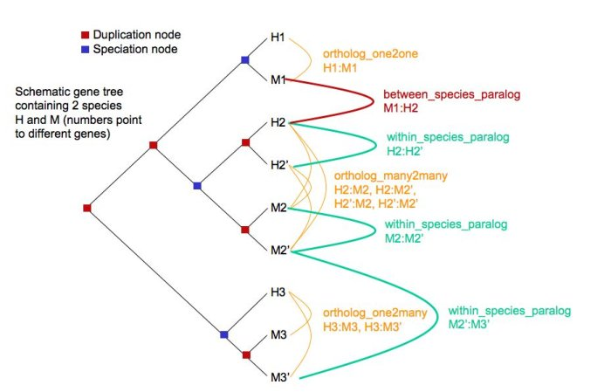
Orthologue and Paralogue Types

Slide 7
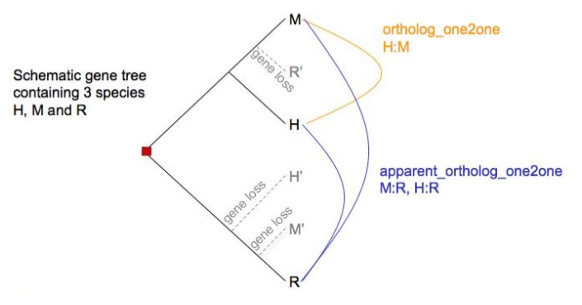
Orthologue and Paralogue types

Slide 8
Origin of Maize Hypotheses
Speciation node
Duplication node
Model 1
Zm^{B}
Autotetraploid: Spontaneous genome doubling within an individual (maize ancestor) resulting in a new species.
From a gene tree perspective model 1 and model 2 are indistinguishable
Zm^{A}
Sb
Os
Model 2
Zm^{B}
Zm^{A}
Allotetraploid 1: Interspecies hybridization by two individuals more closely related to one another than to sorghum.
Sb
Os
Model 3
Sb
Zm^{B}
Allotetraploid 2: Interspecies hybridization by two individuals, one more closely related to sorghum than the other.
Zm^{A}
Os

Slide 9
What Will NJTREE Do?
Can it be used to define orthologous sets (Os, Sb, Zm^{A}, Zm^{B})?
My understanding based on RAP algorithm (Dufayard et al. 2005. Bioinformatics 21:2596) which was previously used by Ensembl prior to switching over to NJTREE
Zm
Simple species tree:
No consideration of maize tetraploid origin
Sb
Os
Gene tree :
Reconciled:
Relationship calls:
Model 1/2
Zm^{B}
Zm^{B}
ortholog_one2many
  Sb::Zm^{A}, Sb::Zm^{B}
within_species_paralog
  Zm^{A}::Zm^{B}
Zm^{A}
Zm^{A}
Sb
Sb
Os
Os
Model 3
Sb
Sb
ortholog_one2one
  Zm^{B}::Sb
within_species_paralog
  Zm^{A}::Zm^{B}
between_species_paralog
  Zm^{A}::Sb
Zm^{B}
Zm^{B}
Sb loss
Zm^{A}
Zm^{A}
Os
Os
Don’t want this behavior…or do we?

Slide 10
What Should We Do?
Initially, define Sb, Os, ZmA, and ZmB orthologous sets based on collinear relationships within syntenic blocks
  Whole Genome Alignment part of Compara
Compare results to Tree-based assignments
  What proportions of orthologous sets are assigned ortholog_one2many vs. ortholog_one2one relationships?
  In ortholog_one2one assignments do the identified maize orthologues cluster physically to the exclusion of the identified between_species_paralog (and do these also cluster)?
May give early support for one hypothesis or another
  Shape decisions about in-depth analysis strategy going forward

