Slide 1
Diversity Module
Terry Casstevens
Institute for Genomic Diversity, Cornell University
Gramene Retreat
May 11, 2009

Slide 2
Future of Genetic Data
15 million SNPs for 7000 maize lines (1.05e11 data values)
Current database schemas can not handle these numbers.
Solution: GDPDM version 4.0 (Haplotype Packing Design)

Slide 3
GDPDM Version 4.0
Haplotype Packing Design
This design uses SQL Blob data types to store identified lists of SNPs/Indels for a given chromosome.
Corresponding physical positions for SNPs are stored.
Lengths for Indels are stored.
http://www.maizegenetics.net/gdpdm

Slide 4
GDPDM Version 4.0
Memory Efficiency
Old schema… 1 million SNPs * ~100 bytes for each div_allele record. (100 Mb)
GDPDM version 4.0… 1 million SNPs * ½ byte. (½ Mb)
~200 Fold Improvement.

Slide 5
GDPDM Version 4.0
Advantages
Packing many SNPs/Indels into a single database entry reduces memory consumption.
Using Physical Positions instead of Genetic Positions is the preferred design going forward.
Bitwise parsing improves performance.

Slide 6
GDPDM Version 4.0
Value Field
Byte 1-3: Bit 1-24: Version of the compression algorithm (3 bytes) (ASCII). This version: 001
Byte 4: Bit 25-32: Blob Type (1 byte) (ASCII). This blob: 1
Byte 5-8: Bit 33-64: Number of Sites (SNP/Indel positions) (4 bytes)
Byte 9-18: Bit 65-144: Genome Version (10 byte) (ASCII)
Byte 19-43: Bit 145-344: Chromosome Name (25 byte) (ASCII)
Byte 44-47: Bit 345-376: Start Position (4 bytes). Smallest Absolute Physical Position.
Byte 48-51: Bit 377-408: End Position (4 bytes). Largest Absolute Physical Position
Byte 52-76: Accession Name (25 bytes) (ASCII)
Remaining bytes through byte 1024 are unused for unknown header information.
Byte 1025 - end: Each SNP/Indel genotyping value uses 4 Bits, represented by IUPAC nucleotide code. Code ‘-’ represents Indels. Code ‘N’ will be unknown. Values are smallest physical position to largest.

Slide 7
DAS Design
The DAS Server accepts queries for features on a chromosome within a physical position range. For example… Chromosome 10: 6,120,976 - 6,121,273
The DAS Server returns SNPs within the given range on the specified chromosome.

Slide 8
Potential DAS Tracks
SNP positions (ticks below 200Kb size, diversity heatmap for larger scales)
Indel positions(same as above)
Fst Heatmap - show differentiation between two groups of lines (e.g.. tropical versus non-tropical)
Recombination rate heatmap
Domestication sweep heatmap

Slide 9
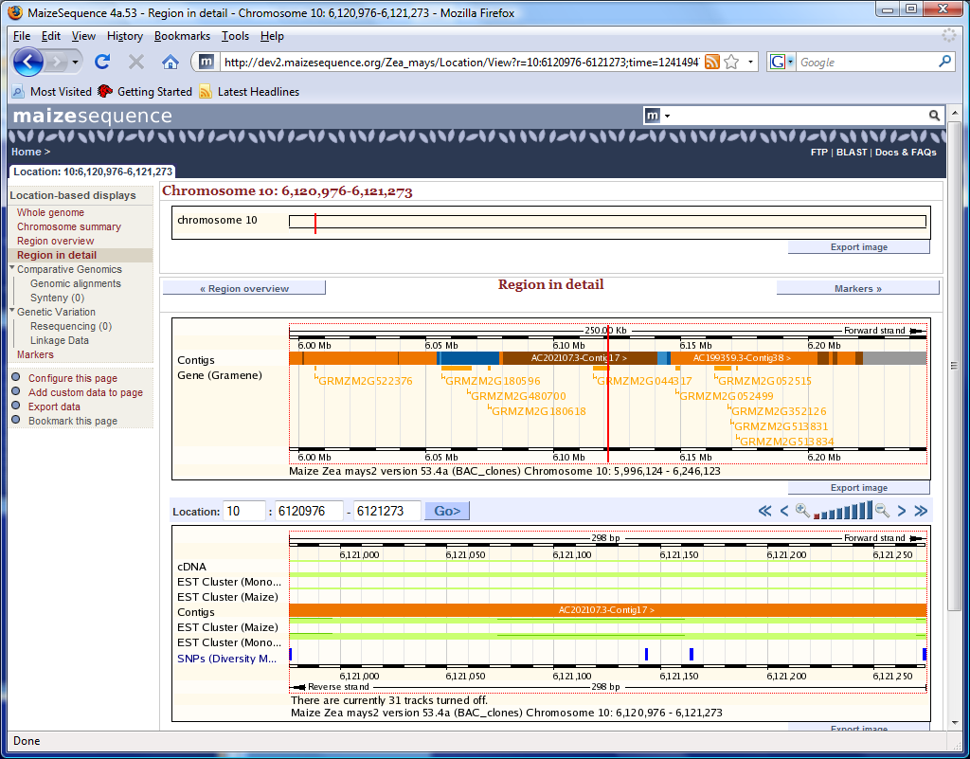

Slide 10
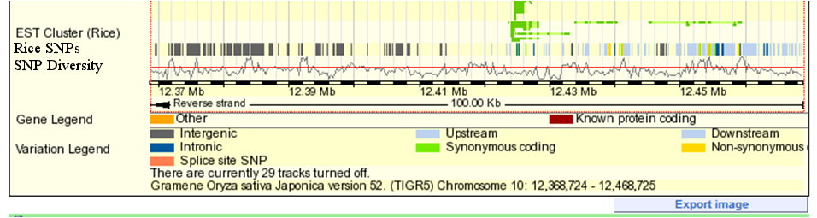
Mock Ensembl Tracks
Rice SNPs
SNP Diversity

Slide 11
Needed to Accomplish DAS Tracks
Database with SNPs, computed heatmap values, etc. (Software tools (i.e. Tassel) needed to generate).
DAS Servers
Support from knowledgeable Ensembl folks to integrate tracks into Gramene Ensembl and maizesequence.org.

Slide 12
Ensembl to Diversity Applications
In Ensembl, Navigate to Desired Range on Chromosome.
From SNP DAS Track, select “Tassel” menu option.
Tassel starts preloaded with SNPs from range shown in Ensembl.

