Slide 1
Maps and Markers
Gramene Retreat 2009
Noel, Ken, Will, Sharon, Jim, Chih-Wei

Slide 2
Aim 1 Objectives
Comparative genetic, physical and sequence maps of O. sativa and 11 wild Oryza species (alta, rufipogon, glaberrima, nivara, minuta, officinalis, australiensis, brachyantha, granulata, ridleyi, coarcta), Z. mays, S. bicolor, and Arabidopsis.
Nucleotide-level genome annotation views of these species, including the functional consequence of SNPs, using Ensembl framework.
Physical (contig) map views of these species, using Ensembl framework.
Protein comparisons among these species.
Detailed gene and protein level views of the annotations of these species.
Incorporation of roughly 9 functional genomics data sets in various species generated by NSF and USDA-funded groups listed in the main text.
Whole genome alignments of rice, maize, sorghum, brachypodium, poplar and arabidopsis, refreshed annually.
Twice-yearly releases via web browser, FTP bulk downloads, GrameneMart data warehouse queries, DAS and SSWAP.

Slide 3
Map Updates
New maps
  Barley - Consensus 2006, Stein
  Maize - IBM2 2005 Neighbors
  Maize - NAM 2008
Upgrade to CMap 1.01
Reduction in number of features dumped to CMap significantly decreased display time
232 map sets
Updated maps
  Rice - Gramene Annotated Nipponbare Sequence 2006
  Rice - BGI 93-11 Sequence 2005
  Maize - FPC maize May 2006
  Maize - FPC Chr maize May 2006
  Wheat - wEST 2003
  Wheat - Composite 2004

Slide 4
Marker Updates
Updates from Genbank, MaizeGDB, GrainGenes
New marker sets
  DNA Microarray probes from Affymetrix, Agilent and NSF
  EST Clusters: UniGene, TGI, PUT, Cornsensus, JVCI Plant Transcript Assemblies
Unified “Primer” marker type
Other marker cleanup resulting from MarkersDB reorganization and schema changes
GrameneMart: MarkersMart [Ken, Will]
Marker DAS sources [Jim, Ken]
Wiki SOPs
47,105,576 markers

Slide 5
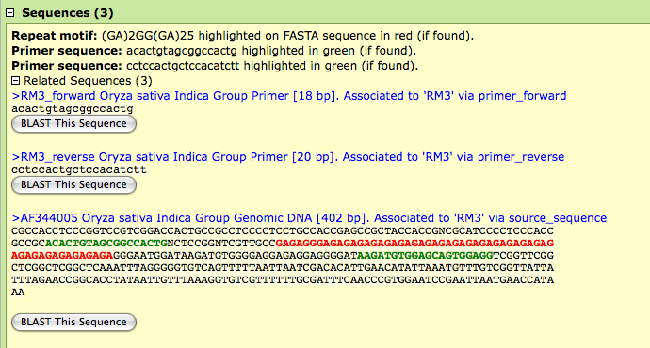
SSR Primer Display

Slide 6
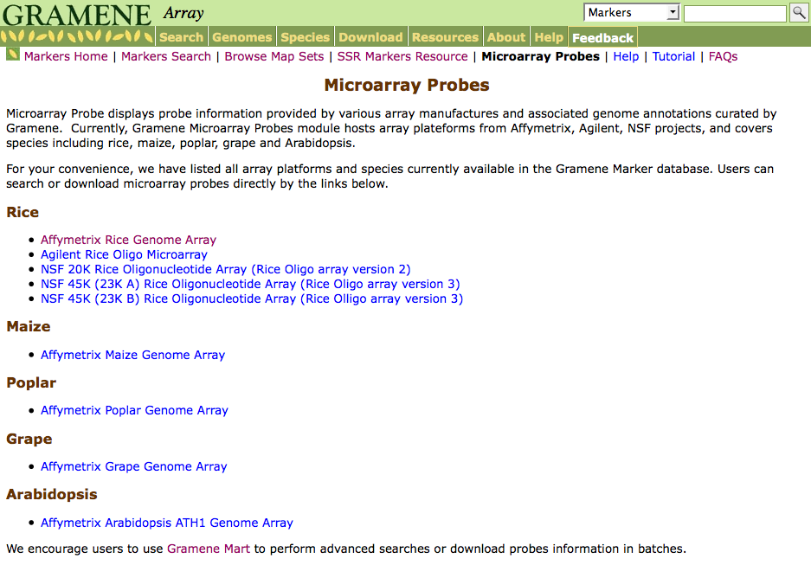
Microarray Probes Page

Slide 7
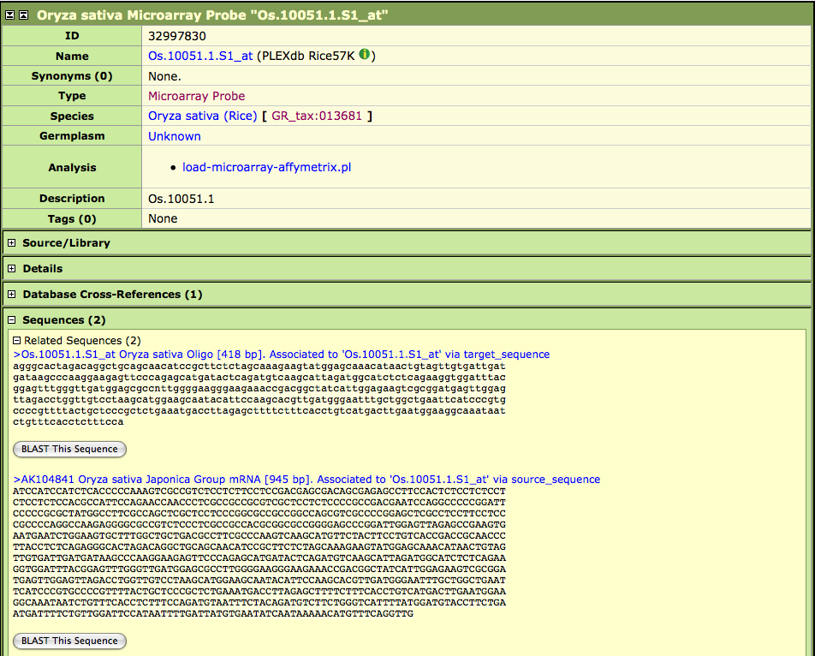
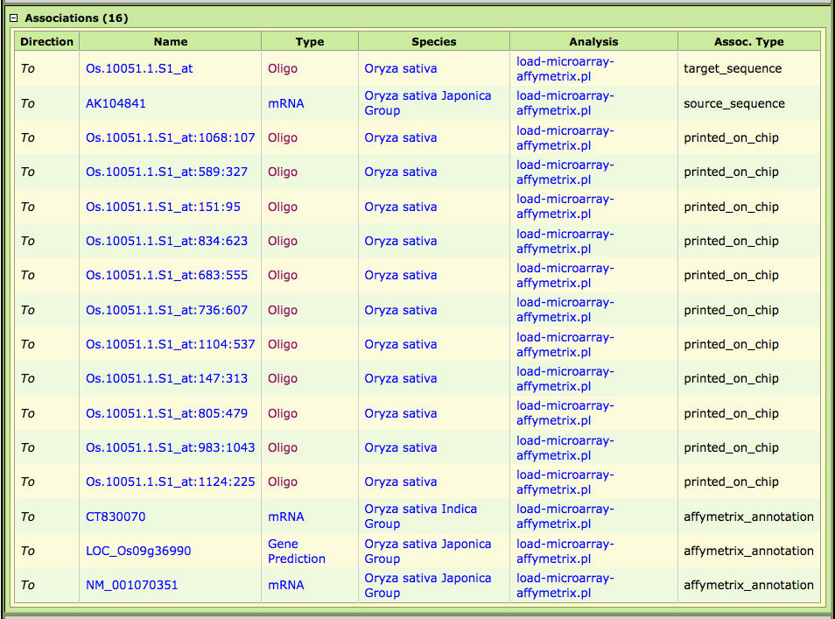
Microarray Probe Record

Slide 8
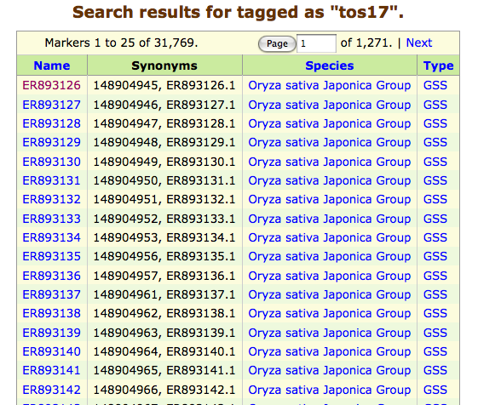
Marker tags

Slide 9
Outstanding Issues
Marker tags
Rice MSU6
Switch rice genome to IRGSP/RAP???
Improve handling of data dumps from MaizeGDB
Dumping more genomes to CMap
  Maize, sorghum, poplar, grape, arabidopsis
Show whole genome alignments in CMap
CMap improvements [Ken]

