Slide 1
Evidence Based Gene Build Using Proteins and cDNAs
Chengzhi Liang
11/08/26

Slide 2
Source Data
Rice genome (TIGRv4): 372M
SwissProt proteins (April, 2007)
  Rice: 1100
  Other: 280k
GenBank mRNAs
  Full-length cDNA: 35K
  EST: 1.1m
Maize mRNAs:
  cDNA 16K
  EST 1.1M
Final genes: 44520 (75606 transcripts)

Slide 3
Gene Build Strategy
Remove redundancy
  Eg, keep high confident, remove low
Combine compatible mappings
Keep all high confident alternative mappings
Keep low confidence mappings in empty regions

Slide 4
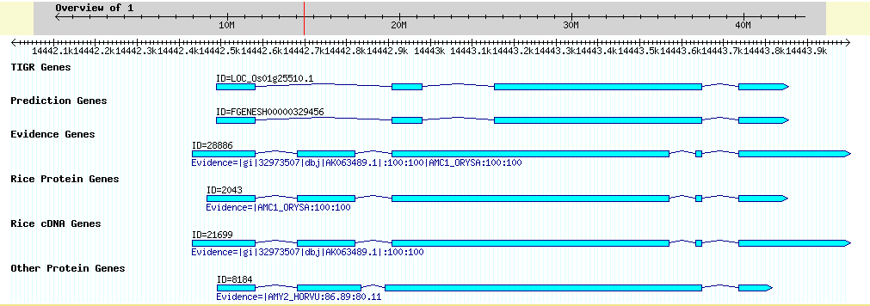
Gene Build Example

Slide 5
Standard gene sets
Rice protein genes
  100% coverage, 100% identity
  469 genes (transcripts)
Rice cDNA genes
  99.9% coverage, 99.9% identity
  15138 genes (16876 transcripts)

Slide 6
Comparison with Standard Sets
 | Gene set | transcripts | Different Transcript (Missing) | Different Exon (Missing) | Nucleotide coverage
Protein standard | TIGR | 64703 | 7.5% | 3.8% | 98%
 | Fgenesh | 56453 | 44.5% | 13.2% | 93.9%
cDNA standard | TIGR | 64703 | 25.6%(4.4%) | 8%(4.2%) | 86.2%
 | Fgenesh | 56453 | 95%(5%) | 35.5%(12.4%) | 55.8%

Slide 7
Transcript Coverage Comparison
 | Full transcripts | Partial transcripts | Missing transcripts | Nucleotide coverage
Evidence vs. TIGR | 38.0% | 48.1% | 13.8% | 73.0%
Evidence vs. Fgenesh | 14.5% | 70.8% | 14.7% | 49.0%
Evidence vs. T+F | 37.8% | 50.1% | 12.1% | 74.4%
TIGR vs. Evidence | 40.0% | 19.3% | 40.7% | 48.4%
TIGR vs. E+F | 82.0% | 17.1% | 0.9% | 97.0%

Slide 8
Exon Coverage Comparison
 | Full exons | Partial exons | Missing exons
Evidence vs. TIGR | 62.4% | 23.1% | 14.5%
Evidence vs. Fgenesh | 42.7% | 36.1% | 21.2%
Evidence vs. T+F | 63.5% | 23.7% | 12.9%
TIGR vs. Evidence | 49.6% | 13.0% | 37.5%
TIGR vs. E+F | 91.2% | 7.6% | 1.2%

Slide 9
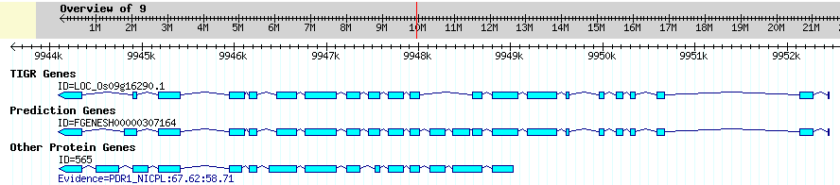
Low Identity Transcript Example

Slide 10
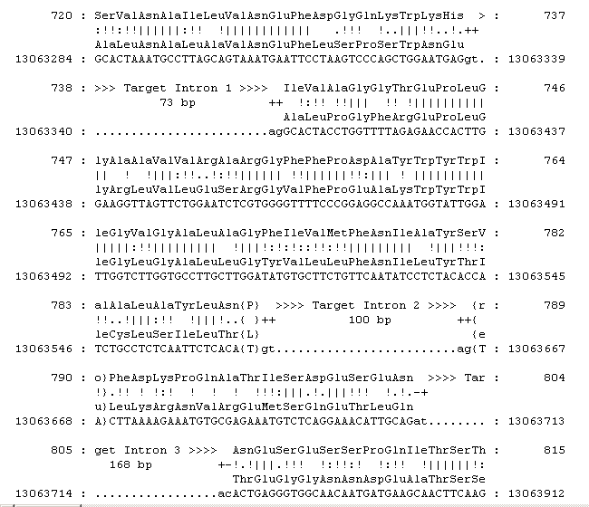
Exonerate Mapping (part)
Tobacco protein
PDR1_NICPL
Coverage: 68%
Identity: 59%

Slide 11
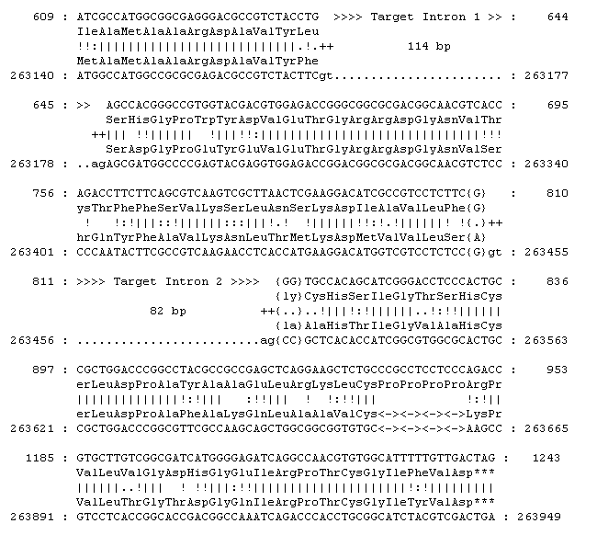
Low Percent Alignment
Maize cDNA
AY109158.1 from
DuPont EST assemblies
Coverage: 68%
Identity: 50%

Slide 12
Intron Boundary Summary
 | GT.AG | GC.AG | Other
Protein | 98% | 2% | <0.1%
cDNA | 98% | 1% | 1%
TIGR | 99% | 1% | <0.1%
Fgenesh | 100% | 0 | 0
Evidence | 95% | 2% | 3%

Slide 13
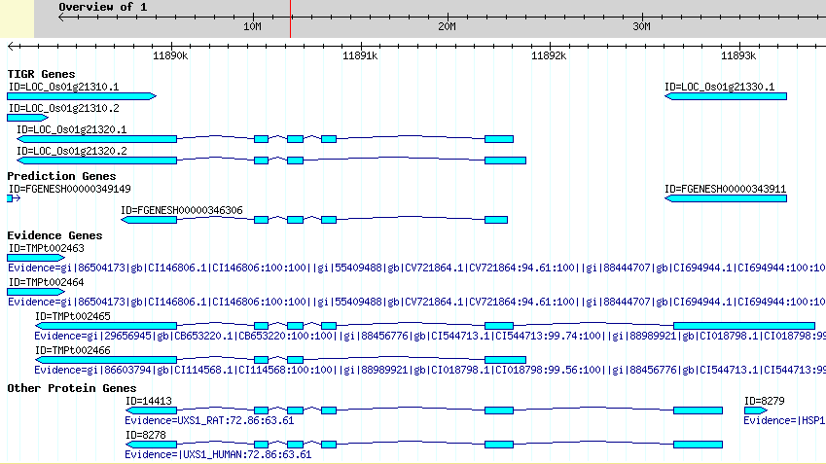
Connected Genes

Slide 14
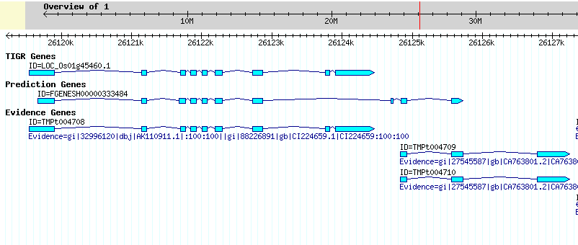
Separated Genes

Slide 15
Identifying TE-related genes
TE datasets
  mips plant repeat library
    Transposons: I, II, others
    5149 DNA sequences
  NR transpons, reverse transcriptase
    29,148 proteins
  Comparing with mips-TE, NR dataset incomplete (data not shown)
Select mips-TE as TE standard

Slide 16
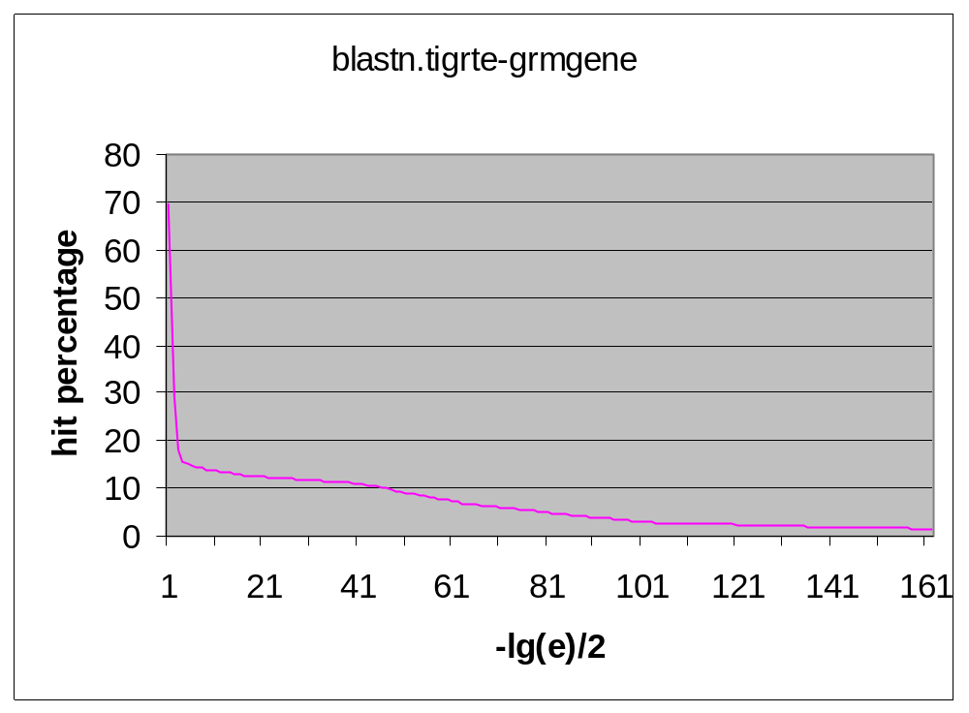
Select True TE-gene set
TIGR repeat library:
  6744 transposons
  Disadvantage: many of these TEs are not genes => too much noise
Find true TE-genes
  Blastn search on Grmgene (75116 transcripts) against TIGR-TE
  Cutoff E-value<1e-50
  9026 transcripts as true TE genes

Slide 17
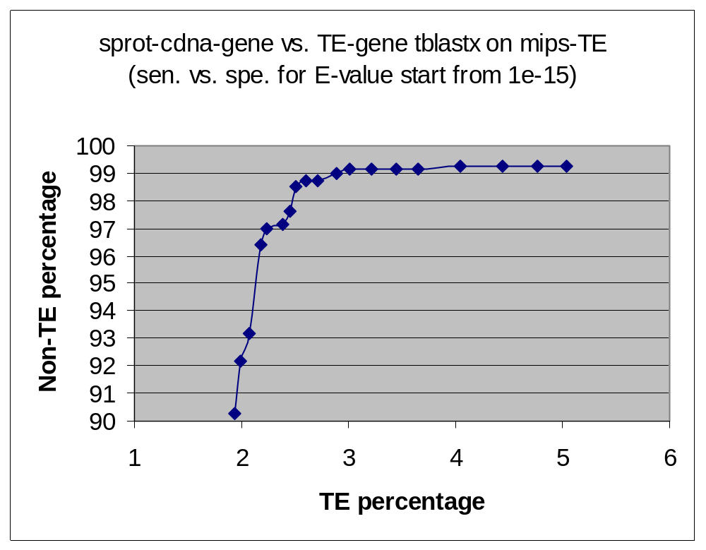
Sensitivity vs. Specificity
Non-TE:
803 cDNA genes with
SwissProt protein
support (100% identity)
TE:
9026 evidence based
genes blastn hit
to TIGR rice repeat lib
transposons
E<=1e-50
Cutoff for identifying TEs
E=1e-26
sensitivity: 97%
specificity: 99.13%
1e-26
1e-19

Slide 18
Inspection non-TE genes with significant hit to mips-TEs
28 (out of 803) non-TE transcripts with E < 1e-19 hit on mips-TE
Using proteins from there transcripts tblastn on mips-TE
  Only 9 proteins with E < 1
  Only 4 proteins with E < 1e-19.
  1 transcript = transposon+sp_protein
    It is either a fused gene or a contaminted cDNA
Conclusion: most hit due to other frame/opposite strand translation

Slide 19
Inspection TE genes with low hit to mips-TEs
4% of TIGR transposons with E < 1e-19
3% of gramene TE-genes with E < 1e-26
Manually inspected 20-30 gramene genes with E-value between 1e-15 to 1e-30
  Short transcripts (<200bp) with large coverage (eg, >70% of the gene length): usually don’t have good translation
  Long transcripts:
    hit coverage is small (due to short region high similarity hit)
    May have other real functions
Conclusion: using cutoff E=1e-26 + translation check can most efficiently remove TEs and keep non-TEs

Slide 20
Summary
~45000 rice genes were obtained based on same species or cross-species proteins, cDNAs, and ESTs
The genes were checked against mips plant transposon library to identify TE related genes (at 1e-20, ~20% are TE related)
The genes were compared with TIGR gene set and Fgenesh set, basically Gramene set + Fgenesh is a superset of of TIGR set
TIGR set missing many genes (5-10%) in Gramene set with high confidence evidence support

